Slide 1

5.9 (C)
solve one- and two-step problems using data from a frequency table, dot plot, bar graph, stem-and-leaf plot, or scatterplot
Intro: 2 minutes
Explain the TEKS

Slide 2
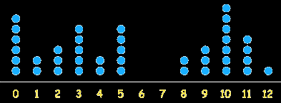
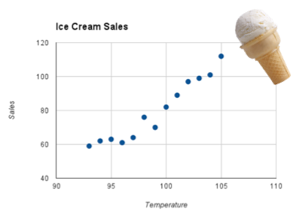
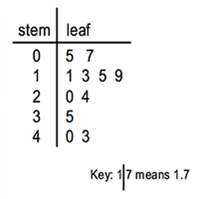
Fluency Practice [5-10 min]
What do these graphics show?

Slide 3
Problem Solving Strategies [explain in 2 minutes]
Intervene’s Problem Solving Strategies:
Step 1: Show what you know
Step 2: Solve and Check
Step 3: Eliminate and Justify

Slide 4
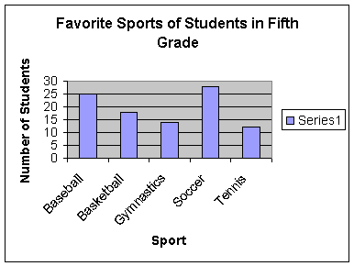
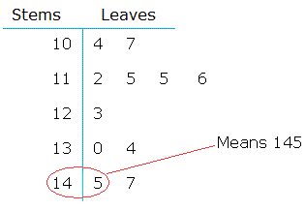
Lesson [2- 5 minutes]
Frequency table
Dot plot
Bar graph
Stem-and-leaf-plot
Scatterplot
What is the difference between the highest and lowest number on the stem-and-leaf plot?
How many more students say that baseball is their favorite sport than students who say tennis is their favorite sport?

Slide 5
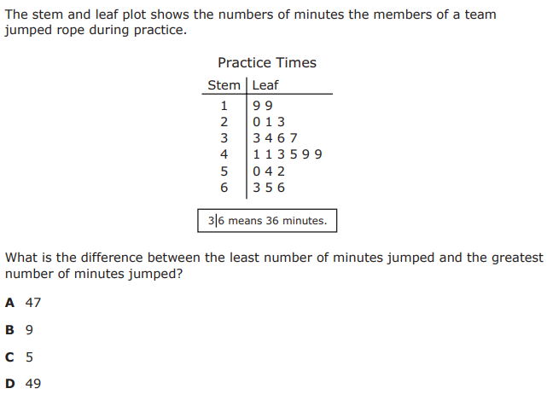
I Do [5 minutes]

Slide 6
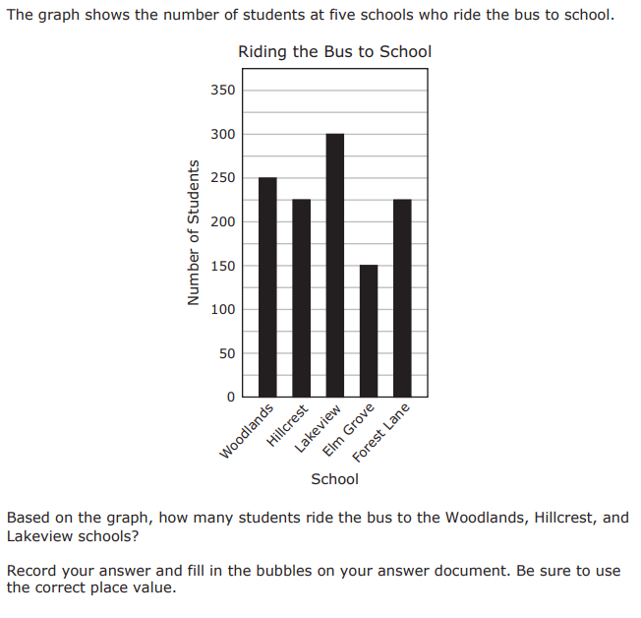
We Do – Student 1 [5 minutes]

Slide 7
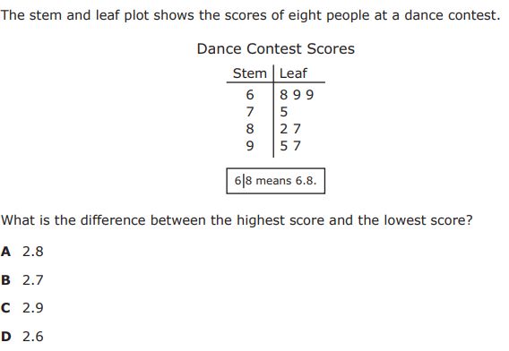
We do - Student 2 [5 minutes]

Slide 8
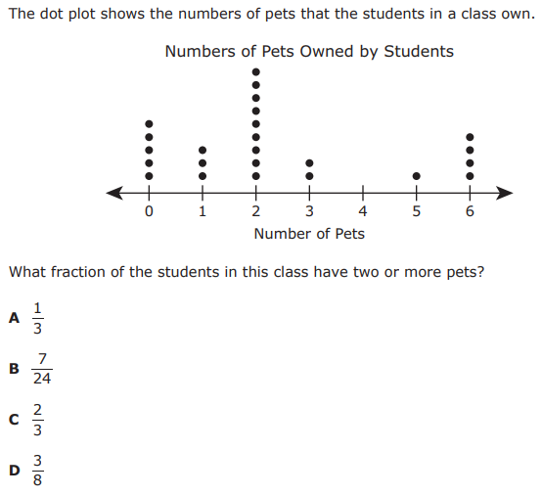
We do - Student 3 [5 minutes]

Slide 9
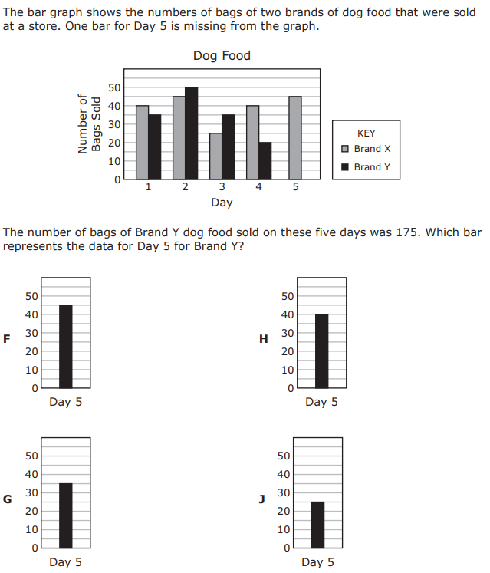
We do - Student 4 [5 minutes]

Slide 10
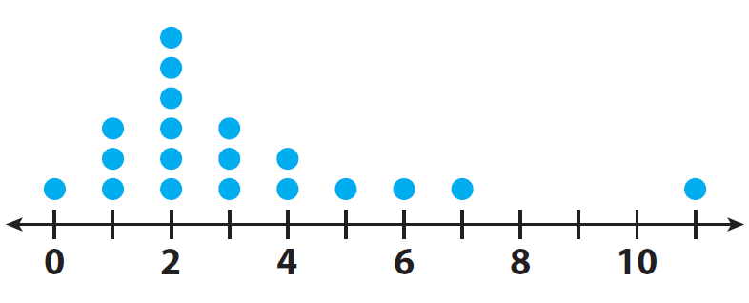
Debrief [2 minutes]
Determine what operation the problem is asking you to perform
Use the graphic to get the information you need
Solve

Slide 11
You Do [1 minute to explain]
Instructions for Content Dev:
Nothing to do here
Instructions for Tutor:
Have students click on the Quiz tab above (on their screen)
Instruct students to take the quiz on this objective, and remind to use their problem solving strategies

