Slide 1

6.14(C)
balance a check register that includes deposits, withdrawals, and transfers
<1 min

Slide 2

So What Is a Check Register?
It just helps you see how much money is left in your account.
With every transaction listed, you can keep an eye on what’s going in and out.
Imagine if all you had was a number….
$500 left in your account
“wait ….I thought I had $650? What happened?”

Slide 3
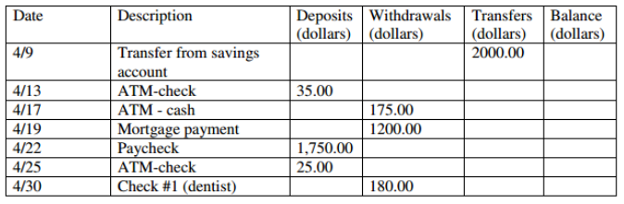
A Check Register
Take money OUT (-)
of your account
Sending money in OR out (look at description)
how much money you have in account
Describes the type of transaction.
putting money
INTO (+) your account
Date of transaction
You add $2000 because it’s going IN checking from savings
1 min

Slide 4
A Check Register
Step 1: Add all of your DEPOSITS. This is money going INTO your account. When you get paid, you make a deposit into your account
35 + 1750 + 25 = $1810
1 min

Slide 5
A Check Register
Step 2: Subtract the WITHDRAWALS. This is money LEAVING your account. When you spend money, it withdraws.
$1810 – 175 – 1200 - 180 = $255
1 min

Slide 6
A Check Register
Step 3: Is the Transfer coming into the account or leaving the account? When it’s coming FROM savings, it’s going IN so you add it. When it’s going OUT, you subtract it.
$255 + $2,000 = $2,255
$2,255

Slide 7
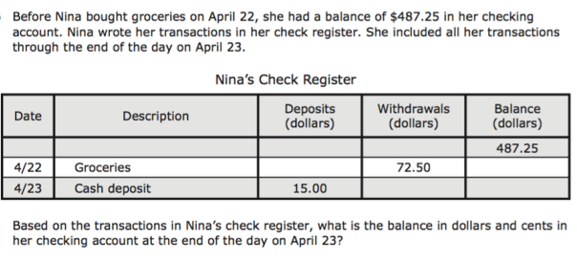
I Do
Notice this starts with a balance. Start here
<5 min
Notes:
j

Slide 8
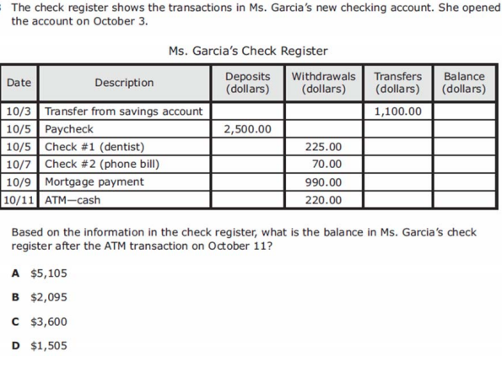
We do - Question 1
<5 min
Notes:
f

Slide 9
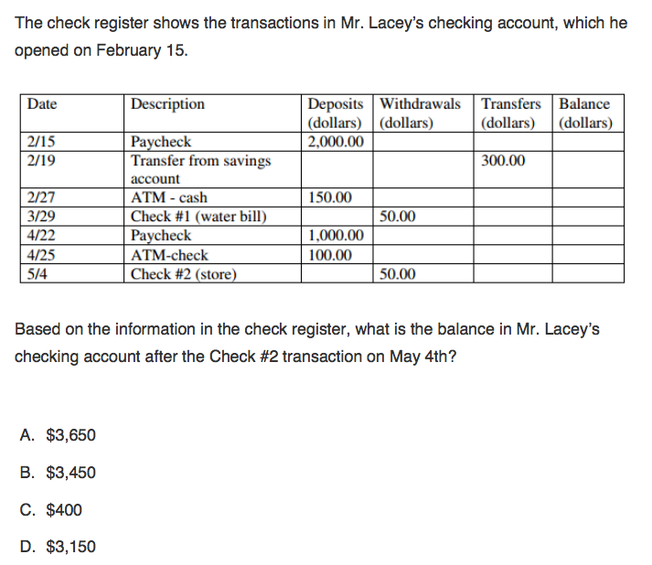
We Do – Question 2
<5 min
Notes:
f

Slide 10
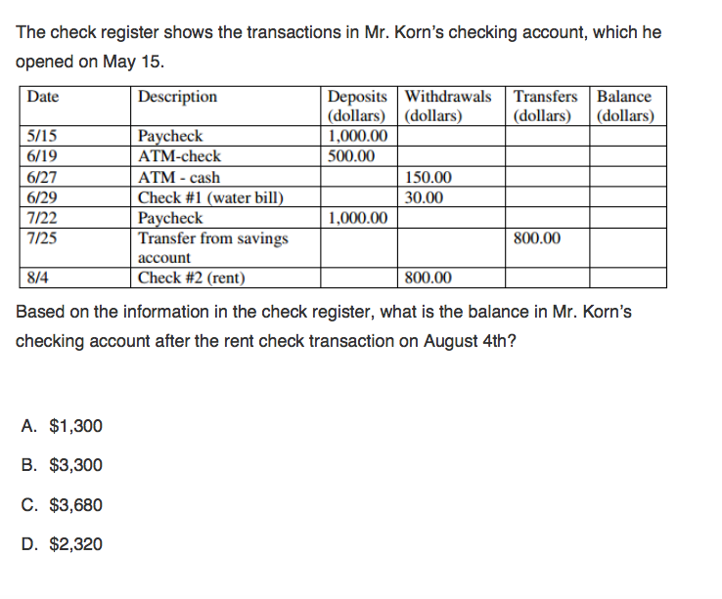
We do - Question 3
<5 min
Notes:
c

Slide 11
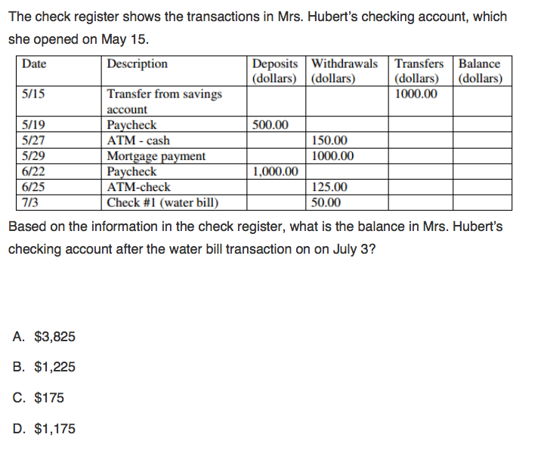
We do - Question 4
<5 min
Notes:
a

Slide 12
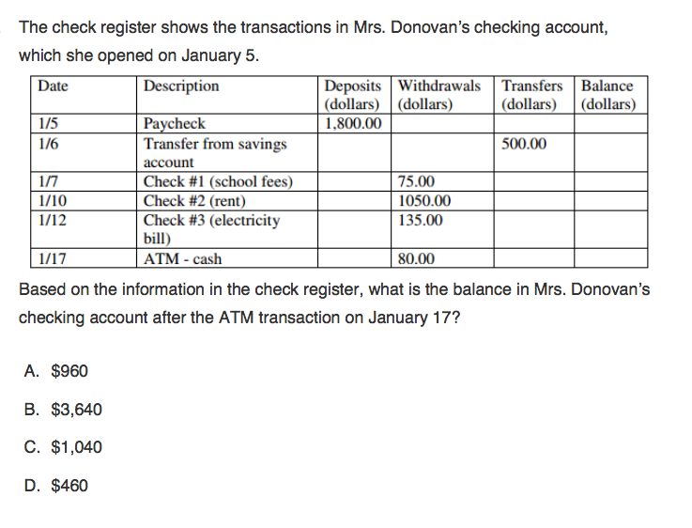
Q5

Slide 13
You Do
Go back to Intervene to take your quiz!

Slide 14
Answer Key
I Do – 429.75
We do 1 – B
We do 2 – B
We do 3 – D
We do 4 – D
We do 5 - A

