Slide 1

7.13(E)
calculate and compare simple interest and compound interest earnings
<1 min

Slide 2
Fluency Practice
What is 32% written as a decimal?
What is 8% written as a decimal?
What is 5 x 3 x 2?
What is 8² + 4³ ?
2 min

Slide 3
Problem Solving Strategies
1. Understand the Problem
Read the problem carefully (at least 2 to 3 times)
Highlight important information (what do I know)
Identify Math Clue words (words that tell you what math operations you need to use)
Underline what you need to find
2.Plan of Action (how you will solve this problem in steps)
First I will
Then I will
Next I will
Finally, I will
3. Show your work in steps (solve using your steps)
4. Check your answer (does my answer make sense? why)
<3 min

Slide 4
What is Interest
You let someone borrow money and they’re paying you a little extra to use that money.
OR
You borrowed money and you’re paying a little extra to use that money
________________
In this lesson, you’re learning about 2 different types of interest. They calculate differently and have different formulas

Slide 5
What’s the difference between simple and compound?
Simple interest – Interest is earned only on the principal amount (the borrowed amount)
Compound interest – Interest is earned on both the principal amount (the borrowed amount) AND the accumulated interest from the past

Slide 6
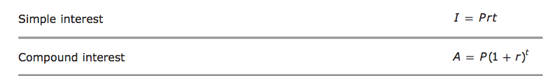
You have formulas!
If the question includes simple interest, use this formula
for compound interest, use this formula
Make sure you’re using the CORRECT formula!
1 min

Slide 7
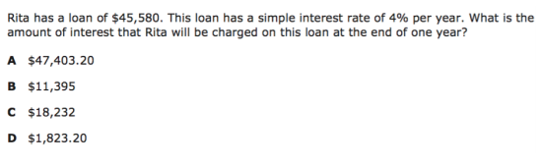
I Do
<5 min
Notes:
j

Slide 8
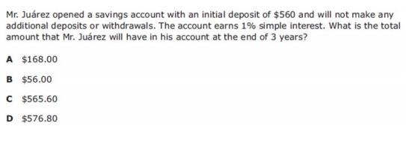
We do - Question 1
<5 min
Notes:
D

Slide 9
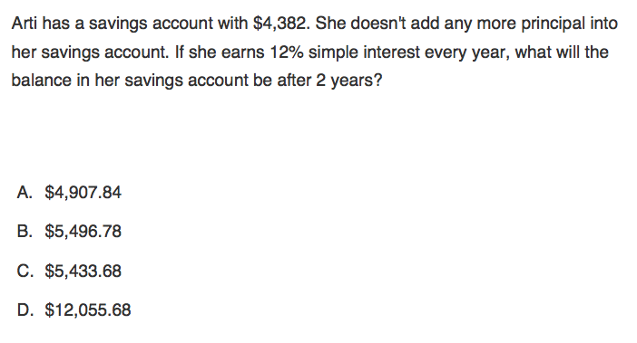
We Do – Question 2
<5 min
Notes:
-27

Slide 10
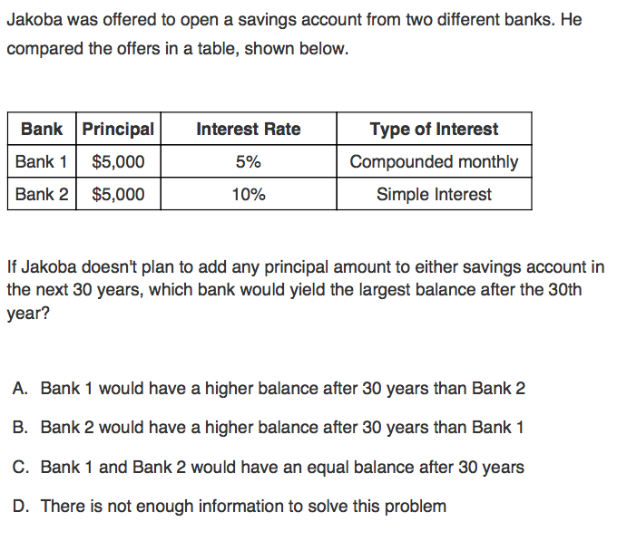
We do - Question 3
<5 min
Notes:
f

Slide 11
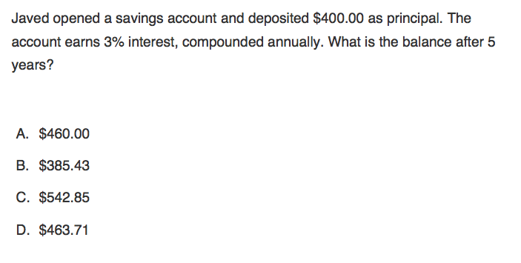
We do - Question 4
<5 min
Notes:
j

Slide 12
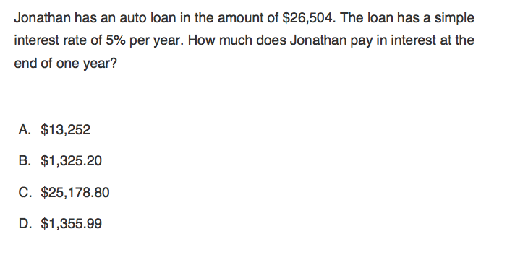
Q5

Slide 13
You Do
Go back to Intervene to take your quiz!

Slide 14
Answer Key
I Do – D
We Do 1 – D
We Do 2 – C
We Do 3- A
We Do 4 – D
We Do 5 – B

