Slide 1

8.11(A)
construct a scatterplot and describe the observed data to address questions of association such as linear, non-linear, and no association between bivariate data
<1 min

Slide 2
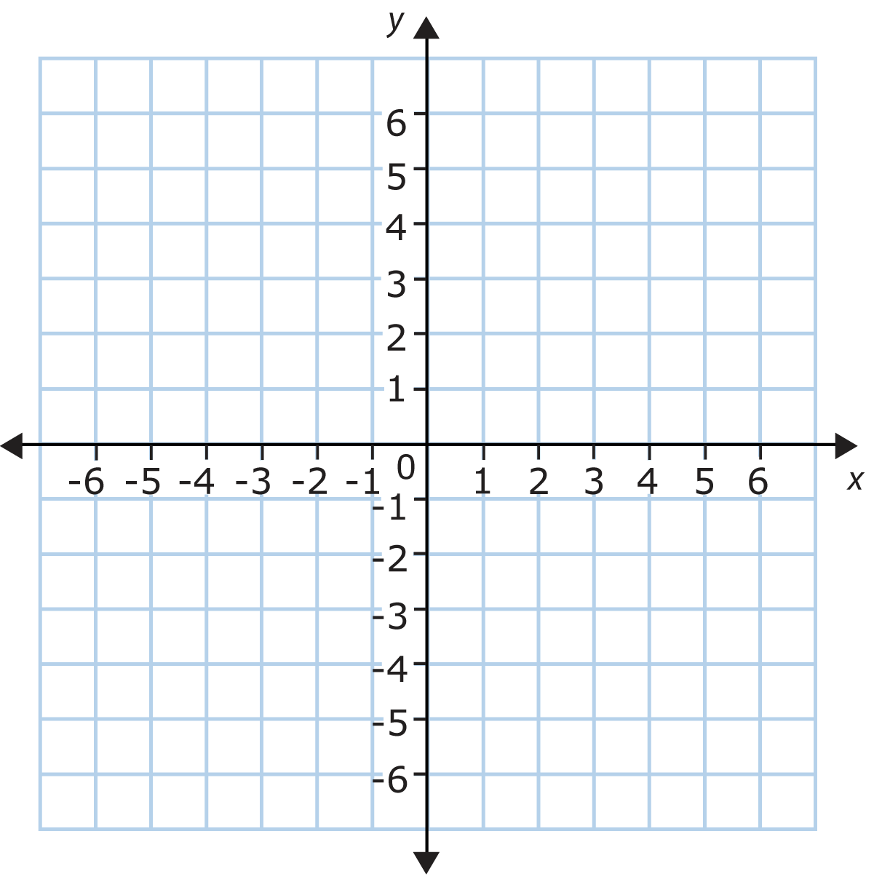
Fluency Practice
Plot the following points:
A (3,4)
B (2,6)
C (-4,-2)
D (2, -3)
E (The Origin)
4 min

Slide 3
Problem Solving Strategies
1. Understand the Problem
Read the problem carefully (at least 2 to 3 times)
Highlight important information (what do I know)
Identify Math Clue words (words that tell you what math operations you need to use)
Underline what you need to find
2.Plan of Action (how you will solve this problem in steps)
First I will
Then I will
Next I will
Finally, I will
3. Show your work in steps (solve using your steps)
4. Check your answer (does my answer make sense? why)
<3 min

Slide 4
Linear Associations, Non-Linear Associations, and No Association
When you represent data on a scatterplot, you can visualize the number and find patterns
If there’s an association, you’ll know, because it’ll look like a swarm of ants moving in the same direction and close together.
If there’s no association, it’ll look like the ants are all scattered and running from a giant animal.
1 min

Slide 5
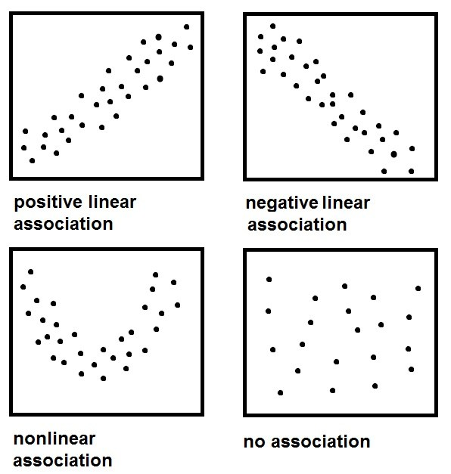
These both hav associations that look like they’re moving in a line (linear)
One of them is moving upward (positive) and the other downward (negative)
Do you see how these dots are moving upward in almost a line? upward = positive.
line = linear.
positive linear
Do you see how these dots are moving downward in almost a line? downward = negative.
line = linear.
negative linear

Slide 6
Do you see how these dots are moving together but not in a line?
not a line = nonlinear.
moving together = association
non-linear assocation
Do you see how these dots look scattered? There’s no pattern to be found here.
no association

Slide 7
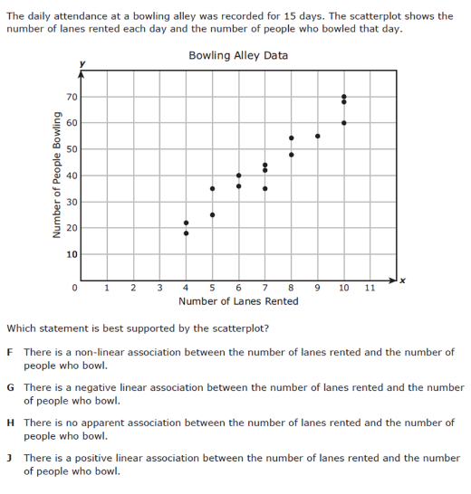
I do
<5 min
Notes:
f

Slide 8
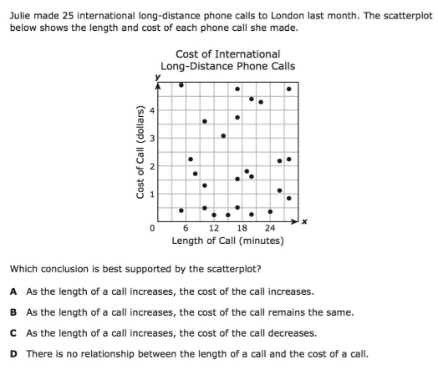
We do - Question 1
<5 min
Notes:
b

Slide 9
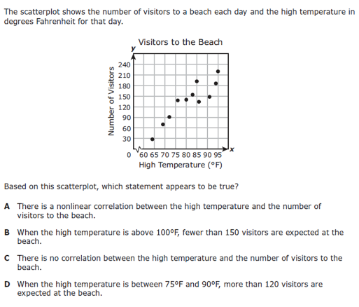
We Do – Question 2
<5 min
Notes:
d

Slide 10
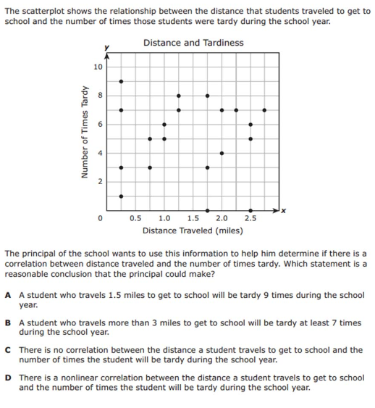
We do - Question 3
<5 min
Notes:
f

Slide 11
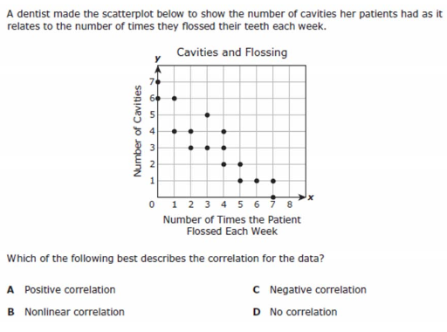

Slide 12
Do you see how these dots are moving upward in almost a line? upward = positive.
line = linear.
positive linear
Do you see how these dots are moving downward in almost a line? downward = negative.
line = linear.
negative linear

Slide 13
Do you see how these dots are moving together but not in a line?
not a line = nonlinear.
moving together = association
non-linear assocation
Do you see how these dots look scattered? There’s no pattern to be found here.
no association

Slide 14
You Do
Go back to Intervene to take your quiz!

Slide 15
Answer Key
I Do: J
We Do 1: D
We Do 2: D
We Do 3: C
We Do 4: C

