Slide 1

How to motivate
Let’s build your tool belt!

Slide 2
Our Social Emotional Component
Why
The students we work with are behind academically. Many times, their home lives are not ideal. We want students to grow in confidence as they work with you. We want them to feel self-motivated and ready to take on challenges as they approach them.
What
Our lessons will have a short Social Emotional Component – and these slides will be scattered throughout the lesson. Think of it as a brain break.
How
Let them talk about what they think.
Allow them to connect the quotes and life lessons to their own lives and to the world around them.
Don’t spend too much time on this, but be sure to include it.

Slide 3
Research-backed
Watch the following video to learn a little more about Social Emotional Learning and why it’s important.
Notes for video
1. Start the day with a check-in.
2. End each day with a checkout.

Slide 4
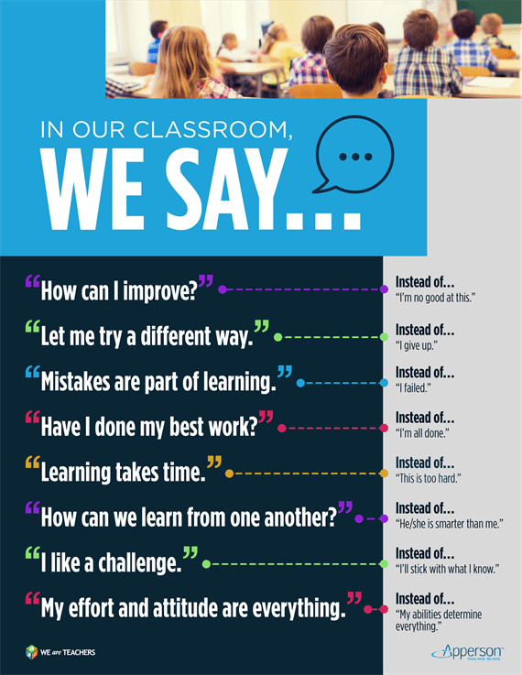

Slide 5


Slide 6
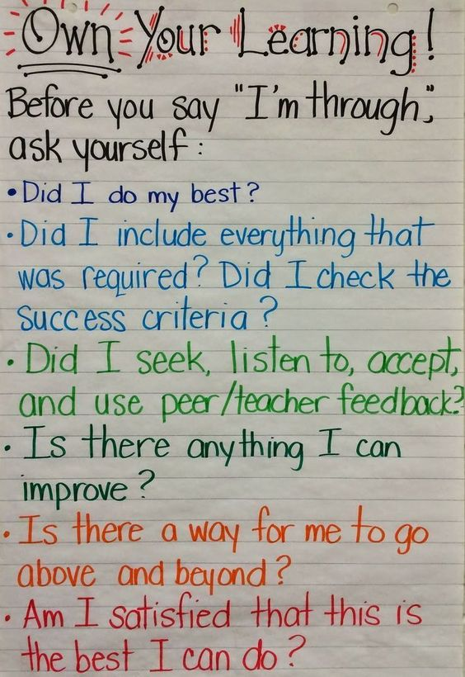

Slide 7
Connect to the Real World
At the end of the day, we want our students to find suitable careers and to be successful in them, socially, emotionally, and with the right skillsets for the job.
Connect to the real world at every opportunity you see.
Did you have a job that required some of the same math? Let them know! Do you know about a particular industry that might interest the kids? Let them know!

