Slide 1


Grade: 9 - 12
CCSS, NGSS
Capstone Project
Opening a Pakistani Restaurant in Karachi, Pakistan
Saifal Talpur

Slide 2
Introduction
This project is related to finding an optimal location for opening a Pakistani restaurant in the metropolitan city of Karachi, located in the southern region of Pakistan.
The city is also termed as the "city of lights." It consists of over 30 million population with diverse ethnicity.
The city is also the financial hub of Pakistan, a south Asian nation bordering China, India, Iran and Afghanistan.
Since it is the major financial attraction and involves a huge population, there exists tremendous business opportunities in Karachi.
Majority of the business carried out in the 'city of lights' is either in manufacturing or in the service sector.
Investing in the service sector is easier and requires less resources and the capital investment.
This project moreover offers the opportunity of availing the potential of applying the data science.
Lesson overview

Slide 3
Introduction
To sum up, the project considered the role of data science towards obtaining an optimal location to open a restaurant.
Although, the project focused on a typical case study of opening the restaurant (a typical but profitable business model in many countries including Pakistan), the technique applied is moreover independent of the type of business or the geographical location.
Towards obtaining the solution, the project involved following techniques, which are moreover explained in the later sections of the report.
Data collection
Data pre-processing
Data clustering and segmentation
Data visualization
Lesson overview

Slide 4
Background
Opening a new restaurant, particularly in a cosmopolitan city is not only challenging but a concern as well in case to turn it into a successful business.
This project thus answers these questions and provide a solution which can assist the entrepreneurs to start their own business.
Lesson overview

Slide 5
Problem
This project focused on finding an optimal location for a restaurant, serving a favorite cuisine for the locality.
Although, many restaurants exist in the region, however, the lack of business knowledge and, despite a huge potential of using the data science, there exists no application of applying the data science in the business models.
This project thus explores the potential of applying the data science in developing the business model with answering the following questions.
1. How the data regarding existing restaurant venues can be collected by applying the data science?
2. How the collected data can be used to find an optimal restaurant location which is besides accessible to public transport also offers reasonable food price?
3. By applying the machine learning techniques, such as segmentation and clustering, how a choice about most and least favorite venues can be extracted?
Lesson overview

Slide 6
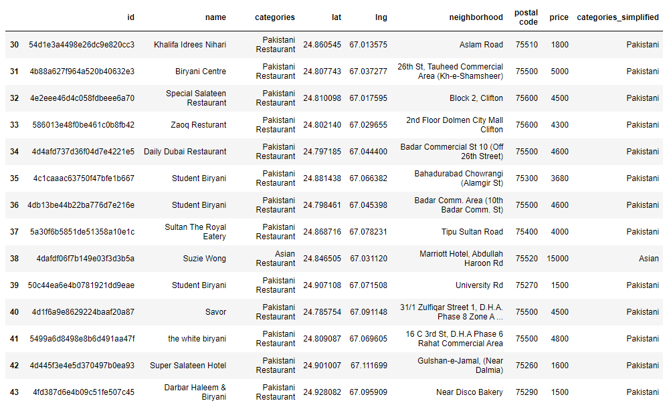
Data acquisition
It was figured out:
what data is required?
how to obtain the required data?
This resulted in obtaining the selected venues for opening a restaurant.
Initially, the type and location of restaurants was figured out followed by optimal distance from the public transport and food prices.
Lesson overview

Slide 7
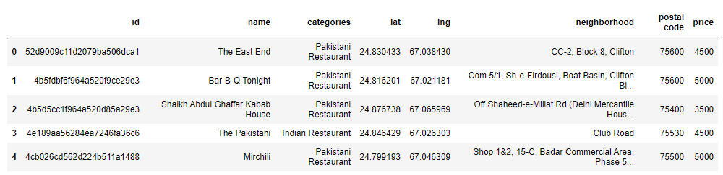
Data source
Information from Foursquare API [1] and Geocoder [2] data sources was used in terms of:
obtaining the data related to location of restaurants in the city within the customized radius besides finding the geo-graphical information like
the latitude and longitude of restaurants to rent, respectively.
Lesson overview

Slide 8
Procedure
Following steps were carried out from data collection to feature selection:
a data set was initially produced based on information from Foursquare API, first requiring the client ID, client password, desired category (restaurant in this project), latitude, longitude and radius of favorite zone to open a restaurant in Karachi.
the data obtained was saved in a csv file and then read through 'Pandas' library.
the data set from step 2 was then merged with another developed data set (including information like postal code and food prices).
Since, food price is also reflected in the rental price, hence any of the available information can be a valuable parameter in deciding the suitable location based on the budget.

Slide 9
Methodology
Since involving several factors, the decision to open a Pakistani restaurant in a locality of Karachi must be made, where each factor influences on finding an optimal restaurant location.
The locality serves different cuisines for instance, Middle Eastern, Asian, Indian, Street food and BBQ.
Since, a variety of food types are served, hence, it is important the subject restaurant will serve the favorite food (particularly, in the optimal vicinity) with amenities like minimum distance to public restaurant, offering food at reasonable cost (moreover dependent on restaurant's rental prices in the area).
To achieve this goal, this project considers the technique K-means Clustering to make segmentations of the types of Pakistani restaurants or, the restaurant with benefits.
After that, research about the prices to rent a place for opening a restaurant will be made.
Lesson overview

Slide 10
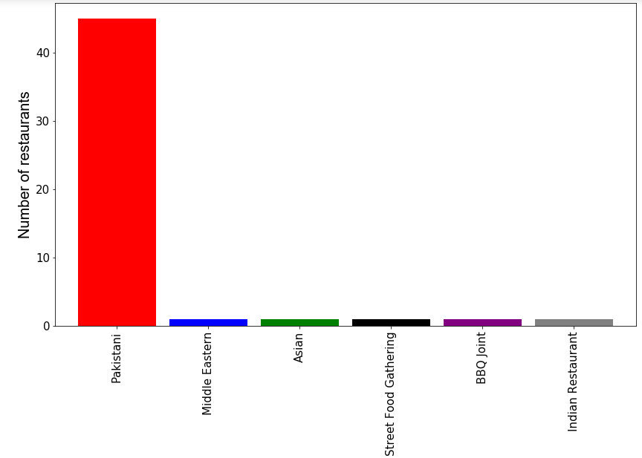
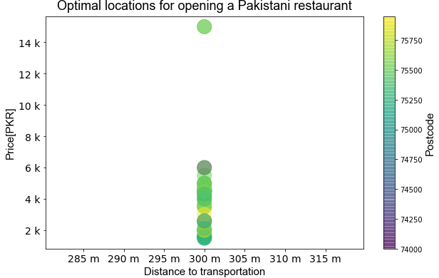
Results
Lesson overview

Slide 11
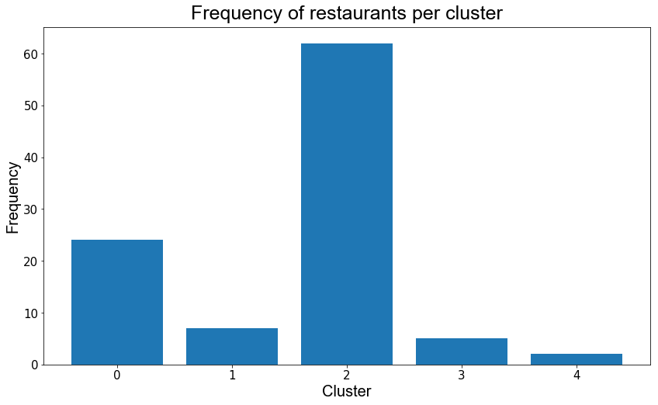
Results
The analysis is carried out to analyze K-mean Clustering, obtain clusters and create datasets for each of them.
Lesson overview

Slide 12
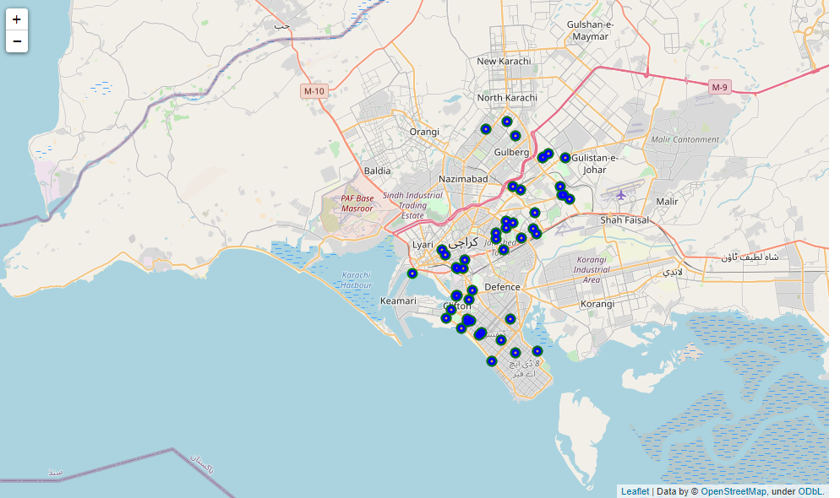
Results

Slide 13
Conclusions
This project resulted in an optimal location as suitable venues to open a restaurant in the central location of Karachi, which is besides accessible to the public transport also offers reasonable food prices.
The list and location of restaurants within a customized proximity was obtained from Foursquare API with latitudes and longitudes as retrieved from the Geocoder.
Techniques like were applied to obtain the required results:
data collection
data pre-processing
segmentation and clustering
The map was drawn with the help of Folium library showing the location of restaurants.
Finally, a score was calculated as an indicator listing the restaurants.
Lesson overview

Slide 14
References
[1] https://developer.foursquare.com/docs/build-with-foursquare/categories/
[2]https://developers.google.com/maps/documentation/geocoding/overview

