Slide 1
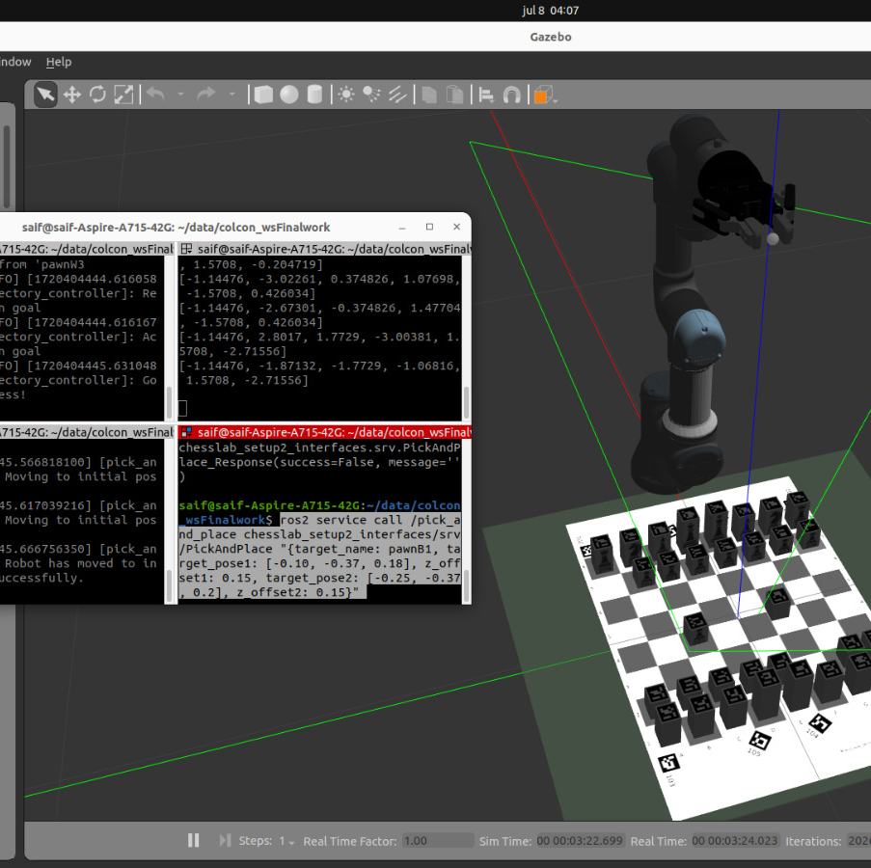
Chess Lab Project
Md Zilan Uddin Saif

Slide 2





Structure
The aim of the project is play a chess game against a human
Initialize the pick-and-place service and set up the callback function.
Create the joint trajectory action client to control the robot's movements.
It includes various clients and services to control the robot arm, gripper, and object attachments.
Implements the action client for sending joint trajectory goals to the UR3 robot arm.

Slide 3
Approach
1. Initialization
Initialize Node: Create and initialize the ROS2 node.
Create Services and Clients:
2. Pick-and-Place Operation
Open Gripper:
Move to Position with Offset:
Move to Original Position:
Close Gripper:
Attach Object:
Move to Second Pose:
Detach Object:
Return to Initial Position:
pick_and_place_service_: Service to handle pick-and-place requests.
Send a request to open the gripper using the GripperOrder service.
Compute the inverse kinematics for the target position with an additional Z-offset.
Compute the inverse kinematics for the original target position.
Send a request to close the gripper using the GripperOrder service.
Send a request to attach the object using the Attach service.
Compute the inverse kinematics for the second target position.
Send a request to detach the object using the Detach service.
Send joint positions for the initial position to the FollowJointTrajectory action client to move the arm back to the starting pose.
gripper_order_client_: Client to control the gripper.
Await the response and confirm the gripper is open.
Send the computed joint positions to the FollowJointTrajectory action client to move the arm.
Send the computed joint positions to the FollowJointTrajectory action client to move the arm.
Await the response and confirm the gripper is closed.
Confirm the object is attached.
Send the computed joint positions to the FollowJointTrajectory action client to move the arm.
Confirm the object is detached.
ik_client_: Client to compute inverse kinematics.
attach_client_: Client to attach objects in the simulation.
detach_client_: Client to detach objects in the simulation.
joint_trajectory_action_client_: Action client to control the robot arm's movements.

Slide 4
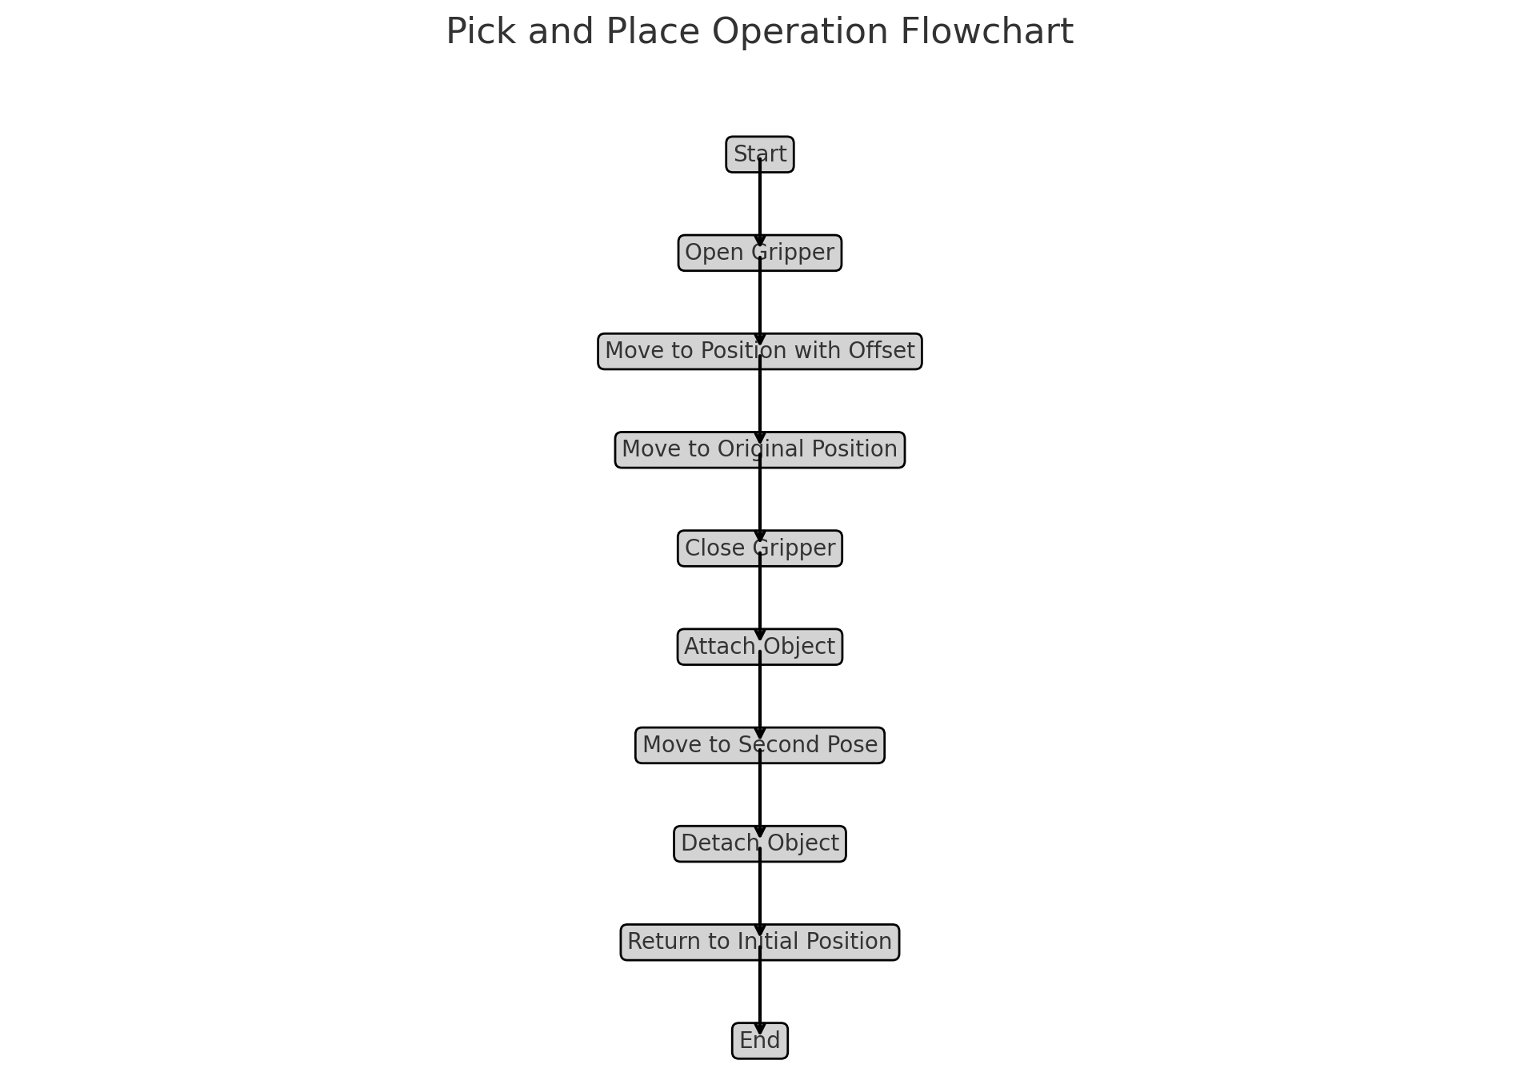
Flowchart

Slide 5
  A request is made to the IK service with the target position and orientation for the robot's end-effector.
  The request is sent to the IK service, which computes the joint angles required to achieve the desired end-effector pose.
the Inverse Kinematics (IK) service to calculate the necessary joint positions for the robot arm to achieve a specified end-effector pose. Here’s how the process is implemented:
  If the IK solution is successful, the computed joint positions are used to move the robot arm to the target pose.
Request Preparation:
Sending the Request:
Handling the Response:

Slide 6
Create an IK Request:
The request is created with the specified target pose and offset.
Send the IK Request Asynchronously:
The request is sent asynchronously to the IK service.
Process the IK Response:
The response from the IK service is checked. If successful, the robot arm moves to the calculated joint positions.

Slide 7
Demo

Slide 10
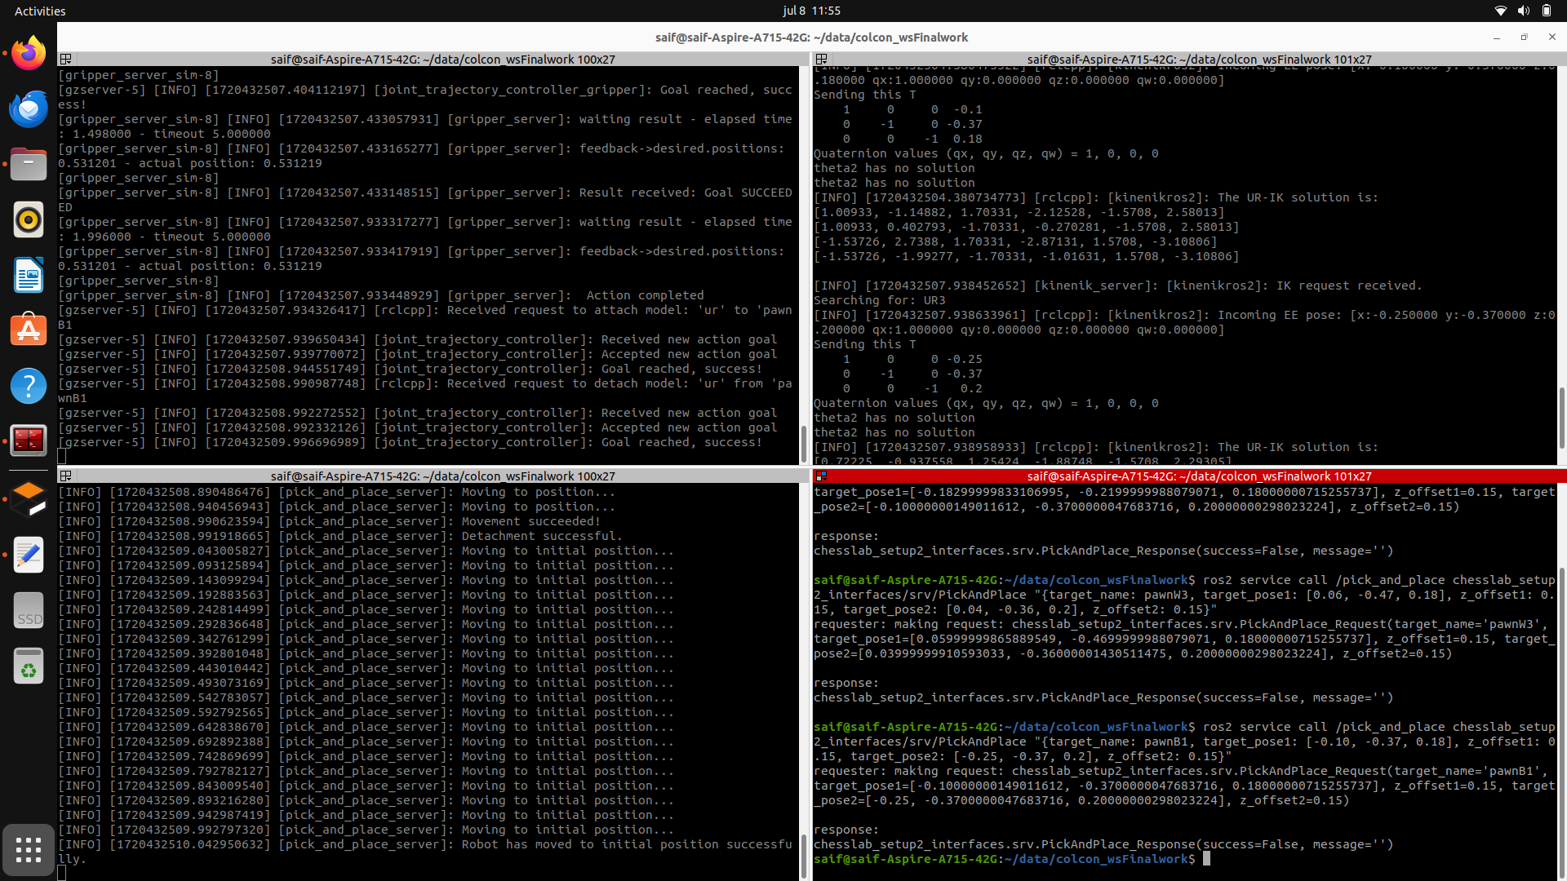
Output From Terminal

Slide 11


Conclusion
As for pick and place and playing the chess the module works perfectly
As for planning a logic should implemented for correct movements

