Slide 1

Drowsiness detection and Encryption of Results
Presented by
Gottumukkala Sai (122004080)
Chukkaluru Mahidhar Reddy (122004064)
Darbar Anwar Basha (122004067)
Project Guide
Dr. Ganapathy R - (AP III)
School of Electrical and Electronics Engineering
SASTRA Deemed to be University

Slide 2
Motivation
It is difficult for any teacher to monitor all the students during the online class session.
This reason has triggered us to work on a solution that can continuously monitor and detect drowsiness on their faces if any.
This requirement can be achieved using a Deep Learning.

Slide 3
Objective
To detect drowsiness on the faces of students during online class sessions using Deep Learning and encrypt the photos of students in drowsy state.

Slide 4
Graphical User Interface
A graphical user interface (GUI) is a type of user interface through which users interact with electronic devices via visual indicator representations.
For taking user input and processing we created login window.
In this project we used Tkinter for implementing GUI.
Steps to create a tkinter window:
1.Importing the module – tkinter
2.Create the main window (container)
3.Add any number of widgets to the main window
4.Apply the event Trigger on the widgets.

Slide 5
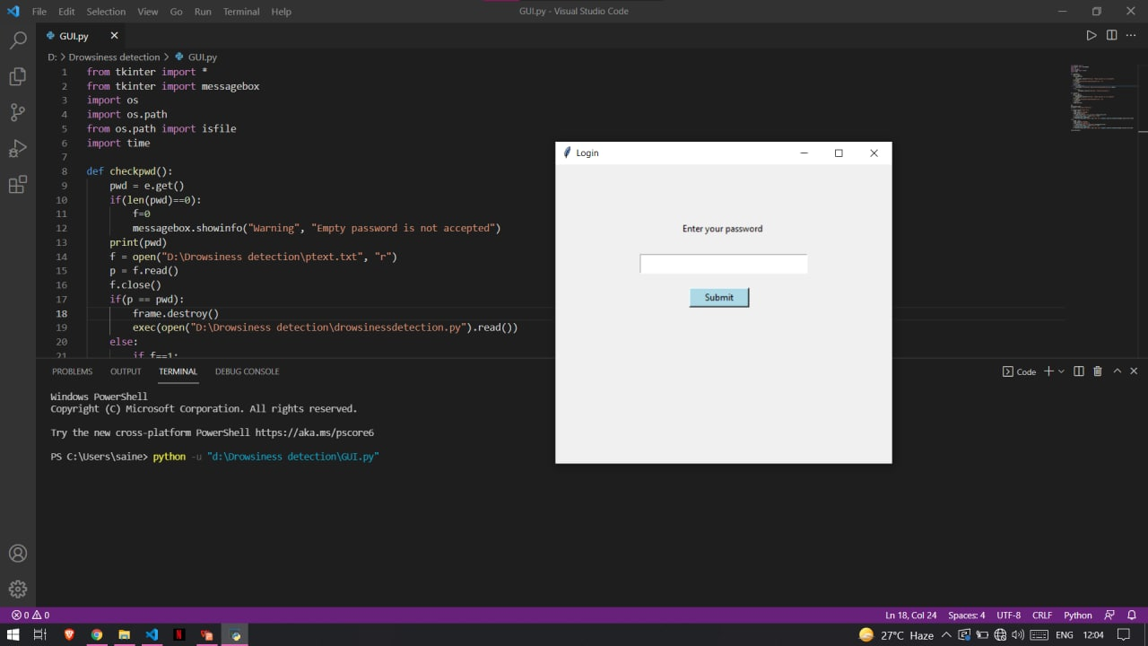
GUI Window

Slide 6
MODEL
In this project we used sequential model for implementing drowsiness detection.
Sequence models are the machine learning models that input or output sequences of data. Sequential data includes text streams, audio clips, video clips, time-series data.
It allows you to build a model layer by layer. We use the 'add()' function to add layers to our model. Our first 2 layers are Conv2D layers. These are convolution layers that will deal with our input images, which are seen as 2-dimensional matrices.
For implementing these models we imported Keras.

Slide 7
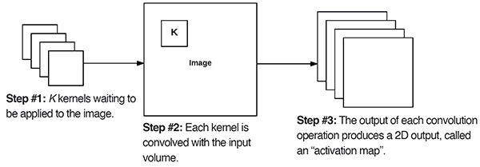
CONVOLUTIONAL 2D LAYER
Keras Conv2D is a 2D Convolution Layer, this layer creates a convolution kernel that is wind with layers input which helps produce a tensor of outputs.
In image processing, kernel is a convolution matrix or masks which can be used for blurring, sharpening, embossing, edge detection, and more by doing a convolution between a kernel and an image.
This layer creates a convolution kernel that is wind with layers input which helps produce a tensor of outputs.

Slide 8
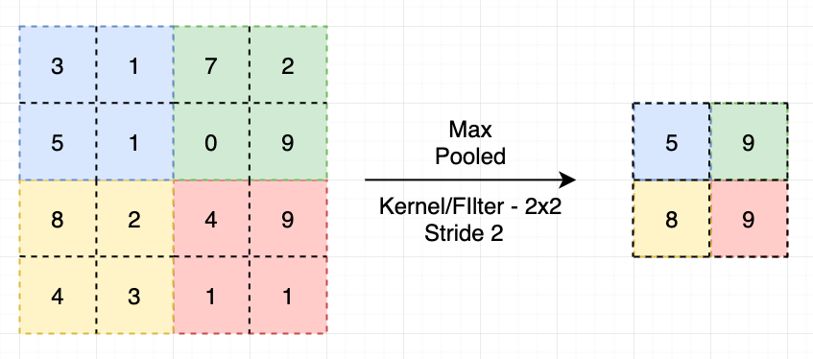
MAX POOLING
A pooling layer is another building block of a CNN. Its function is to progressively reduce the spatial size of the representation to reduce the amount of parameters and computation in the network.
Pooling layer operates on each feature map independently.
Max Pooling calculates the maximum value for patches of a feature map, and uses it to create a downsampled (pooled) feature map. It is usually used after a convolutional layer.
Global max pooling = ordinary max pooling layer with pool size equals to the size of the input (minus filter size + 1, to be precise).

Slide 9
NEURAL NETWORKS
DROPOUT:
Dropout is a technique where randomly selected neurons are ignored during training. They are “dropped-out” randomly. This means that their contribution to the activation of downstream neurons is temporally removed on the forward pass and any weight updates are not applied to the neuron on the backward pass.
A Simple Way to Prevent Neural Networks from Overfitting.
The outputs of a layer under dropout are randomly subsampled, it has the effect of reducing the capacity or thinning the network during training. As such, a wider network, e.g. more nodes, may be required when using dropout.

Slide 10
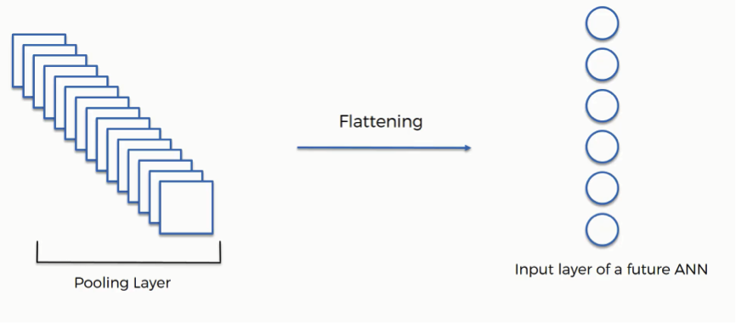
NEURAL NETWORKS
FLATTEN:
Flattening is converting the data into a 1-dimensional array for inputting it to the next layer. We flatten the output of the convolutional layers to create a single long feature vector. And it is connected to the final classification model, which is called a fully-connected layer.

Slide 11
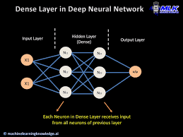
NEURAL NETWORKS
DENSE:
The dense layer is a neural network layer that is connected deeply, which means each neuron in the dense layer receives input from all neurons of its previous layer. The dense layer is found to be the most commonly used layer in the models.
Dense Layer is used to classify image based on output from convolutional layers.

Slide 12
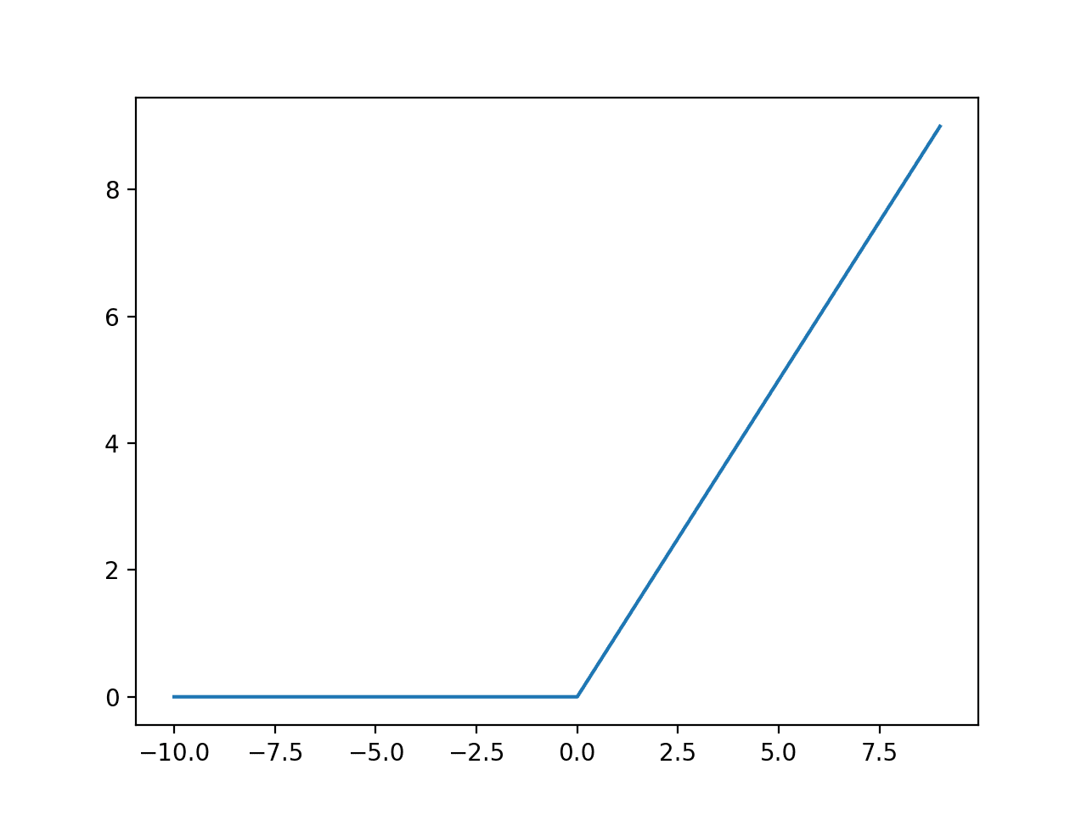
NEURAL NETWORKS
ACTIVATION-RELU:
RELU stands for Rectified Linear Unit Activation.
Activation function is a function that is added into an artificial neural network in order to help the network learn complex patterns in the data.
The rectified linear activation function or ReLU for short is a piecewise linear function that will output the input directly if it is positive, otherwise, it will output zero.

Slide 13
Drowsiness Detection
Steps to be followed:
a. Take image as input from a camera.
b. Detect the face in the image and create a Region of Interest (ROI).
c. Detect the eyes from ROI and feed it to the classifier.
d. Classifier will categorize whether eyes are open or closed.
e. Calculate score to check whether the person is drowsy.
f. If the score exceeds the threshold, we capture the face.

Slide 14
Algorithm used: CNN
What is CNN?
Convolutional Neural Networks(CNN) is a special type of deep neural network which performs extremely well for image classification purposes. A CNN basically consists of an input layer,an output layer and a hidden layer which can have multiple layers.
A convolutional operation is performed on these layers using a filter that performs 2D matrix multiplication on the layer and filter.

Slide 15
The CNN model architecture consists of the following layers:
Convolution layer;32 nodes,kernel size 3
Convolution layer;32 nodes,kernel size 3
Convolution layer;64 nodes,kernal size 3
Fully connected layer;128 nodes
The final layer is also a fully connected layer with 2 nodes. A Relu activation function is used in all the layer except the output layer in which we use softmax

Slide 16
Advantages of CNN:
Very High accuracy in image recognition problems.
Automatically detects the important features without any human supervision.
Weight sharing.
Project Requirements:
The requirement for this Python project is a webcam through which we will capture images. You need to have Python (3.6 version recommended) installed on your system, then using pip, you can install the necessary packages.

Slide 17
Required packages:
OpenCV – pip install opencv-python (face and eye detection).
TensorFlow – pip install tensorflow (keras uses TensorFlow as backend).
Keras – pip install keras (to build our classification model).

Slide 18
Detailed step explantion:
Step 1 – Take Image as Input from a CameraWith a webcam, we will take images as input. So to access the webcam, we made an infinite loop that will capture each frame. We use the method provided by OpenCV, cv2.VideoCapture(0) to access the camera and set the capture object (cap). cap.read() will read each frame and we store the image in a frame variable.

Slide 19
Step 2 – Detect Face in the Image and Create a Region of Interest (ROI)
To detect the face in the image, we need to first convert the image into grayscale as the OpenCV algorithm for object detection takes gray images in the input. We don’t need color information to detect the objects. We will be using haar cascade classifier to detect faces. This line is used to set our classifier face = cv2.CascadeClassifier(‘ path to our haar cascade xml file’). Then we perform the detection using faces = face.detectMultiScale(gray). It returns an array of detections with x,y coordinates, and height, the width of the boundary box of the object. Now we can iterate over the faces and draw boundary boxes for each face.

Slide 20
Step 3 – Detect the eyes from ROI and feed it to the classifier
The same procedure to detect faces is used to detect eyes. First, we set the cascade classifier for eyes in leye and reye respectively then detect the eyes using left_eye = leye.detectMultiScale(gray). Now we need to extract only the eyes data from the full image. This can be achieved by extracting the boundary box of the eye and then we can pull out the eye image from the frame with this code.

Slide 21
Step 4 – Classifier will Categorize whether Eyes are Open or Closed
We are using CNN classifier for predicting the eye status. To feed our image into the model, we need to perform certain operations because the model needs the correct dimensions to start with. First, we convert the color image into grayscale using r_eye = cv2.cvtColor(r_eye, cv2.COLOR_BGR2GRAY). Then, we resize the image to 24*24 pixels as our model was trained on 24*24 pixel images cv2.resize(r_eye, (24,24)). We normalize our data for better convergence r_eye = r_eye/255 (All values will be between 0-1). Expand the dimensions to feed into our classifier. We loaded our model using model = load_model(‘models/cnnCat2.h5’) . Now we predict each eye with our model lpred = model.predict_classes(l_eye). If the value of lpred[0] = 1, it states that eyes are open, if value of lpred[0] = 0 then, it states that eyes are closed.

Slide 22
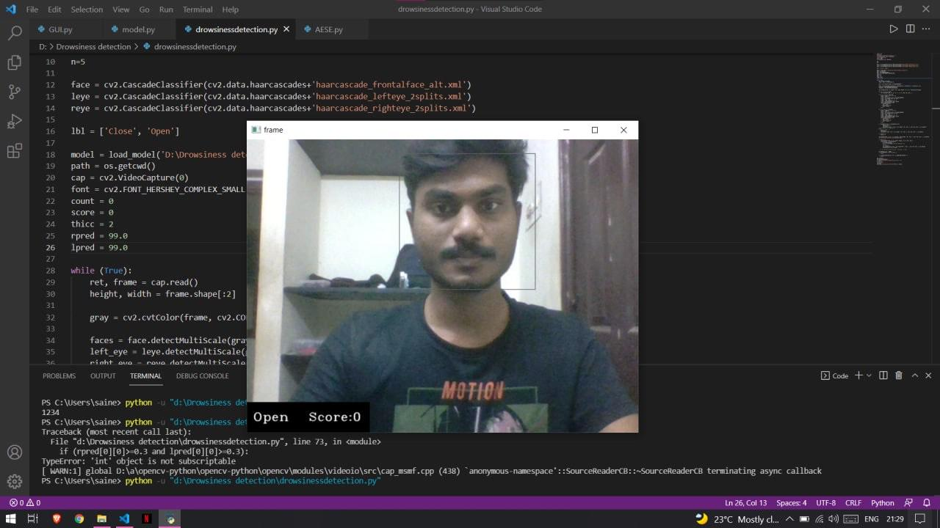
Sample output:

Slide 23
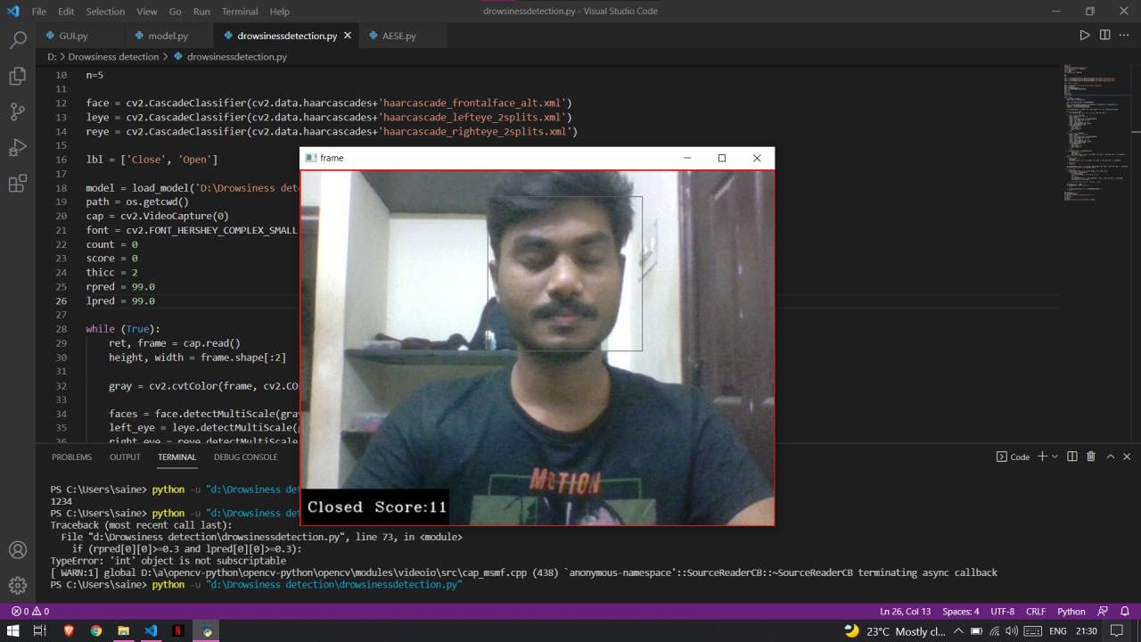

Slide 24
Encryption
Encryption is a means of securing digital data using one or more mathematical techniques, along with a password or "key" used to decrypt the information.
The encryption process translates information using an algorithm that makes the original information unreadable.
In this project we need encryption to protect private information, sensitive data of users.
In essence, when your data is encrypted, even if an unauthorized person or entity gains access to the data, they will not be able to read it.
We use AES encryption in this project.

Slide 25
AES Encryption
Advanced Encryption Standard (AES) is a specification for the encryption of electronic data established by the U.S National Institute of Standards and Technology (NIST) in 2001. AES is widely used today as it is a much stronger than DES and triple DES despite being harder to implement.
It takes 128 bits as input and outputs 128 bits of encrypted cipher text as output. AES relies on substitution-permutation network principle which means it is performed using a series of linked operations which involves replacing and shuffling of the input data.
For a key length of 128 bits we perform 10 rounds of AES process.

Slide 26
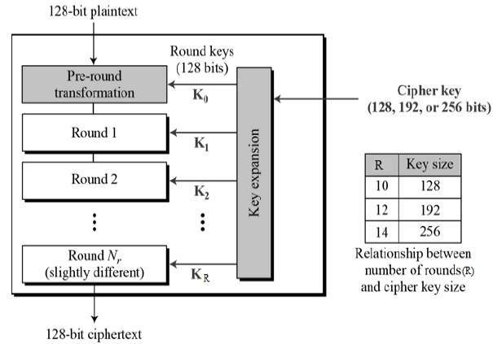
AES Encryption
Schematic of AES encryption process

Slide 27
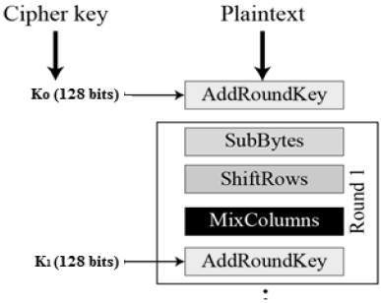
Process in each round
Plaintext is taken and is processed through the following four steps :
Byte Substitution (SubBytes)
Shiftrows
MixColumns
Addroundkey

Slide 28
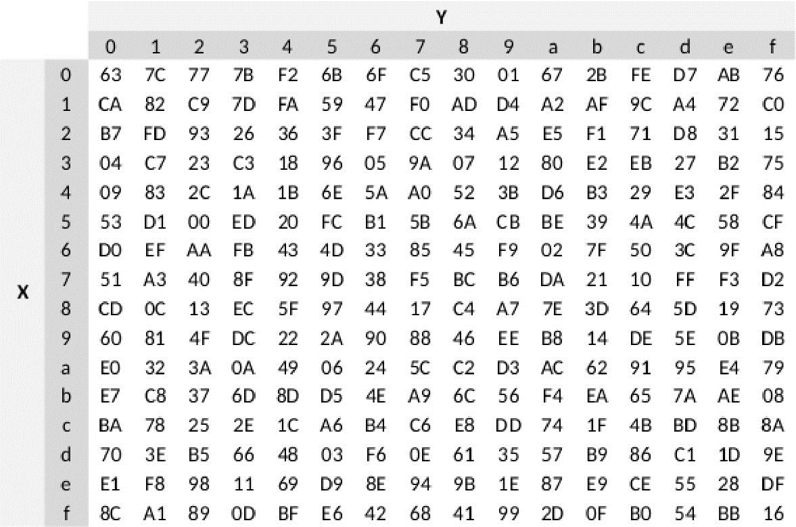
Byte Substitution (SubBytes)
The 16 input bytes are substituted by the ones in the S-box. The result is in a matrix of four rows and four columns.
For example :
20 in hex is substituted as B7 according to the table.
In this way all the 16 bytes are substituted

Slide 29
Shiftrows
Each of the four rows of the matrix is shifted to the left. Any entries that ‘fall off’ are re-inserted on the right side of row. Shift is carried out as follows −
First row is not shifted.
Second row is shifted one (byte) position to the left.
Third row is shifted two positions to the left.
Fourth row is shifted three positions to the left.
The result is a new matrix consisting of the same 16 bytes but shifted with respect to each other.

Slide 30
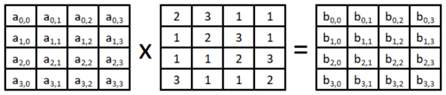
MixColumns
Each column of four bytes is now transformed using a special mathematical function. This function takes as input the four bytes of one column and outputs four completely new bytes, which replace the original column. The result is another new matrix consisting of 16 new bytes. It should be noted that this step is not performed in the last round.

Slide 31
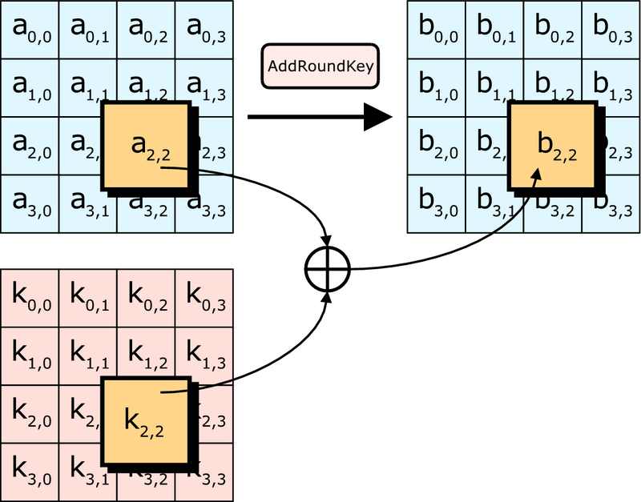
Add Round Key
The 16 bytes of the matrix are now considered as 128 bits and are XORed to the 128 bits of the round key. If this is the last round then the output is the ciphertext. Otherwise, the resulting 128 bits are interpreted as 16 bytes and we begin another similar round.

Slide 32
AES Encryption
Python provides us with a module called Crypto in which we have libraries like AES, Random etc.
In this project, we considered a key of length 32 bytes or 256 bits.
So we perform the 14 rounds of AES process.
In this project we operate in CBC mode.
CBC is a mode of operation where each plaintext block gets XOR-ed with the previous ciphertext block prior to encryption.
It is one of the most commonly used block cipher modes of operation due to its ease of implementation and support for parallelized decryption.

Slide 33
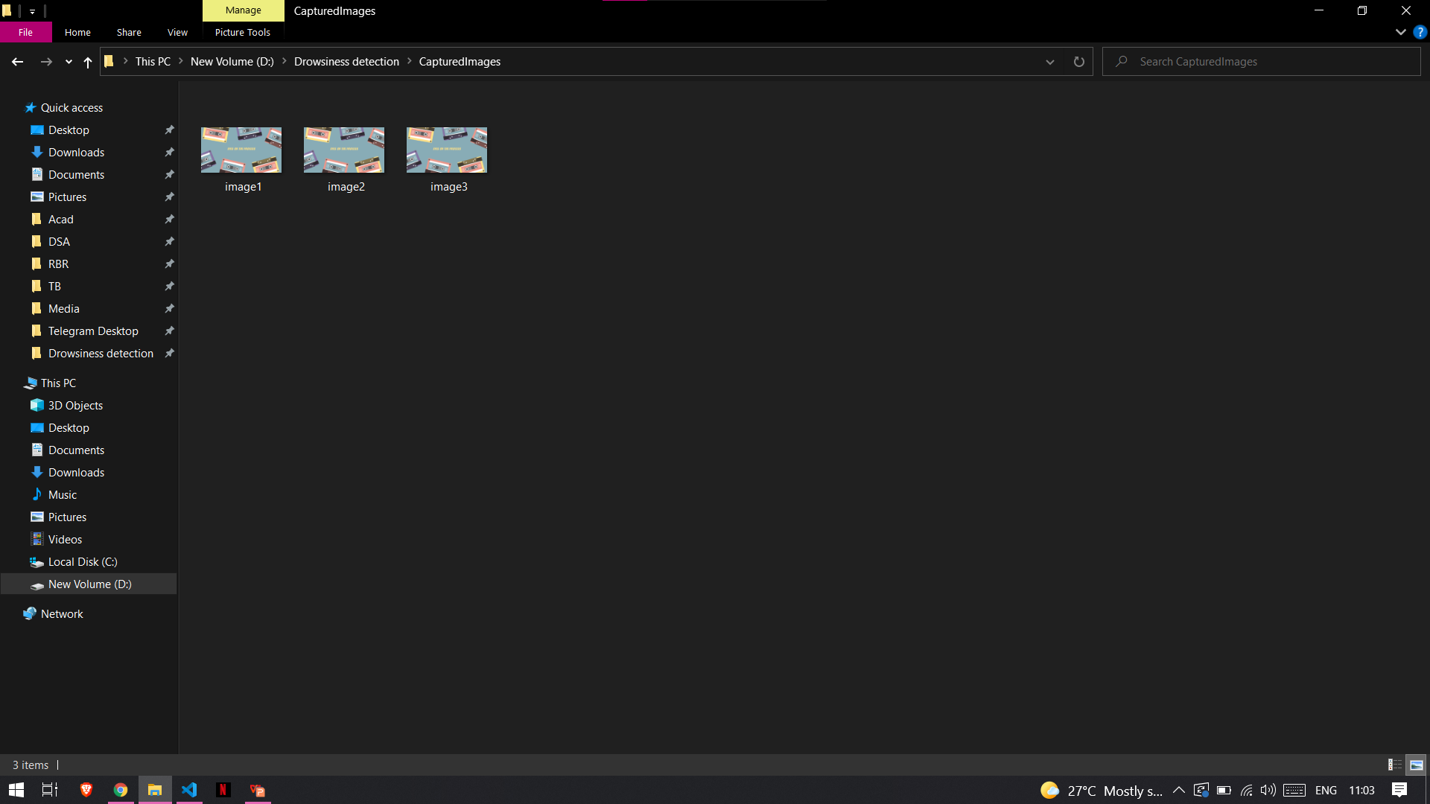
Sample images in the directory

Slide 34
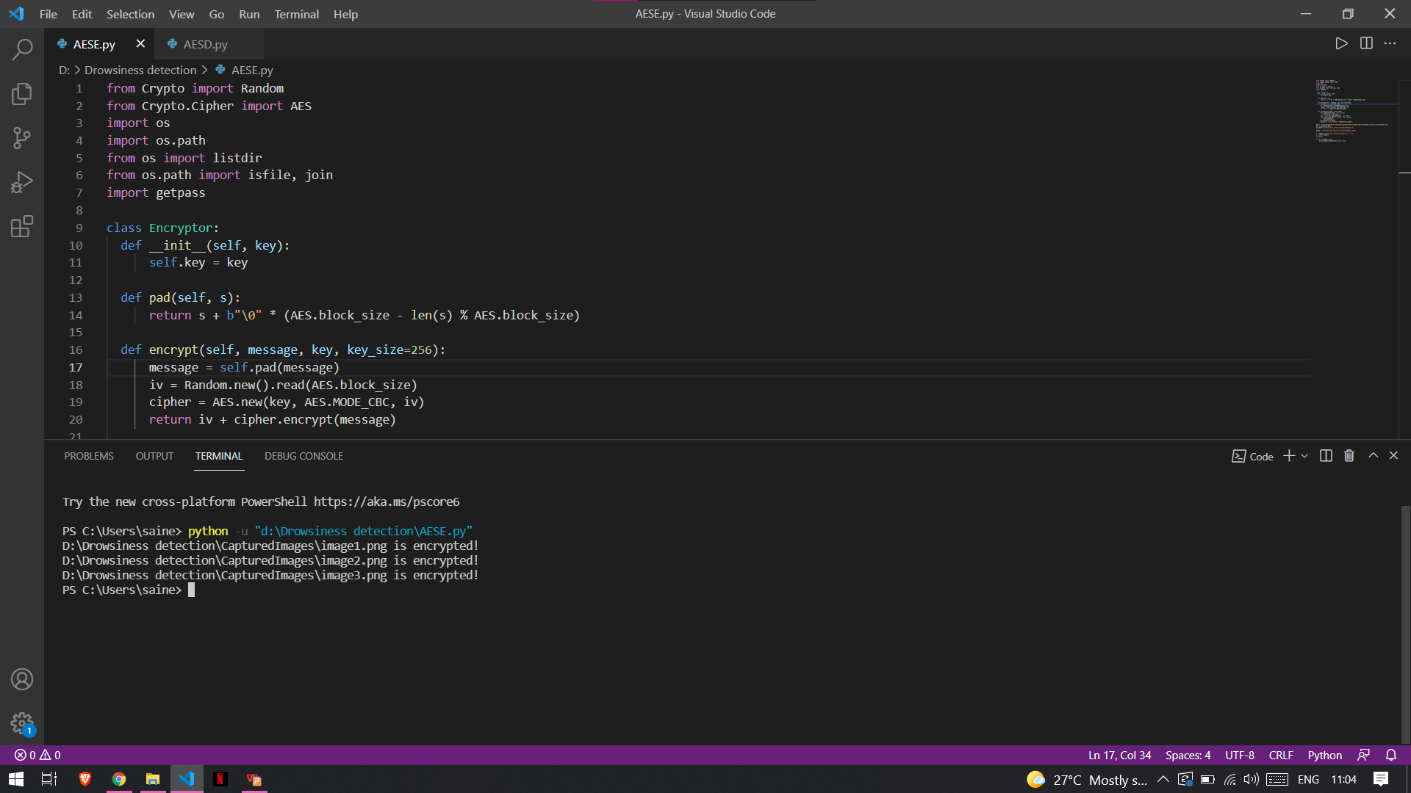
Encryption

Slide 35
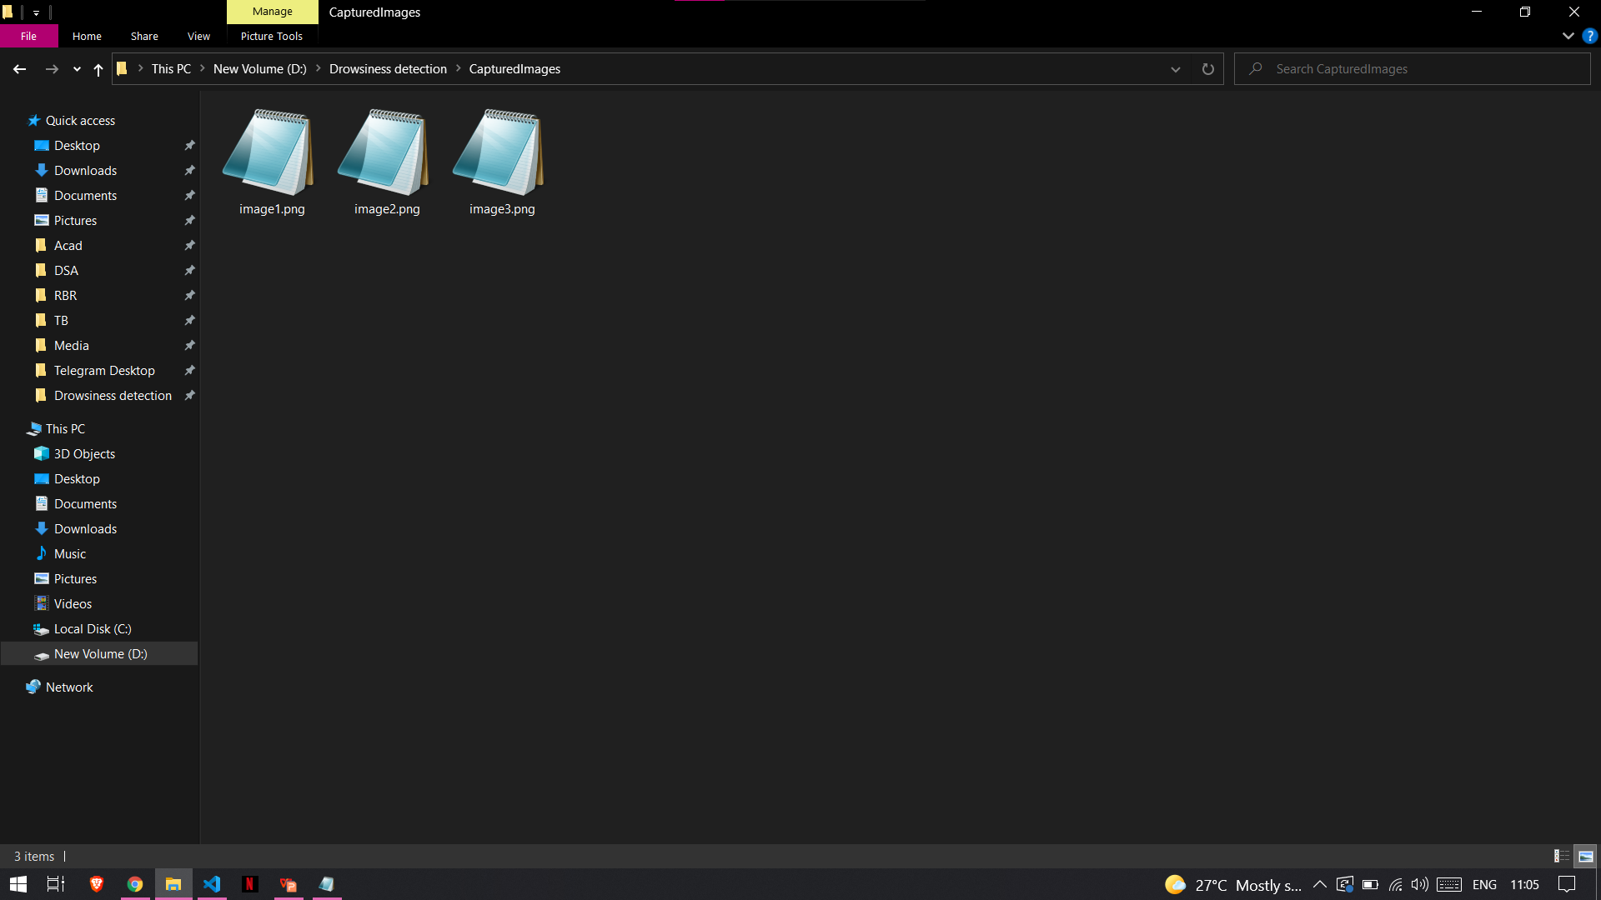
Sample images after Encryption

Slide 36
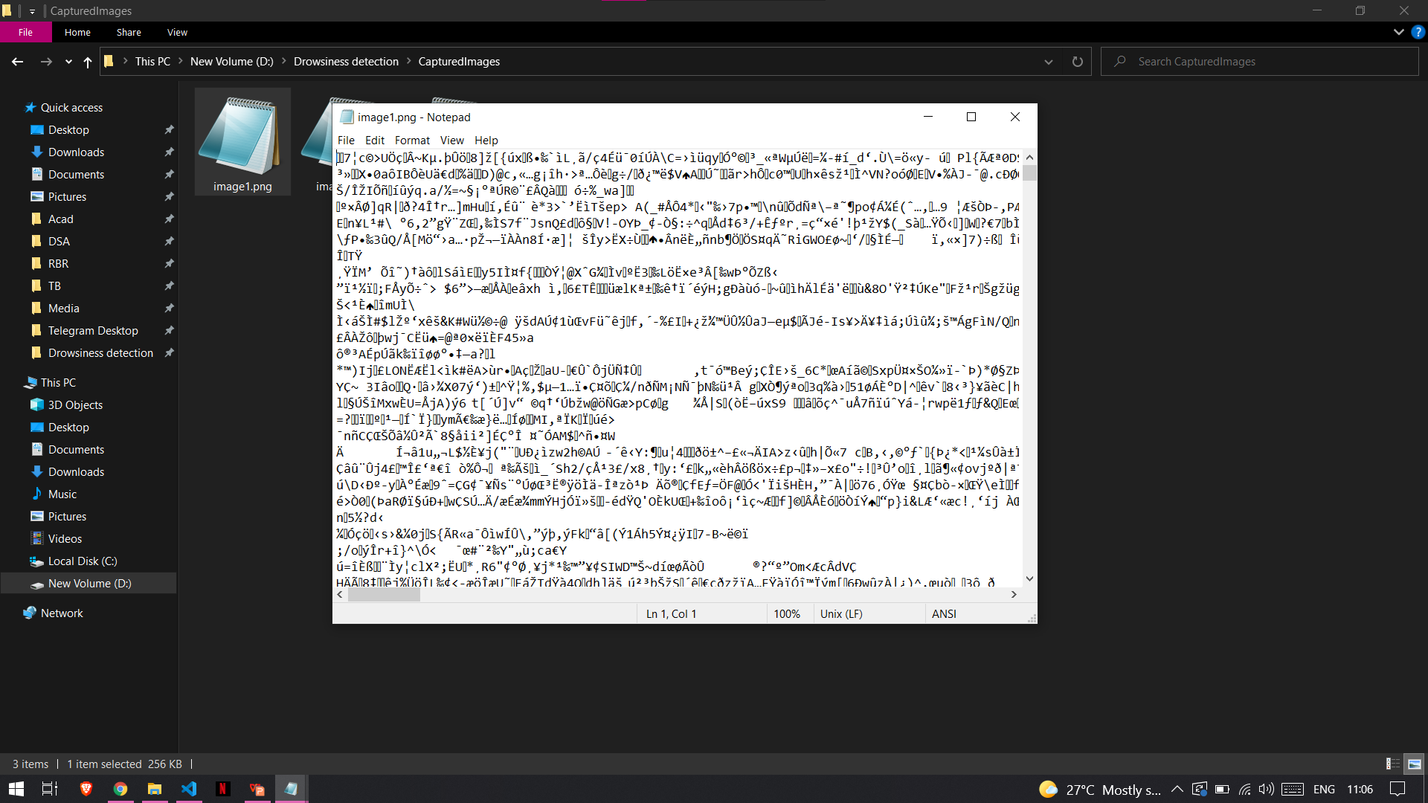
Unreadable format

Slide 37
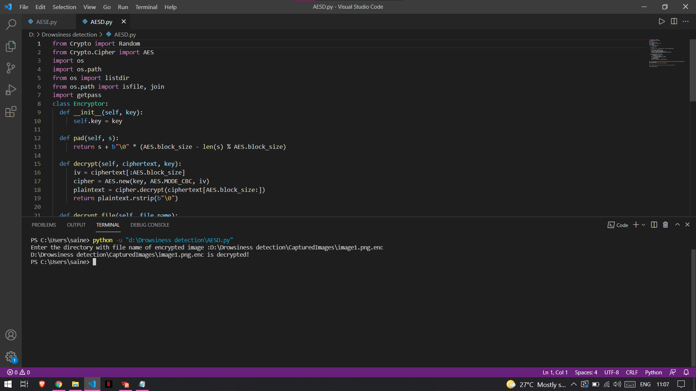
Decryption

Slide 38
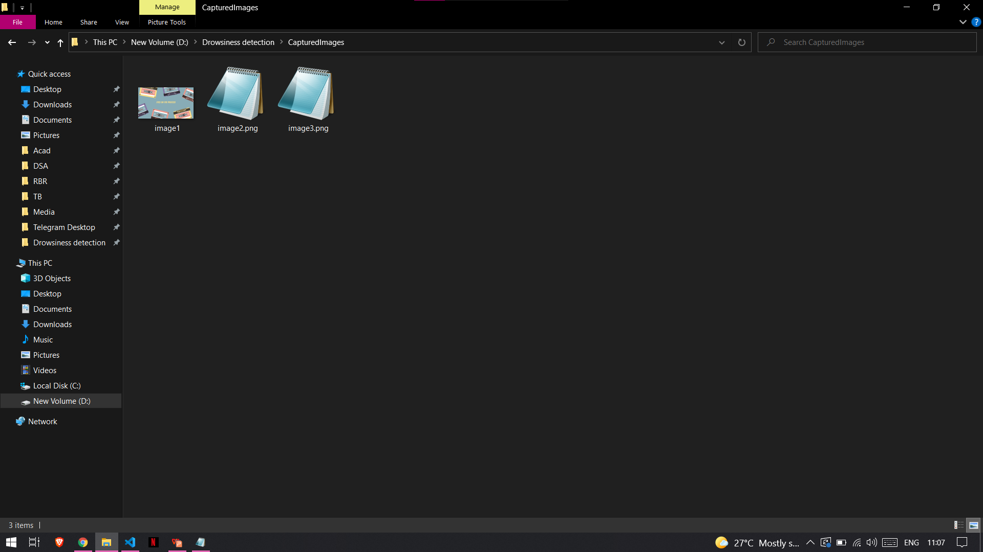
Decrypted files

Slide 39
References
A journal on Driver Drowsiness Detection by V B Navya Kiran, Raksha R and team published on IJERT
A journal on Image encryption and decryption using AES algorithm by Priya Deshmukh published on IJSER

Slide 40
THANK YOU!

