Slide 1

RAGHU ENGINEERING COLLEGE(Autonomous) Department of Electrical & Electronics Engineering
Academic Year : 2021- 2022 IV Year PROJECT
ISLANDING OPERATION AND AUTONOMOUS POWER MANAGEMENT FOR INTERLINKED AC/DC MICROGRIDS
BATCH-08:
K.Diwakar 19985A0231
M.Anjali 19985A0242
T.Sai Ganesh 19985A0290
Y.Dileep Prudhvi 19985A0298
Project Guide:
Mr. P. Srinivas
Assistant Professor

Slide 2
Contents
Main objective
Abstract
Introduction
Literature Survey
PV Renewable sources
Block diagram
Tie converter
abc to dq transformation
PI controller
PWM technique
Simulation blocks and Results
Conclusion
References

Slide 3
Main Objective
The main objective of this proposed scheme is to control the flow of power from AC micro grid to DC micro grid whenever there is peak load demand or the contingency condition by keeping in view of the specific loading condition of the DC micro grid.
It will also reduces the number of tie converters used by adopting the priortisied system unlike the other power management control strategies.

Slide 4
Abstract
The existing power management schemes are either concerned about power sharing or regulation of voltage but not on both.
But the proposed scheme will enable us to regulate the voltage on the basis of specific loading condition of the DC micro grid.
The proposed scheme will also enable us to transfer power from AC micro grid to DC micro grid during the peak load demand or at contingency condition.
The results reveal the usefulness of the proposed scheme in the power management and then results are verified through MATLAB/SIMULINK environment.

Slide 5
Introduction
The proposed scheme will enable us autonomous power transfer between the AC micro grid and DC micro grid.
This will enable the management of power only when one micro grid is heavily loaded and another micro grid is lightly loaded.
Their network topologies and control strategies are mainly determined to maximize the benefits while meeting the load requirements.
The deployment of these new technologies in the form of a micro grid is preferred due to several advantages, such as optimal utilization of resources, improved power quality and enhanced supply reliability

Slide 6
Literature Survey
By enabling AC microgrids in the distributed network will increase the performance and reliability of the electrical system.
This is mainly devoted to minimising the operation cost, coordinating support services, and maximising the reliability and controllability of microgrids.
A single-stage inverter system with maximum power point tracking control (MPPT) which is applicable in low power photovoltaic (PV) energy conversion systems is proposed in this project.
The proposed system is successfully implemented by using a single digital signal processor TMS320F2808.

Slide 7
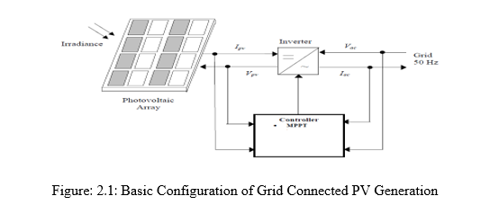
PV Renewable sources
The usage of solar cells to transform energy from solar irradiance through electricity is really a process that renewable support.
The main reason for the fluctuation with PV systems production capacity is the seasonal variation of solar irradiance which is due to the passing of clouds across a PV field.

Slide 8
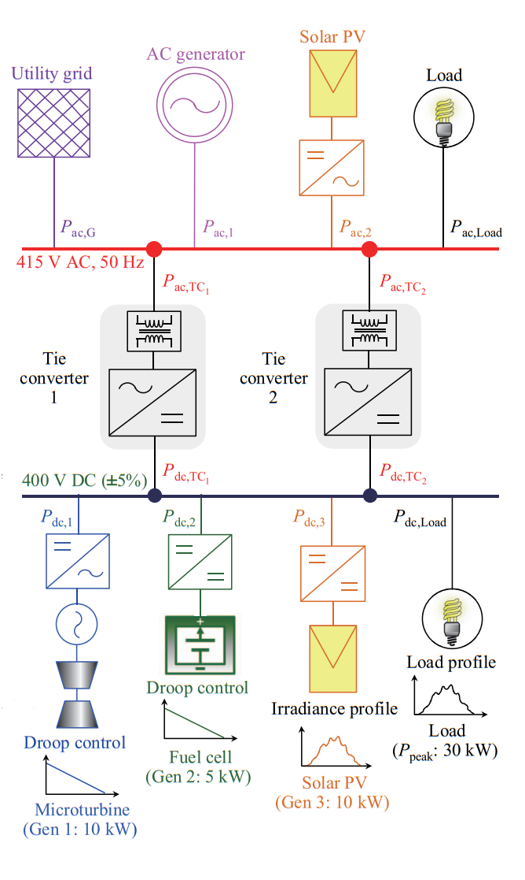
BLOCK DIAGRAM
AC Grid (AC-G)
Characterized by regulated Frequency and Voltage
Tie Converters (TCs)
1)With the proposed hybrid control (droop and voltage control mode), tie-converters autonomously transfer power from AC to DC microgrid when the load demand in DC microgrid is high and all generators are heavily loaded
2)At the same time, tie-converters autonomously regulate the voltage of DC microgrid to avoid further degradation.
3)The number of converters in operation are reduced to avoid unnecessary operational losses.
4)The proposed scheme is fully autonomous and allow plug-n-play of generators and tie-converters.
DC Grid (DC-G)
1)Dispatchable generators are droop controlled.
2)DC grid voltage is regulated within defined range.
3)Non-dispatchable generators produce maximum power

Slide 9
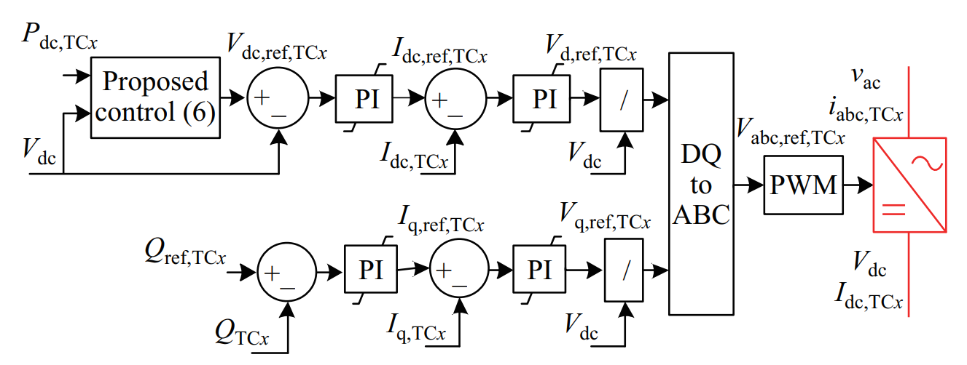
Control block diagram of tie converter

Slide 10
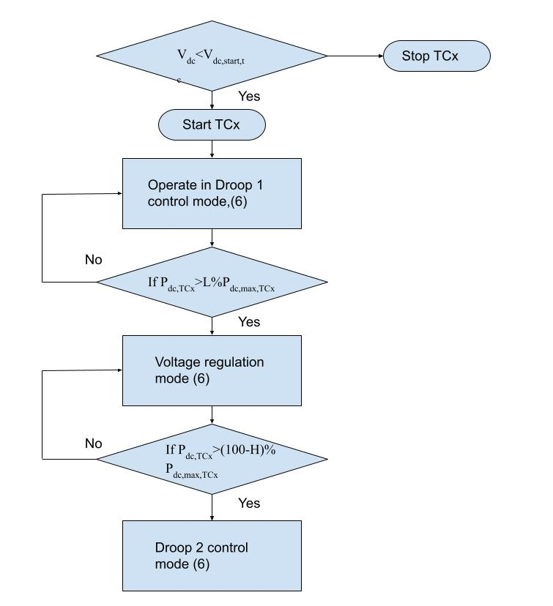
Logic flow diagram showing mode transitions of tie converter

Slide 11
Maximum power point tracking(MPPT)
It can be used in solar-charged controllers that charge batteries from the solar PV array.
The voltage at which the PV module can produce maximum power is called maximum PowerPoint.
PSO based MPPT is used for PV which reduces steady-state oscillations.

Slide 12
ABC to dq0 transformation
The ABC to dq0 transformation uses Park transformation to transform a three-phase signal into a dq0 reference frame whereas dq0 to ABC transformation uses inverse Park transformation.
The ABC-to-dq0 transformation depends on the dq frame alignment at t = 0.
The ABC to dq0 transformation is done in order to make computation easy and it also allows to independently control of active (d axis) and reactive (q axis) components.
In dq0 frame, the mutual inductance is constant so that it allows to achieve the desired output.

Slide 13
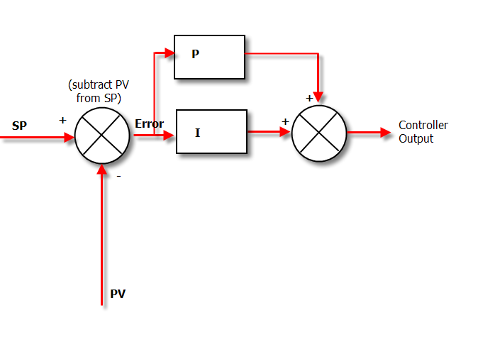
PI CONTROLLER

Slide 14
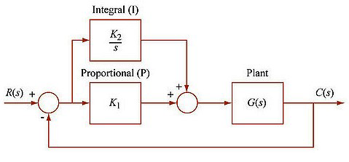

Slide 15
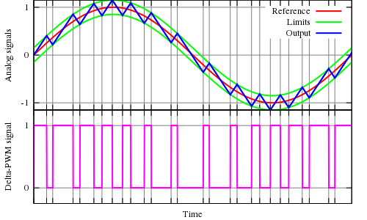
PULSE WIDTH MODULATION (PWM)
Pulse-width modulation (PWM) is a modulation process or technique used in most communication systems for encoding the amplitude of a signal right into a pulse width or duration of another signal, usually a carrier signal, for transmission.
Input reference wave is compared with carrier wave signals, their coincidence points will be as gate pulse on and off.

Slide 16
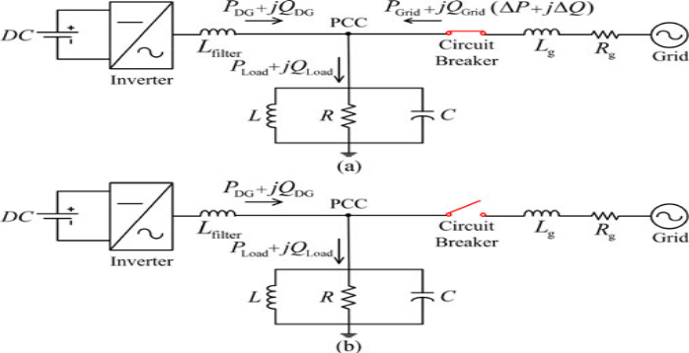
CONFIGURATION OF THE ISLANDING DETECTION METHOD
Islanding is the intentional isolation of a part of power system during external widespread grid disturbance. This isolated part of Grid is called Island. Such a disturbance may lead to black out. Therefore, islanding scheme provides a mean to continue to supply power to the essential services in a zone or area.

Slide 17
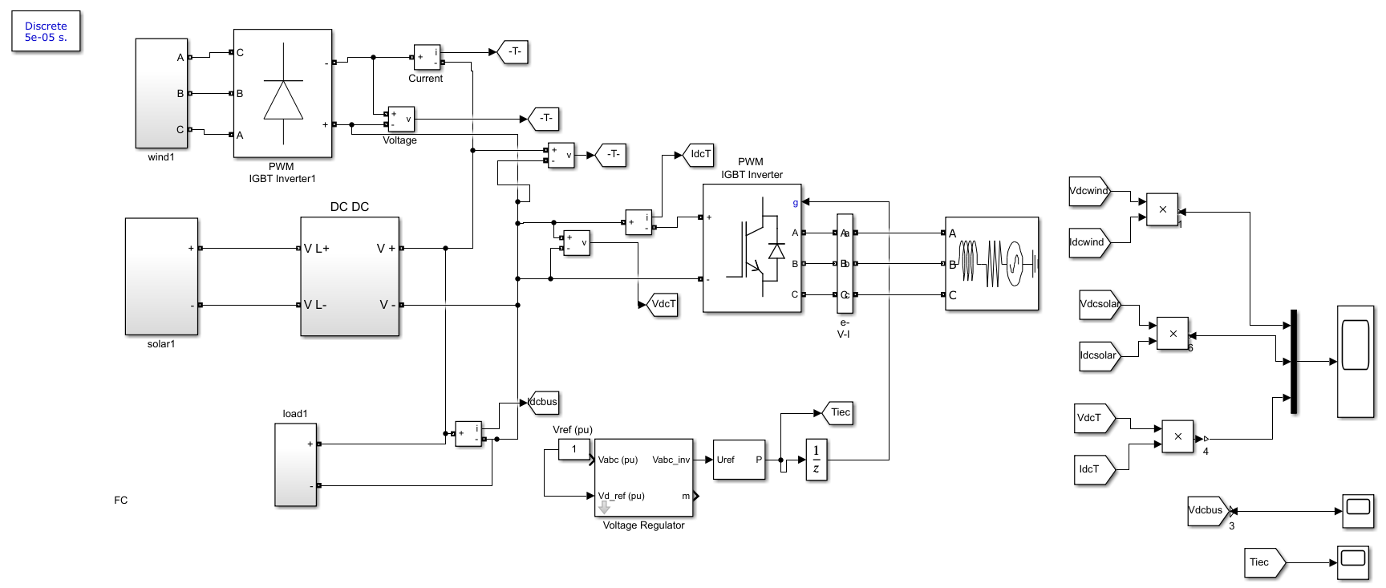
SIMULATION BLOCK OF DIFFERENT GENERATIONS AND CONVERTER

Slide 18
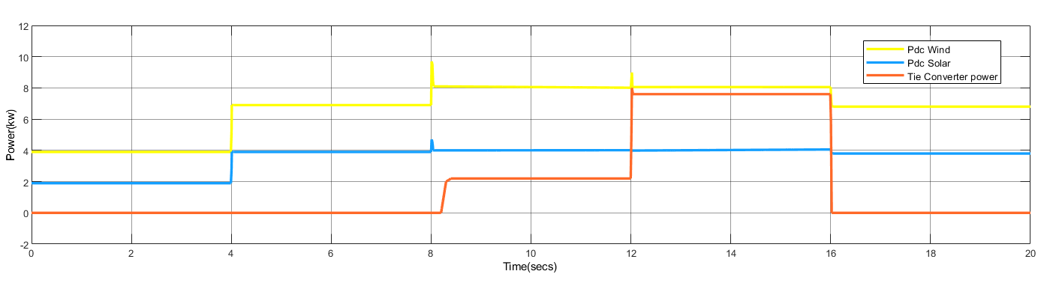
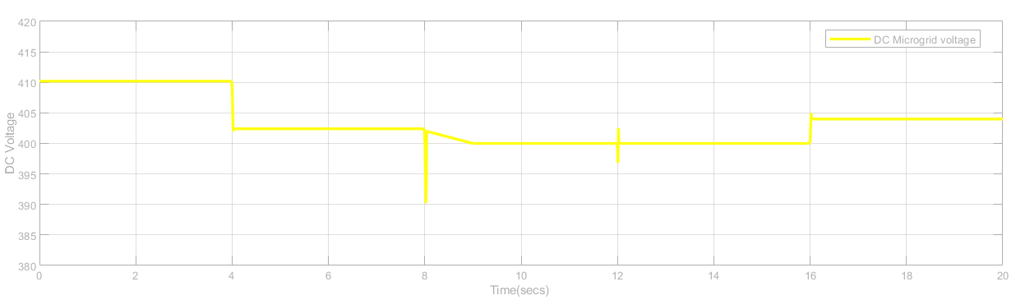
SIMULATION RESULTS
generators and tie-converter power
DC microgrid voltage

Slide 19
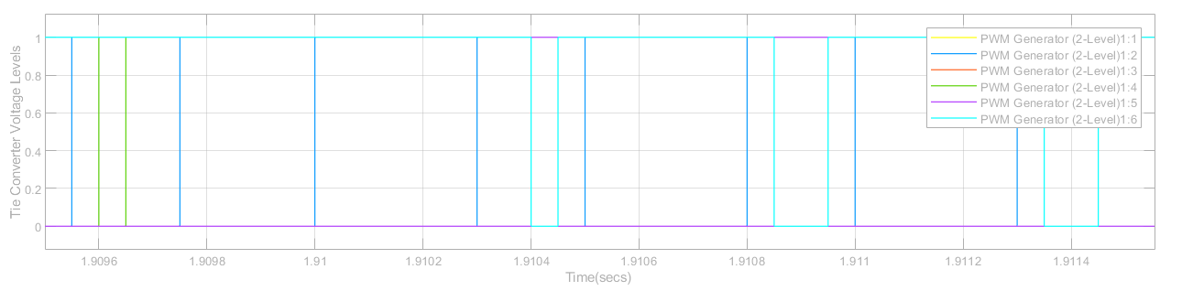
tie-converter control signals for four different load operating conditions.

Slide 20
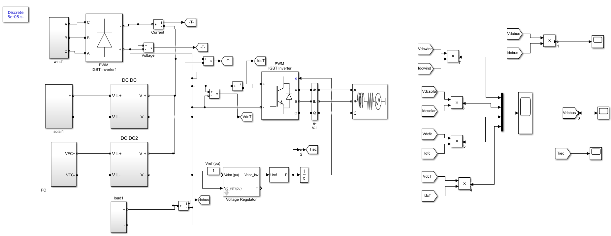
SIMULATION BLOCK OF DIFFERENT GENERATIONS, LOAD AND CONVERTER

Slide 21
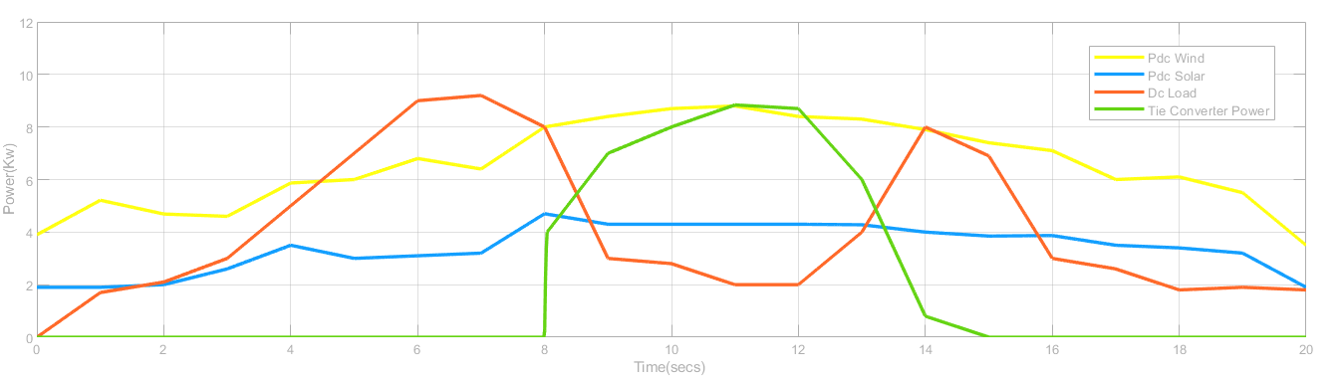
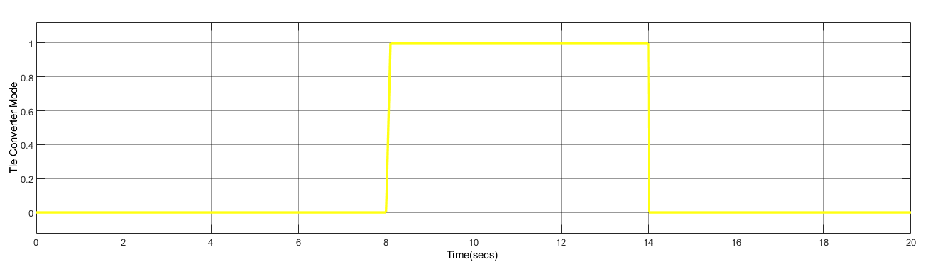
generators and tie-converter power
tie-converter control signals at varying solar PV and load operating conditions

Slide 22
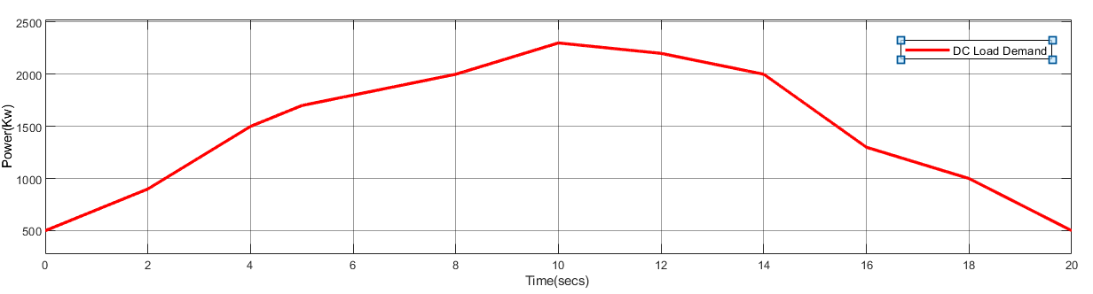
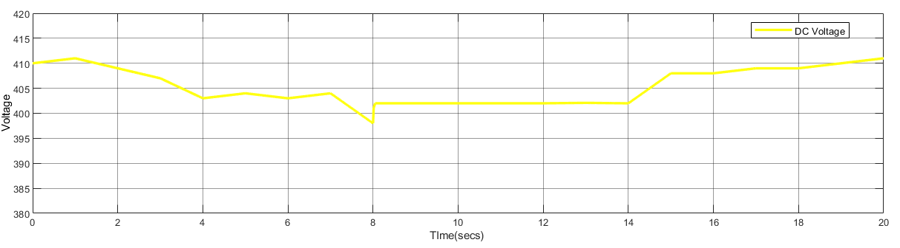
DC microgrid load demand
DC microgrid voltage

Slide 23
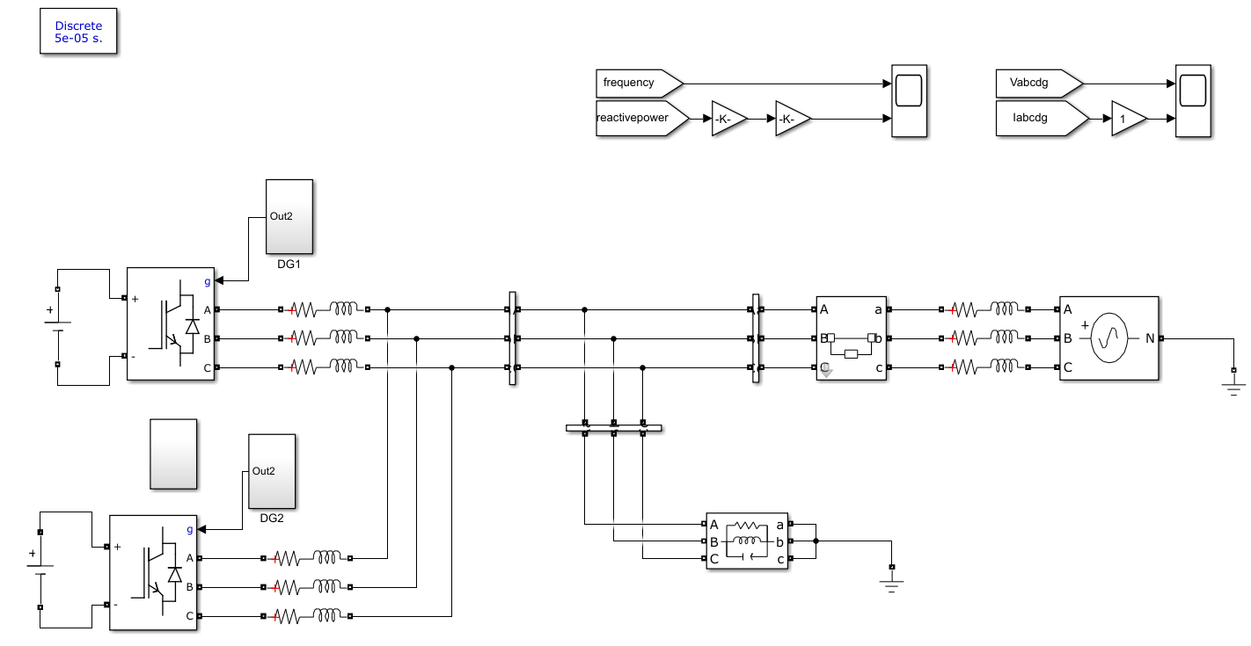
SIMULATION CONFIGURATION OF THE ISLANDING DETECTION METHOD

Slide 24
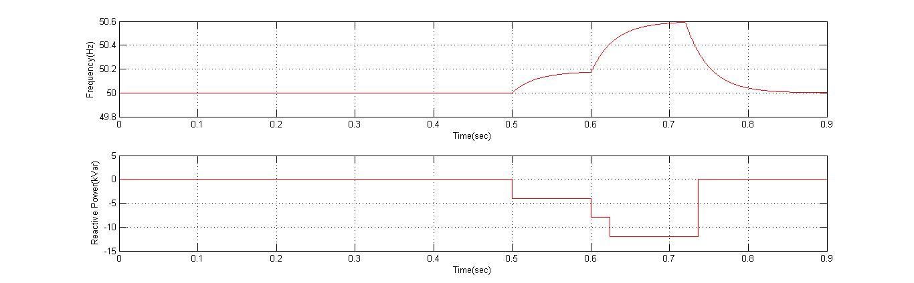
shows Reactive power and frequency vs time in sec

Slide 25
CONCLUSION
An autonomous power management scheme has been presented for interlinked AC-DC micro grids having different configurations. The proposed scheme manages the power deficit in the DC micro grid efficiently and autonomously. The number of tie-converters in operation has been reduced with the proposed prioritization to avoid unnecessary operational losses. The scheme has demonstrated better voltage regulation in the DC micro grid. The performance and robustness of the proposed scheme have been validated for two different scenarios of the DC micro grid at variable load conditions.

Slide 26
RFERENCES
[1] J. Rocabert, A. Luna, F. Blaabjerg, and P. Rodr´ıguez, “Control of power converters in AC microgrids,” IEEE Transactions on Power Electronics, vol. 27, no. 11, nov-2011 [2] M. Liserre, T. Sauter, and J. Y. Hung, “Future energy systems: integrating renewable energy sources into the smart power grid through industrial electronics,” IEEE Industrial Electronics Magazine, vol.4. no. 1, pp. 18–37, Mar. 2010. [3] M. Tsili and S. Papathanassiou, “A review of grid code technical requirements for wind farms,” IET Renewable Power Generation, vol. 3, no. 3, pp. 308–332, Sep. 2009. [4] T. Strasser, F. Andren, J. Kathan, C. Cecati, C. Buccella, P. Siano, P. ´ Leitao, G. Zhabelova, V. Vyatkin, P. Vrba, and V. Ma ˜ ˇ r´ık, “A review of architectures and concepts for intelligence in future electric energy systems,” IEEE Transactions on Industrial Electronics, vol. 62, no. 4, pp. 2424–2438, Apr. 2015. [5] A. Kwasinski, “Quantitative evaluation of dc microgrids availability: Effects of system architecture and converter topology design choices,” IEEE Transactions on Power Electronics, vol. 26, no. 3, pp. 835–851, Mar. 2011.

Slide 27
THANK`YOU’

