Slide 1
Intel Products Sentiment Analysis from Online Reviews
Intel Unnati Industrial Training Program 2024

Slide 2
Problem Statement
Intel Products are reviewed by end users and tech reviewers on various platforms(for example, Amazon and Flipkart).
Category A: End Users/ Buyers Reviews
Category B: Technical Reviews by Experts
Scope: Intel Core Processors(Mobile/Desktop)
Our project revolves around forecasting user sentiment analysis. Specifically, the project aims to predict customer reviews of mobile phones/desktops and then categorize the reviews as positive, negative, or neutral for the organization. The machine learning model leverages Selenium, Textblob as well as other packages such as pandas and scikit-learn. This tool will be beneficial to organizations as it enables them to gather reliable user feedback and enhance their models.

Slide 3
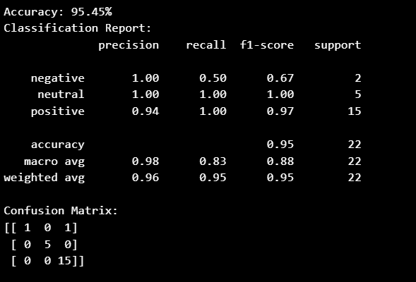
Solution
In our project, we employed a supervised learning algorithm called Random Forest Classifier for the machine learning model. The model was trained on the training data to classify sentiments, and its performance was assessed using metrics such as accuracy, classification report, and confusion matrix.
Here are the results we obtained:

Slide 4
Features Offered
The dataset is organized into columns labeled title, description, and sentiment. The title column contains a brief summary of the customer's review, typically indicating the product name or satisfaction level. The description column offers detailed insights into the product, including features, performance, quality, and the customer's personal experiences and feedback. It elaborates on usability, reliability, and any issues encountered, providing a thorough evaluation from the customer's perspective.
This project analyzes the sentiment of reviews for various Intel products using TextBlob. TextBlob classifies reviews into positive, negative, or neutral based on polarity scores: scores greater than 0 are positive, scores less than 0 are negative, and scores equal to 0 are neutral. It provides an overall sentiment score for each review, summarizing user opinions.

Slide 5
Process flow
Step 1 :Scraping the data form amazonand Load The Dataset -
Performing sentiment analysis on Intel product reviews to assess customer satisfaction and identify areas for improvement.
Step 2 : Sentiment Analysis With TextBlob -
Using TextBlob, classifying the customer feedback as positive, negative and neutral.
Step 3 : Count Sentiments -
It quantifies the distribution of positive, negative and neutral sentiments.

Slide 6
Step 4 : Save The Cleaned Data -
Conducting sentiment analysis on Intel product reviews to determine and quantify the overall customer sentiment.
Step 5 : Load And Explore The Dataset -
Categorising the customer feedback into positive, negative or neutral sentiments and analyse their distribution.
Step 6 : Data Preprocessing -
Analysing Intel product reviews to classify customer feedback as positive, negative or neutral and understand the sentiment distribution among English- language reviews.

Slide 7
Step 7 : Heuristic For Filtering English Text -
Analysing Intel product reviews to catergorise and quantify the distribution of sentiments( positive, negative, neutral) among English-language feedback using a heuristic filter for non- English text.
Step 8 : Redefine The Clean Text Function -
Analysing Intel product reviews, filter for English text using a heuristic approach,clean and categorise sentiments ( positive, negative, neutral) based on customer feedback.
Step 9 : Convert Emojis To Text -
Converting emojis to text descriptions in titles and descriptions,and saving the modified dataset for sentiment analysis.

Slide 8
Step 10 : Exploratory Data Analysis ( EDA) And Clustering -
Analysing Intel product reviews using clustering and sentiment analysis techniques to understand customer sentiment and identify common themes in feedback.

Slide 9
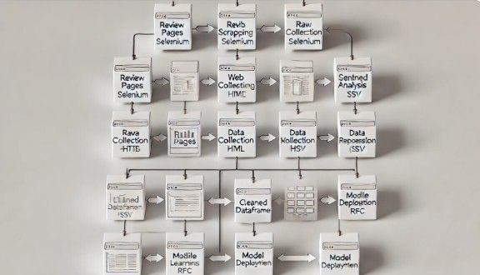
Architecture Diagram

Slide 10
Technologies used
pandas-2.0.3
selenium-4.10.0
webdriver_manager-3.8.6
textblob-0.17.1
wordcloud-1.8.2.2
emoji-2.4.0
langid-1.1.6
matplotlib-3.7.2
scikit-learn-1.3.1

Slide 11
Team members and contribution:
Team member 1 : Scraping the data from online reviews
Team member 2: Data cleaning and preparation for sentiment analysis.
Team member 3: Implementing sentiment detection using TextBlob.
Counting and classifying positive and negative reviews.
Team member 4: Conducting Exploratory Data Analysis (EDA) and visualizations.
Compiling results and insights for reporting.

Slide 12
Conclusion
Sentiment analysis of Intel products from online reviews goes beyond surface-level feedback, providing actionable insights that drive product innovation, enhance customer satisfaction, manage brand reputation, and optimize marketing strategies.
By analyzing sentiment trends, strengths and weaknesses can be identified, guiding product improvements and marketing strategies to enhance customer satisfaction and competitiveness in the market.
We have demonstrated the performance of sentiment analysis on Amazon reviews using a Random Forest classifier.
The process involved loading of dataset, preprocessing the data, training the model,and evaluating it’s performance.
This process facilitates informed decision-making, ensuring Intel can effectively meet consumer expectations and maintain a positive brand image.

