Slide 1
Title: Building a Model to Predict Housing Prices
Author: Nicolás Gallardo

Slide 2
Introduction
The main goal of this project was to improve the linear regression model created in video 7.9 by Dr. Williams.
To reach that goal, several steps were settled:
Importing the data using the Pandas library
Exploring the dataframe created and definition of the target and the features to create the Linear Regression model
Exploration of the target through a histogram. Revision of the concept of skewness in Gaussian distribution.
Creation of scatterplots to understand how these plots help in understanding relationships between variables.
Clearing the NaN values of the data to prepare the data for modeling.
Revision of the concept of Correlation and looking for the best correlated variables for the target.
Creation of 3 Linear Regression model for the housing price with different variables. Revision of the concept of R-Squared score.
Discussion and conclusions of the results.

Slide 3
The Data
The data presented in this project is the one that will be worked to create a model to predict the housing sale price within this framework. The rows represent the values of the data, while the columns indicate the attributes used in this database. The attributes include different characteristics of a property and its environment: they include information about the neighborhood, the commodities within the property, the type of construction of it, the area of the property, the quality of the different features, etc. To see the details and the description of the data, it can be found in the data folder of this project.
The data had a shape of (100, 82) as a pandas dataframe, being 39 variables numeric.

Slide 4
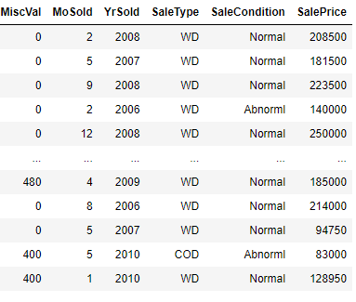
Data Exploration
The most important variable that was used in this model is the sale price of the property, because it's the target and the variable that will let the model predict that price of the different properties.
Figure 1.- Representation of SalePrice in the dataframe worked.

Slide 5
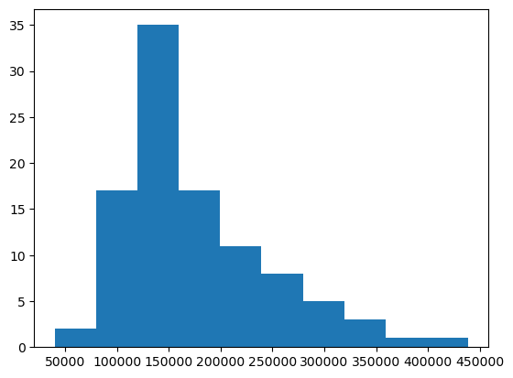
Data Exploration
In this case, it would be important to show how the data of SalePrice is distributed.
Figure 1.- Representation of SalePrice in the dataframe worked.
Figure 2.- Histogram of SalePrice

Slide 6
Data Exploration
As can be seen in figure 2, the data is not normally distributed, and there is a right-tailed showing in the distribution. It should be a positive skewness, and it will be calculated to confirm it.
One of the methods used to transform the data and make it more normally distributed, it's to transform this data into a logarithmic scale due to its compactable nature.

Slide 7
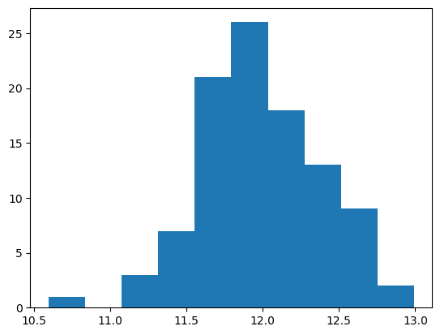
Data Exploration
Figure 3.- Histogram of the natural logarithmic transformation of SalePrice

Slide 8
Data Exploration
The skewness of each was calculated, given 1.17 for the original scaled target and -0.09 for the logarithmic scaled target. The data is more naturally distributed.
This is helpful in creating a machine learning algorithm that uses linear regression, because having a tailed or skewed data can be harmful to the statistical model, because the tail can be interpreted as outliers, affecting the performance of the model.

Slide 9
Data Exploration
Another important step is to create scatterplots to check the relationship between variables. The scatterplots are used to show the relationship between variables. As the algorithm used was of a Linear Regression model, the idea is to look for linearity between the variables.

Slide 10
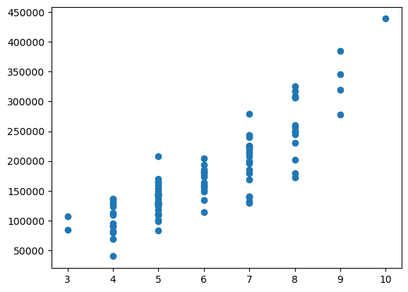
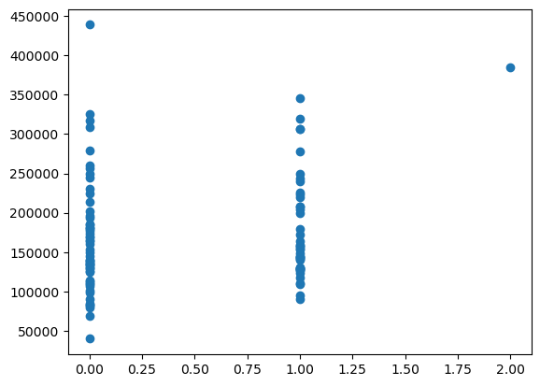
Data Exploration
Figure 5a.- OverallQual vs SalePrice
Figure 5b.- BsmtFullBath vs SalePrice

Slide 11
Data Exploration
The main differences between figure 5a vs figura 5b, is that the first one has a linearity between the variables and the other is not linear. Considering the model that was built, the importance of linearity in variables should be the main feature of how the data is connected.

Slide 12
Data Preparation
To prepare the data, only the numeric variables were used to be possible candidates of being the independent variables of the Linear Regression model.
It was important to look for NaN values considering the sklearn algorithm did not let having NaN values to create the model.
PoolQC had 100 NaN values, opting not to use this variable. LotFrontage had 14 NaN and GarageYrBLt had 6 NaN. They were filled with the mean values of each columna, being 71.4 and 1977.4, respectively.

Slide 13
Correlation
The correlation concept indicates the relationship between two variables. The correlation coefficient is a statistical numeric measure that ranges between -1 and 1, where the extremes represent a perfect strong relationship (which can be negative or positive) and 0 means no relationship between the two variables.
The most common correlation coefficient is the Pearson's correlation coeficient. This is a measure of linear relationship, which is why it is used to test what variables can be useful to create a Linear Regression model.

Slide 14
Correlation
The SalePrice target was compared with the rest of the numeric variants to look for the correlation between them.
This process was also done with the logarithmic transformed target.

Slide 15
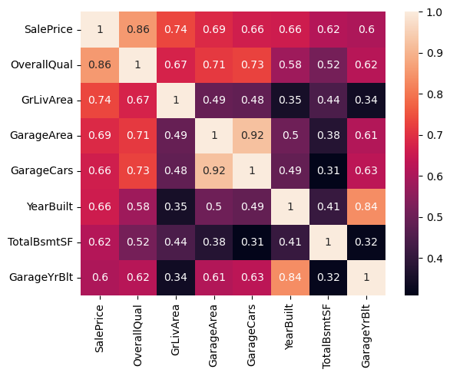
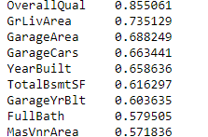
Correlation
Figure 6a.- Correlation between the original SalePrice vs the rest of the variables. The top 9 best correlated variables are shown.

Slide 16
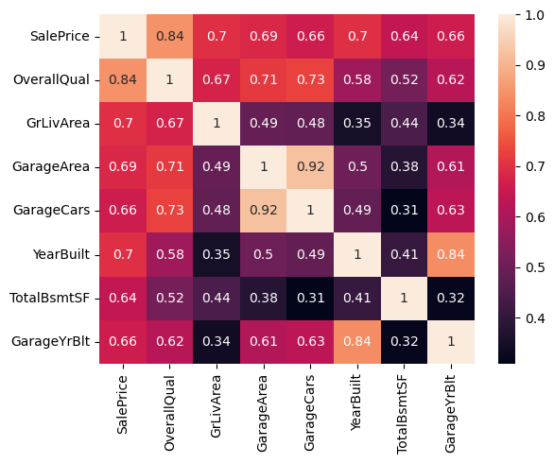
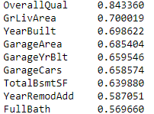
Correlation
Figure 6a.- Correlation between the logarithmic transformed scaled SalePrice vs the rest of the variables. The top 9 best correlated variables are shown.

Slide 17
Correlation
Figure 6a.- Correlation between the logarithmic transformed scaled SalePrice vs the rest of the variables. The top 9 best correlated variables are shown.

Slide 18
Correlation
From the figures can be extrated the conclusion that the correlation between the variables did not change importantly, but that mean does not mean that the linear regression won't be fitter for the logarithmic scaled target because it is more normally distibuted.

Slide 19
Project Description
This project consisted in creating a Linear Regression model with the SalePrice variable as a target using the 9 best related independent variables explored in the previous page. The chosen algorithm was of the Multiple Linear Regression Model because it is used linear correlated variables, which are multiple in this case. The models were compared with the performance of its R-Squared score and they were tested with test data provided.
Three models were created, with the following characteristics:
Model 1: Original scaled target (SalePrice) vs the 9 best correlated variables.
Model 2: Logarithmic scaled target (SalePrice) vs the 9 best correlated variables.
Model 3: Logarithmic scaled target (SalePrice) vs the 2 best correlated variables.

Slide 20
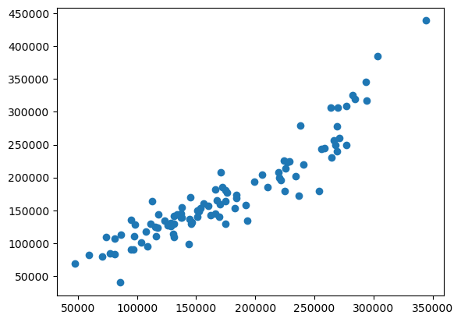
Analysis and Results
Figure 7a.- Scatterplot of model 1 (OverallQual, GrLiveArea, YearBuilt, GarageArea, GarageYrBlt, GarageCars, TotalBsmtSF, YearRemodAdd, Fullbath vs Original Scaled SalePrice). R2 is 0.854

Slide 21
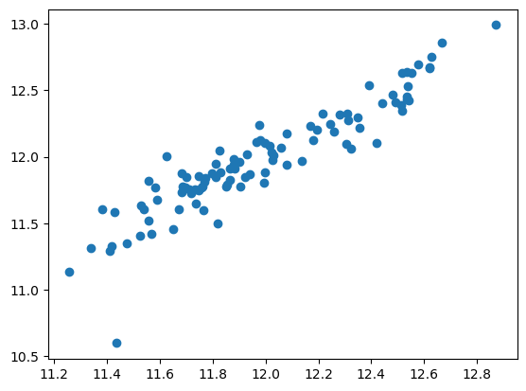
Analysis and Results
Figure 7b.- Scatterplot of model 1 (OverallQual, GrLiveArea, YearBuilt, GarageArea, GarageYrBlt, GarageCars, TotalBsmtSF, YearRemodAdd, Fullbath vs Logarithmic Scaled SalePrice). R2 is 0.858

Slide 22
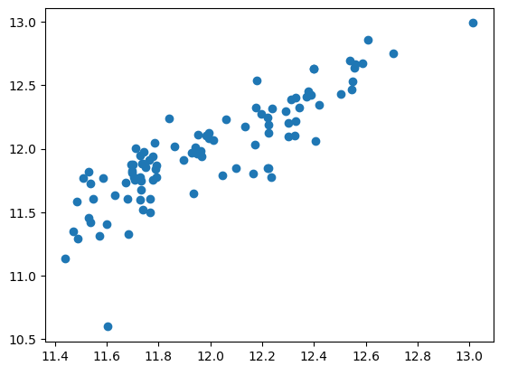
Analysis and Results
Figure 7c.- Scatterplot of model 1 (OverallQual, GrLiveArea, YearBuilt, GarageArea, GarageYrBlt, GarageCars, TotalBsmtSF, YearRemodAdd, Fullbath vs Logarithmic Scaled SalePrice). R2 is 0.743

Slide 23
Analysis and Results
For the first case, the R-squared score is 0.854. This means that the data is well-fitted in its own model, and that the model should be good to predict the house pricing.
For the second case, the R-squared score is 0.858. This makes sense because this model had the target variable normally distributed, making the model to be more fitted with the data. It is slightly better, though.
In the third case, it can be noticed that the R-squared score has a worse performance compared to the other two. This has to do with the less variables used to create this model, considering there were many numeric variables that had a good correlation to SalePrice. This indicates that the more correlated variables are used to create a model, the better the performance to predict a target should be.

Slide 24
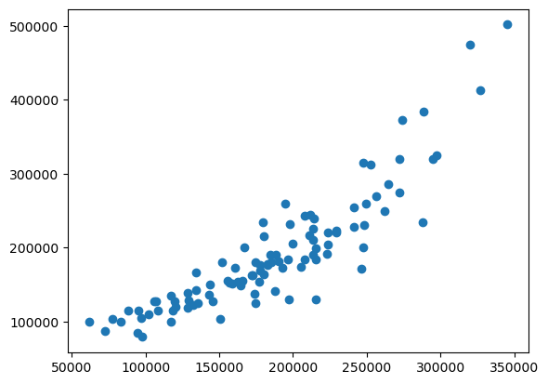
Verification
Figure 8a.- Scatterplot of verification of model 1. R2 is 0.767

Slide 25
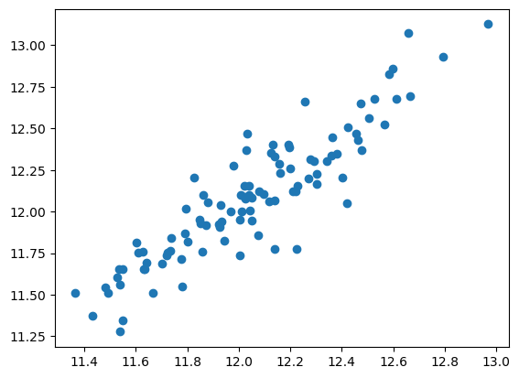
Verification
Figure 8a.- Scatterplot of verification of model 2. R2 is 0.811

Slide 26
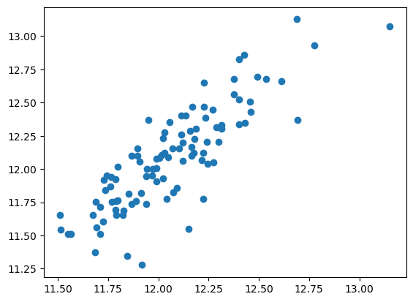
Verification
Figure 8a.- Scatterplot of verification of model 3. R2 is 0.706

Slide 27
Verification
The data for testing is used in the first model created for this project. The result shows that the R-Squared score was lower than when it was compared with the same data to create the model. This is expected, and the result is still very good. The model is still good at predicting the target variable.
The R-squared score for the test on the second model was better than the one for the first model, indicating a 0.811 R-squared score. This indicates a strong prediction for the pricing of the properties. It makes sense that this one performed better than the first one with the test data, because the transformation to logarithm made the skewness of the distribution of the variable closer to zero, and it is important to remember that linear regressions are affected by outliers, and tailed-distribution can provoke that data is taken as outliers. This is why it's important to transform the data when there is a tailed-distribution.
The data is not as fitted for model 3. The R-squared score is 0.706. While still good for prediction, is not as strong as the first or second one. Even though the target is in a Gaussian distribution in this model, there are just two dependent variables taken to create this linear regression. This indicates that, while it's important to adjust the distribution of the target, it's very important to take as many correlated independent variables as possible to create a good model that has a strong R-Squared score, because that model is taking account the many variables that are shaping the target outcome.

Slide 28
Conclusion
When exploring the data, it's of extreme importance to understand what is what needs to be predicted by the model. When that is covered, it's also important to see how distributed the target variable is, because the skewness of a distribution can be harmful for methods like the linear regression model.
It is important to fill or drop columns that have too many NaN values, as they make some algorithm impossible to create, like the linear regression model.
Correlation is an important concept that indicates how strongly related are two variables. The Pearson's correlation coefficient is easy to compute by the Pandas library and the seaborn library helps in showing many correlation coefficients quickly to make conclusions about the relationships of the variables.
The R-Squared score, or coefficient of determination, is an important score to understand if the data fits well a model and is strong and accurate to predict a target outcome.
The independent variables that are more correlated to the target are the ones that need to be included to create a model with better performance of the R-Squared score, as these variables are shaping the target outcome and they have to be taken account.
It is important to understand the theory of the model that is used, to have a bigger picture of how the model can be affected by outliers or other statistics concept, like the covariance, correlation, or distribution of a feature.
Finally, for a linear regression model, the best outcome was when many correlated independent variables were taken account and when the skewness of the target was more normally distributed.

Slide 29
References
Bruce, Peter. Practical Statistics for Data Scientists. 2017. 24 - 60
Müller, A. Introduction to Machine Learning with Python. 2017. 45 - 49.
Joshi, P. Python Machine Learning Cookbook. 2016. 11 - 12.
Fernando, J. "R-Squared: Definition, Calculation Formula, Uses, and Limitations" Investopedia. Dotdash Meredith, 2023. www.investopedia.com/
Chawla, A. "A Common Misconception About Log Transformation" Daily Dose of Data Science. Substack, 2023. www.blog.dailydoseofds.com/

