Slide 1

News Article Summarization
Presented by:
Bhanu Chander Reddy Sama
Prashant Mourya
Sai Kumar Reddy Gheereddy
Sumedha Sirikonda

Slide 2
Project Goals
Abstractive text summarization using Newsroom dataset on PyTorch.
Models used:
Google T5 Transformer
BERT (Bidirectional Encoder Representations from Transformers)

Slide 3

Project Overview:
Types of Summaries:
Extractive Text Summarization : It is the traditional method developed first. The main objective is to identify the significant sentences of the text and add them to the summary. You need to note that the summary obtained contains exact sentences from the original text.
Abstractive Text Summarization : It is a more advanced method; many advancements keep coming out frequently(I will cover some of the best here). The approach is to identify the important sections, interpret the context and reproduce in a new way. This ensures that the core information is conveyed through shortest text possible.
Newsroom Dataset:
Dataset of 1.3 Million Articles & Summaries with Diverse Extractive Strategies.
Obtained from search and social metadata between 1998 to 2007.
Combine both extractive and abstractive strategies.

Slide 4
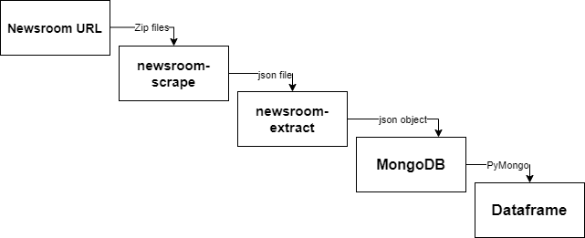
Obtaining Dataset:
Newsroom contains two scripts for downloading and processing data downloaded from Archive.org
Download & extract the tar file and yield the tar file directory.
Newsroom-extract and newsroom-scrape scripts used to process the data
Newsroom-extract – extracts summaries and articles from the data downloaded by newsroom-scrape.
Newsroom-scrape – produces an unmodified file out of the original output file.
MongoDB as data storage system.
Data preprocessing in done using Dataframes.

Slide 5
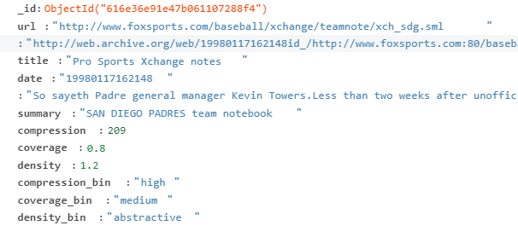
Understanding Data:
URLs : Article Original site and its archive location
Important aspects : title, text and summary
Quantifying summaries:
Compression – size of summaries compared to articles.
Coverage – percentage of summary words from articles.
Density – How long extractive fragments used by summary?
Useful in understanding the diversity of the dataset.

Slide 6
Exploratory Data Analysis:
Expand Contradictions
Sentence Tokenization
Word Tokenization
Character Tokenization
Lemmatization
Data Cleaning - Lowercase words, Remove punctuations, Stopwords etc.,
Visualize
Handle Outliers
Topic Modelling

Slide 7
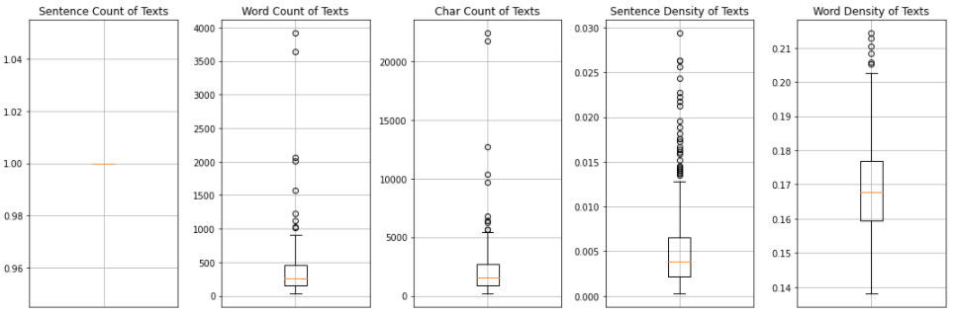
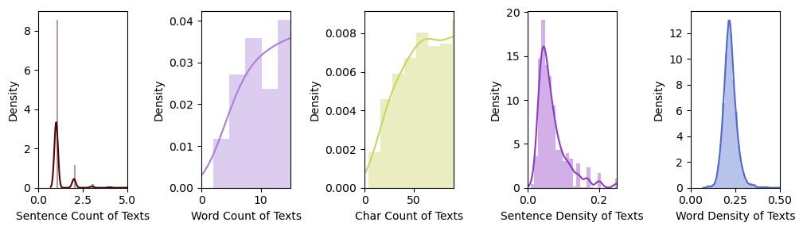
Feature Distribution on Text variable
The count of rows with outliers values is a medium number comparitively, we can consider removing them but it does not look a great deal.
The count mostly looks like a left skewed distribution, 50% of rows in the range 10-40 words and the count of char is a normal distribution.

Slide 8
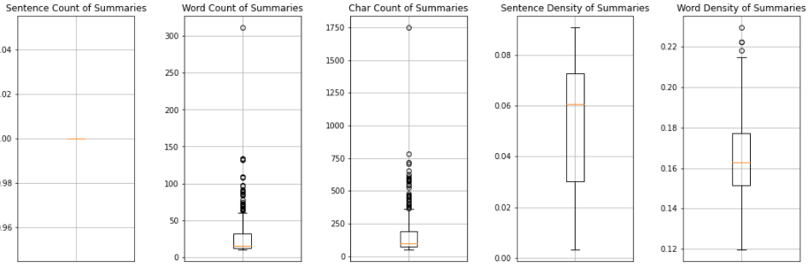
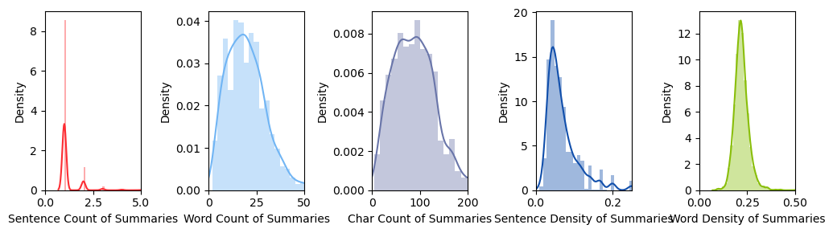
Feature Distribution on Summary variable
Large Outlier band for words and character counts
Data is mostly right-skewed distribution.
Outliers are present

Slide 9
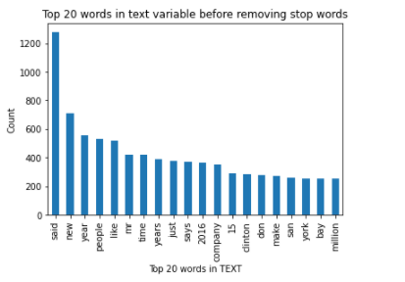
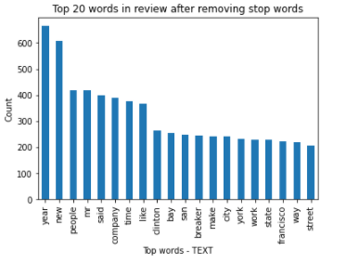
Lemmatization: It is an algorithmic process of determining the lemma of a word based on its intended meaning. Lemmatization depends on correctly identifying the intended part of speech and meaning of a word in a sentence, as well as within the larger context surrounding that sentence, such as neighboring sentences or even an entire document.
Before Text Lemmatization
After Text Lemmatization

Slide 10
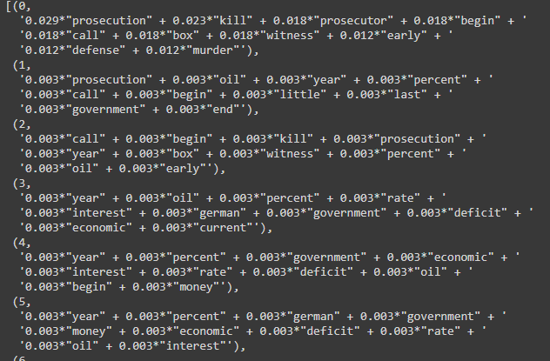
Topic Modelling
Topic modelling is an unsupervised approach of recognizing or extracting the topics by detecting the patterns like clustering algorithms which divides the data into different parts.
Technique implemented : Latent Dirichlet Allocation(LDA)
The visualization tells about the mixture of topics and their distribution in the data or different documents.

Slide 11
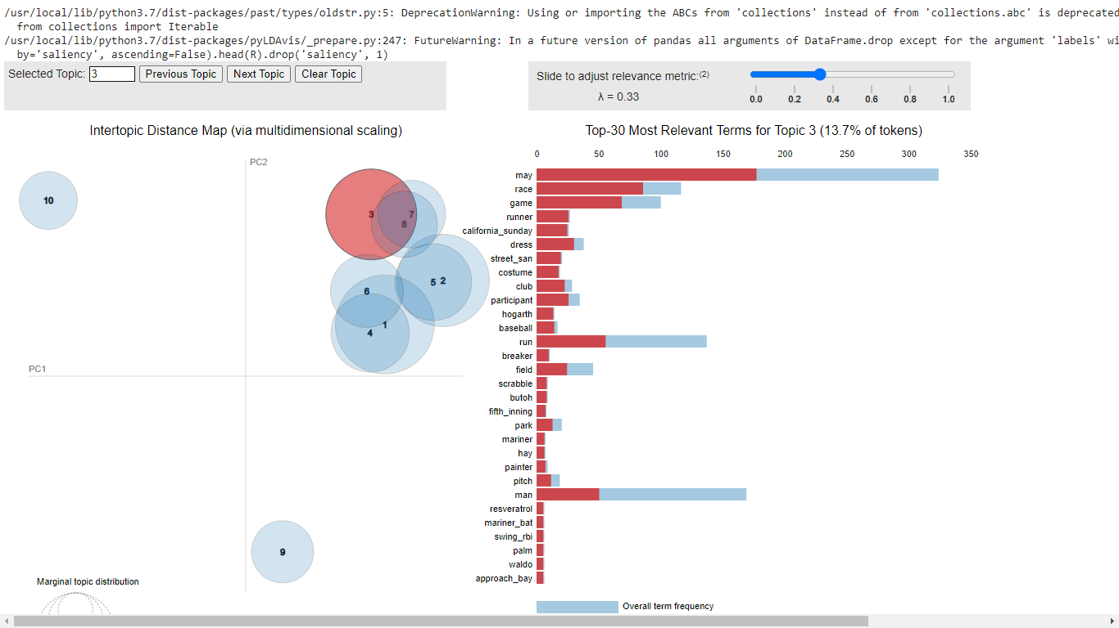

Slide 12
Model Build Idea:
Implement Transformer based models for Article Summarization.
A Transformer is an attention mechanism that learns contextual relations between words or sub-words in a text.
A Transformer includes two separate mechanisms – An Encoder system that reads the input text and a Decoder system that produces a prediction for the task.
Models Implemented :
T5 Transformer
BERT-Summarizer

Slide 13

T5 transformer is a text-to-text transformer model. The architecture in the framework is encoder-decoder
The model is first pretrained unsupervised on a large corpus before supervised training with input text representing all these tasks and the associated labelled data which is also text (where specific tokens in the input stream “translate English to French” or “stsb sentence 1:… sentence2”, “question”/”context” etc. encode the task type and the model is trained to output text matching the labelled data). With this approach of specifying input and output for supervised learning, the model shares its loss function, decoder etc. across all the disparate tasks.
It is trained using teacher forcing.
We load the t5-base pretrained model from Hugging face's repository. Then we can fine-tune it using the transformers. Trainer API.

Slide 14
Steps for building T5 model
Creating Py torch Dataset Class
Define the Pre-Process function or Dataset Class
Define the Data Module Class
Define the Model Class
Define the Py torch Lightning Module Class
Define the Trainer Parameters
Train the Model

Slide 15
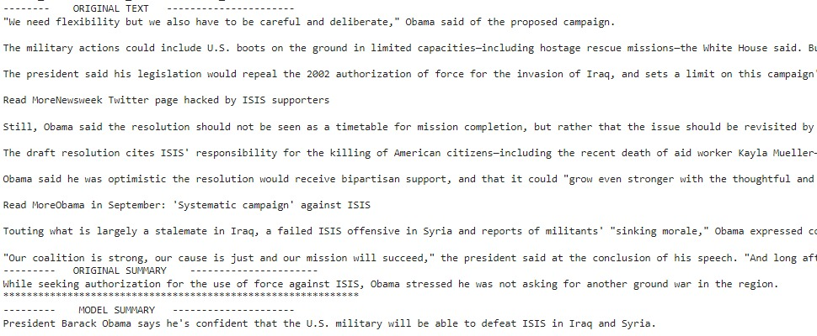
T5-Model Result

Slide 16
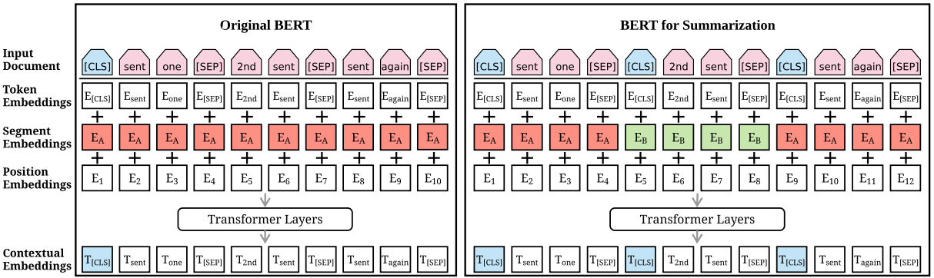
BERT – Summarizer
BERT (Bidirectional Encoder Representations from Transformers).
BERT main goal is to generate a language model, hence only encoder mechanism is mainly utilized.
To help the model distinguish between the two sentences in training, the input is processed in the following way before entering the model:
A [CLS] token is inserted at the beginning of the first sentence and a [SEP] token is inserted at the end of each sentence.
A sentence embedding indicating Sentence A or Sentence B is added to each token. Sentence embeddings are similar in concept to token embeddings with a vocabulary of 2.
A positional embedding is added to each token to indicate its position in the sequence. The concept and implementation of positional embedding are presented in the Transformer paper.
Steps
The entire input sequence goes through the Transformer model.
The output of the [CLS] token is transformed into a vector, using a transformer layer (learned matrices of weights and biases).
Calculating the probability of the sequence with SoftMax function.
Fine tune parameters:
Loss function – Flattening Label Smoothing Cross Entropy loss
Train the decoder with one cycle scheduling , unfreeze all the layers and train the whole model.
Save the weights with best validation losses

Slide 17
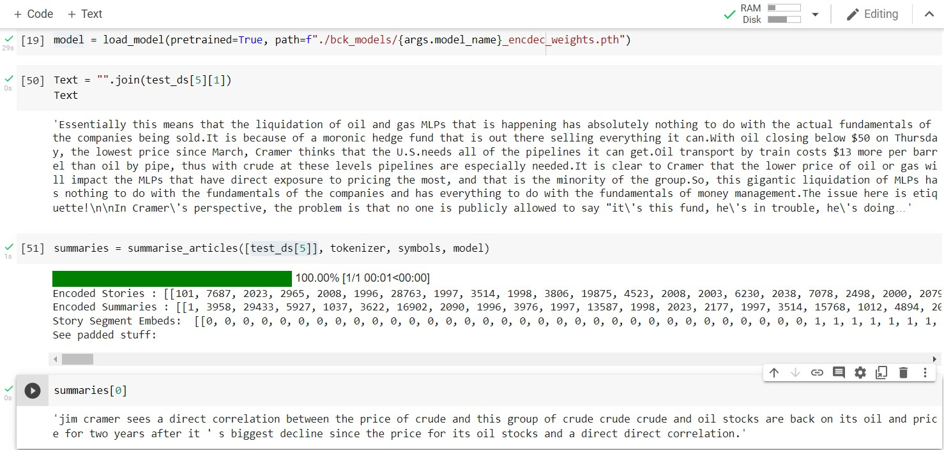
BERT-Model Result

Slide 18
Evaluation Metrics
ROUGE-N Metrics
ROUGE – N(Recall-Oriented Understudy for Gisting Evaluation) : Metrics used for evaluating Automatic Summarization and Machine translation in NLP. The metrics compares generated summary against a set of references. ROUGE-N works by Overlapping of N-grams^{[2]} between the system and reference summaries.
ROUGE-1 : overlap of unigram (each word) between the system and reference summaries.
ROUGE-2 : overlap of bigrams between the system and reference summaries.
ROUGE-L: Longest Common Subsequence (LCS)^{[3]} based statistics. Longest common subsequence problem takes into account sentence level structure similarity naturally and identifies longest co-occurring in sequence n-grams automatically.
BLEU Metrics
BLEU (bilingual evaluation understudy) : An algorithm used for evaluating the quality of the text which has been machine translated from one language to another. Scores are calculated for individual translated segments—generally sentences—by comparing them with a set of good quality reference translations. Those scores are then averaged over the whole corpus to reach an estimate of the translation's overall quality. Intelligibility or grammatical correctness are not taken into account

Slide 19
Evaluation Metrics
Metrics | R-score | F-score | P-score
ROUGE-1 | 0.69 | 0.58 | 0.55
ROUGE-2 | 0.53 | 0.36 | 0.52
ROUGE-L | 0.67 | 0.47 | 0.58
ROUGE -1 | 0.66 | 0.5 | 0.5
ROUGE-2 | 0.48 | 0.48 | 0.6
ROUGE-L | 0.59 | 0.57 | 0.57
Metrics/Models | T5 | BERT
BLEU | 0.7 | 0.63

Slide 20
Source code:
GitHub Repo:
https://github.com/Sumedha-Sirikonda/News-Article-Summarization

Slide 21
References:
https://analyticsindiamag.com/python-guide-to-googles-t5-transformer-for-text-summarizer/
https://arxiv.org/abs/1905.08836
https://towardsdatascience.com/extractive-summarization-using-bert-966e912f4142
https://lil.nlp.cornell.edu/newsroom/index.html

Slide 22


