Slide 1


E-Kart

Slide 2

TEAM MEMBERS
Ramya Sri Chigurupati
Laya B
Keerthi G N
Gopika Ulavala
Sai Girija Kumari Vegi

Slide 3

Problem Statement
There are many shops and other stores to buy items, but in this scenario, we must physically go shopping.
As such, it takes a lot of time, requires patience, and travelling.
To tackle problems with the existing system we are launching an E-kart

Slide 4

Road Map
The Application is developed using MERN STACK
M-MongoDB :- Database server that stores data structures in a binary JSON format
E – Express:- It is a backend web application of JavaScript framework based on Nodejs
R-React:- Front- end web application framework.
N-Nodejs:-It is JavaScript runtime environment.
Tools:
VS code
Mongoose
Postman

Slide 5
Plans
Design
Divided modules
Deployment

Slide 6
Modules
Admin
Supplier
Customer

Slide 7
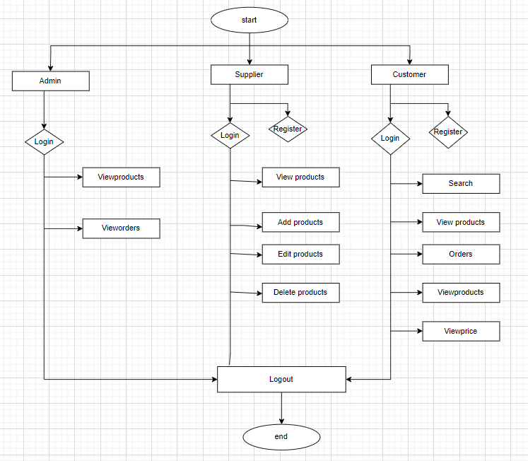
Flow Diagram

Slide 8
Thank you

