Slide 1
Mid2 update on my PhD effort
Aum Sri Sai Rama
Sai Gollapudi
IIIT-H/SERC/Advisor: Dr. Choppella
Oct 22, 2015

Slide 2
Summary of mid2 work
Did more detailing on the earlier narrative
Looked for cases where renarration would help, looked at structuring the semantic transformation, tried to conceptualize the flow of activity
Did more reading and writing
Also, quite importantly, presented the pitch to people
Linguistics team
CogSci folks
Prof. Nori
Dr. TB Dinesh
Response has been quite positive from all.

Slide 3
Motivation

Slide 4
Motivation
Motivated by tier 2 student’s struggle with predominantly (foreign) English-only content
Web-page renarration helps (assumption – to be validated?)

Slide 5
Sample Text
Giddy-up, cowboys and girls! In the Southwest during early half of the 1800s, cows were only worth 2 or 3 dollars a piece. They roamed wild, grazed off of the open range, and were abundant. Midway through the century though, railroads were built and the nation was connected. People could suddenly ship cows in freight trains to the Northeast, where the Yankees had a growing taste for beef. Out of the blue, the same cows that were once worth a couple of bucks were now worth between twenty and forty dollars each, if you could get them to the train station. It became pretty lucrative to wrangle up a drove of cattle and herd them to the nearest train town, but it was at least as dangerous as it was profitable. Cowboys were threatened at every turn. They faced cattle rustlers, stampedes and extreme weather, but kept pushing those steers to the train station. By the turn of the century, barbed wire killed the open range and some may say the cowboy too, but it was the train that birthed him.
http://www.ereadingworksheets.com/free-reading-worksheets/reading-comprehension-worksheets/summarizing-worksheets-and-activities/
http://www.ereadingworksheets.com/reading-comprehension-worksheets/summary-and-main-idea-worksheet-1-answers.htm

Slide 6
Challenges
Vocabulary is too high-level for L2
Grammar:
“birthed him” … where him is an anaphora referring to Cowboy… this is too subtle for the reader in Tier 2
Context:
context in which the scene is set is necessary for the student to understand. Yankees, Openrange, Beef eaters, Cowboys, Rustle-up, Stampede…
Genre differences:
English style is very American, Western and indirect in its message
General assessment / conclusion: Too highlevel for a tier2 non native English speaker college kid in rural India.

Slide 7
Enhancing it by…
Potential usages of the text (intent)
To develop comprehension
Maybe to teach history (of the world)
Reading skills
Writing skills
(context)… he is a history student, maybe preparing for GRE/GMAT, learning English… he maybe wanting to learn how to write better prose…
If the context & intent are to be preserved…
Need a virtual tutor
Need to have value adds by the tutor
Put in pictures: how cowboys look, ranches
Show videos: western scene, context
Linking with dictionary
Use of L1 / vernacular
Tutor’s own commentary
If the usage is now in a new context, with a new intent… (context: wants to be a writer, intent: to teach style of the cowboy-text American author)
(assume style to mean E.g. style focus: Scene description, making the point at the end, using western words, assuming the audience’s prior knowledge…)
Pose questions : How are the metaphors used, are they any synonyms, idoms, metaphors…

Slide 8
Sample Summary
(context: American, Intent: history): Cows were not worth a lot of money until they could be easily transported to the East after the invention of the train. Many people then became cowboys despite the dangers they faced.
(context: Indian student, intent: teach writing skills)
What enhancements to original text are necessary?
http://www.ereadingworksheets.com/free-reading-worksheets/reading-comprehension-worksheets/summarizing-worksheets-and-activities/
http://www.ereadingworksheets.com/reading-comprehension-worksheets/summary-and-main-idea-worksheet-1-answers.htm

Slide 9
Another example case
A case for renarration
Orange Juice Futures example case

Slide 10
CSE problem

Slide 11
CSE Problem
Semantic Transformation problem
What mediation platform, tools, systems, semantic structures help in doing this in a systematic manner for a variety of domains?
Feedback
Inputs:
Transformed
Content of web page
Presentation of web page
Transforming
Annotation that is ontology based
Transformation Process
Primary Outputs:
Modified page which is semantically relevant for a new context & intent

Slide 12
Existing CSE work (Content repurposing areas)
Text summarization
Language translations
Mash-up
Content aggregators
Personalization systems
Accessibility systems
(?) Annotation systems
Notes:
The web page modification can be reduced / abstracted in CSE as “semantic transformation” of web content

Slide 13
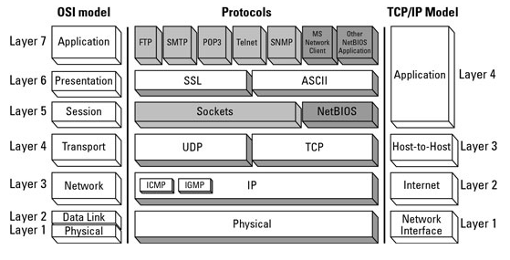
Existing CSE work (counter intuitive areas)
Earlier uses of Semantic Transformation
Math (has domain transforms)
OSI and TCP / IP stack
Notes:
The web page modification can be reduced / abstracted in CSE as “semantic transformation” of web content
http://computernetworkhomeworkhelp.com/wp-content/uploads/2014/01/comparision.png

Slide 14
Semantic Stacks
Perspective 1
Perspective 2
User Interface (for renarration) Theory / Concept Model
User Interface Theory / Concept Model
Application (for Xformation) Studio, Browser, Portal
Prototype application
Dbase for storing records
Studio for editing
Browser for viewing
Admin portal for configuration
Language /Script Manipulation of semantic objects
Abstract Data Types
Compound Sweets
Layer of Ontologies
Task/Intent-Ontology
Context/Domain-Ontology
Semantic Records
Sweets
Physical Layer - Implementation
RDF / Turtle / JSON etc.
Layer of annotations
Raw Web-Data - Content
Raw Web-Data - Content

Slide 15
Structure of Application
A web based app
Portal for administrative configuration
Will use Sweets (Swtstore)
Will link to two types of ontologies
Context (domain) related Ontology
Intent (Task) related Ontology
Annotation system
Studio for renarration by curator
Enabling editing, creating end-page-xformation
New renarrator should be pluggable on the platform
Browser for end-user to view transformed / renarrated pages
End-user should be able to view modified content thru portal

Slide 16
Domain – Education/CBSE/11th Grade

Slide 17
Focusing on one domain
Education/CBSE curriculum
11th grade syllabus for biz studies
Other choices
Math, science … are more structured but usually the principles do not vary as much in context, intent. Whereas, biz studies, has scope for variation, local interpretation, differences in presentation style etc. Therefore, biz studies topic may give us more opportunities to highlight our content transformation

Slide 18
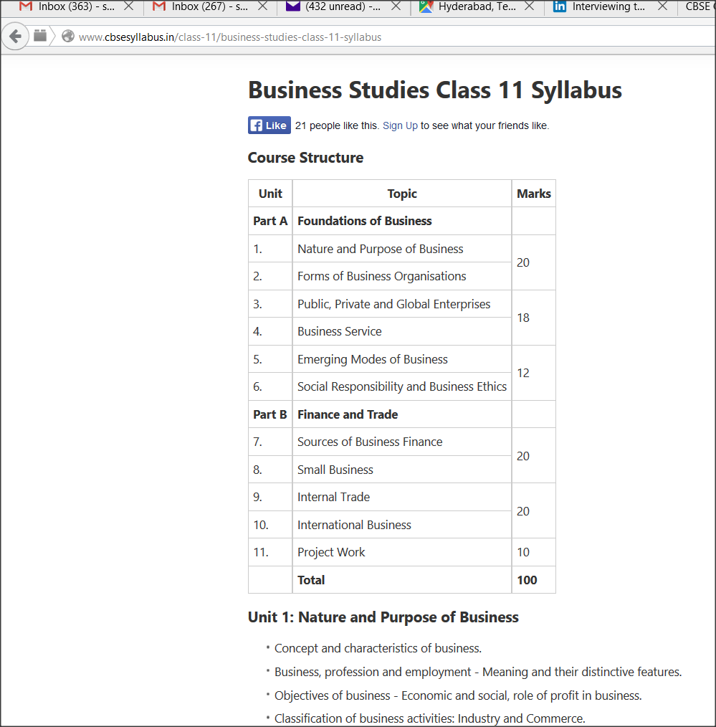
Syllabus is available online as well as
Offline (PDF)
Higherarchy of goals
With specifics on what to cover are listed Teachers, Schools & Students may use this as a template for their learning agenda
Therefore, a good context ontolgoy (domain)
Notes:
http://www.cbsesyllabus.in/class-11/business-studies-class-11-syllabus

Slide 19
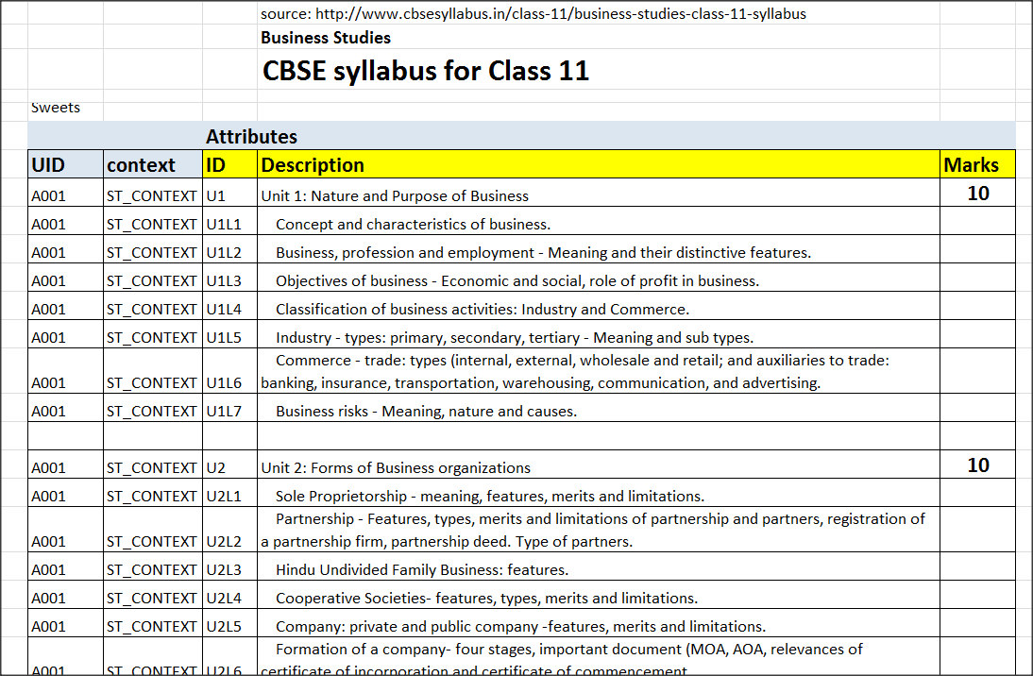
Can this be in Sweets?

Slide 20
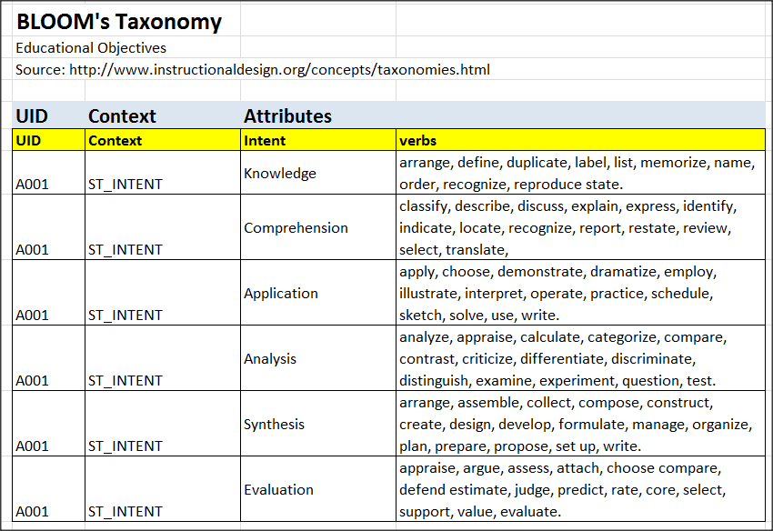
Basis Intent / Task Ontology

Slide 21
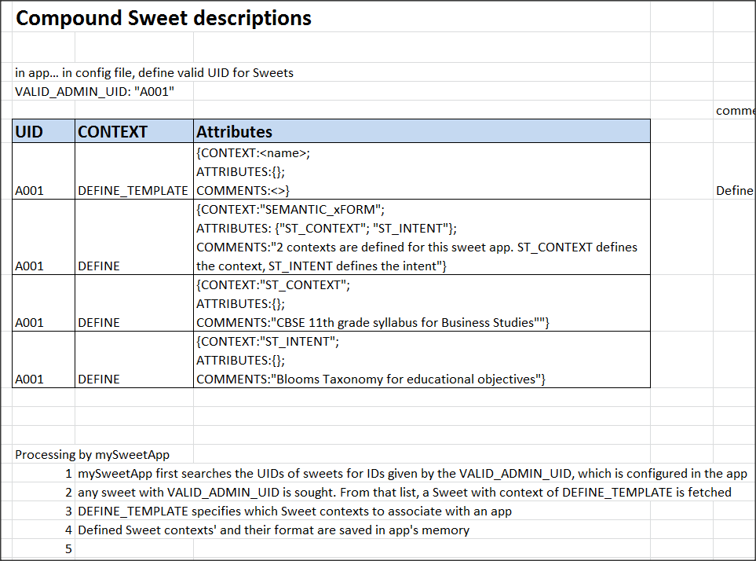
How to setup ontologies?
Should I use Sweets for creating compound data structures?
Should I use existing OWL? What is the difference / value addition for doing one over the other?

Slide 22
Annotation
Angular JS has annotator library
“Restory” has some of this implemented
Cognitive Linguistics – Context, Intent
Annotation will be identified using 3D
Annotation(app, context, intent)
Same page can have multiple annotations… the 3 dimensions will be used to filter one set from another
Application ID
Annotations
Intent ID
Existing web-page
Context ID

Slide 23
Work ahead

Slide 24
Work requiring further detailing
three areas of work need further detailing
information hiding, abstraction, decoupling
Programming language theory wrt SWEETs
Type Systems? Formal language for abstraction?
Ontology
To link context and intent of renarrator with new end-users
For context – domain ontology (e.g. CBSE 11th class syllabus for business studies class)
For Intent – task ontology (e.g. Bloom’s taxonomy of educational objectives)
mediation platform
Framework where I can incorporate moderators as plug-n-play modules
This is where semantic transformation is keyed in
Should be scalable and also domain-independent

Slide 25
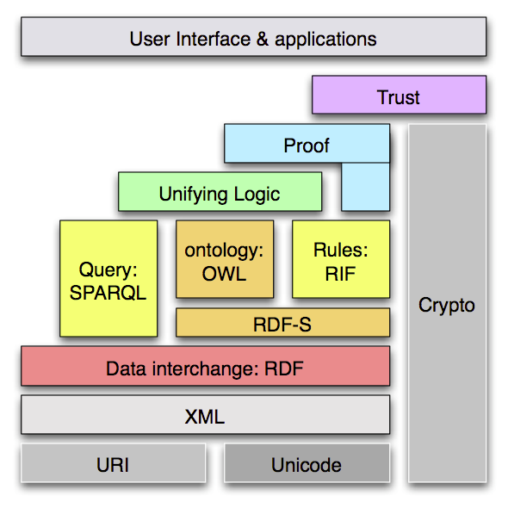
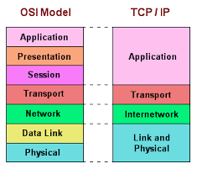
Semantic stack
Semantic web stack from Tim Berners Lee's work
3
Presentation (UI)
1
Semantic is for computer
RDF->Ontology lacks granularity
Applications (Semantic Transforms)
Language (simple scripts)
Abstract Data Objects (Compound SWeets)
Human Semantic record (SWeets)
2
Physical implementation
(RDF / JSON)
Our proposed semantic stack
Inspired by TCP /IP
OSI stack
Notes:
http://www.w3.org/2007/Talks/0130-sb-W3CTechSemWeb/layerCake-4.png
http://www.just2good.co.uk/images/gif/tcpipstack.gif

Slide 26
Programming Language Theory
Looking for ways to abstract Sweets into higher order composite Sweets (with recursion) and also scripting language which uses these Sweets.
To explore lambda calculus
Sweet is a record... do I not need an object model? (record vs object)
The scripting language can have recursion as well
Language w/ recursion -> using composite Sweet objects which can also be recursive in their definitions -> which are based on well defined Sweet logic --> which are based on current Sweets definitions and architecture
User Interface (for renarration) Theory / Concept Model
Application (for Xformation) Studio, Browser, Portal
Karaka roles Sanskrit grammar
Language /Script Manipulation of semantic objects
Abstract Data Types
Compound Sweets
Semantic Records
Sweets
Physical Layer - Implementation
RDF / Turtle / JSON etc.
Raw Web-Data - Content

Slide 27
Typed systems
The untyped component for me is either an RDF tuple or a Sweet record.
What is the semantic of a Sweet is based on the interpretation of a external application which consumes the Sweet.
Trying to categorize sweets according to their usage and behavior
A more rigorous type system is required to be enforced on the untyped Sweets because we want to avoid some misuse of interpreted meanings of certain Sweets.
Typing can allow type checking and more rigourous discipline for the programmer
monomorphic

Slide 28
Ontology based structures
The Sweet based programmable scripts should be linked to ontological structures
The ontological structures can be from (for example) Education domain
As an example a curriculum from reputed govt. Agencies and a lesson plan from a university can then be converted to searchable ontological structures
Annotations (essentially Sweets) can be linked to this ontological structure.
Users (i.e. students) can search such structures for learnings related to their curriculum / lesson plans
In current approach, I am looking at Domain/context ontology and also task/intention ontology.
In my chosen domain of education, I am proposing to use CBSE 11th class syllabus for a particular class (biz studies) as my domain or context ontology.
For the same domain, I am proposing to use Bloom’s taxonomy as my intention or task ontology.

Slide 29
Students & teachers share view
Student's
Perspective
Context: Schooling
Intention: To learn, To demonstrate, To inquire / clarify
Teacher's
Perspective
Context: Curriculum
Intention: To teach, To test, To give feedback

Slide 30
P/AOI is at intersection of Provider & Receiver
POI Point of interest
AOI Area of interest
Provider's perspective defined by context and intention should be compatible with receivers perspective defined by their own context and intention
In the case of Education,
Teacher's perspective is follow curriculum and practice pedagogy
Student's perspective is to go to school and learn
Interest is at the point of intersection between the two perspectives
Are there more compatible terms to a contexts & intentions that i have identified?
E.g. Curriculum is compatible with Schooling;
To teach /to guide is compatible with to learn, to enquire
To assess is compatible with to demonstrate
To give feedback / to guide is compatible with to enquire, to learn
Is this mapping unique (or 1:1) or can it be (1:m)

Slide 31
Open questions
It appears as if I am building a prototype system… so, is my PhD a “system building” work?
What is my core research problem in computer science? And, what are my contributions in it?
Is it “semantic transformation”?
What am I looking for?? Ways of enabling Semantic Transformation? Structures and techniques?? – well, that is my current narrative… but
is it heavy enough for a PhD?
Are there other angles that I could explore?

Slide 32
Open questions cont.
I wish to target a Journal. Any advise on how to scope my work for it? How to develop content? What to include /exclude?
Also, this effort requires development of a web-app. What strategy to follow? Build or get it built?

Slide 33
Contacts
Anon Ray rayanon004@gmail.com
Bhanu @ servelots
Pradyumna @servelots

