Slide 1

Agile and Waterfall Methodologies
Sai Gorla
T-1753

Slide 2
What is Agile Methodology?
The Agile methodology is a project management and software development approach that emphasizes flexibility, collaboration, and customer-centricity. It is the latest model used by major companies today like Facebook, google, amazon, etc. It follows the iterative as well as incremental approach that emphasizes the importance of delivering of working product very quickly. This article focuses on discussing Agile Methodology in detail.

Slide 3
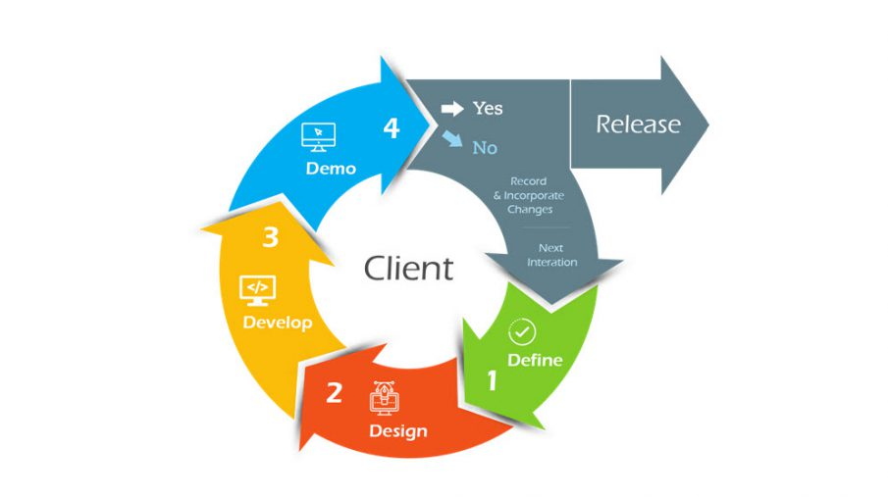
Life cycle of Agile Methodology
The Agile software development life cycle helps you break down each project you take on into six simple stages

Slide 4
When to use the Agile Methodology?
If you want to know when to use the Agile methodology, then it is particularly well-suited for projects and organizations where the following conditions or needs are present
Unclear or Changing Requirements: Agile is great for projects with requirements that aren't well-defined or might change.
Complex Projects: It's good for big, complex projects by breaking them into smaller pieces.
Customer Focus: Use Agile when making customers happy is a priority and you want to involve them throughout.
Quick Time-to-Market: If you need to get your product out fast, Agile can help.
Small to Medium Teams: Agile works well for teams of a few to a few dozen people.

Slide 5
Team Skills: It's best when you have a mix of skills in your team, like development, testing, design, and more.​
Collaboration: Agile promotes working together and open communication.​
Regular Updates: If you want to check progress often and make changes as needed.​
Transparency: Agile emphasizes being open and clear with everyone involved in the project.​
Risk Control: It helps manage risks by tackling issues as they come up.​
Innovation: If you encourage trying new things and learning from experience, Agile supports that.​
Continuous Improvement: Agile fosters a culture of always getting better over time.​

Slide 6
Pros of Agile
Quickly adapts to changes in scope or project plan
Frequent updates keep customers and product owners engaged
Early and frequent testing enhances product quality
Keeps all team members actively involved
Speeds up delivery through iterative cycles
Early problem detection lowers failure risks

Slide 7
Cons of Agile
Flexibility can lead to constant changes, impacting budget and timeline
Outcomes are less certain without a fixed project plan
Requires a lot of time and commitment from development teams
Effective management requires experienced Agile leaders
Less effective for projects with static, defined requirements

Slide 8
What is Waterfall Methodology?
The Waterfall Model is a classical software development methodology. It was first introduced by Winston W. Royce in 1970. It is a linear and sequential approach to software development that consists of several phases. It must be completed in a specific order. This classical waterfall model is simple and idealistic. It was once very popular. Today, it is not that popularly used. However, it is important because most other types of software development life cycle models are a derivative of this. In this article we will see waterfall model in detail.

Slide 9
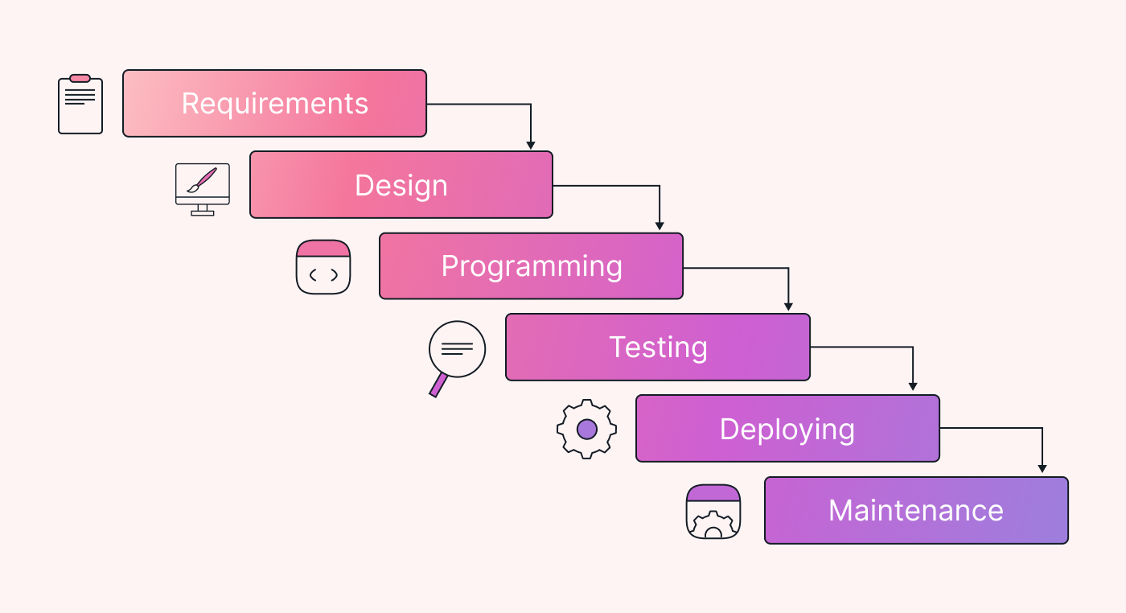
Life cycle of Waterfall Methodology
The classical waterfall model divides the life cycle into a set of phases. This model considers that one phase can be started after the completion of the previous phase. That is the output of one phase will be the input to the next phase. Thus the development process can be considered as a sequential flow in the waterfall. Here the phases do not overlap with each other.

Slide 10
When to Use Waterfall Model?
Well-understood Requirements: Before beginning development, there are precise, reliable, and thoroughly documented requirements available.
Very Little Changes Expected: During development, very little adjustments or expansions to the project’s scope are anticipated.
Small to Medium-Sized Projects: Ideal for more manageable projects with a clear development path and little complexity.
Predictable: Projects that are predictable, low-risk, and able to be addressed early in the development life cycle are those that have known, controllable risks.

Slide 11
Regulatory Compliance is Critical: Circumstances in which paperwork is of utmost importance and stringent regulatory compliance is required.​
Client Prefers a Linear and Sequential Approach: This situation describes the client’s preference for a linear and sequential approach to project development.​
Limited Resources: Projects with limited resources can benefit from a set-up strategy, which enables targeted resource allocation.

Slide 12
Pros of Waterfall Model
Easy to Understand: The Classical Waterfall Model is very simple and easy to understand.
Individual Processing: Phases in the Classical Waterfall model are processed one at a time.
Properly Defined: In the classical waterfall model, each stage in the model is clearly defined.
Clear Milestones: The classical Waterfall model has very clear and well-understood milestones.
Properly Documented: Processes, actions, and results are very well documented.
Reinforces Good Habits: The Classical Waterfall Model reinforces good habits like define-before-design and design-before-code.
Working: Classical Waterfall Model works well for smaller projects and projects where requirements are well understood.

Slide 13
Cons of Waterfall
No Feedback Path: In the classical waterfall model evolution of software from one phase to another phase is like a waterfall. It assumes that no error is ever committed by developers during any phase. Therefore, it does not incorporate any mechanism for error correction.
Difficult to accommodate Change Requests: This model assumes that all the customer requirements can be completely and correctly defined at the beginning of the project, but the customer’s requirements keep on changing with time. It is difficult to accommodate any change requests after the requirements specification phase is complete.
No Overlapping of Phases: This model recommends that a new phase can start only after the completion of the previous phase. But in real projects, this can’t be maintained. To increase efficiency and reduce cost, phases may overlap.
Lengthy Development Cycle: The Waterfall Model can result in a lengthy development cycle, as each phase must be completed before moving on to the next. This can result in delays and increased costs if requirements change or new issues arise.

Slide 14
Differences
Agile
Waterfall
Client input is required throughout the product development.
Changes can be made at any stage.
Coordination among project teams is required to ensure correctness.
It completes the project in comparatively less time.
After each sprint/cycle test plan is discussed.
Client input is required only after completing each phase.
Changes cannot be made after the completion of a phase.
Coordination is not needed as one team starts the work after the finish of another team.
It takes more time compared to agile
Hardly any test plan is discussed during a cycle.

Slide 15
Conclusion
Choosing between Agile and Waterfall project management depends on the project’s needs. Waterfall is good for projects with clear and stable requirements, offering structured planning and clear milestones. Agile is flexible, suited for projects with evolving requirements, allowing for continuous improvement and faster delivery. Both have strengths and weaknesses, and the choice should consider project scope, timeline, team dynamics, and customer feedback, both methodologies have their strengths and weaknesses, and the decision should be based on factors such as project scope, timeline, team dynamics, and customer requirements.

Slide 16
Thank You

