Slide 1
Mental Health Assistant Chatbot
By,
Kavya K Puranik
Minnu Ann Abraham
Sai Gowri Kumar

Slide 2
What is MeHA?

Slide 3
FEATURES
The chatbot provides a simulated conversation regarding mental health which includes:
Evaluation of mental wellness of user using standard World Health Organization (WHO) questionnaire
Evaluation of depression level
Remedy for any problems faced by the user
Lightening mood of user by suggesting approved list of music, books and videos
Details about mental health institutions and doctors nearby to user using user's browser geolocation
Providing information about illnesses

Slide 4
Conversational flow along with context is maintained with the user, allowing them to either enter free-text or choose from provided options.
Conversation flow for PUSH-D registered users is different from that of unregistered users.
For every user, information collected during the conversations is stored as history.
Sentiment Analysis is done on few messages to assess the mood of the user. According to the analysis, the further flow is decided.
Security aspects of chatbot include
Privacy of users is maintained and their information is not disclosed to anyone except the doctor registered with the chatbot.
Users can also choose to remain anonymous during the conversation.
Registration and log-in of the user can be done only through PUSH-D application.
In cases where email is needed from unregistered users, OTP verification is done through e-mail.

Slide 5
In cases where the user is showing suicidal tendencies, an emergency notification is immediately sent via e-mail to a registered doctor.
At the end of every conversation, rating and feedback is collected from the user to help improve the chatbot as well as PUSH-D application.
A report is generated daily summarizing the conversation details with the users that interacted with the chatbot. It also includes the feedback provided for the chatbot and related applications by various users.
All free-text messages collected from users' chat are sent to the chat administrator at the end of each day. This is used as the data to train and improve the chatbot.

Slide 6
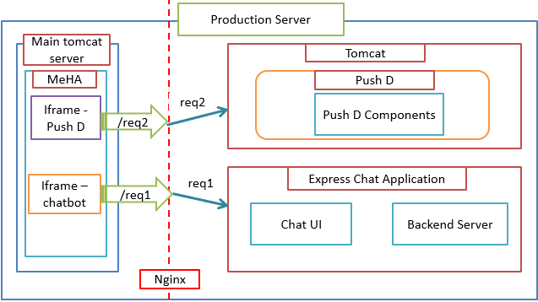
BIG PICTURE

Slide 7
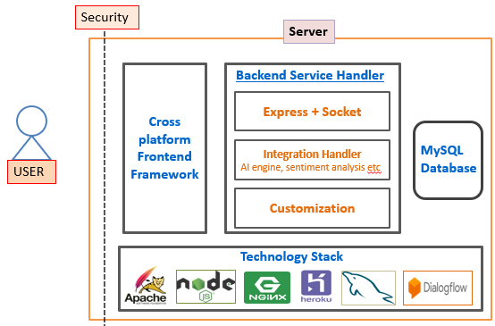
OVERALL ARCHITECTURE

Slide 8
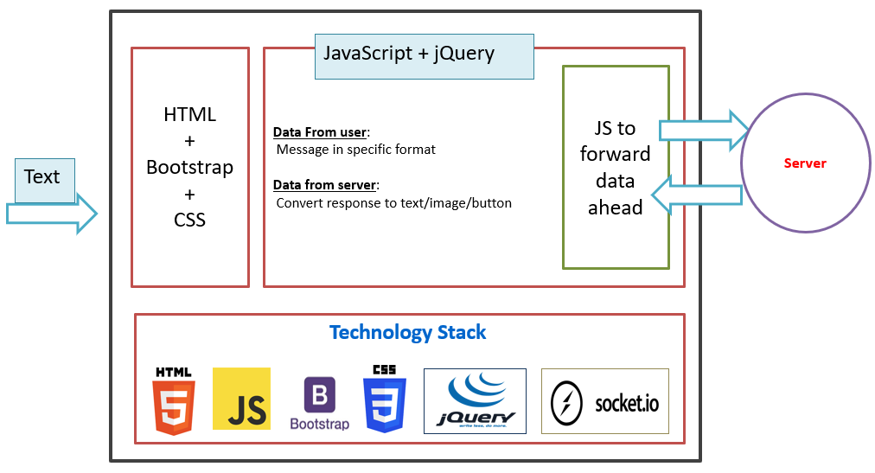
FRONT-END ARCHITECTURE

Slide 9
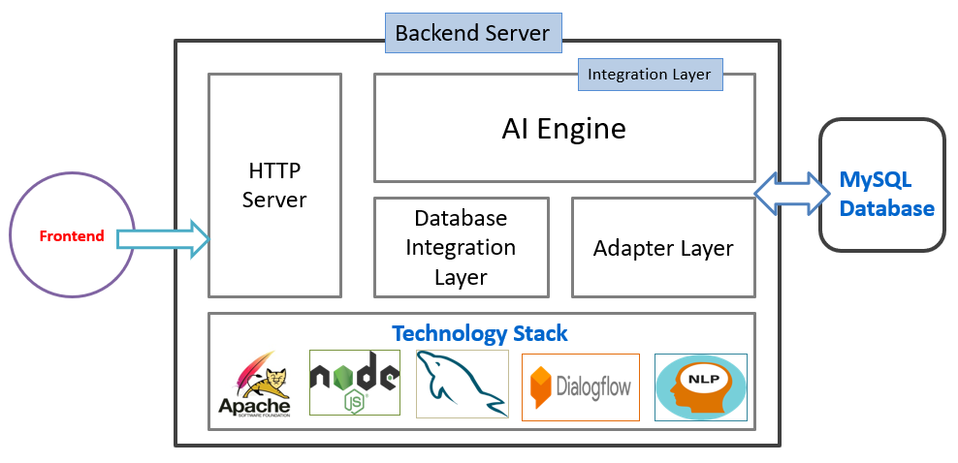
BACK-END ARCHITECTURE

Slide 10
FUTURE ENHANCEMENTS
Extension of the hospital database
Adding more free-text and better free-text analysis
Integration with EHRC registered doctors database
Processing Indian regional languages messages
Adding complex rules and handling different scenarios for sentiment analysis library
Use of users’ history to track the progress of each user and give them better advice
Handling fraudulent users

Slide 11
DEMO

Slide 12
THANK YOU!

