Slide 1
Word2Vec
EHSG

Slide 2
Definition:
Word2vec is a technique in natural language processing for obtaining vector representations of words.
These vectors capture information about the meaning of the word based on the surrounding words.
The word2vec algorithm estimates these representations by modeling text in a large corpus.
Once trained, such a model can detect synonymous words or suggest additional words for a partial sentence.
Word2vec was developed by Tomáš Mikolov, Kai Chen, Greg Corrado, Ilya Sutskever and Jeff Dean at Google, and published in 2013.

Slide 3
Word2vec represents a word as a high-dimension vector of numbers which capture relationships between words.
In particular, words which appear in similar contexts are mapped to vectors which are nearby as measured by cosine similarity.
This indicates the level of semantic similarity between the words;
so for example the vectors for walk and ran are nearby, as are those for "but" and "however", and "Berlin" and "Germany".

Slide 4
CBOW
SKIP-Gram

Slide 5
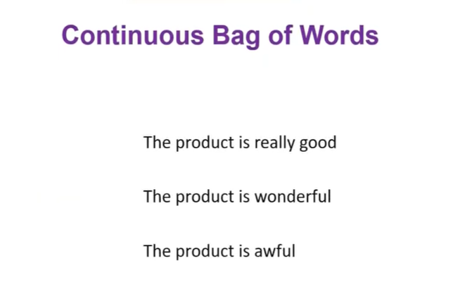
CBOW we will find the center with near by words.

Slide 6
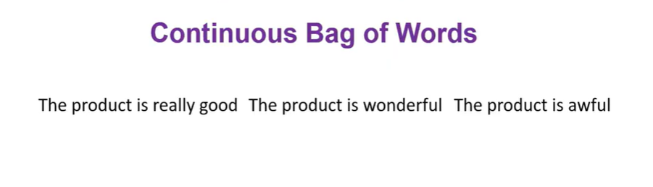
Concatenating the all the sentences, to make a one single senense.

Slide 7
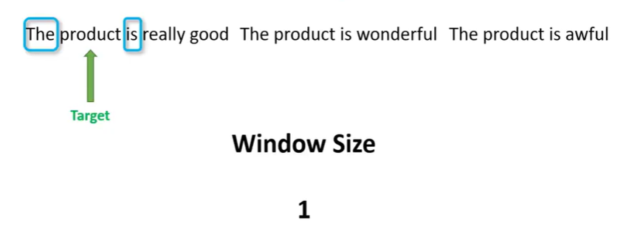
Choose Window size, Here (The, is) = input words & Product as Target word.

Slide 8
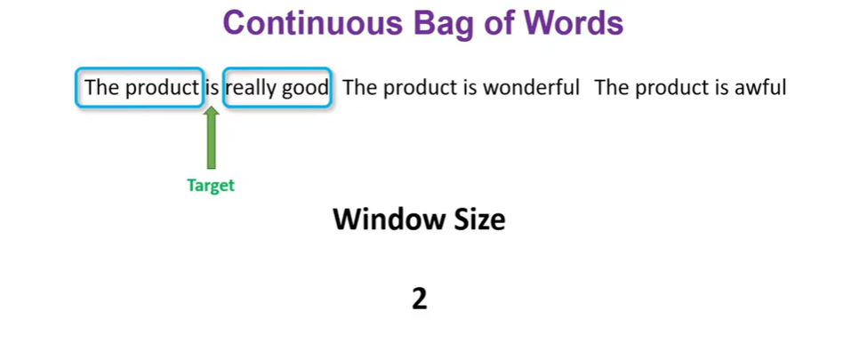

Slide 9
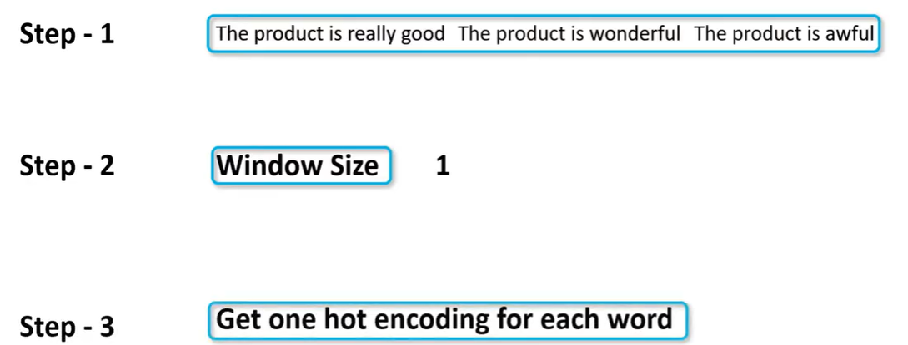

Slide 10
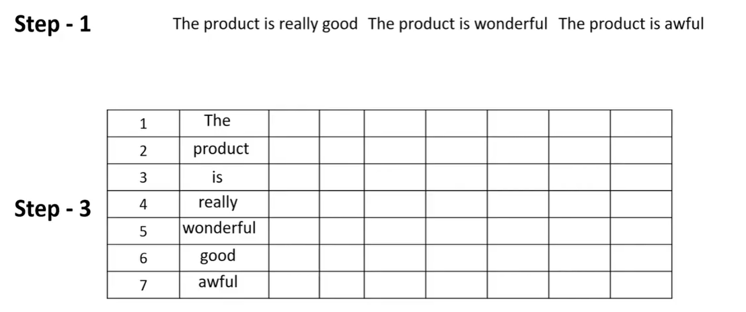

Slide 11
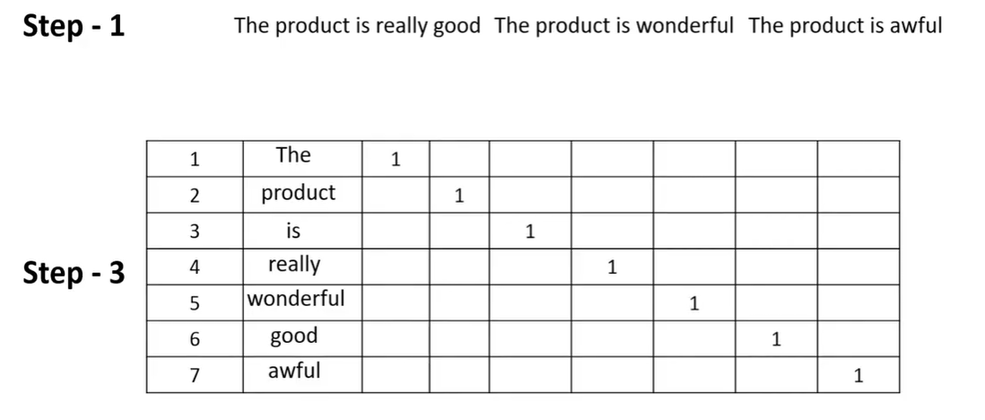

Slide 12
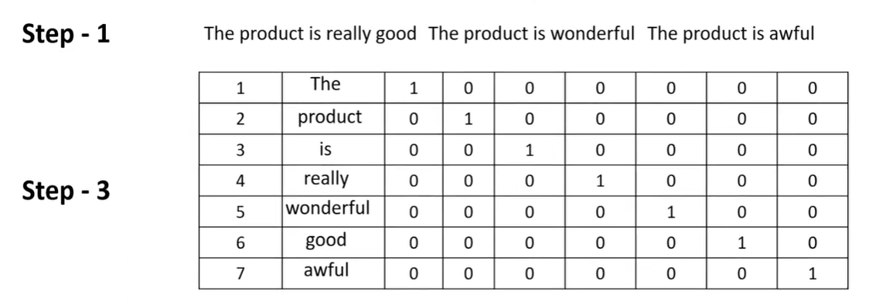

Slide 13
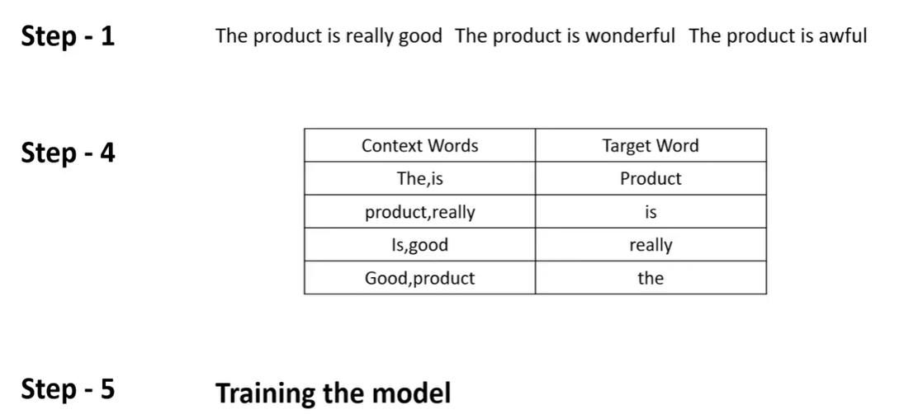
Step 4: Represents Training data

Slide 14
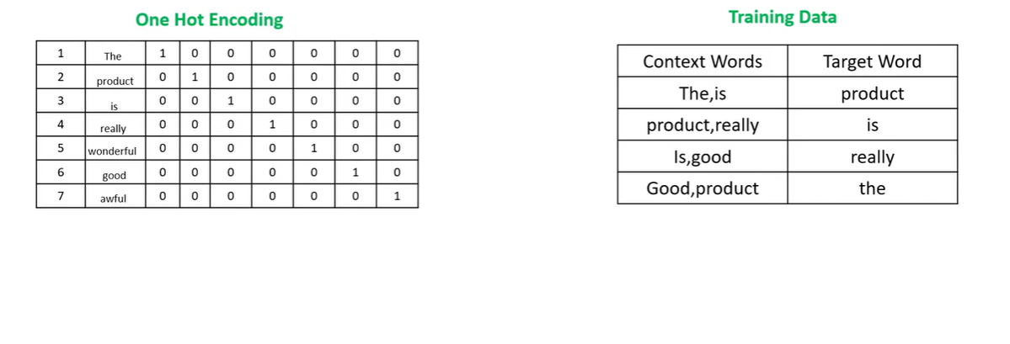

Slide 15
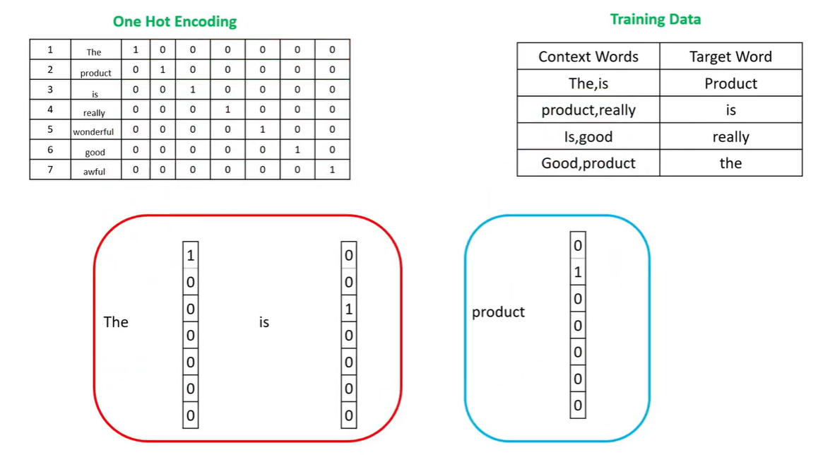

Slide 16
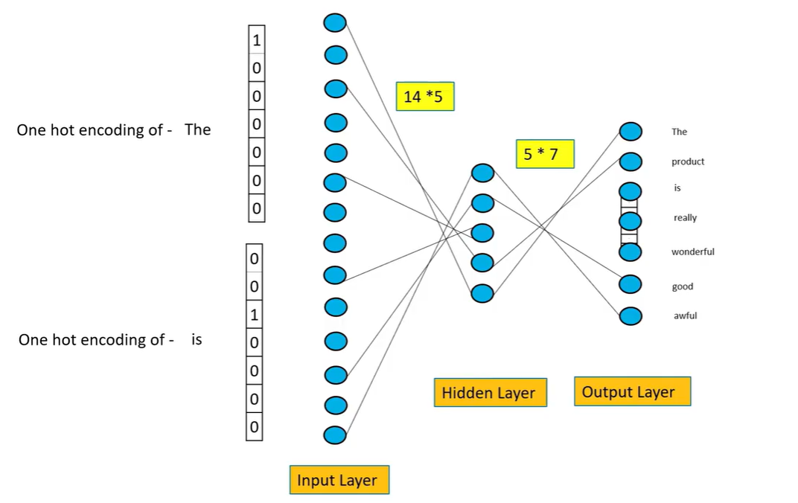
O/P : indicates 7 unique words

Slide 17
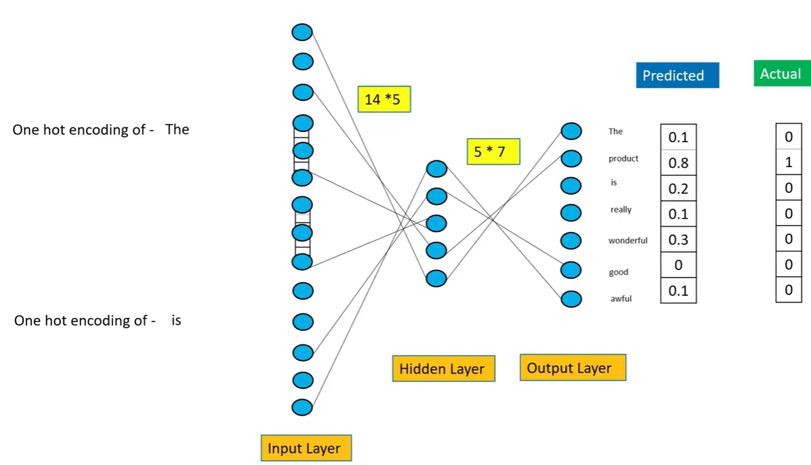

Slide 18
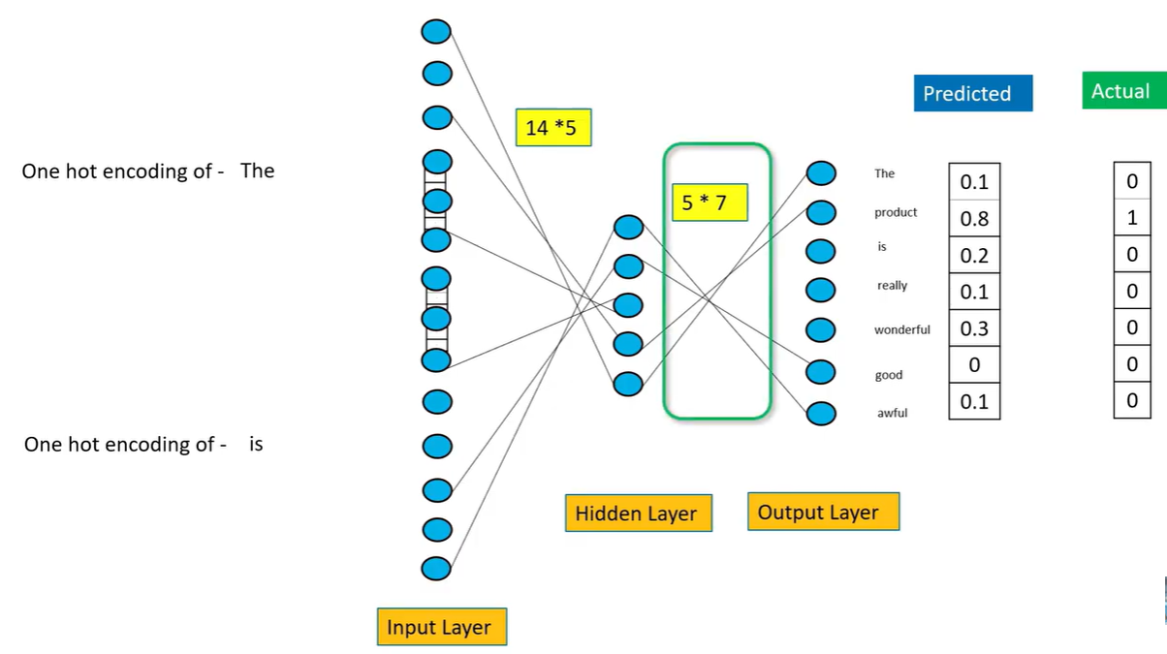

Slide 19
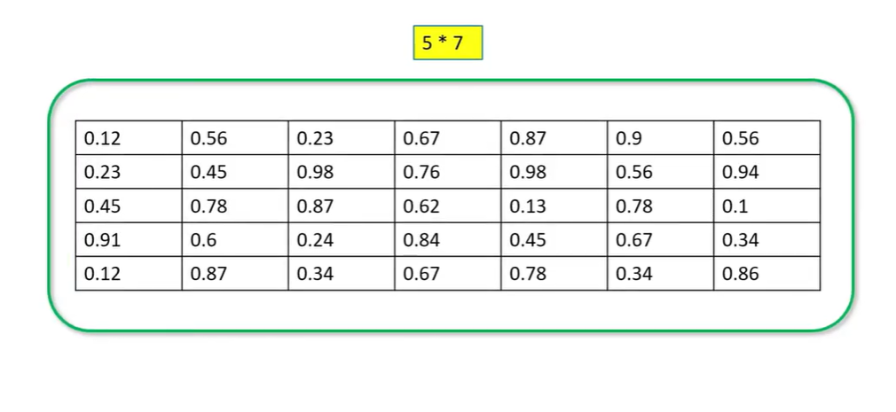
This is the actual Word embedding we are looking for

Slide 20
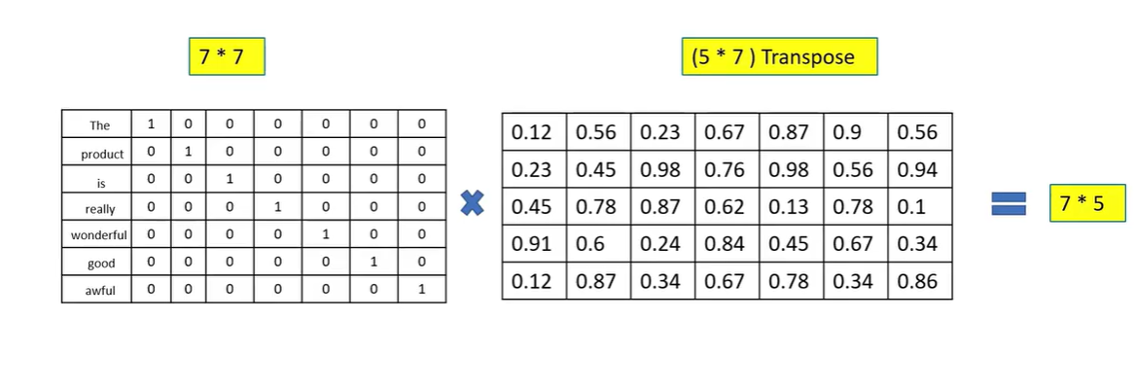

Slide 21
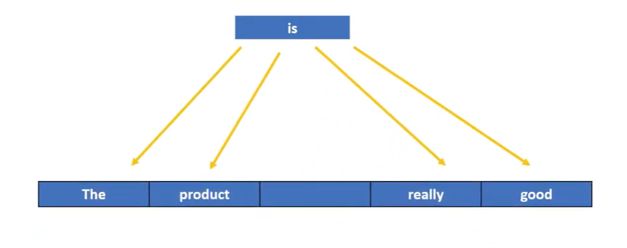
SKIP-GRAM

Slide 22
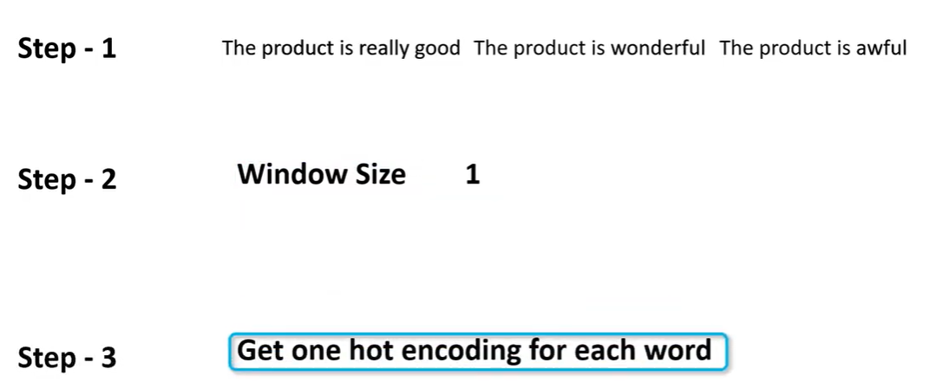

Slide 23
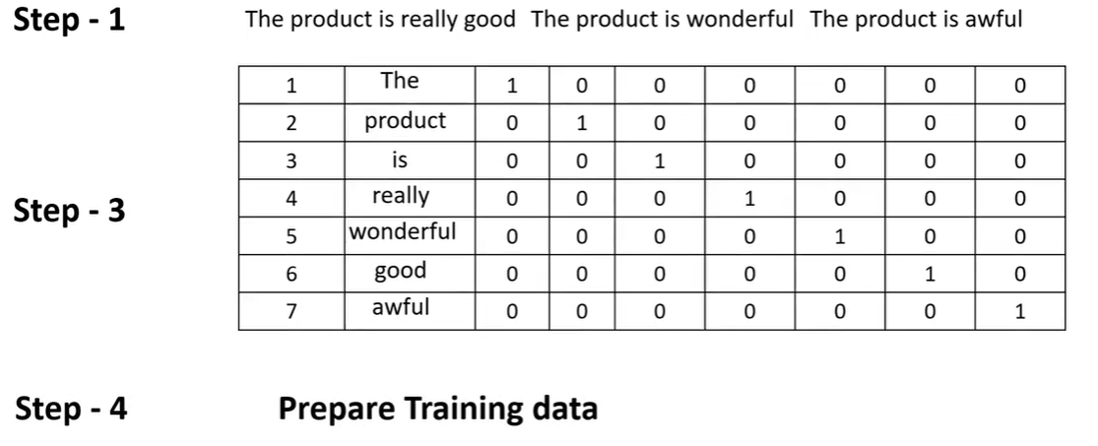

Slide 24
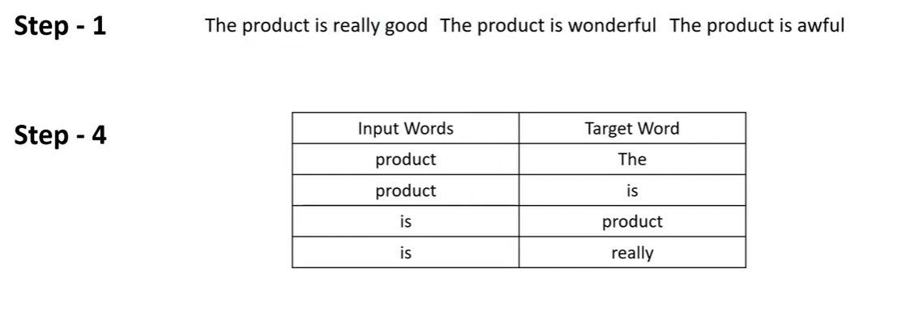

Slide 25
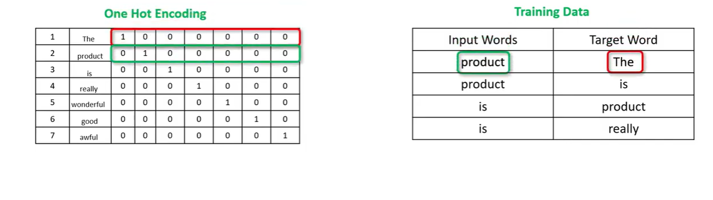

Slide 26
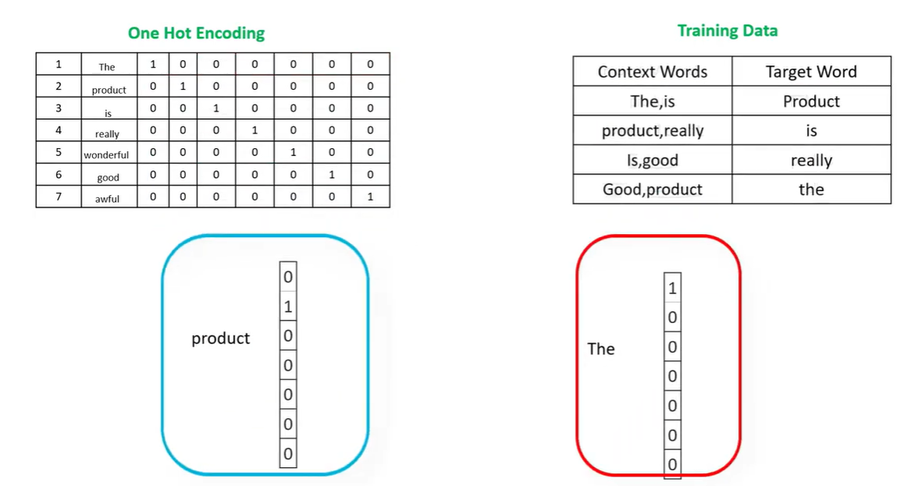

Slide 27
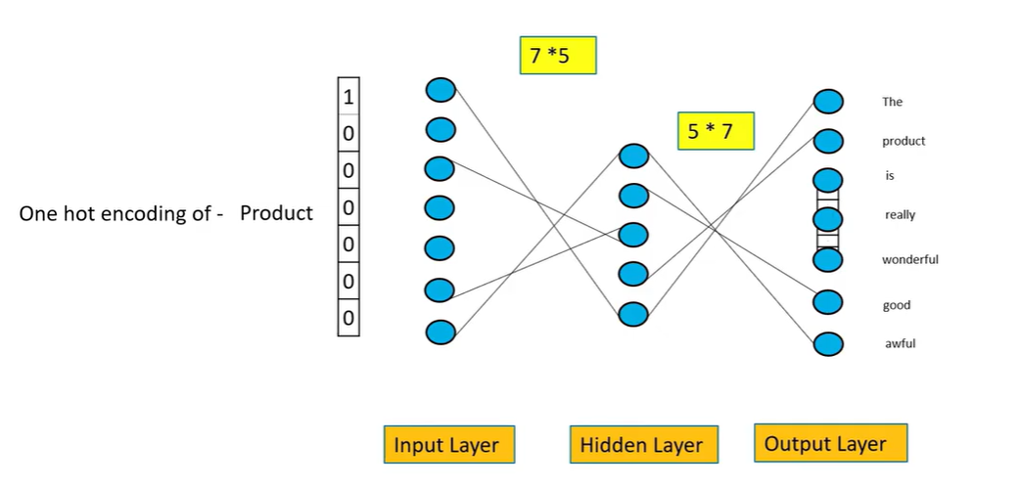

Slide 28
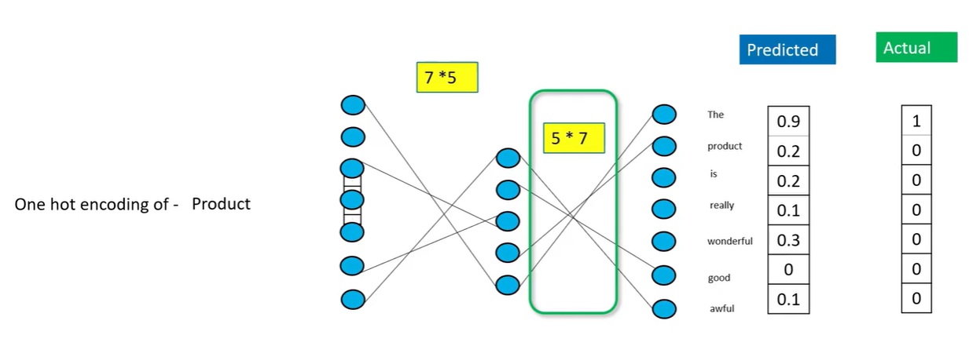

Slide 29
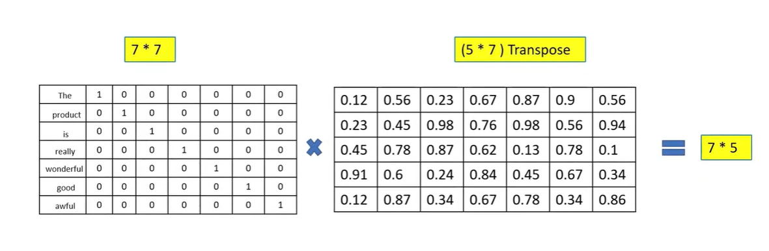

Slide 30
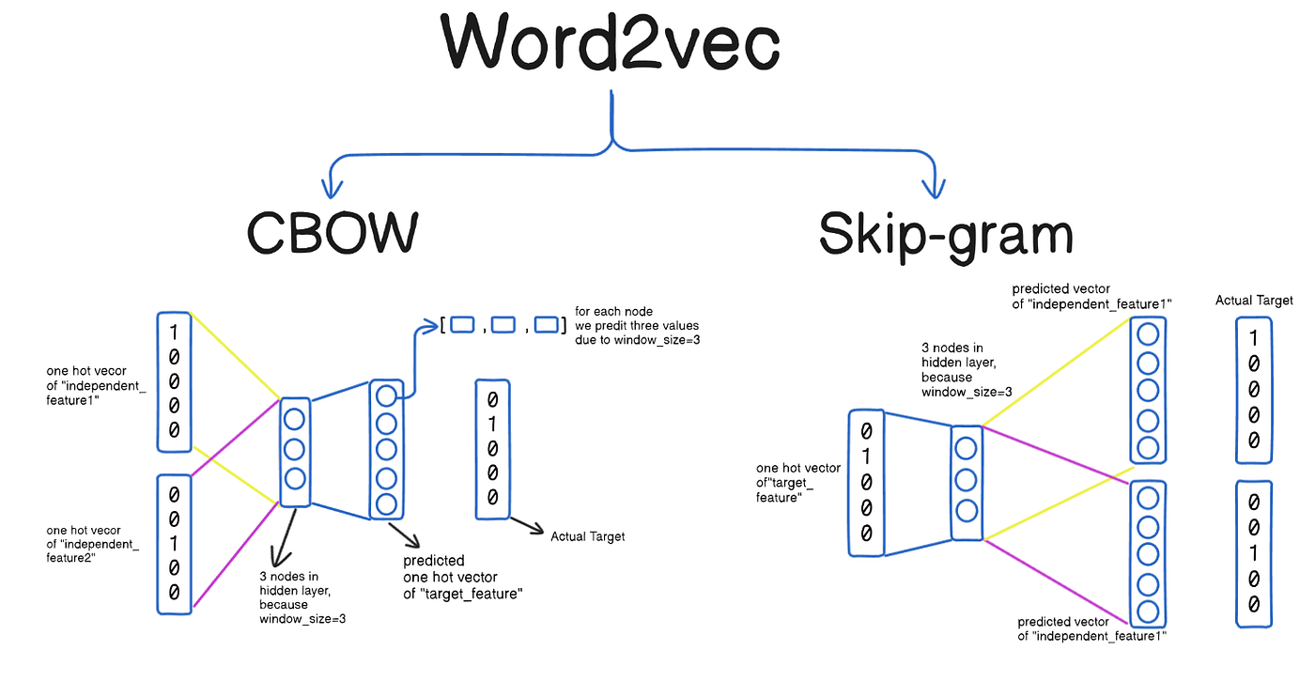

Slide 31
Model | What it predicts
CBOW | Predicts the target (center) word from context words
Skip-Gram | Predicts context words from the target (center) word

Slide 32
Feature | CBOW | Skip-Gram
Prediction Direction | Context → Target | Target → Context
Training Speed | Faster | Slower
Performance on Small Data | Average | Better
Handles Rare Words | Poor | Very good
Computational Cost | Low | High
Best For | Large datasets | Small datasets / rare words

