Slide 1
NLP
Course Instructor : E. Hanuman Sai Gupta
Department of Computer Science & Engineering

Slide 2
NLP
Natural Language Processing : PE- III
Sem: VI (CSE& CST)
Course Code: V23CSTPE10
Total Modules : 05
Course Outcomes:
CO1: Explain the fundamental concepts of language modeling, English morphology, and spelling correction techniques using regular expressions and finite-state automata.
CO2: Apply N-gram models and part-of-speech tagging techniques using stochastic and rule-based approaches to perform word-level language analysis.
CO3: Construct syntactic parsers using context-free grammars and apply probabilistic parsing methods such as PCFG and CYK for syntactic analysis.
CO4: Describe semantic representation techniques and methods for word sense disambiguation using supervise and knowledge-based approaches.
CO5: Apply discourse segmentation and reference resolution techniques using lexical resources like WordNet, Penn Treebank, and Brill‘s Tagger for effective text analysis.

Slide 3
NLP- Syllabus
UNIT I: Introduction: Origins and challenges of NLP – Language Modeling: Grammar-based LM, Statistical LM – Regular Expressions, Finite-State Automata – English Morphology, Transducers for lexicon and rules, Tokenization, Detecting and Correcting Spelling Errors, Minimum Edit Distance.
UNIT II:Word Level Analysis: Unsmoothed N-grams, Evaluating N-grams, Smoothing, Interpolation and Backoff – Word Classes, Part- of-Speech Tagging, Rule-based, Stochastic and Transformation-based tagging, Issues in PoS tagging – Hidden Markov and Maximum Entropy models.
UNIT III: Syntactic Analysis: Context-Free Grammars, Grammar rules for English, Treebanks, Normal Forms for grammar – Dependency Grammar – Syntactic Parsing, Ambiguity, Dynamic Programming parsing – Shallow parsing Probabilistic CFG, Probabilistic CYK, Probabilistic Lexicalized CFGs – Feature structures, Unification of feature structures
UNIT IV:Semantics And Pragmatics: Requirements for representation, First-Order Logic, Description Logics – Syntax-Driven Semantic analysis, Semantic attachments – Word Senses, Relations between Senses, Thematic Roles, selectional restrictions – Word Sense Disambiguation, WSD using Supervised, Dictionary & Thesaurus, Bootstrapping methods – Word Similarity using Thesaurus and Distributional methods.
UNIT V:Discourse Analysis And Lexical Resources: Discourse segmentation, Coherence – Reference Phenomena, Anaphora Resolution using Hobbs and Centering Algorithm – Coreference Resolution – Resources: Porter Stemmer, Lemmatizer, Penn Treebank, Brill‘s Tagger, WordNet, PropBank, FrameNet, Brown Corpus, British National Corpus (BNC).

Slide 4
Textbooks & Reference Books
Textbooks:
Speech and Language Processing: An Introduction to Natural Language Processing, Computational Linguistics and Speech, 2ndEdition, Daniel Jurafsky, James H. Martin -Pearson Publication,2O14.
Natural Language Processing with Python, First Edition, Steven Bird, Ewan Klein and Edward Loper, OReilly Media,2OO9.
Reference Books:
  Language Processing with Java and Ling Pipe Cookbook, 1stEdition, Breck Baldwin, Atlantic Publisher, 2O15.
  Natural Language Processing with Java, 2ndEdition, Richard M Reese, OReilly Media,2O15.
  Handbook of Natural Language Processing, Second, NitinIndurkhya and Fred J. Damerau, Chapman and Hall/CRC Press, 2O1O.Edition
  Natural Language Processing and Information Retrieval, 3rdEdition, TanveerSiddiqui, U.S. Tiwary, Oxford University Press,2OO8.

Slide 5
Pre Requisites
Programming Language : Python (Regex & libraries)
Mathematics : LA, P&S
ML concepts: SVM, KNN, Decision tress ….
DL fundamentals : RNN, LSTMs…..
Basic Linguistics:
Parts of Speech (Noun, Verb, Adjective...) &
grammar rules
Syntax (sentence structure)
Morphology (word formation)
Semantics (meaning)
Named Entities (persons, places, dates)
Many NLP tasks rely on language structure.

Slide 6
Tools:
NLTK (natural language Toolkit) – basic NLP learning:
https://www.nltk.org/
spaCy – industrial NLP
https://spacy.io/
scikit-learn – ML models:
https://scikit-learn.org/stable/
HuggingFace transformers – advanced deep NLP:
https://huggingface.co/docs/transformers/en/index
Library ------ Packages------- Modules

Slide 7
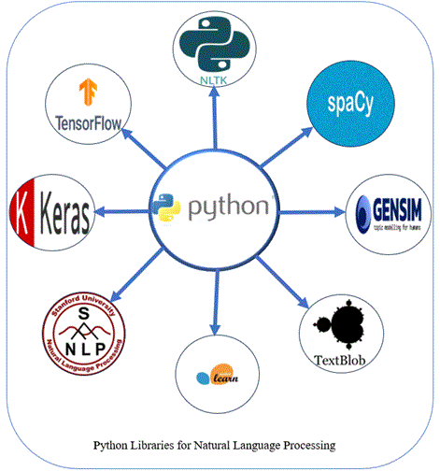

Slide 8
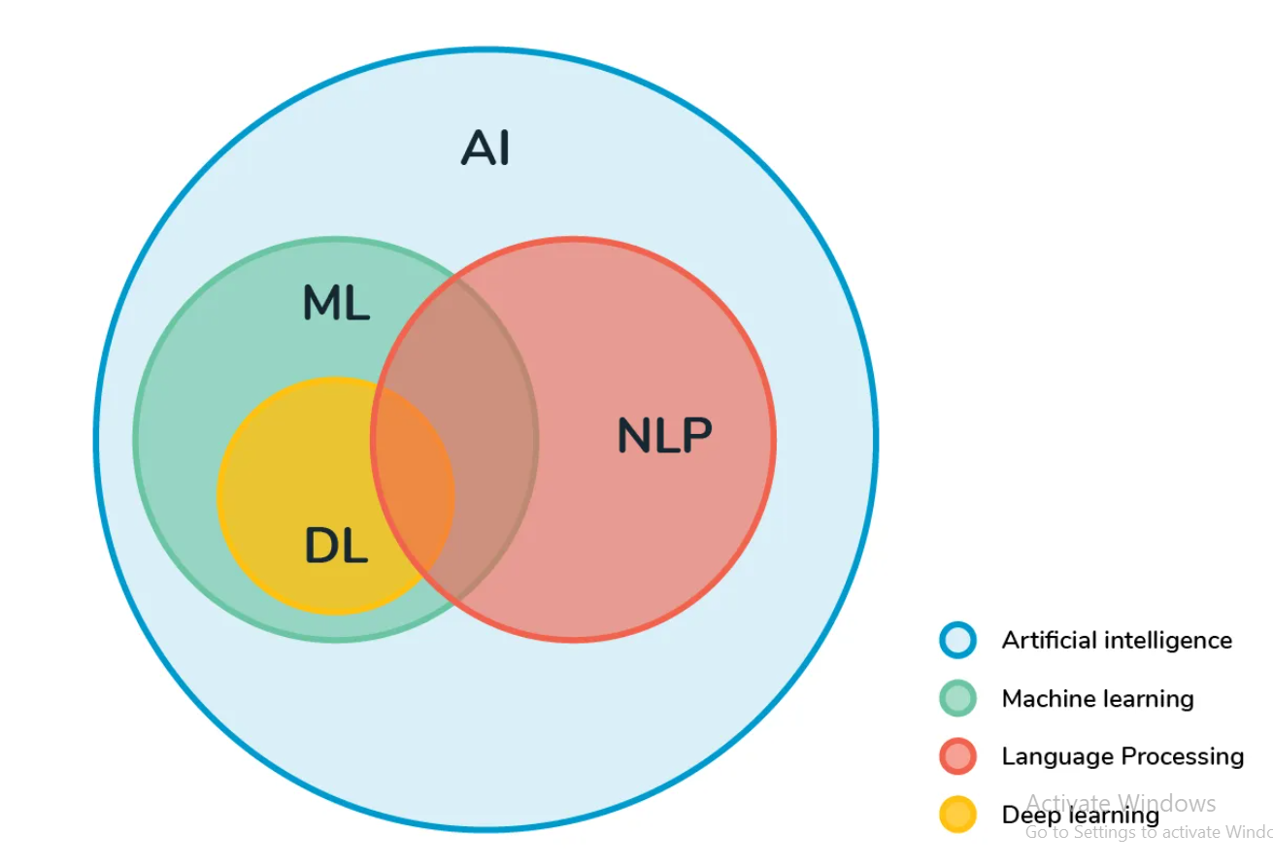

Slide 9
AI: the broad idea that machines can intelligently execute tasks by mimicking human behavior
ML: Subset of AI, revolves around the idea that machines can learn & adapt through experience & data to complete specific tasks.
DL: It attempts to mimic the human brain through NNs.

Slide 10
What is NLP ?
Amazon: Natural language processing (NLP) combines computational linguistics, predictive artificial intelligence, and deep learning models to process human language.
IBM: Natural language processing (NLP) is a subfield of computer science and artificial intelligence (AI) that uses machine learning to enable computers to understand and communicate with human language.
Natural Language Processing (NLP) is a field that combines computer science, artificial intelligence and language studies. It helps computers understand, process and create human language in a way that makes sense and is useful.

Slide 11
Natural language Vs Artificial language
Natural language: The language that is used for every day communication by humans; Like: english, hindi, portuguese;
Artificial language: Programming languages;

Slide 12
Origin/History of NLP
1. Early Beginnings (1950s): Machine Translation & Turing Test
2. Rule-Based NLP Era (1950s–1980s)
3. Statistical NLP Era (1980s–2000s): Data-Driven Approach
4. Machine Learning & Deep Learning Era (2010s–Present)

Slide 13
1. Early Beginnings (1950s): Machine Translation & Turing Test
The 1950s mark the birth of Natural Language Processing (NLP).
This period laid the foundation for all future language technologies.
The Turing Test (1950) – Can Machines Think?
Proposed by Alan Turing, one of the fathers of computer science, in his paper “Computing Machinery and Intelligence” (1950).
He asked the very important question:
"Can machines think?"
Instead of defining “thinking,” Turing proposed a practical test.

Slide 14
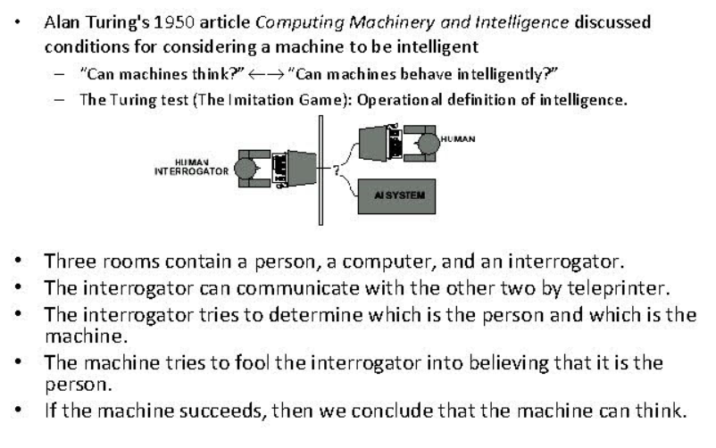

Slide 15
The Turing Test:
Introduced the idea that language understanding = intelligence
Encouraged research in:
  dialogue systems
  question answering
  natural conversation
Influenced early chatbots such as ELIZA (1966)

Slide 16
Machine Translation (MT) – Beginning of Practical NLP
Machine Translation was one of the first real-world NLP applications.
What is Machine Translation?
It is the automatic translation of text from one language to another.
During the Cold War, the U.S. wanted quick translation of Russian scientific and military documents.This created huge interest in using computers for translation.

Slide 17
Georgetown–IBM Machine Translation Experiment (1954)
This was the first major NLP success.
What happened in the experiment?
IBM and Georgetown University demonstrated a system that could translate 60 carefully chosen Russian sentences into English. It used 6 grammar rules and a dictionary of 250 words.

Slide 18
Я вижу машину
I see the machine
Why did people become excited?
Newspapers claimed:
“Machine translation is solving language barriers!”
Researchers believed:
Translation would be solved in 3–5 years
Computer understanding of every language was possible

Slide 19
But there was a problem…
Early systems were too simple.
They relied on:
word-for-word translation
hand-written rules
no context understanding
Example mistake:
Russian: за столом стоит ваза
Literal translation: at the table stands vase
Correct: there is a vase on the table

Slide 20
Summary of Early NLP (1950s)
Topic | Key Ideas
Turing Test | Proposed a method to evaluate machine intelligence using conversation
Machine Translation | First real NLP application; attempted rule-based translation
Georgetown–IBM experiment | Translated 60 Russian sentences; sparked excitement
Limitations | Word-by-word translation, no deep understanding
Legacy | Started the fields of AI, computational linguistics, and NLP

Slide 21
2. Rule-Based NLP Era (1950s–1980s)
Also known as the “Symbolic NLP Era” or “Classical NLP”.
This period is important because researchers tried to build NLP systems using human-created rules, not data or machine learning.
Rule-Based NLP uses explicit linguistic rules written by humans to process language.
These rules can describe:
Grammar
Word structure
Sentence structure
Meaning
Dialogue patterns

Slide 22
Noun Phrase → Determiner + Noun
Verb “eat” → past tense “ate”
Why Rule-Based NLP?
During 1950s–1980s:
No large datasets
No machine learning
Computers had low processing power
Linguists believed language must be modeled using logic and grammar
So rule-based systems were the only possible approach.

Slide 23
Key Components of Rule-Based NLP:
a) Morphological Rules
Used to analyze word structure.
Example:
play + ed → played
run + ing → running
b) Syntax Rules (Grammar Rules)
Used to understand sentence structure.
Example:
Sentence → Noun Phrase + Verb Phrase
Verb Phrase → Verb + Noun Phrase
c) Semantic Rules:
Used to derive meaning.
Example:
Agent (Subject) performs Action (Verb) on Object

Slide 24
Strengths of Rule-Based NLP
Advantage | Explanation
Interpretable | Rules are human-written → easy to understand
Precise | Works well in restricted domains (medicine, finance)
Transparent | Easy debugging (just modify rules)
Good for formal languages | e.g., grammar checking, code parsing

Slide 25
Weaknesses of Rule-Based NLP
Limitation | Explanation
Not scalable | Thousands of rules needed for real language
Ambiguity problems | One rule can conflict with another
Language is too complex | Idioms, slang, context cannot be handled
Expensive | Requires linguists to manually write rules
Domain-specific | Works only in limited areas
Example of failure:
I saw the man with the telescope.
Rule-based system cannot decide:
Who has the telescope?
Did I use a telescope or did the man?

Slide 26
3. Statistical NLP Era (1980s–2000s): Data-Driven Approach
As more digital text became available, researchers shifted to statistics and probabilities.
Why the shift?
Rule-based systems failed for large vocabularies and noisy language.
Computers became more powerful.
Large text corpora (news articles, books) were available.
Key Techniques:
N-gram language models
Hidden Markov Models (HMMs)
Part-of-speech tagging using probabilities
Machine translation using statistics (IBM Models)
Example: Bigram Model
Probability of “I am learning NLP”
= P(am | I) × P(learning | am) × P(NLP | learning)
This period made NLP more accurate and robust.

Slide 27
4. Machine Learning & Deep Learning Era (2010s–Present)
With large datasets and powerful GPUs, NLP moved to neural networks.
Key breakthroughs:
Word embeddings (2013) – Word2Vec, GloVe
  Words represented as vectors
RNNs, LSTMs (2014–2016)
  Better sequence understanding
Transformers (2017) – “Attention Is All You Need”
  Foundation for BERT, GPT, T5
  Enabled state-of-the-art results in:
    Translation , Summarization, Question answering, Chatbots

Slide 28
Today’s NLP:
Relies on pretrained large language models (LLMs) like GPT, BERT, LLaMA.
These models understand context, generate text, translate, summarize, and more.

Slide 29
Challenges of NLP
Challenge | Explanation
Ambiguity | Same word or sentence has multiple meanings
Context | Words depend on surrounding text
Language Variability | Many ways to express same idea
Sarcasm | Meaning opposite of words
Idioms | Non-literal expressions
Named Entities | Brands, people, places
World Knowledge | Computers lack common sense
Multilingual Issues | Different scripts, grammar
Speech Variation | Accents and homophones
Data Sparsity | New or rare words
Domain Adaptation | Models fail across domains
High Computation | Requires large datasets & GPUs

Slide 30
1. Ambiguity:
Human language is full of multiple meanings.
Types:
a) Lexical Ambiguity (word has multiple meanings)
Example:
“bank” ---- river bank or money bank
b) Syntactic Ambiguity (sentence structure unclear)
Example:
“I saw the man with the telescope.”
Who has the telescope? You or the man?
c) Semantic Ambiguity (meaning unclear)
Example:
“Visiting relatives can be annoying.”
Are the relatives visiting?
Or is the act of visiting them annoying?

Slide 31
2. Context Understanding:
Words change their meaning depending on the context.
Example:
“Apple” --- a fruit or Apple Inc (company)
Sentence:
“Apple released a new iPhone.” → company
“Apple is good for health.” → fruit
NLP must understand the surrounding words to pick the right sense.

Slide 32
3. Variability in Human Language:
People can express the same idea in many ways.
Example:
“I am hungry.”
“I need food.”
“Can we grab something to eat?”
“I’m starving!”
All mean the same, but look different.
Computers struggle with:
synonyms
paraphrases
slang

Slide 33
4. Sarcasm and Irony:
Humans easily detect sarcasm, but computers can't.
Example:
“Wow, that’s just great!”
------Could mean frustration, not praise.
NLP models usually take text literally.
5. Idioms & Figurative Language:
Idioms are phrases whose meanings are not derived from the words.
Example:
“Kick the bucket” → means “to die”
“Break the ice” → start conversation
Literal translation confuses NLP systems.

Slide 34
6. Named Entity Recognition Challenges:
Identifying names, places, brands is hard.
Example:
“Amazon” - a company or a rainforest
“Apple” – fruit or brand
NLP must know which “Apple” is being used depending on domain.
7. Lack of World Knowledge:
Humans use common sense, but computers do not.
Example:
“John dropped the glass. It broke.”
Computer must infer:
“it” refers to glass
glass is fragile
This requires implicit world knowledge, which is difficult to encode.

Slide 35
8. Multilingual Complexity:
There are: different scripts (Devanagari, Arabic, Chinese)
different grammar rules
different word orders
languages without clear word boundaries (e.g., Chinese)
Example:
Chinese sentence:
“我喜欢看电影”
There are no spaces between words → tokenization becomes challenging.
9. Speech & Pronunciation Variations (for Speech NLP):
Difficulties include:
accents
background noise
Example: “two”, “too”, “to”
Even humans mishear speech in noisy environments.

Slide 36
10. Data Sparsity and Rare Words:
Language is infinite — new words appear daily
(e.g., COVID-19, meme words, trending hashtags)
Models struggle with:
rare words
new vocabulary
uncommon phrases
11. Domain Adaptation:
Model trained on news articles may fail on:
medical reports
legal documents
social media slang
Example:
“BP is high.”
Medical: blood pressure
Finance: British Petroleum stock

Slide 37
12. Computational Challenges:
Some NLP tasks require:
huge datasets
powerful hardware
expensive training
long computation time
Transformer models like BERT/GPT require billions of parameters.

