Slide 1
ALGORITHM ANALYSIS
provides theoretical estimation for the required resources of an algorithm to solve a specific computational problem.
Analysis of algorithms is the determination of the amount of time and space resources required to execute it.

Slide 2
There are ways to Analyse the Algorithms
Competitive analysis
Amortized Analysis
Probabilistic Analysis
Asymptotic Analysis Is available then why other Analysis methods?
Asymptotic Analysis is the big idea that handles the above issues in analysing algorithms.
In Asymptotic Analysis, we evaluate the performance of an algorithm in terms of input size (we don’t measure the actual running time).
We calculate, how the time (or space) taken by an algorithm increases with the input size.
Click it to view Asymptotic Analysis Representation

Slide 3


Amortized analysis is a method for analysing a given algorithm's complexity, or how much of a resource, especially time or memory, it takes to execute.
amortized analysis averages the running times of operations in a sequence over that sequence.
conclusion: "Amortized analysis is a useful tool that complements other techniques such as worst-case and average-case analysis.
Aggregate method
method that involves computing the total cost T(n) for a sequence of n operations, then dividing T(n) by the number n of operations to obtain the amortized cost or the average cost in the worst case.
For all operations the same amortized cost T(n)/n is assigned, even if they are of different types.
The other two methods may allow for assigning different amortized costs to different types of operations in the same sequence.
Example :Click me!

Slide 4
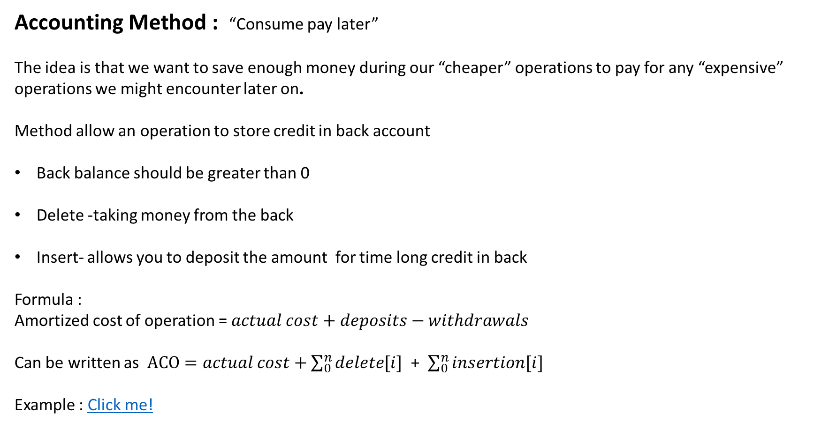
Accounting Method : “Consume pay later”
The idea is that we want to save enough money during our “cheaper” operations to pay for any “expensive” operations we might encounter later on.
Method allow an operation to store credit in back account
Back balance should be greater than 0
Delete -taking money from the back
Insert- allows you to deposit the amount for time long credit in back
Formula :
Amortized cost of operation = $actual cost+deposits−withdrawals$
Can be written as $ACO=actual cost+\sum_{0}^{n}{delete[i]}$ + $\sum_{0}^{n}{insertion[i]}$
Example : Click me!

Slide 5

potential method is a method used to analyse the amortized time and space complexity of a data structure, a measure of its performance over sequences of operations that smooths out the cost of infrequent but expensive operations.
The potential approach focuses on how the current potential, may be calculated directly from the algorithm’s or data structure’s present state.
Steps :
Define potential function Φ
Function should be non zero
$amortized cost for each state$=$actual cost for each state$ +$delta of potentials fot each sate$
$delta\left(\text{Φ}\right)=$Φ(after operation)- Φ (before operation)
$$\sum_{i=0}^{i=n}{amortized cost=\sum_{i=0}^{i=n}{actual cost+delta(\text{Φ})}}$$
Example : click me!

Slide 6
Probabilistic analysis of algorithms
In probabilistic analysis of probabilistic (randomized) algorithms, the distributions or average of all
possible choices in randomized steps is also taken into account, in addition to the input distributions.
Probabilistic Analysis
We must know or make assumptions about the distribution of inputs.
The expected cost is over this distribution.
The analysis will give us average case running time.
We don't have this information for the Hiring Problem, but suppose we could assume that candidates come in random order. Then the analysis can be done by counting permutations:
Each ordering of candidates (relative to some reference ordering such as a ranking of the candidates) is equally likely to be any of the n! permutations of the candidates.
In how of these permutations many do we hire once? twice? three times? ... n−1 times? n times?
It depends on how many permutations have zero, one two ... n−2 or n−1 candidates that come before a better candidate.
This is complicated! You would not want to count those up.
Fortunately, this analysis is much easier with indicator variables (next section)

Slide 7
Randomized Algorithms
We might not know the distribution of inputs or be able to model it.
However, uniform random distributions are easier to analyze than unknown distributions.
To obtain such a distribution regardless of input distribution, we can randomize within the algorithm to impose a distribution on the inputs. Then it is easier to analzye expected behavior.
An algorithm is randomized if its behavior is determined in parts by values provided by a random number generator.
This requires a change in the hiring problem scenario:
The employment agency sends us a list of n candidates in advance and lets us choose the interview order.
We choose randomly.
Thus we take control of the question of whether the input is randomly ordered: we enforce random order, so the average case becomes the expected value.

Slide 8
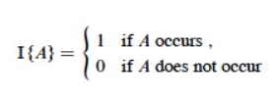
Example :
What is the expected number of heads when flipping a fair coin once?
Sample space S is {H, T}
Pr{H} = Pr{T} = 1/2
Define indicator random variable X_{H}= I{H}, which counts the number of heads in one flip.
Since Pr{H} = 1/2, Lemma 1 says that E[X_{H}] = 1/2.
Probabilistic Analysis with Indicator Random Variables
Here we introduce a technique for computing the expected value of a random variable, even when there is dependence between variables.
A random variable (e.g., X) is a variable that takes on any of a range of values according to a probability distribution.
The expected value of a random variable (e.g., E[X]) is the average value we would observe if we sampled the random variable repeatedly.
Indicator Random Variables
Given sample space S and event A in S, define the indicator random variable
We will see that indicator random variables simplify analysis by letting us work with the probability of the values of a random variable separately.

Slide 9
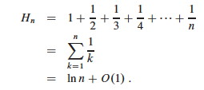
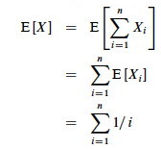
For an event A, let XA = I{A}. Then the expected value E[XA] = Pr{A} (the probability of event A).
Proof: Let ¬A be the complement of A. Then
E[XA] = E[I{A}] (by definition) = 1*Pr{A} + 0*Pr{¬A} (definition of expected value) = Pr{A}.
For an event A, let XA = I{A}. Then the expected value E[XA] = Pr{A} (the probability of event A).
Proof: Let ¬A be the complement of A. Then
E[XA] = E[I{A}] (by definition)
= 1*Pr{A} + 0*Pr{¬A} (definition of expected value)
= Pr{A}.
Hiring Problem
Candidate i is hired iff candidate i is better than candidates 1, 2, ..., i−1
Assumption of random order of arrival means any of the first i candidates are equally likely to be the best one so far.
Thus, Pr{candidate i is the best so far} = 1/i.
The sum is a harmonic series. From formula A7 in appendix A, the n^{th} harmonic number is:
Thus, the expected hiring cost is Θ(c_{h} ln n), much better than worst case Θ(c_{h}n)! (ln is the natural log. Formula 3.15 of the text can be used to show that ln n = Θ(lg n.)

Slide 10
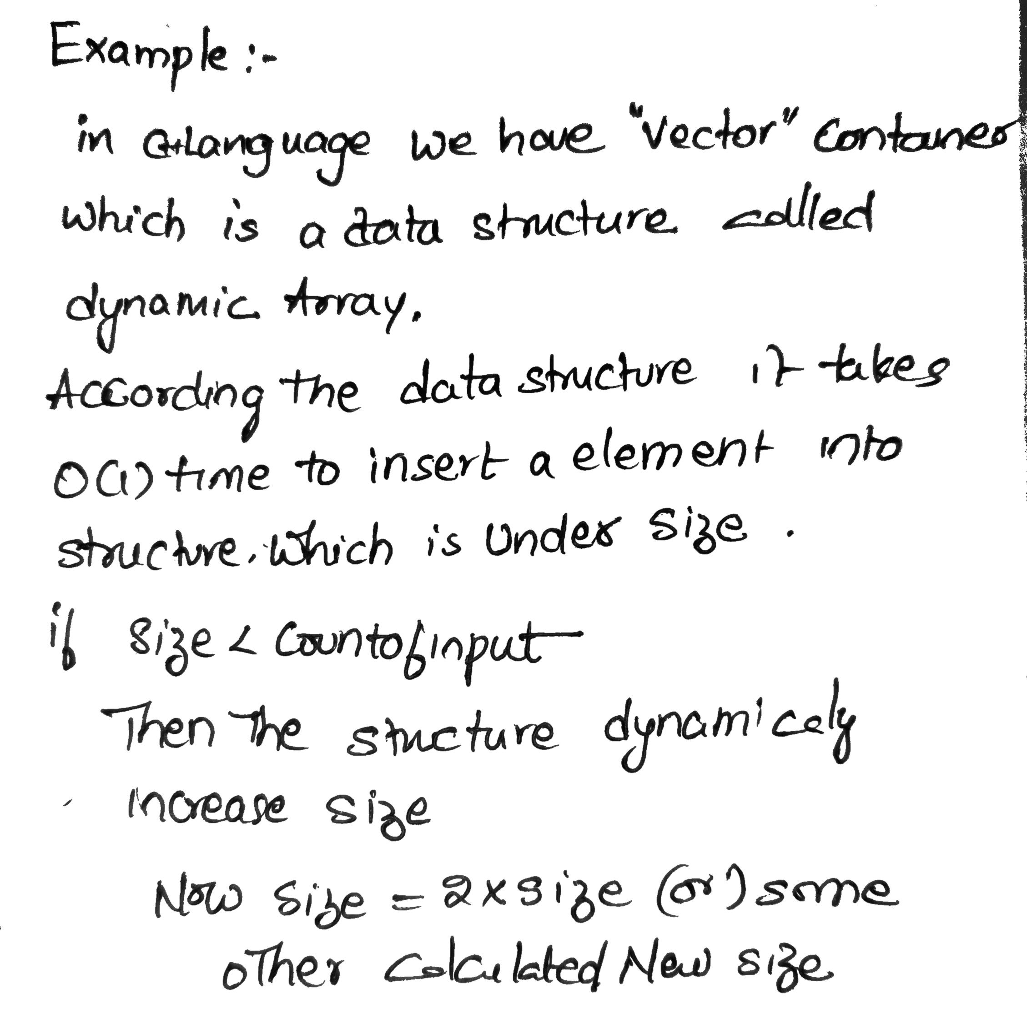
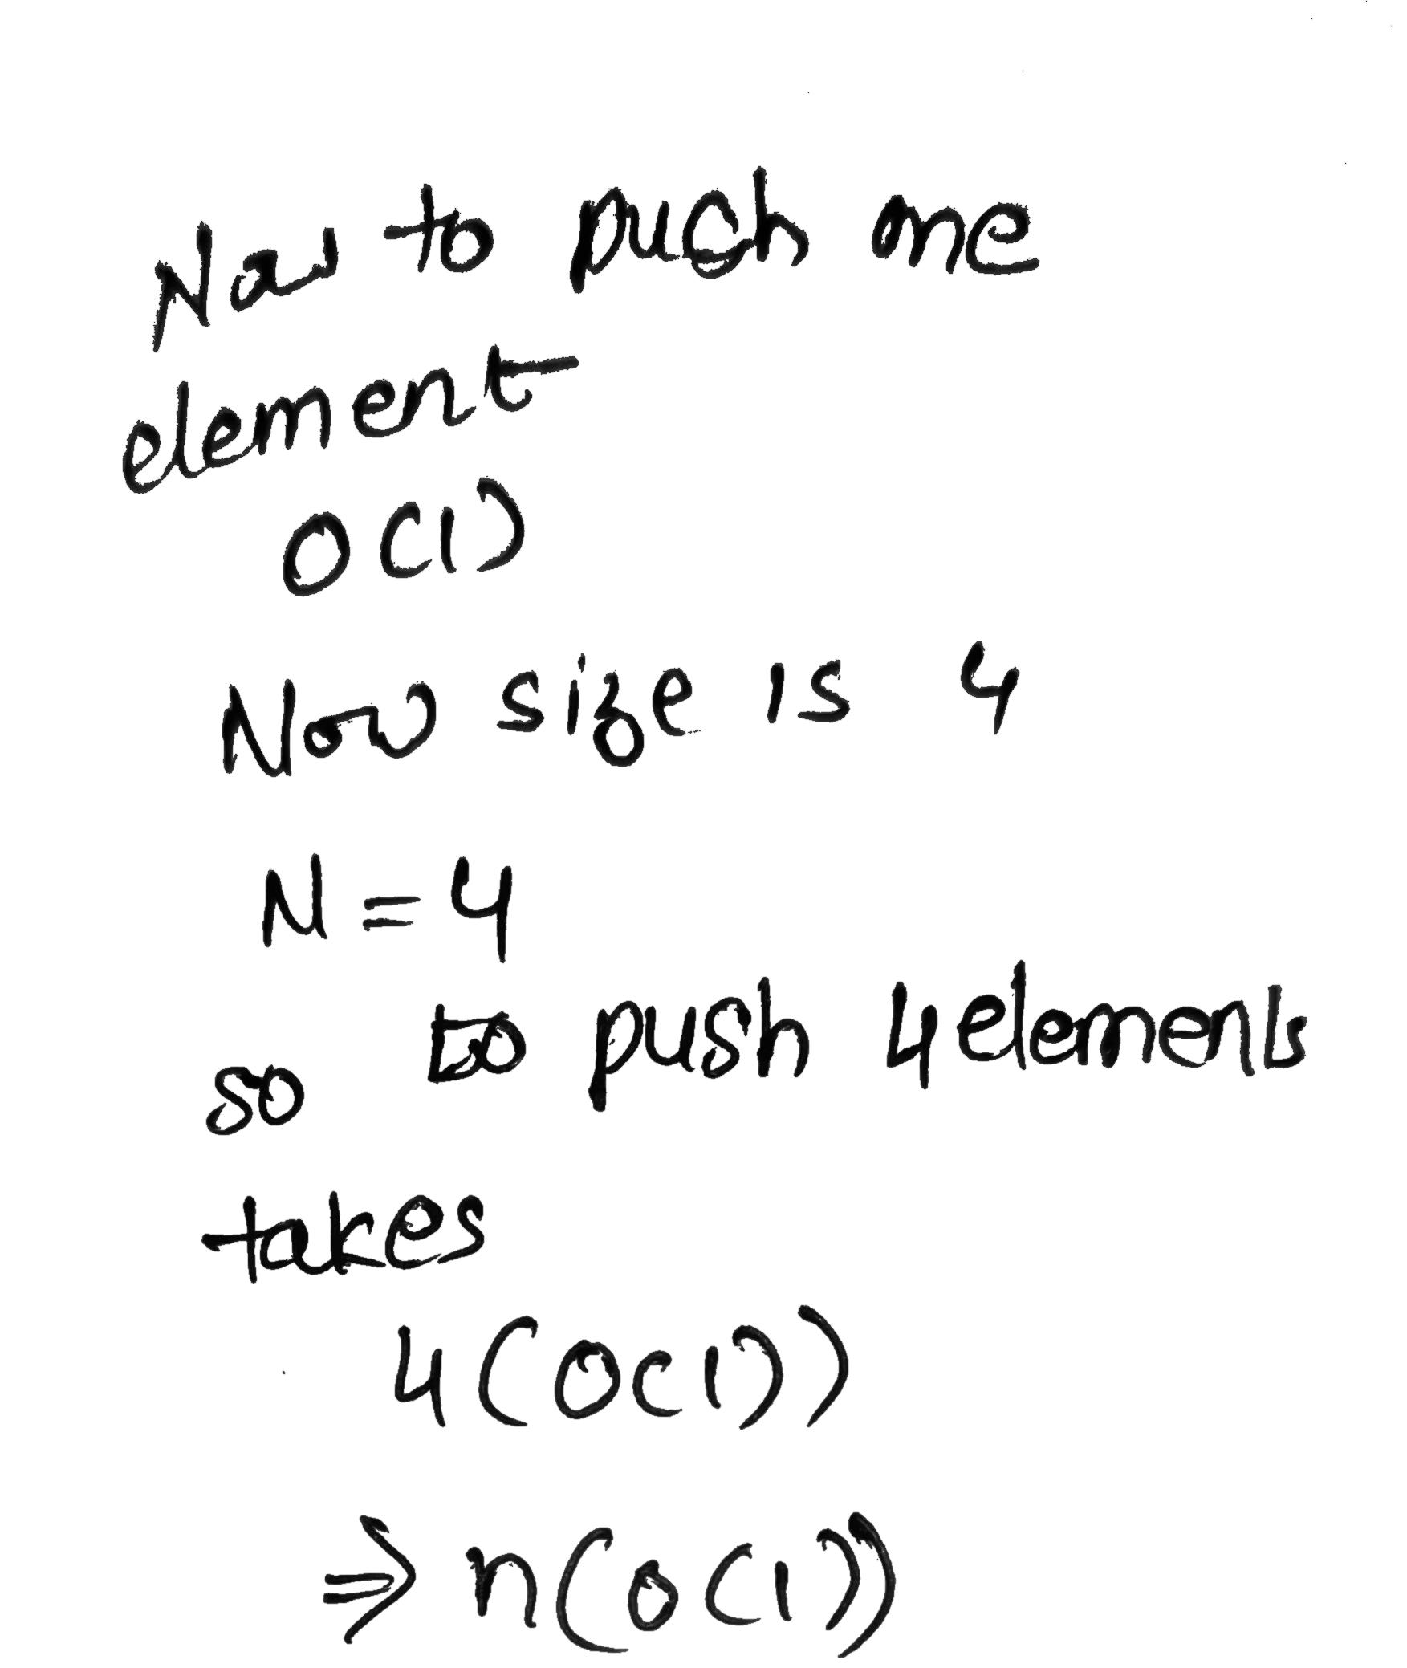

Slide 11
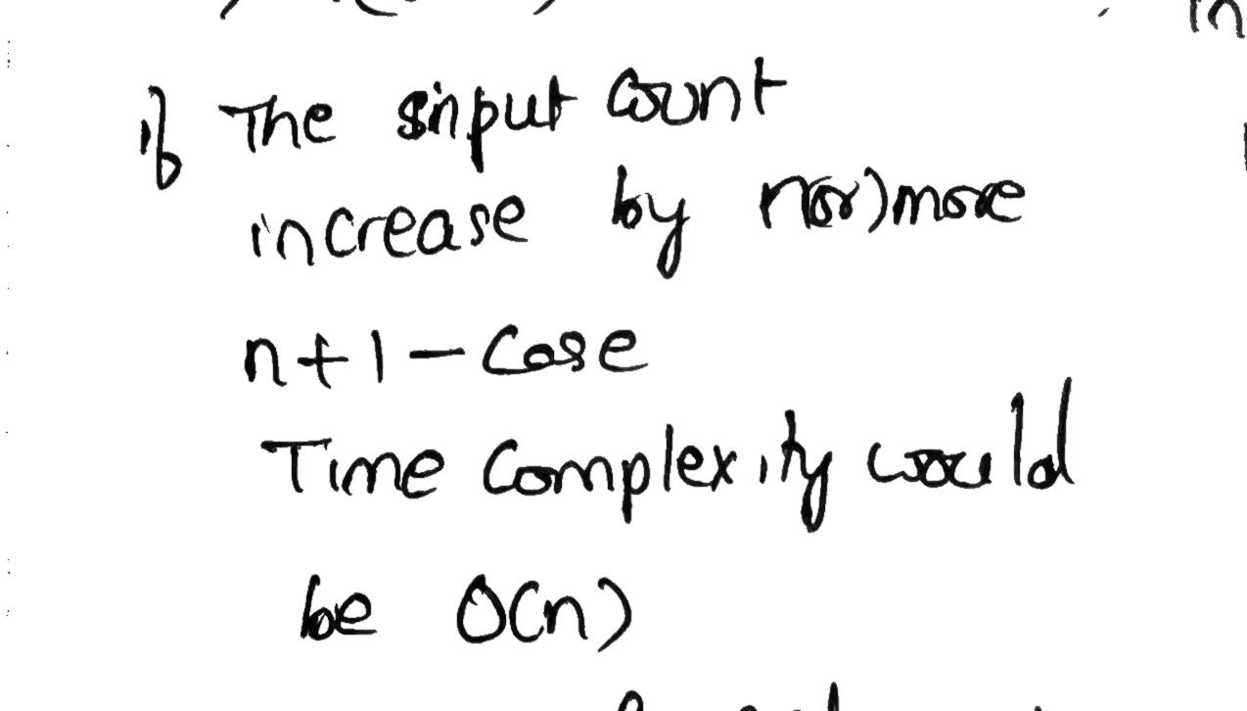
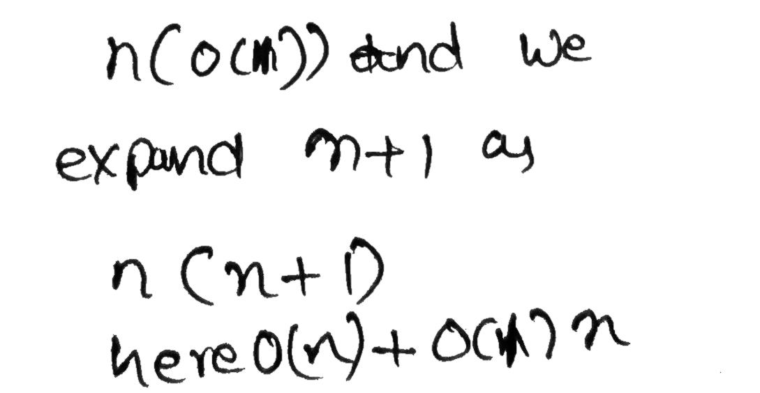
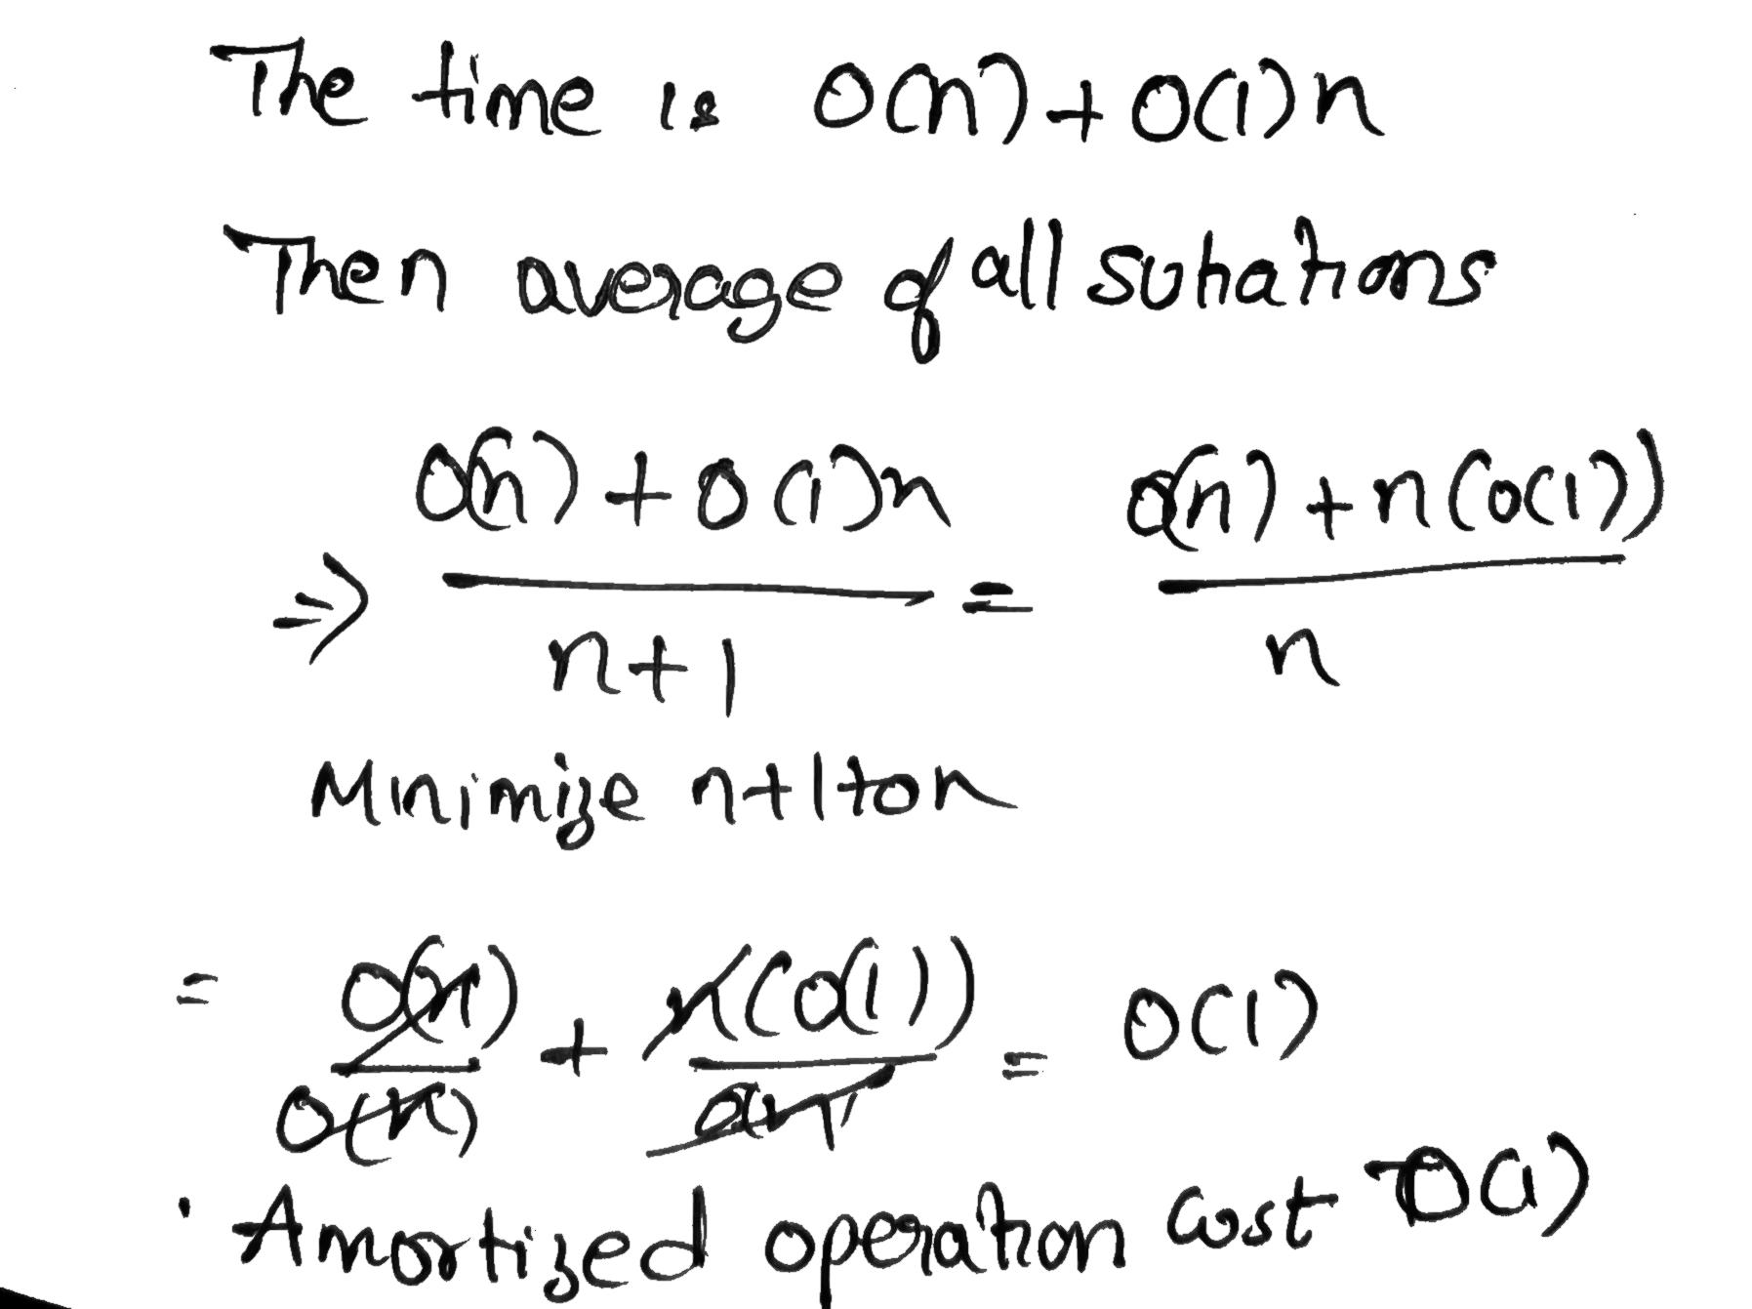


Slide 12
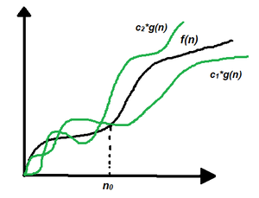
But consider two algorithms with 100nlogn and 10nlogn time complexities then also by asymptotic analysis we can tell both are same with nlogn growth. But both are not having same time complexities

Slide 13
Aggregate Method
The worst case running time occurs when all k bits are flipped, so increment( A) has running time O(k).
In a sequence of n increment operations, few increments will cause that many bits to flip. Indeed,
bit 0 flips with every increment bit 1 flips with every 2nd increment
bit 2 flips with every 4th increment, . .

Slide 14
Aggregate Method
Total number of bit flips in n increment operations is
n + n/2 + n/4 + … + n/2^{k} < n(1/(1-1/2))= 2n
So total cost of the sequence is O(n).
Amortized cost per operation is O(n)/n = O(1).
21

Slide 15
Binary Counter
A binary k-bit counter can be implemented with a k-element binary array. The counter is initially 0.
The only operation is increment(A), which adds 1 to the current number in the counter.
The increment operation can be implemented using the grade-school ripple-carry algorithm.
•

Slide 16
Accounting Method for k-Bit
The actual cost for an increment operation is the number of bits flipped.
We can assign an amortized cost of 2 for each increment operation. The main idea is to use 1 to flip the bit from 0 to 1 and store 1 credit to flip it back to 0 later.

Slide 17

Accounting Method for k-Bit Counter
 |  |  |  |  |  |  |  | 1
0 | 0 | 0 | 0 | 0 |  | 0 | 0 | 1 | 0 | 0
 |  |  |  | 1 |  |  |  | 1 |  | 1
0 | 0 | 0 | 0 | 1 |  | 0 | 0 | 1 | 0 | 1
 |  |  | 1 |  |  |  |  | 1 | 1
0 | 0 | 0 | 1 | 0 |  | 0 | 0 | 1 | 1 | 0
 |  |  | 1 | 1 |  |  |  | 1 | 1 | 1
0 | 0 | 0 | 1 | 1
0 | 0 | 1 | 1 | 1

Slide 18

Accounting Method
All changes from 1 to 0 are paid for with previously stored credit (never go into red)
The amortized time per operation is O(1)

Slide 19
Potential Method
Potential Function Bi = number of 1s in counter after i^{th} increment.
Suppose i^{th} operation resets ti bits. Actual cost: ci = ti + 1
if Bi > 0, then Bi = Bi-1 - ti + 1

Slide 20
Potential Method
Difference in Potentials:
Bi - Bi-1 <= (Bi-1 - ti + 1) - Bi-1
= -ti + 1
Amortized cost: ci + Bi - Bi-1 <= ti + 1 -ti + 1 = 2
Advantage of the potential method: We can use it to analyze counters that do not start from 0, see CLRS.

