Slide 1

TRAVEL AND TOUR GUIDE MANAGEMENT SYSTEM
Contributed by :
1.
2.
3.
4.
5.

Slide 2





PACKAGES USED IN SDBMS
OS, Time, main(user defined python module class), random
FUNCTIONS IN TTGMS
Display(self)
Costid(self,place)
Printcity(self,place)
Journey(self)
Selectguide(self)
Time.Sleep(time)
Random.sample(range(a,b),output_count)
DATA STORAGE CLASSES:
List
Dictionaries
Integers
Strings
MAIN MODULE:
Class name: com
Class attributes scope: private
Class functions scope : public

Slide 3
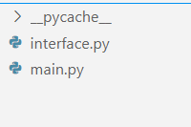
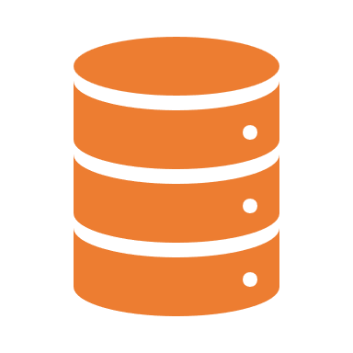


Folder TRAVEL AND TOUR GUIDE MANAGEMENT SYSTEM Detailization
Interface.py is a python file which is a interface or ui of TTGMS project in this file we included all the functions which is created to TTGMS.
This file has implemented is mainly on match function which is to switch the control flow according to the user.
Main.py is a python file which is a backend frame of TTGMS project, in this file we implemented the operations regarding to TTGMS and we created a class of name com and all the operations are public and attributes are private. So when we Import the file to any other file that file cant access the encapsulated data.

Slide 4
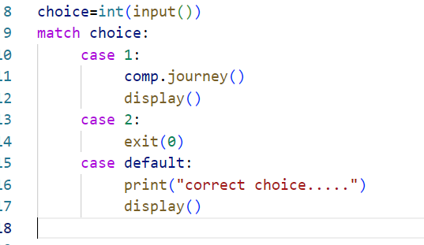

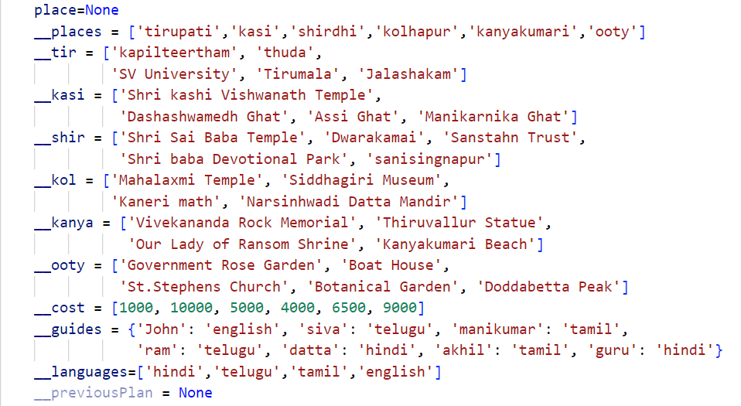
Match keyword plays a important roll in decision making
Private data in com class which is the prentered data

Slide 5
THANK YOU

