Slide 1
Customer LifeTime Value Prediction
Sai Jyothi Gurram

Slide 2
Data Overview
Brazilian Ecommerce dataset had various features tying an order to it’s product, customer, seller, marketing(MQL & lead characteristic data).
After careful analysis, the marketing metrics had a lot of missing data and therefore haven't been used in this analysis.
All the data sources were combined and the unnecessary features were removed.

Slide 3
Problem Statement
Understand how new vs existing customers are growing and what are their revenue contributions.
Predict the Revenue at transaction level and combine it with their customers.

Slide 4
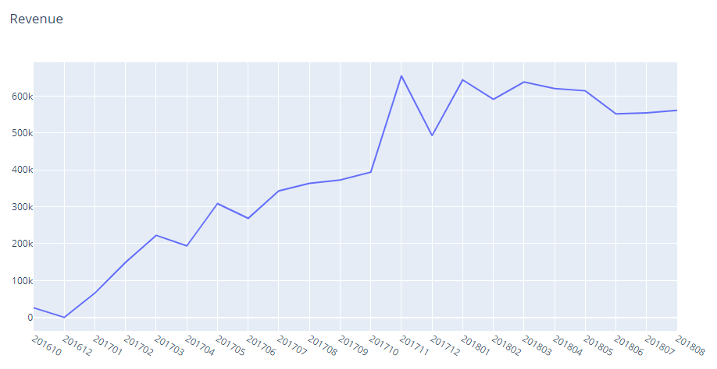
Revenue Distribution
The Revenue distribution consistently increased with a peak in November 2017
Notes:
The outliers in revenue data were removed using InterQuartile range method

Slide 5
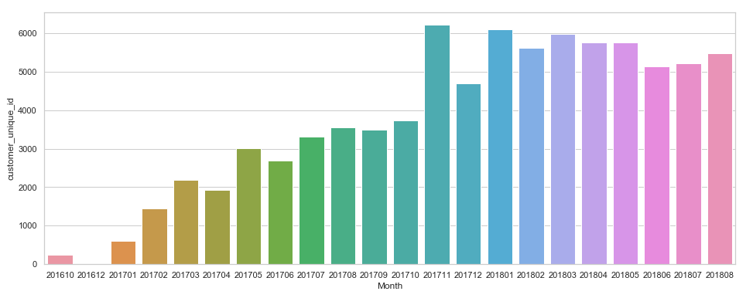
Customer Distribution
Similar to Revenue the number of unique customers also increased consistently.

Slide 6
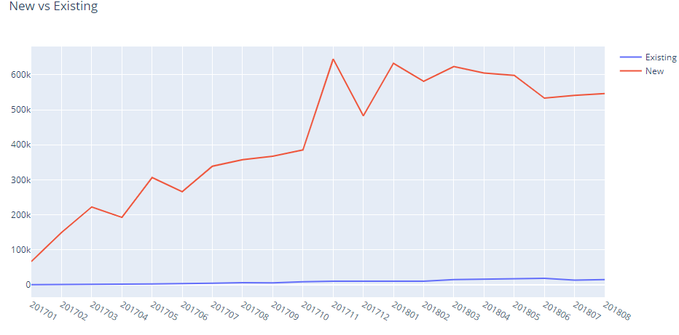
New Vs Existing Customers
Existing customers Revenue contribution is negligible i.e organization wasn’t able to retain existing customers.

Slide 7
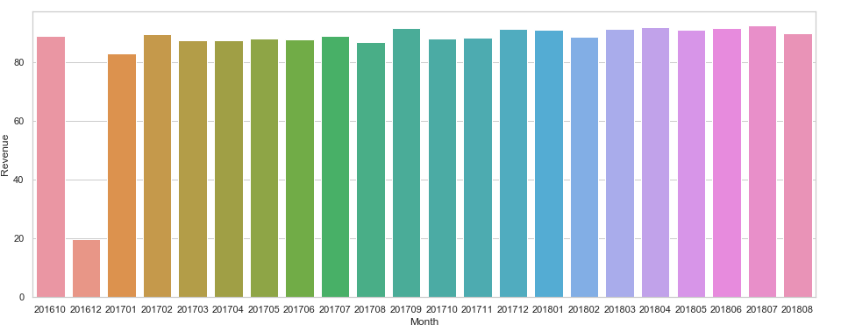
Average Order Size
Average order is consistent across all months (except December 2016)

Slide 8
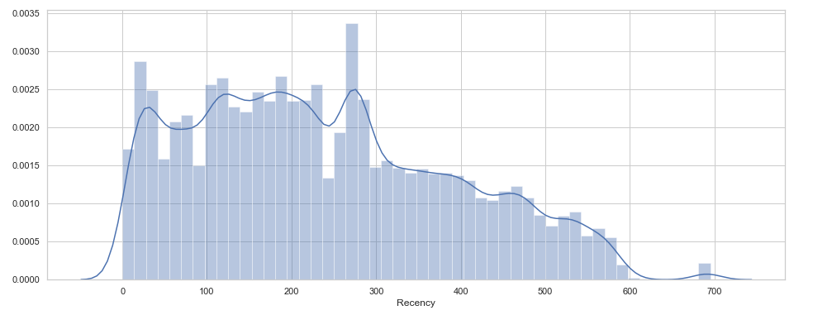
Recency Distribution
Created a new feature Recency.
More than 70% of customers were acquired within last year.

Slide 9
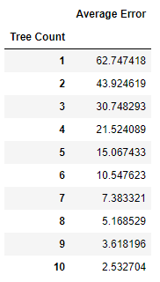
Decision Tree Errors
Created a base Decision Tree model and as the number of trees increased, the average prediction error decreased.

Slide 10
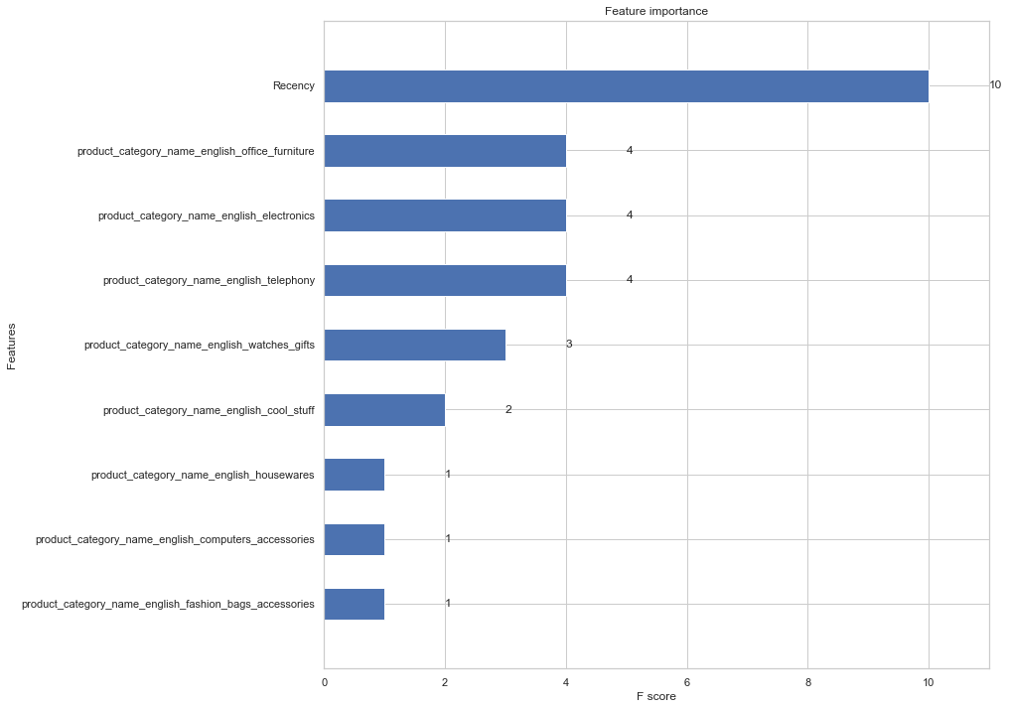
Notes:
Important features for base decision tree model

Slide 11
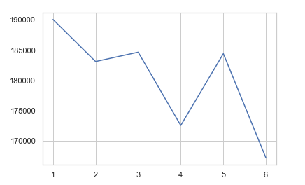
Kmodes Algorithm
Using Kmodes Algorithm created Product Category clusters with respect to Revenue
The cost function reduced at k=4
Created 4 clusters and removed product category features

Slide 12
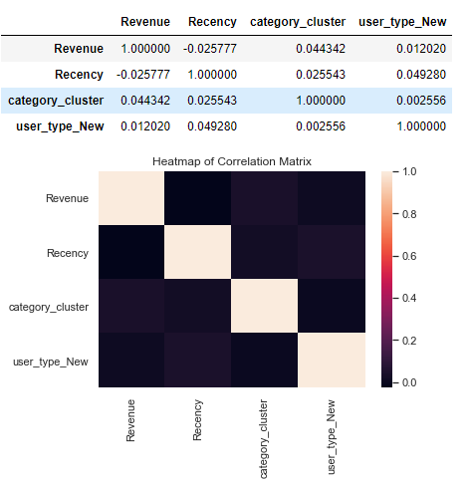
Correlation
Notes:
No correlation

Slide 13
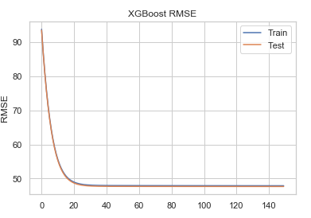
XGBoost Performance
Used an XGBoost ensemble to create the model.
Used GridSearchCV to identify the best parameters.
Log Loss Curve indicates no overfitting.

Slide 14
Summary
This ensemble model can now be used to predict future revenue.
As the number of existing customers were less, I haven't included any frequency feature to cluster audience segments.
Areas of Improvement:
This model can be improved by adding new features.
The geographical locations of customers and sellers can determine why customers in few areas are purchasing more compared to the others.

