Slide 1
Customer LifeTime Value Prediction
Sai Jyothi Gurram

Slide 2
Data Overview
Brazilian Ecommerce dataset had various features tying an order to it’s product, customer, seller, marketing(MQL & lead characteristic data).
After careful analysis, the marketing metrics had a lot of missing data and therefore haven't been used in this analysis.
All the data sources were combined and the redundent features were removed.
Finally a dataframe with order_id, customer_id, customer_unique_id, product_category, revenue, order_date was created.

Slide 3
Problem Statement
Predict the Customer Revenue at transaction level.

Slide 4
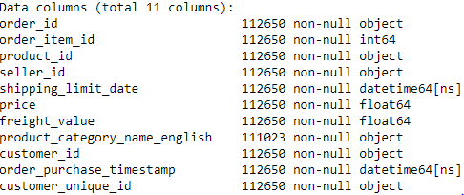
Null Values
There weren’t any null values in most of the columns except product category
Imputed missing product categories as Other

Slide 5
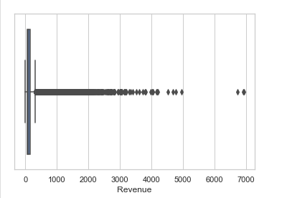
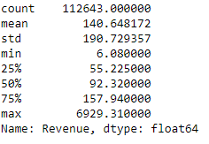
Outliers
Clearly there are outliers in the revenue based on the above results and boxplot. There are many values beyond the 4rth Quartile.
Removed all the outliers that are not within 1.5*times InterQuartile Range (16674 rows).

Slide 6
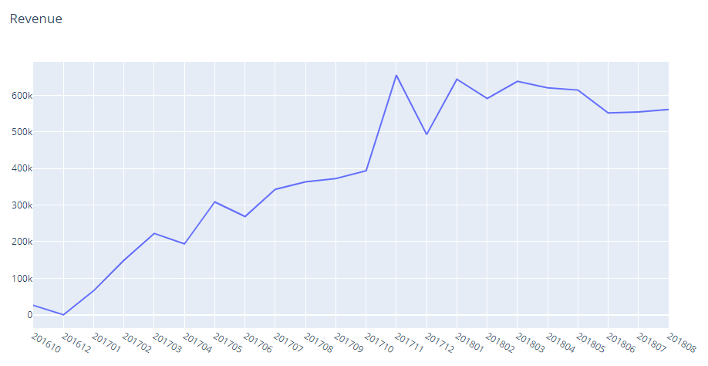
Revenue Distribution - EDA
The Revenue distribution consistently increased with a peak in November 2017
Notes:
The outliers in revenue data were removed using InterQuartile range method

Slide 7
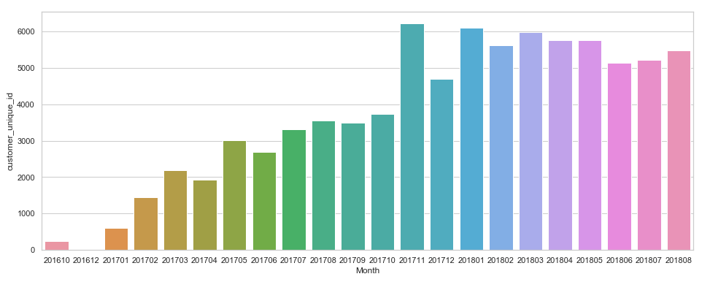
Customer Distribution - EDA
Similar to Revenue the number of unique customers also increased consistently.

Slide 8
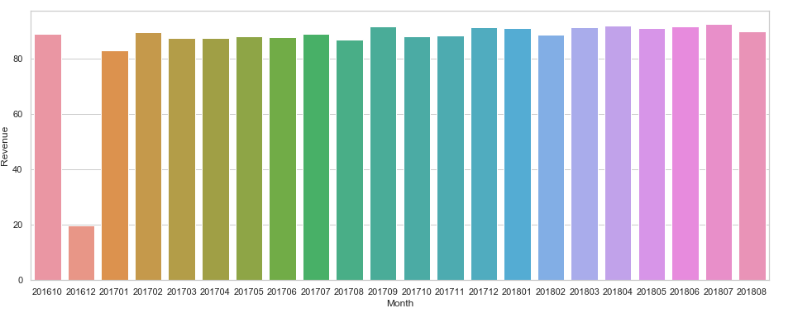
Average Order Size -EDA
Average order is consistent across all months (except December 2016)

Slide 9
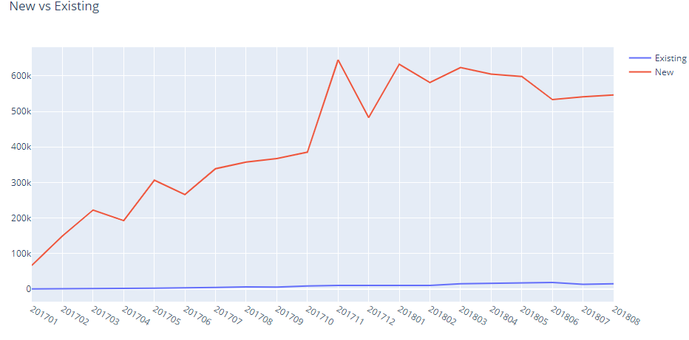
New Vs Existing Customers - EDA
Created a new feature user_type to distinguish New customer vs existing customer.
Existing customers Revenue contribution is negligible i.e organization wasn’t able to retain existing customers.

Slide 10
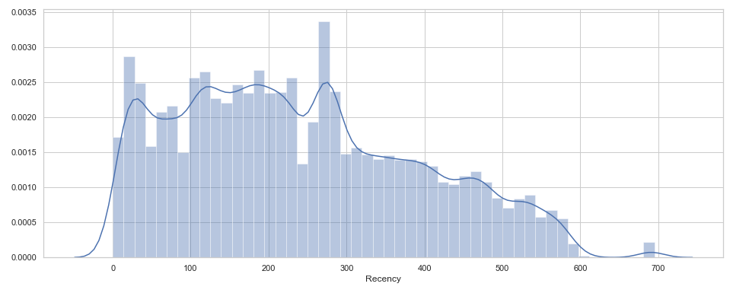
Recency Distribution - EDA
Created a new feature Recency – Difference between maximum order date and actual order date
More than 70% of customers were acquired within last year.

Slide 11
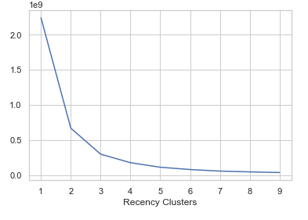
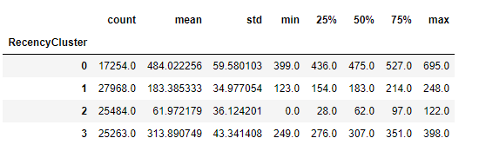
K-Means Clustering for Recency Feature
Used Elbow Method to identify optimal k value(here 4)
Divided Recency into 4 clusters
Recency 0 - Very Old , Recency1 – Less Recent, Receny2- Recent, Recency3 - Old

Slide 12
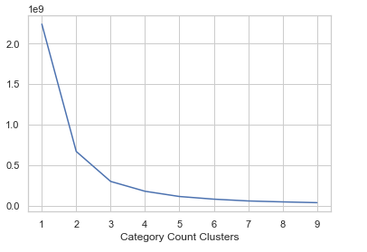
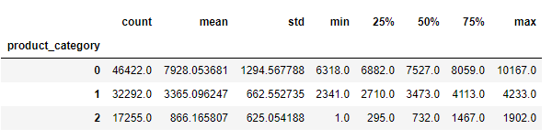
K-Means Clustering for Product Category Count Feature
There are 72 distinct product categories
Created New feature category count (the count of various product categories)
Used K-means elbow method and clustered into 3 categories
Category0 – High, Category1 – Medium, Category2 - Low

Slide 13
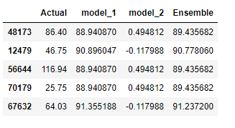
Base Model
Created a Base decision tree model and predicted the revenue
Created a second model by training the model on model1 errors
Finally created an ensemble
The ensemble now has lower error compared to model1

Slide 14
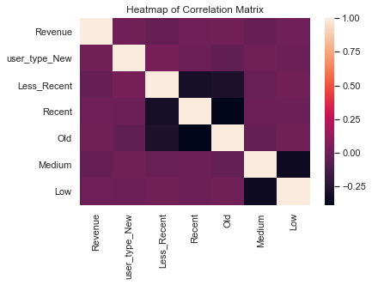
Correlation
Notes:
No correlation

Slide 15
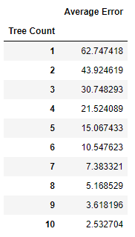
Model Selection
The target variable revenue is not normally distributed to use Linear regression algorithm.
Created a base Decision Tree model and as the number of trees increased, the average prediction error decreased.

Slide 16
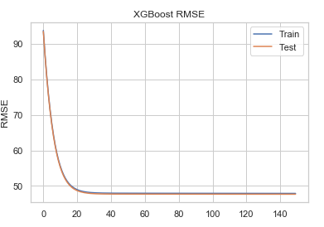

XGBoost Performance
Used an XGBoost ensemble to create the best model.
Used GridSearchCV to identify the best parameters.
Log Loss Curve indicates no overfitting.

Slide 17
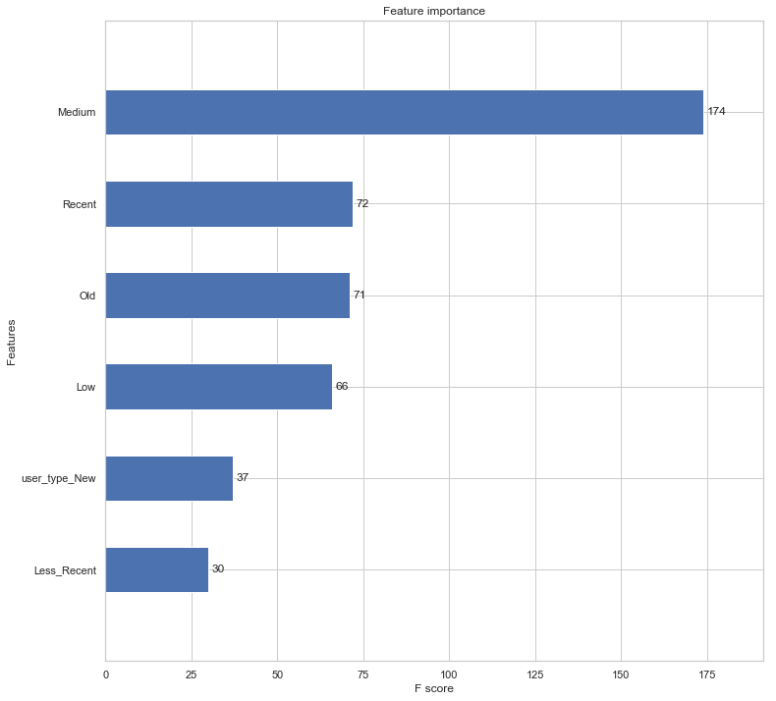
Notes:
Checking the order of feature importance

Slide 18
Summary
This ensemble model can now be used to predict future revenue.
As the number of existing customers were less, I haven't included any related feature to cluster audience segments.
Areas of Improvement:
The geographical locations of customers and sellers can determine why customers in few areas are purchasing more compared to the others.
Creating new segments with respect to customer behavior, channels can improve model’s performance.

