Slide 1
Customer LifeTime Value Prediction
Sai Jyothi Gurram

Slide 2
Data Overview
Brazilian Ecommerce dataset had various features tying an order to it’s product, customer, seller, marketing(MQL & lead characteristic data).
After careful analysis, the marketing metrics had a lot of missing data and therefore haven't been used in this analysis.
All the data sources were combined and the redundent features were removed.

Slide 3
Problem Statement
Understand how new vs existing customers are growing and what are their revenue contributions.
Predict the Revenue at transaction level and combine it with their customers.

Slide 4
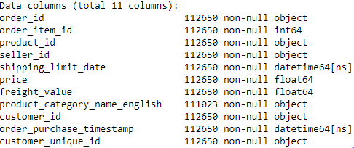
Null Values
There weren’t any null values in most of the columns except product category
Imputed missing product categories as Other

Slide 5
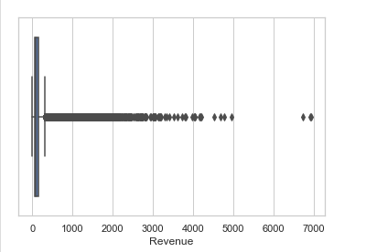
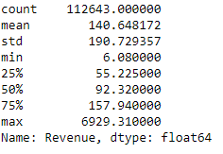
Outliers
Clearly there are outliers in the revenue based on the above results and boxplot. There are many values beyond the 4rth Quartile.
Removed all the outliers that are not within 1.5*times InterQuartile Range (16674 rows).

Slide 6
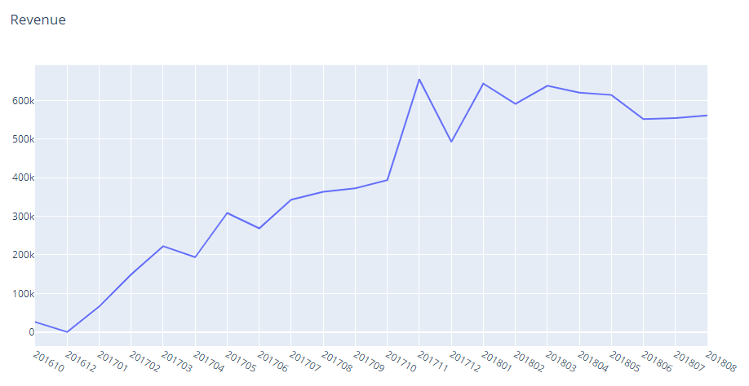
Revenue Distribution
The Revenue distribution consistently increased with a peak in November 2017
Notes:
The outliers in revenue data were removed using InterQuartile range method

Slide 7
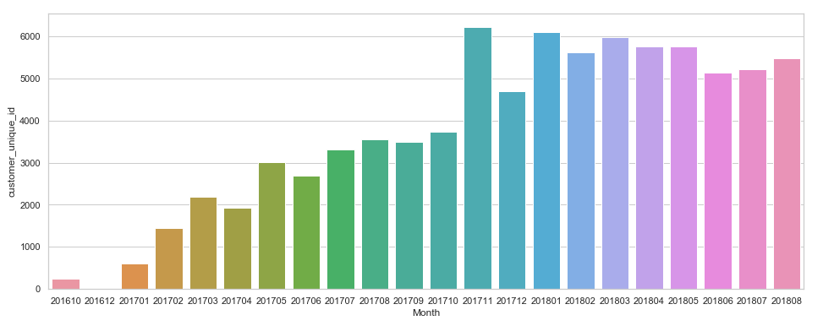
Customer Distribution
Similar to Revenue the number of unique customers also increased consistently.

Slide 8
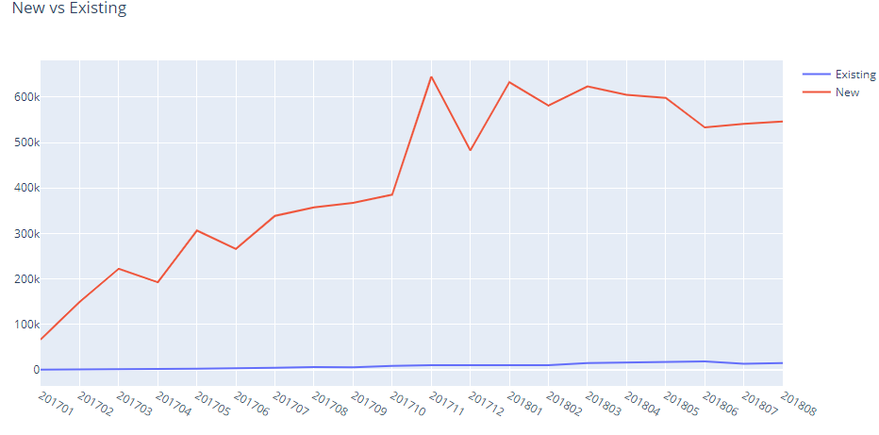
New Vs Existing Customers
Existing customers Revenue contribution is negligible i.e organization wasn’t able to retain existing customers.

Slide 9
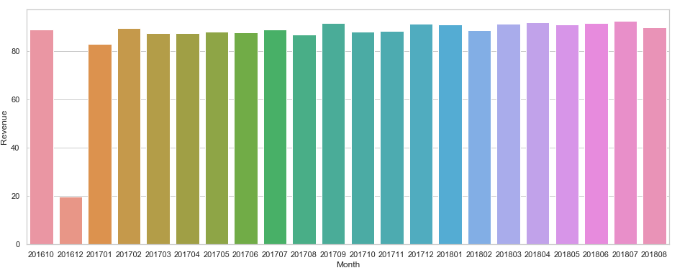
Average Order Size
Average order is consistent across all months (except December 2016)

Slide 10
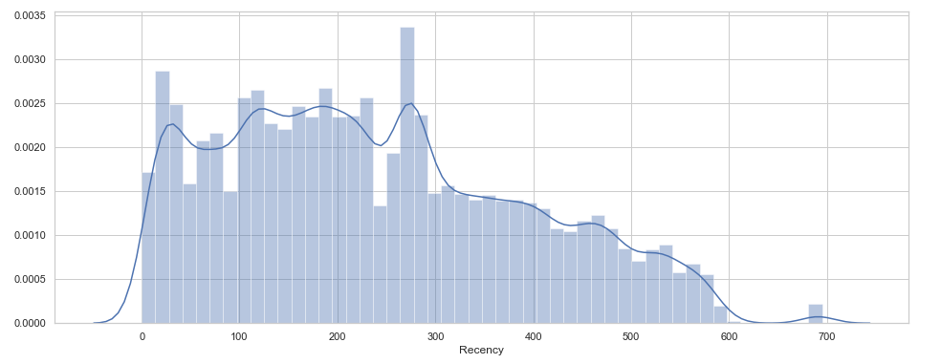
Recency Distribution
Created a new feature Recency.
More than 70% of customers were acquired within last year.

Slide 11
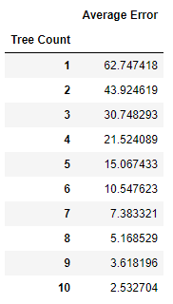
Model Selection
The target variable revenue is not normally distributed to use Linear regression algorithm.
Created a base Decision Tree model and as the number of trees increased, the average prediction error decreased.

Slide 12
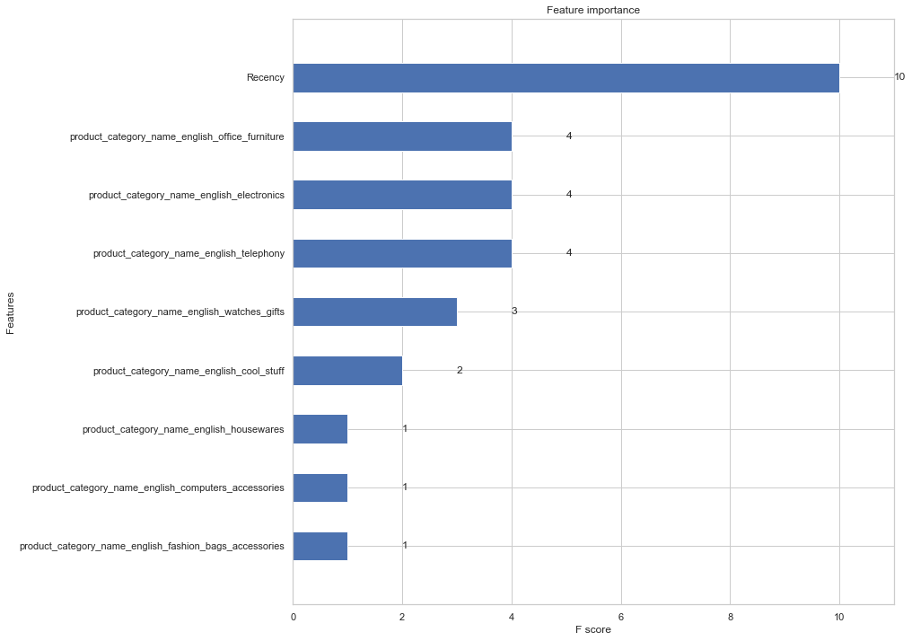
Notes:
Important features for base decision tree model

Slide 13
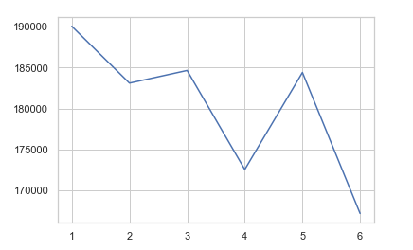
Kmodes Algorithm
There are 72 distinct product categories and the model wasn’t using all product categories in the model.
Kmodes algorithm efficiently groups categorical variables.
Created Product Category clusters with respect to Revenue.
The cost function reduced at k=4.
Created 4 clusters and removed product category features.

Slide 14
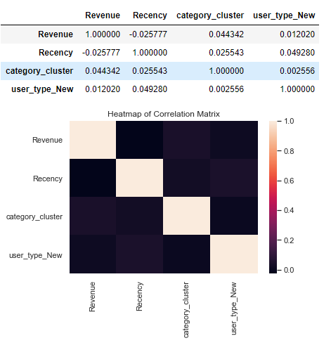
Correlation
Notes:
No correlation

Slide 15
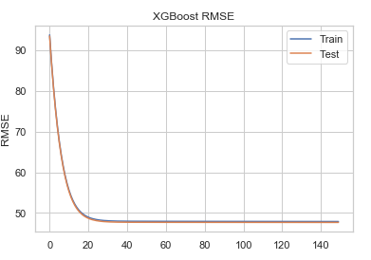
XGBoost Performance
Used an XGBoost ensemble to create the model.
Used GridSearchCV to identify the best parameters.
Log Loss Curve indicates no overfitting.

Slide 16
Summary
This ensemble model can now be used to predict future revenue.
As the number of existing customers were less, I haven't included any frequency feature to cluster audience segments.
Areas of Improvement:
This model can be improved by adding new features.
The geographical locations of customers and sellers can determine why customers in few areas are purchasing more compared to the others.

