Slide 1
Shampoo Sales Forecast
Sai Jyothi Gurram

Slide 2
Data Overview
The shampoo sales dataset has the sales information at Month level for three consecutive years.
The dataset doesn’t contain any missing values.
For easier analysis, Month has been set as the index.

Slide 3
Objective
Forecast the shampoo sales for any given period.

Slide 4
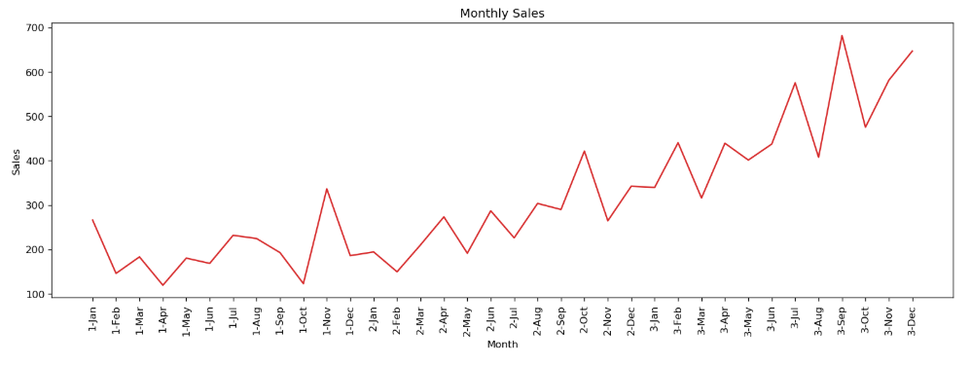
Shampoo Sales Distribution - EDA
The Sales distribution has an upward trend but cannot identify any seasonality

Slide 5
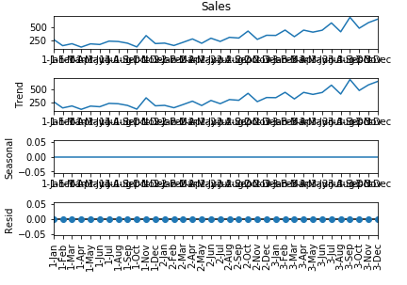
Seasonal Decomposition
There is an upward trend but there is no seasonality and no noise in the residuals. There is no difference between using an additive or multiplicative model here.

Slide 6
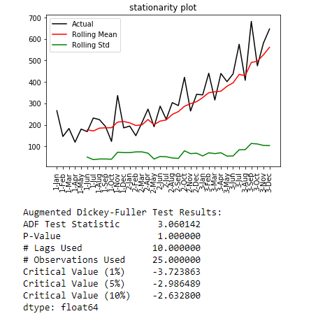
Stationarity
Stationarity of the original data is checked by using rolling statistics and augmented Dickey-Fuller test.
The mean has an upward trend while the standard deviation is approximately flat.
The test statistic proves that the data is not stationary.

Slide 7
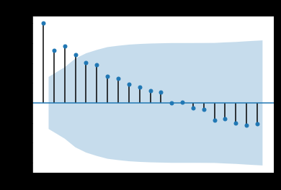
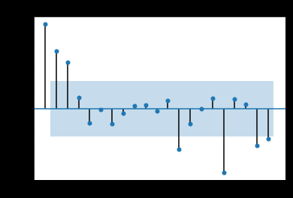
ACF and PACF plot
The PACF plot clearly indicates that there is correlation until 3 lags.
The ACF plot indicates that there is correlation until 4 lag errors.

Slide 8
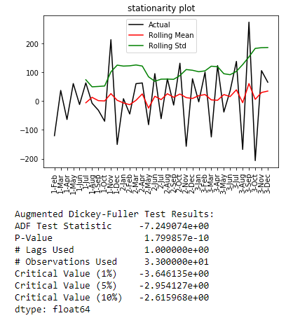
Stationarity
Stationarity of the first order differenced data is checked by using rolling statistics and augmented Dickey-Fuller test.
The mean and the standard deviation are approximately flat.
The test statistic proves that the data is stationary.

Slide 9
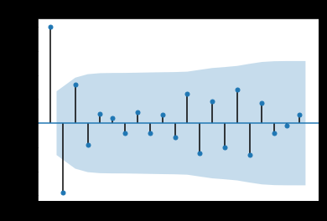
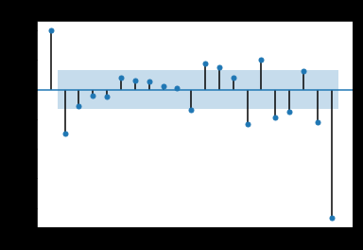
ACF and PACF plot - 1st order data
The PACF plot clearly indicates that there is correlation until 2 lags.
The ACF plot indicates that there is correlation until 2 lag errors.

Slide 10
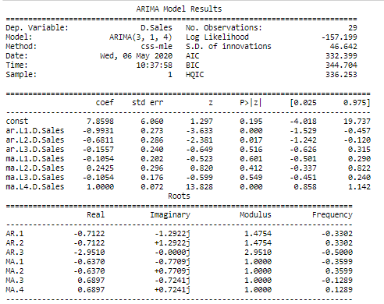
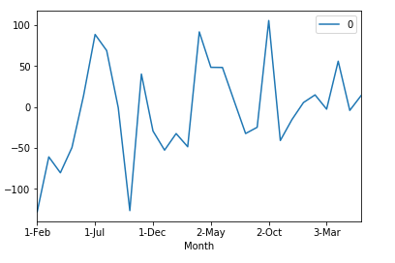
Base Model
The coefficients of the AR and MA terms is low . The AIC value is 332.
The residuals still have slight upward trend and the mean value is not close to 0.

Slide 11
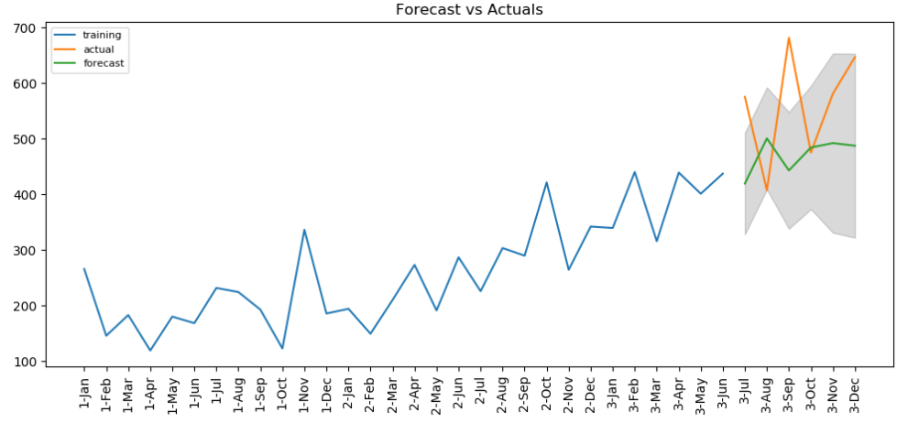
Base Model Forecasts VS Actuals
The upward trend is captured but the AIC value and the error values should be reduced.
The MAPE error of the base model is 0.211

Slide 12
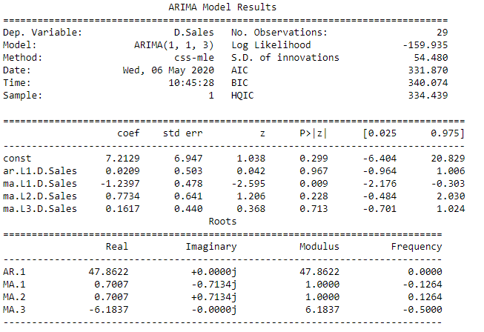
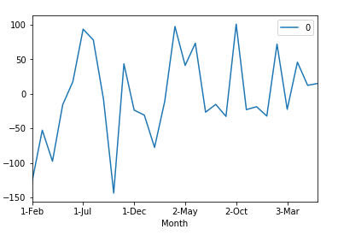
Final Model
The coefficients of the AR term is low but the MA terms are now very significant. The AIC value is 331 which is slightly less than the base model.
The residuals still have slight upward trend and the mean value is -2 which is closer to 0 compared to the base model.

Slide 13
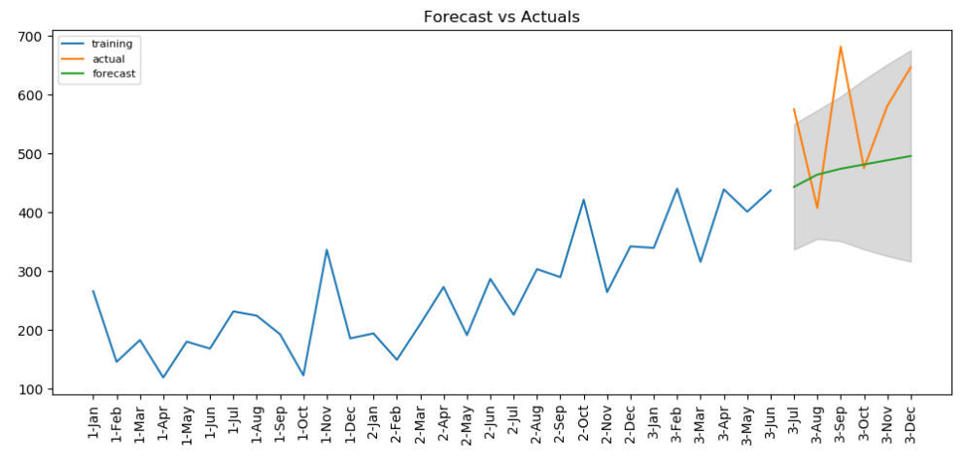
Final Model Forecasts VS Actuals
The upward trend is captured.
The MAPE error of the base model is 0.17.

Slide 14
Summary
This model can now be used to forecast the shampoo sales for any given period.
Applied exponential smoothing techniques to make the series stationary but first order differentiation worked better.
Areas of Improvement:
The MAPE error here is still 0.17 in the final model. This error can further be reduced.
Along with log transformation and rolling statistics other differentiation techniques can be explored.
The test statistic of the AR and MA can be improved to make it statistically significant.
Other algorithms like LSTM, Prophet can be used to optimize the forecasts.

