Slide 1
ONLINE MOVIE TICKET BOOKING SYSTEM
P.Preetham Babu
B.Teja Sai Varma
M.Ramesh
K.Mahesh Babu
T.Balaji Sai Kumar

Slide 2
Introduction:
E-ticket system is basically made for providing the customer an anytime and anywhere service for booking the seat in the cinema hall and to gather information about the movies online. The user can easily be able to know about the movies released and then make their choice.

Slide 3
Proposed System:
Customer can book the movie tickets by selecting the seats of his/her choice.
Customer can avail discounts by using premium membership cards.
Customer can pay for tickets online by credit card/Debit card.
customer can experience more flexibility to the system.

Slide 4
Goals of the system :
To provide anytime anyplace service to customer.
To minimize the number of staff at the ticket counter.
To promotes the film publicity through internet facilities.
To obtain statistic information from the booking records.

Slide 5
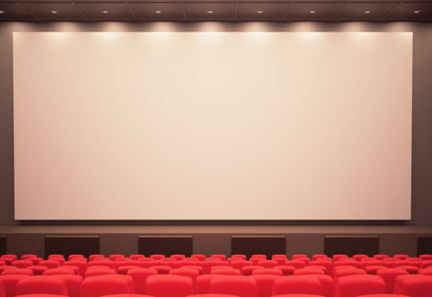
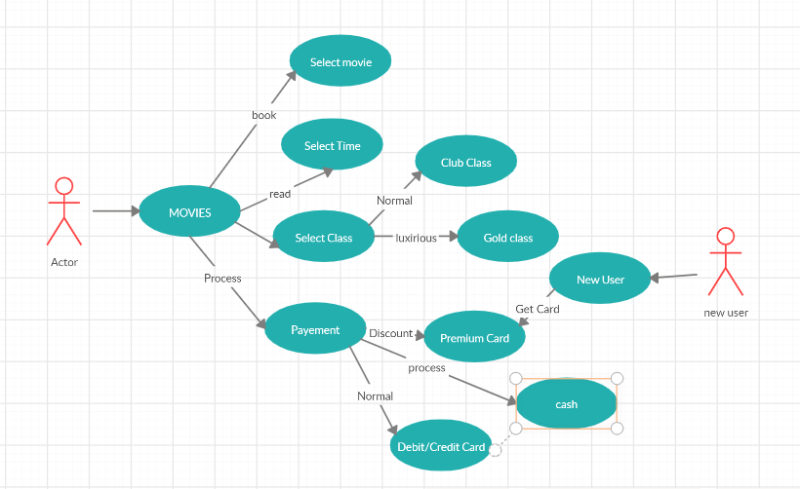

Slide 6
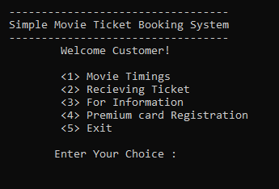
Home Page:

Slide 7
Our Features:
Simple Movie Ticket Booking System is based on a concept of recording and booking customer’s movie ticket details. Here the user can perform all the tasks like booking a movie show, receiving tickets, and card registration and view all movie show details. There’s no login system for this project. This project contains fewer features but the essentials ones.

Slide 8
Contd..
Talking about the features of the Simple Movie Ticket Booking System, a user can select any movie provided in the list. After selecting a show, he/she has to select timings, then the system asks for personal information which include Name, contact number. There are two types of seat class i.e. Normal class and Gold Class. For certain purpose, he/she can also make payment using the card. He/she has to provide card number, expiry date, and CVV. After that, the system automatically displays the final outcome which is the user’s bill. For the system, the user can also register DTCard from the system.

Slide 9
Contd..
This project uses classes and file handling features of C++. In order to store all the user’s data, an external file (DAT file) is created by the system, so every time we get into the system we can operate with the existing records. Simple Movie ticket booking System is developed using C++ Programming Language and different variables, strings have been used for the development of it. This project provides the simplest system for managing movie booking system.

Slide 10
SOFTWARE REQUIREMENTS
Language : C++ language IDE : Code Blocks or Dev C++
Operating system : Windows 7 and above

Slide 11
HARDWARE REQUIREMENTS
RAM : 128MB
Disc Space : 5GB
Processor : Intel i3 and above

Slide 12
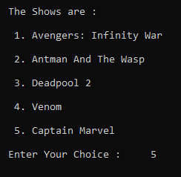
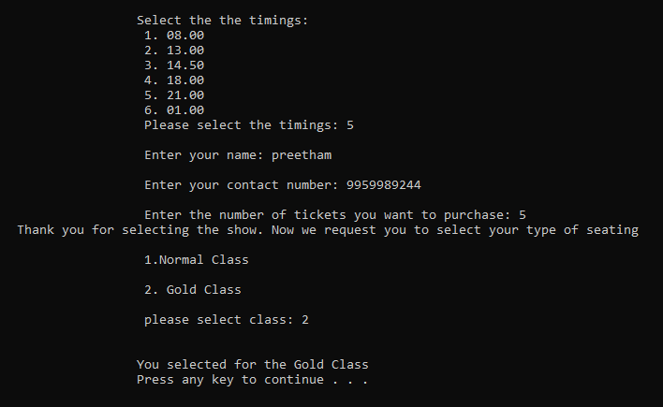
MOVIE TICKET BOOKING

Slide 13
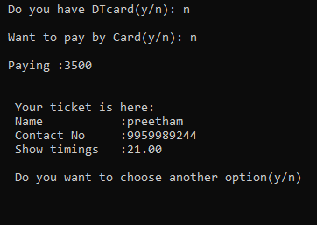

Slide 14
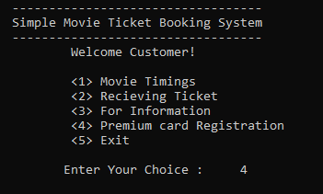
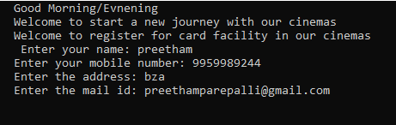
PREMIUM CARD REGISTRATION

Slide 15
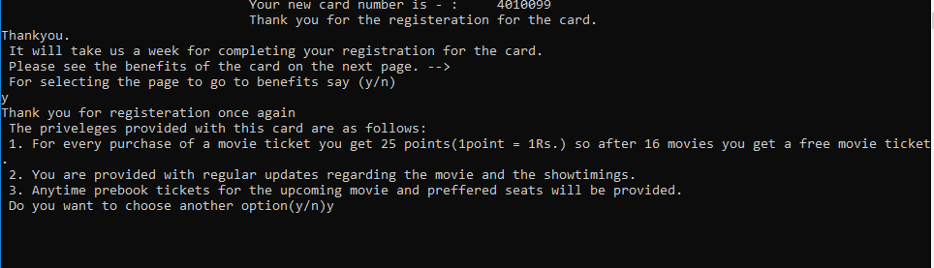

Slide 16
THE END

