Slide 1
Lecture 10
The Earley Algorithm
CS 4705

Slide 2
Dynamic Programming
Create table of solutions to sub-problems (e.g. subtrees) as parse proceeds
Look up subtrees for each constituent rather than re-parsing
Since all parses implicitly stored, all available for later disambiguation
Examples: Cocke-Younger-Kasami (CYK) (1960), Graham-Harrison-Ruzzo (GHR) (1980) and Earley (1970) algorithms
Notes:
Cocke-Younger-Kasami
Graham-Harrison-Ruzzo

Slide 3
Earley’s Algorithm
Uses dynamic programming to do parallel top-down search in (worst case) O(N³) time
First, L2R pass fills out a chart with N+1 states (N: the number of words in the input)
  Think of chart entries as sitting between words in the input string keeping track of states of the parse at these positions
  For each word position, chart contains set of states representing all partial parse trees generated to date. E.g. chart[0] contains all partial parse trees generated at the beginning of the sentence
Notes:
Dynamic programming makes top-down parsing tractable: from exponential to polynomial time algorithm

Slide 4
Chart entries represent three type of constituents:
  predicted constituents
  in-progress constituents
  completed constituents
Progress in parse represented by Dotted Rules
  Position of • indicates type of constituent
  ₀ Book ₁ that ₂ flight ₃
    S --> • VP, [0,0] (predicting VP)
    NP --> Det • Nom, [1,2] (finding NP)
    VP --> V NP •, [0,3] (found VP)
  [x,y] tells us where the state begins (x) and where the dot lies (y) wrt the input

Slide 5
₀ Book ₁ that ₂ flight ₃
S --> • VP, [0,0]
  First 0 means S constituent begins at the start of the input
  Second 0 means the dot here too
  So, this is a top-down prediction
NP --> Det • Nom, [1,2]
  the NP begins at position 1
  the dot is at position 2
  so, Det has been successfully parsed
  Nom predicted next

Slide 6
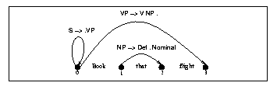
VP --> V NP •, [0,3]
  Successful VP parse of entire input

Slide 7
Successful Parse
Final answer found by looking at last entry in chart
If entry resembles S --> α • [0,N] then input parsed successfully
But note that chart will also contain a record of all possible parses of input string, given the grammar -- not just the successful one(s)

Slide 8
Parsing Procedure for the Earley Algorithm
Move through each set of states in order, applying one of three operators to each state:
  predictor: add predictions to the chart
  scanner: read input and add corresponding state to chart
  completer: move dot to right when new constituent found
Results (new states) added to current or next set of states in chart
No backtracking and no states removed: keep complete history of parse

Slide 9
Predictor
Intuition: new states represent top-down expectations
Applied when non part-of-speech non-terminals are to the right of a dot
  S --> • VP [0,0]
Adds new states to current chart
  One new state for each expansion of the non-terminal in the grammar
    VP --> • V [0,0]
    VP --> • V NP [0,0]

Slide 10
Scanner
New states for predicted part of speech.
Applicable when part of speech is to the right of a dot
  VP --> • V NP [0,0] ‘Book…’
Looks at current word in input
If match, adds state(s) to next chart
  VP --> V • NP [0,1]

Slide 11
Completer
Intuition: parser has discovered a constituent, so must find and advance states all that were waiting for this
Applied when dot has reached right end of rule
  NP --> Det Nom • [1,3]
Find all states w/dot at 1 and expecting an NP
  VP --> V • NP [0,1]
Adds new (completed) state(s) to current chart
  VP --> V NP • [0,3]

Slide 12
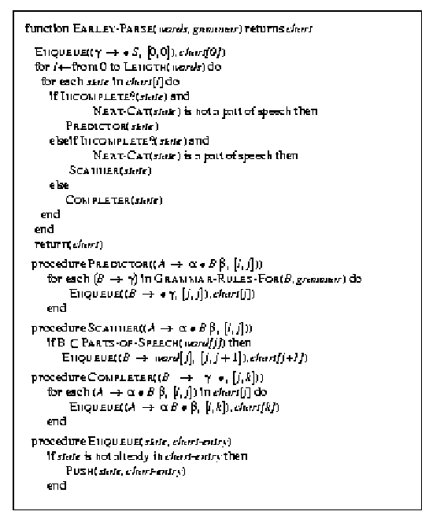
The Earley Algorithm

Slide 13
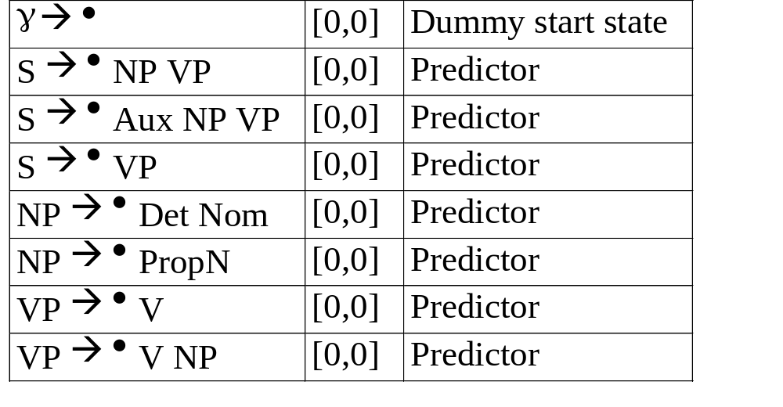
Book that flight (Chart [0])
Seed chart with top-down predictions for S from grammar

Slide 14
CFG for Fragment of English
S → NP VP
Det → that | this | a
S → Aux NP VP
N → book | flight | meal | money
S → VP
V → book | include | prefer
NP → Det Nom
Aux → does
Nom → N
Nom → N Nom
Prep →from | to | on
NP →PropN
PropN → Houston | TWA
VP → V
Nom → Nom PP
VP → V NP
PP → Prep NP

Slide 15
When dummy start state is processed, it’s passed to Predictor, which produces states representing every possible expansion of S, and adds these and every expansion of the left corners of these trees to bottom of Chart[0]
When VP --> • V, [0,0] is reached, Scanner called, which consults first word of input, Book, and adds first state to Chart[1], VP --> Book •, [0,0]
Note: When VP --> • V NP, [0,0] is reached in Chart[0], Scanner does not need to add VP --> Book •, [0,0] again to Chart[1]

Slide 16
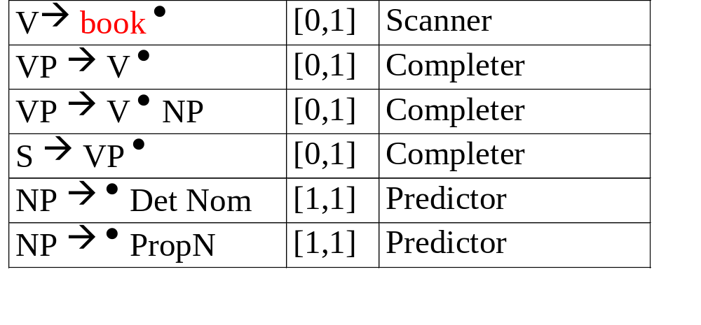
Chart[1]
V--> book • passed to Completer, which finds 2 states in Chart[0] whose left corner is V and adds them to Chart[1], moving dots to right
Notes:
Order of rules differs from text, since I believe the Completer finds all rules it can complete in Chart[0] before working on rules it’s adding in Chart[1]

Slide 17
When VP → V • is itself processed by the Completer, S → VP • is added to Chart[1] since VP is a left corner of S
Last 2 rules in Chart[1] are added by Predictor when VP → V • NP is processed
And so on….

Slide 18
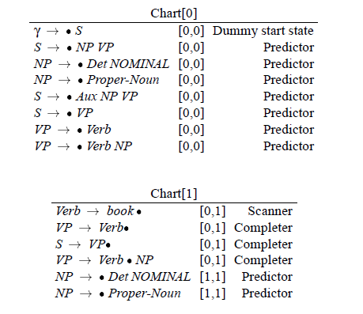

Slide 19
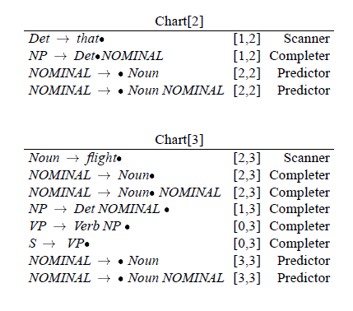

Slide 20
How do we retrieve the parses at the end?
Augment the Completer to add ptr to prior states it advances as a field in the current state
  I.e. what state did we advance here?
  Read the ptrs back from the final state

Slide 21
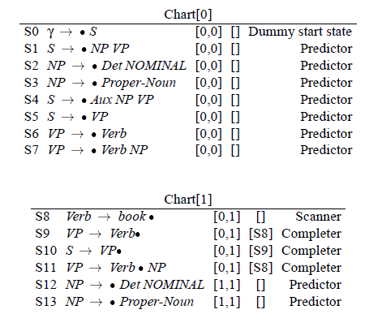

Slide 22
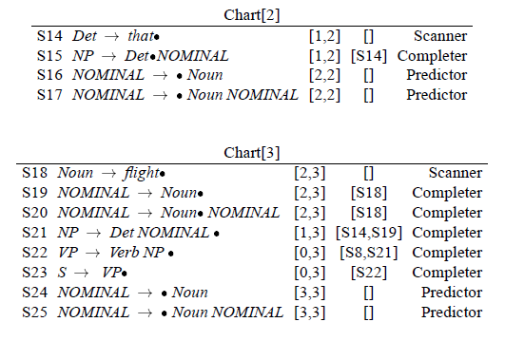

Slide 23
