Slide 1
11. FEATURES AND UNIFICATION
BİL711 Natural Language Processing

Slide 2
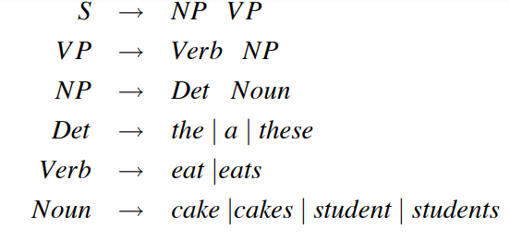
BİL711 Natural Language Processing

Slide 3
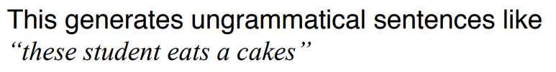
BİL711 Natural Language Processing

Slide 4
Problems with CFGs
We know that CFGs cannot handle certain things which are available in natural languages.
In particular, CFGs cannot handle very well:
  agreement
We will look at a constraint-based representation schema which will allow us to represent fine-grained information such as:
  number/person agreement
BİL711 Natural Language Processing

Slide 5
Agreement Problem
What is the problem with the following CFG rules:
S → NP VP
NP → Det NOMINAL
NP → Pronoun
Answer: Since these rules do not enforce number and person agreement constraints, they over-generate and allow the following constructs:
* They sleeps
* He sleep
* A dogs
* These dog
BİL711 Natural Language Processing

Slide 6
An Awkward Solution to Agreement Problem
One way to handle the agreement phenomena in a strictly context-free approach is to encode the constraints into the non-terminal categories and then into CFG rules.
For example, our grammar will be:
S → SgS | PlS
SgS → SgNP SgVP
PlS → PlNP PlVP
SgNP → SgDet SgNOMINAL
SgNP → SgPronoun
PlNP → PlDet PlNOMINAL
PlNP → PlPronoun
This solution will explode the number of non-terminals and rules. The resulting grammar will not be a clean grammar.
BİL711 Natural Language Processing

Slide 7
A Better Solution
A better solution for agreement and subcategorization problems is to treat terminals and non-terminals as complex objects with associated properties (called features) that can be manipulated.
So, we may code rules as follows: (not CF rules anymore)
S → NP VP Only if the number of the NP is equal to the number of the VP.
Where number of are features of NP and VP, and they are manipulated (they are checked to see whether they are equal or not) by the rule above.
BİL711 Natural Language Processing

Slide 8
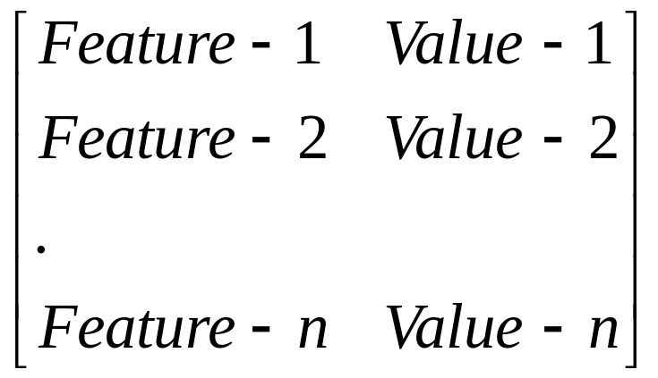
Feature Structures
We can encode the properties associated with grammatical constituents (terminals and non-terminals) by using Feature Structures.
A feature structure is a set of feature-value pairs.
  A feature is an atomic symbol.
  A value is either an atomic value or another feature structure.
A feature structure can be illustrated by a matrix-like diagram (called attribute-value matrix).
BİL711 Natural Language Processing

Slide 9

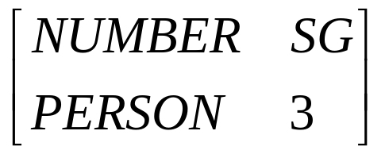
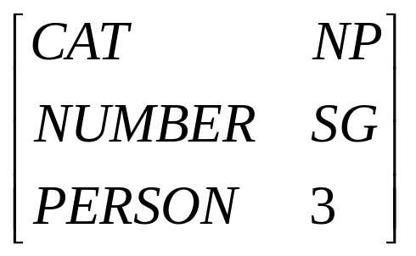
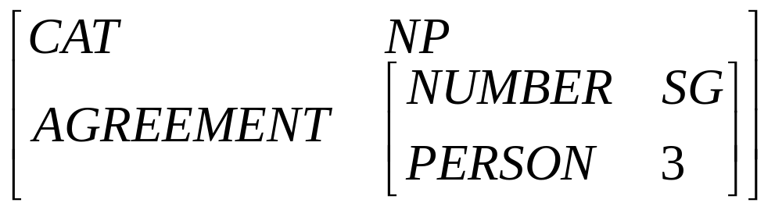
Example - Feature Structures
BİL711 Natural Language Processing

Slide 10
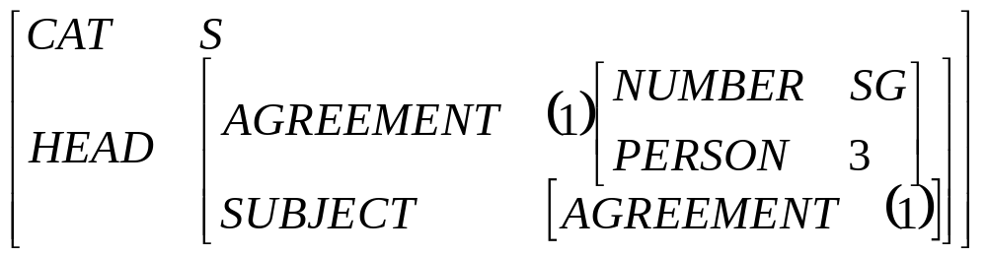
Reentrant Feature Structures
We will allow multiple features in a feature structure to share the same values.
They share the same structures not just that they have same value.
BİL711 Natural Language Processing

Slide 11
Feature Path
A feature path is a list of features through a feature structure leading to a particular value.
For example,
<HEAD AGREEMENT NUMBER> leads to SG
<HEAD SUBJECT AGREEMENT PERSON> leads to 3
We will use feature paths in the constraints of the rules.
S → NP VP
<NP AGREEMENT> = <VP AGREEMENT>
BİL711 Natural Language Processing

Slide 12
DAG Representation of Feature Structures
A feature structure can also be represented by using a DAG (directed acyclic graph).
• NP
CAT
•
AGREEMENT NUMBER • SG
•
PERSON • 3
BİL711 Natural Language Processing

Slide 13
DAG of A Reentrant Feature Structure
• S
CAT
• SG
•
NUMBER
HEAD
AGREEMENT
•
•
PERSON
• 3
SUBJECT
AGREEMENT
•
BİL711 Natural Language Processing

Slide 14
Unification of Feature Structures
By the unification of feature structures, we will:
  Check the compatibility of two feature structures.
  Merge the information in two feature structures.
The result of a unification operation of two feature structures can be:
  unifiable -- they will merge into a single feature structure
  fails -- if two feature structures are not compatible.
We will look at how does this unification process perform the above tasks.
BİL711 Natural Language Processing

Slide 15
Unification Example
We say that two feature structures can be unified if two feature structures that make them up are compatible.
succeeds
fails
Unification Operator
BİL711 Natural Language Processing

Slide 16
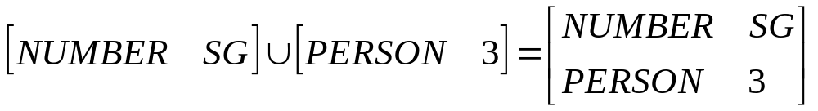
Unification Example (cont.)
The unification process can bind an undefined value to a value,
or can merge the information in two feature structures.
BİL711 Natural Language Processing

Slide 17
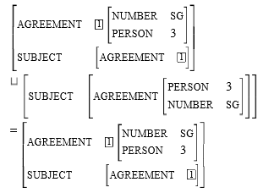
Unification Example -- Complex Structures
BİL711 Natural Language Processing

Slide 18
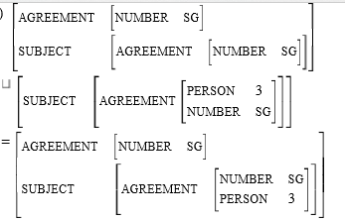
BİL711 Natural Language Processing

Slide 19
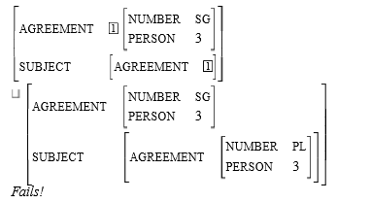
BİL711 Natural Language Processing

Slide 20
Feature Structures in The Grammar
We will incorporate the feature structures and the unification process as follows:
  All constituents (non-terminals) will be associated with feature structures.
  Sets of unification constraints will be associated with grammar rules, and these rules must be satisfied for the rule to be satisfied.
These attachments accomplish the following goals:
  To associate feature structures with both lexical items and instances of grammatical categories.
  To guide the composition of feature structures for larger grammatical constituents based on the feature structures of their component parts.
  To enforce compatibility constraints between specified parts of grammatical constraints.
BİL711 Natural Language Processing

Slide 21
Unification Constraints
Each grammar rule will be associated with a set of unification constraints.
β₀ → β₁ … β_{n} {set of unification constraints}
Each unification constraint will be in one of the following forms.
< β_{i} feature path> = Atomic value
< β_{i} feature path> = < β_{j} feature path>
BİL711 Natural Language Processing

Slide 22
Unification Constraints -- Example
For example, the following rule
S → NP VP
Only if the number of the NP is equal to the number of the VP.
will be represented as follows:
S → NP VP
<NP NUMBER> = <VP NUMBER>
BİL711 Natural Language Processing

Slide 23
Agreement Constraints
S → NP VP
<NP NUMBER> = <VP NUMBER>
S → Aux NP VP
<Aux AGREEMENT> = <NP AGREEMENT>
NP → Det NOMINAL
<Det AGREEMENT> = <NOMINAL AGREEMENT>
<NP AGREEMENT> = <NOMINAL AGREEMENT>
NOMINAL → Noun
<NOMINAL AGREEMENT> = <Noun AGREEMENT>
VP → Verb NP
<VP AGREEMENT> = <Verb AGREEMENT>
BİL711 Natural Language Processing

Slide 24
Agreement Constraints -- Lexicon Entries
Aux → does <Aux AGREEMENT NUMBER> = SG
<Aux AGREEMENT PERSON> = 3
Aux → do <Aux AGREEMENT NUMBER> = PL
Det → these <Det AGREEMENT NUMBER> = PL
Det → this <Det AGREEMENT NUMBER> = SG
Verb → serves <Verb AGREEMENT NUMBER> = SG
<Verb AGREEMENT PERSON> = 3
Verb → serve <Verb AGREEMENT NUMBER> = PL
Noun → flights <Noun AGREEMENT NUMBER> = PL
Noun → flight <Noun AGREEMENT NUMBER> = SG
BİL711 Natural Language Processing

Slide 25
Implementing Unification
Each feature structure will consists of two fields:
  Content Field -- This field can be NULL or may contain ordinary feature structure.
  Pointer Field -- This field can be NULL or may contain a pointer into another feature structure.
If the pointer field of a DAG is NULL, the content field of DAG contains the actual feature structure to be processed.
If the pointer field of a DAG is not NULL, the destination of that pointer represents the actual feature structure to be processed.
BİL711 Natural Language Processing

Slide 26
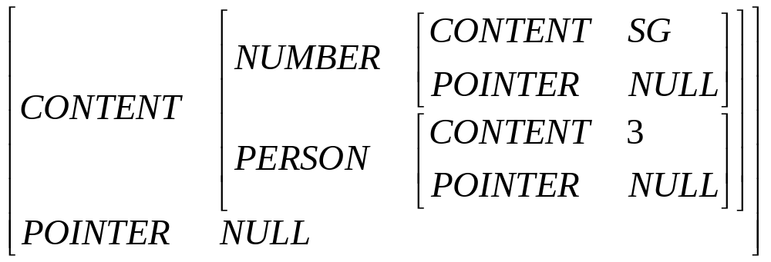
Extended Feature Structures
⇓
BİL711 Natural Language Processing

Slide 27
Extended DAG
•
SG
C
Num
•
•
P
C
•
Null
•
•
3
P
Per
C
•
Null
•
P
•
Null
BİL711 Natural Language Processing

Slide 28
Unification of Extended DAGs
•
SG
C
•
Num
•
C
P
•
•
Null
•
3
P
C
•
Null
•
Per
•
C
P
•
•
Null
P
•
Null
BİL711 Natural Language Processing

Slide 29
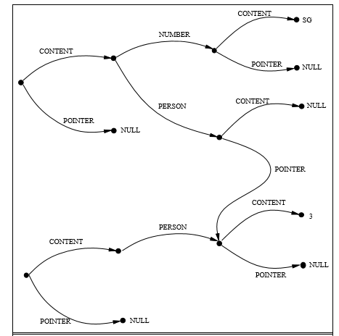
BİL711 Natural Language Processing

Slide 30
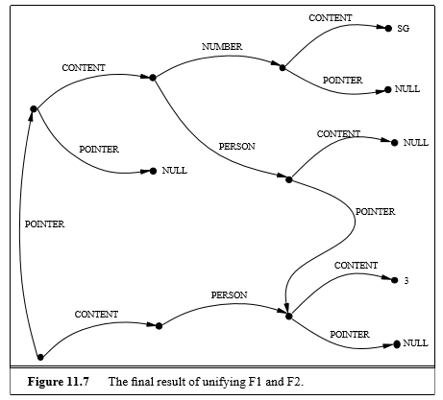
Final result of unification
BİL711 Natural Language Processing

Slide 31
Unification of Extended DAGs (cont.)
•
SG
C
•
Num
•
C
P
•
•
Null
Per
P
•
Null
•
Null
C
•
P
•
Null
P
•
3
C
•
Per
•
C
P
•
•
Null
P
•
Null
BİL711 Natural Language Processing

Slide 32
Unification Algorithm
function UNIFY(f1,f2) returns fstructure or failure
f1real ← real contents of f1 /* dereference f1 */
f2real ← real contents of f2 /* dereference f2 */
if f1real is Null then { f1.pointer ← f2; return f2; }
else if f2real is Null then { f2.pointer ← f1; return f1; }
else if f1real and f2real are identical then { f1.pointer ← f2; return f2; }
else if f1real and f2real are complex feature structures then
{ f2.pointer ← f1;
for each feature in f2real do
{ otherfeature ← Find or create a feature corresponding to feature in f1real;
if UNIFY(feature.value,otherfeature.value) returns failure then
return failure; }
return f1; }
else return failure;
BİL711 Natural Language Processing

Slide 33
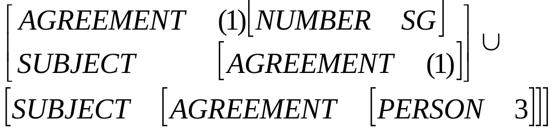
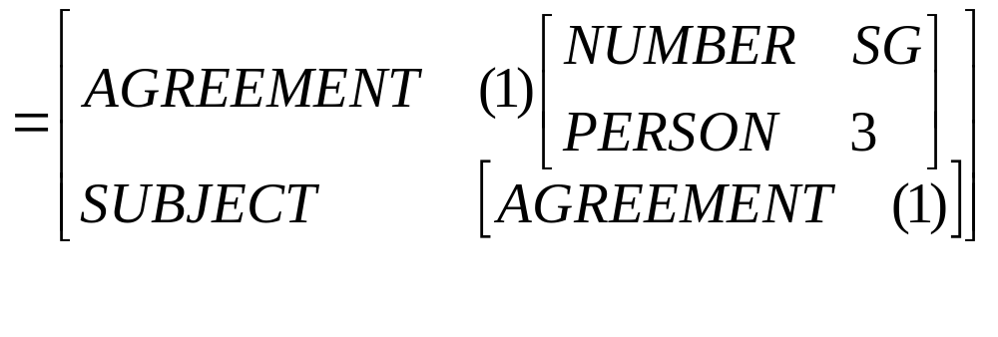
Example - Unification of Complex Structures
BİL711 Natural Language Processing

Slide 34
Example - Unification of Complex Structures (cont.)
•
C
•
Agr
•
C
•
Num
•
C
•
SG
•
Null
•
Null
•
Null
Sub
Per
•
C
•
•
C
•
Agr
•
C
•
Null
Null
•
Null
•
Null
•
C
•
Sub
•
C
•
Agr
•
C
•
Per
•
C
•
3
•
Null
•
Null
•
Null
•
Null
BİL711 Natural Language Processing

Slide 35
Parsing with Unification Constraints
Let us assume that we have augmented our grammar with sets of unification constraints.
What changes do we need to make a parser to make use of them?
  Building feature structures and associate them with sub-trees.
  Unifying feature structures when sub-trees are created.
  Blocking ill-formed constituents
BİL711 Natural Language Processing

Slide 36
Earley Parsing with Unification Constraints
What do we have to do to integrate unification constraints with Earley Parser?
  Building feature structures (represented as DAGs) and associate them with states in the chart.
  Unifying feature structures as states are advanced in the chart.
  Blocking ill-formed states from entering the chart.
The main change will be in COMPLETER function of Earley Parser. This routine will invoke the unifier to unify two feature structures.
BİL711 Natural Language Processing

Slide 37
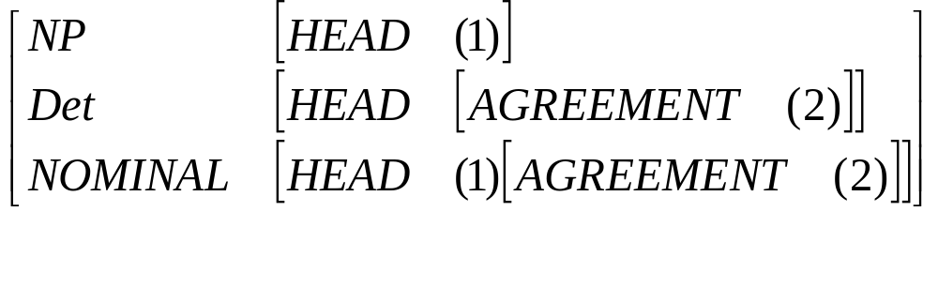
Building Feature Structures
NP → Det NOMINAL
<Det HEAD AGREEMENT> = <NOMINAL HEAD AGREEMENT>
<NP HEAD> = <NOMINAL HEAD>
corresponds to
BİL711 Natural Language Processing

Slide 38
Augmenting States with DAGs
Each state will have an additional field to contain the DAG representing the feature structure corresponding to the state.
When a rule is first used by PREDICTOR to create a state, the DAG associated with the state will simply consist of the DAG retrieved from the rule.
For example,
S → • NP VP, [0,0],[],Dag₁
where Dag₁ is the feature structure corresponding to S → NP VP.
NP → • Det NOMINAL, [0,0],[],Dag₂
where Dag₂ is the feature structure corresponding to S → Det NOMINAL.
BİL711 Natural Language Processing

Slide 39
What does COMPLETER do?
When COMPLETER advances the dot in a state, it should unify the feature structure of the newly completed state with the appropriate part of the feature structure being advanced.
If this unification process is succesful, the new state gets the result of the unification as its DAG, and this new state is entered into the chart. If it fails, nothing is entered into the chart.
BİL711 Natural Language Processing

Slide 40
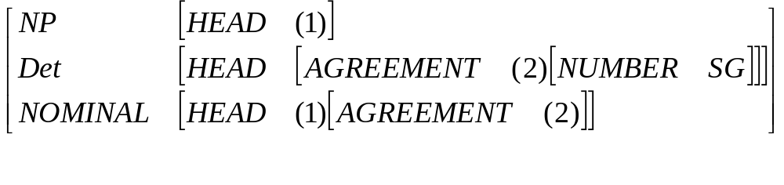
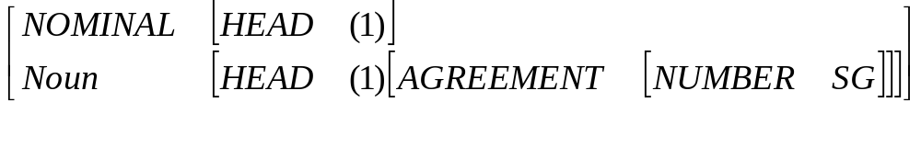
A Completion Example
Parsing the phrase that flight after that is processed.
NP → Det • NOMINAL, [0,1],[SDet],Dag₁
Dag₁
A newly completed state
NOMINAL → Noun •, [1,2],[SNoun],Dag₂
Dag₂
To advance in NP, the parser unifies the feature structure found under
the NOMINAL feature of Dag2, with the feature structure found under
the NOMINAL feature of Dag1.
BİL711 Natural Language Processing

Slide 41
Earley Parse
function EARLEY-PARSE(words,grammar) returns chart
ENQUEUE((γ → • S, [0,0], chart[0],dagγ)
for i from 0 to LENGTH(words) do
for each state in chart[i] do
if INCOMPLETE?(state) and NEXT-CAT(state) is not a PS then
PREDICTOR(state)
elseif INCOMPLETE?(state) and NEXT-CAT(state) is a PS then
SCANNER(state)
else
COMPLETER(state)
end
end
return(chart)
BİL711 Natural Language Processing

Slide 42
Predictor and Scanner
procedure PREDICTOR((A → α • B β, [i,j],dagA))
for each (B → γ) in GRAMMAR-RULES-FOR(B,grammar) do
ENQUEUE((B → • γ, [i,j],dagB), chart[j])
end
procedure SCANNER((A → α • B β, [i,j],dagA))
if (B ∈ PARTS-OF-SPEECH(word[j]) then
ENQUEUE((B → word[j] • , [j,j+1],dagB), chart[j+1])
end
BİL711 Natural Language Processing

Slide 43
Completer and UnifyStates
procedure COMPLETER((B → γ • , [j,k],dagB))
for each (A → α • B β, [i,j],dagA) in chart[j] do
if newdag ← UNIFY-STATES(dagB,dagA,B) ≠ fails then ENQUEUE((A → α B • β, [i,k],newdag), chart[k])
end
procedure UNIFY-STATES(dag1,dag2,cat)
dag1cp ← CopyDag(dag1);
dag2cp ← CopyDag(dag2);
UNIFY(FollowPath(cat,dag1cp),FollowPath(cat,dag2cp));
end
BİL711 Natural Language Processing

Slide 44
Enqueue
procedure ENQUEUE(state,chart-entry)
if state is not subsumed by a state in chart-entry then
Add state at the end of chart-entry
end
BİL711 Natural Language Processing

