Slide 1
UNIT-II
N-Grams

Slide 2
Word prediction
Some Applications-
1. speech recognition
2. hand-writing recognition
3. augmentative communication for the disabled
4. spelling error detection

Slide 3
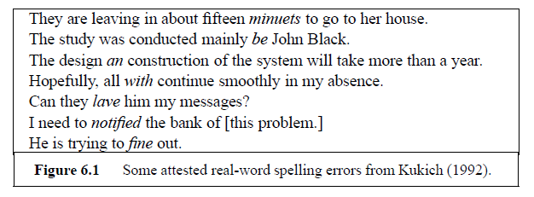
Real-word errors
Probability of 3 words:
they lave him, to fine out
Probability of these 3 words is low

Slide 4
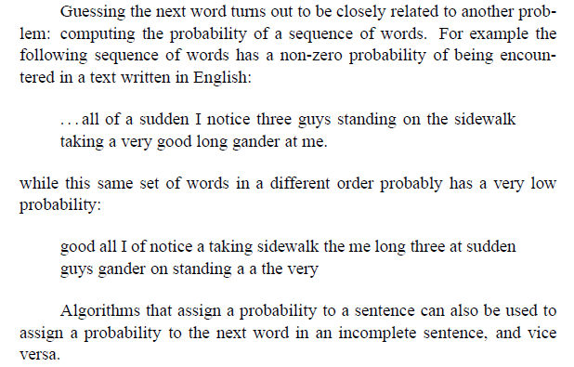

Slide 5
N-Grams
The big red dog
Unigrams: P(dog)
Bigrams: P(dog|red)
Trigrams: P(dog|big red)
Four-grams: P(dog|the big red)
In general, we’ll be dealing with
P(Word| Some fixed prefix)

Slide 6
Berkeley Restaurant Project Sentences
A speech understand system
Berkeley Restaurant Project: speech-based restaurant consultant
Users ask questions about restaurant in Berkeley, California
System displays appropriate information from a database of local restaurants

Slide 7
Berkeley Restaurant Project Sentences
Can you tell me about any good Cantonese restaurants close by
Mid priced thai food is what i’m looking for
Can you give me a listing of the kinds of food that are available
I’m looking for a good place to eat breakfast
When is caffe venezia open during the day
Speech and Language Processing - Jurafsky and Martin

Slide 8
A Simple Example
  P(I want to eat Chinese food) = P(I | <start>) P(want | I) P(to | want) P(eat | to) P(Chinese | eat) P(food | Chinese)

Slide 9
<start> I
.25
want some
.04
<start> I’d
.06
want Thai
.01
<start> Tell
.04
to eat
.26
<start> I’m
.02
to have
.14
I want
.32
to spend
.09
I would
.29
to be
.02
I don’t
.08
British food
.60
I have
.04
British restaurant
.15
want to
.65
British cuisine
.01
want a
.05
British lunch
.01

Slide 10
P(I want to eat British food) = P(I|<start>) P(want|I) P(to|want) P(eat|to) P(British|eat) P(food|British) = .25*.32*.65*.26*.001*.60 = .000080
vs. I want to eat Chinese food = .00015
  eat is often followed by an NP
  British food is not too popular

Slide 11
Counting words in corpus
  He stepped out into the hall, was delighted to encounter a water brother.
    13 tokens, 15 if we include “,” and “.” as separate tokens.
Speech and Language Processing - Jurafsky and Martin

Slide 12
Counting
Not always that simple
  I do uh main- mainly business data processing
Spoken language poses various challenges.
  Should we count “uh” , “um” and other fillers as tokens?
  Uh: is used when they know what they want to say, but searching for the exact word to express it.
  Um: when speakers are having major planning problems in producing an utterance.
  What about the repetition of “mainly”? Should such do-covers count twice or just once?
Speech and Language Processing - Jurafsky and Martin

Slide 13
Counting: Types and Tokens
They picnicked by the pool, then lay back on the grass and looked at the stars.
    18 tokens (again counting punctuation)
    only 16 types
In going forward, we’ll sometimes count types and sometimes tokens
Speech and Language Processing - Jurafsky and Martin

Slide 14
Terminology
Sentence: unit of written language
Utterance: unit of spoken language
Types: number of distinct words in a corpus (vocabulary size)
Tokens: total number of words

Slide 15
Corpora
Corpora are online collections of text and speech
  Brown Corpus
  Wall Street Journal
  AP news
  Hansards
  DARPA/NIST text/speech corpora (Call Home, ATIS, switchboard, Broadcast News, TDT, Communicator)
  TRAINS, Radio News

Slide 16
Language Modeling
Simplest Model:
Any word can follow any other word.
Slightly complex model:
based on the frequency of occurrence.
Chain rule:
Speech and Language Processing - Jurafsky and Martin

Slide 17
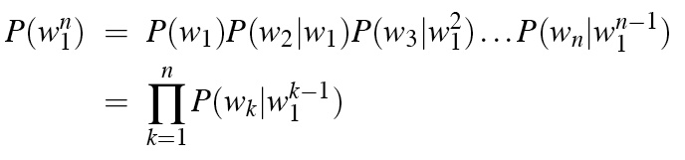
The Chain Rule
P(its water was so transparent)=
P(its)*
P(water|its)*
P(was|its water)*
P(so|its water was)*
P(transparent|its water was so)
Speech and Language Processing - Jurafsky and Martin

Slide 18
Unfortunately
That doesn’t help since its unlikely we’ll ever gather the right statistics for the prefixes.

Slide 19
Markov Assumption
Assume that the entire prefix history isn’t necessary.
In other words, an event doesn’t depend on all of its history, just a fixed length near history

Slide 20
Berkeley Restaurant Project Sentences
Can you tell me about any good Cantonese restaurants close by
Mid priced thai food is what i’m looking for
Can you give me a listing of the kinds of food that are available
I’m looking for a good place to eat breakfast
When is caffe venezia open during the day
Speech and Language Processing - Jurafsky and Martin

Slide 21
A Bigram Grammar Fragment from BERP
eat on
.16
eat Thai
.03
eat some
.06
eat breakfast
.03
eat lunch
.06
eat in
.02
eat dinner
.05
eat Chinese
.02
eat at
.04
eat Mexican
.02
eat a
.04
eat tomorrow
.01
eat Indian
.04
eat dessert
.007
eat today
.03
eat British
.001

Slide 22
<start> I
.25
want some
.04
<start> I’d
.06
want Thai
.01
<start> Tell
.04
to eat
.26
<start> I’m
.02
to have
.14
I want
.32
to spend
.09
I would
.29
to be
.02
I don’t
.08
British food
.60
I have
.04
British restaurant
.15
want to
.65
British cuisine
.01
want a
.05
British lunch
.01

Slide 23
P(I want to eat British food) = P(I|<start>) P(want|I) P(to|want) P(eat|to) P(British|eat) P(food|British) = .25*.32*.65*.26*.001*.60 = .000080
vs. I want to eat Chinese food = .00015
  eat is often followed by an NP
  British food is not too popular

Slide 24
How do we get the N-gram probabilities?
N-gram models can be trained by counting and normalization

Slide 25
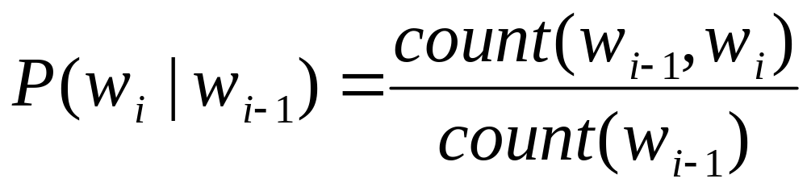
Estimating Bigram Probabilities
The Maximum Likelihood Estimate (MLE)
Speech and Language Processing - Jurafsky and Martin

Slide 26
BERP Bigram Counts
I
want
to
eat
Chinese
food
lunch
I
8
1087
0
13
0
0
0
want
3
0
786
0
6
8
6
to
3
0
10
860
3
0
12
eat
0
0
2
0
19
2
52
Chinese
2
0
0
0
0
120
1
food
19
0
17
0
0
0
0
lunch
4
0
0
0
0
1
0
Notes:
I want occurred 1087 times

Slide 27
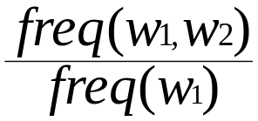
BERP Bigram Probabilities
Normalization: divide each row's counts by appropriate unigram counts for w_{n-1}
Computing the bigram probability of I I
  C(I,I)/C(all I)
  p (I|I) = 8 / 3437 = .0023
Maximum Likelihood Estimation (MLE): relative frequency of e.g.
I
want
to
eat
Chinese
food
lunch
3437
1215
3256
938
213
1506
459

Slide 28
BERP Table: Bigram Probabilities

Slide 29
What do we learn about the language?
What's being captured with ...
  P(want | I) = .32
  P(to | want) = .65
  P(eat | to) = .26
  P(food | Chinese) = .56
  P(lunch | eat) = .055
What about...
  P(I | I) = .0023
  P(I | want) = .0025
  P(I | food) = .013

Slide 30
  P(I | I) = .0023 I I I I want
  P(I | want) = .0025 I want I want
  P(I | food) = .013 the kind of food I want is ...

Slide 31
Add-One (Laplace)
Make the zero counts 1.
Rationale: They’re just events you haven’t seen yet. If you had seen them, chances are you would only have seen them once… so make the count equal to 1.

Slide 32
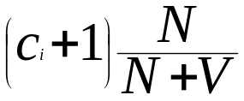
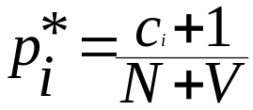
Add-one Smoothing
For unigrams:
  Add 1 to every word (type) count
  Normalize by N (tokens) /(N (tokens) +V (types))
  Smoothed count (adjusted for additions to N) is
  Normalize by N to get the new unigram probability:

Slide 33


For bigrams:
  Add 1 to every biagram c(w_{n-1} w_{n}) + 1
  Incr unigram count by vocabulary size c(w_{n-1}) + V
  _{Smoothed Probability:}
  _{Smoothed count:}

Slide 34
Original BERP Counts

Slide 35
BERP Table: Bigram Probabilities

Slide 36
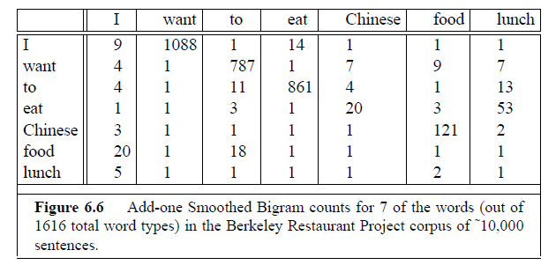
Updated count(after adding ONE)

Slide 37
BERP After Add-One
Was .65

Slide 38
Add-One Smoothed BERP
COUNT Reconstituted

Slide 39
  Discount: ratio of new counts to old (e.g. add-one smoothing changes the BERP count (to|want) from 786 to 331 (d_{c}=.42) and p(to|want) from .65 to .28)
  Problem: add one smoothing changes counts drastically:
    too much weight given to unseen ngrams
    in practice, unsmoothed bigrams often work better!

Slide 40
Smoothing
Smoothing is the task of adjusting the maximum likelihood estimate of probabilities to produce more accurate probabilities.
The name comes from the fact that these techniques tend to make distributions more uniform, by adjusting low probabilities such as zero probabilities upward, and high probabilities downward.
Smoothing not only prevents zero probabilities, attempts to improves the accuracy of the model as a whole.

Slide 41
Concept of “Discounting”
This concept is the central idea in all smoothing algorithms.
To assign some probability mass to unseen event, we need to take away some probability mass from seen events
Discounting is the lowering each non-zero count c to c* according the smoothing algorithm

Slide 42
Add-one smoothing(Laplace Correction) – Observations and shortcomings
It makes a very big change to the counts. For example, C(want to) changed from 786 to 331.
The sharp change in counts and probabilities occurs because too much probability mass is moved to all the zeros. (can be avoided by adding smaller values to the counts).
Add-one is much worse at predicting the actual probability for bigrams with zero counts.

Slide 43
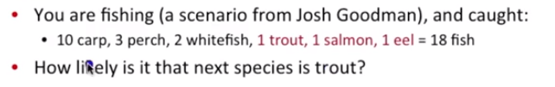
General example
Speech and Language Processing - Jurafsky and Martin

Slide 44
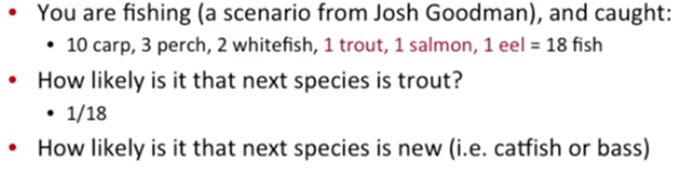
Speech and Language Processing - Jurafsky and Martin

Slide 45
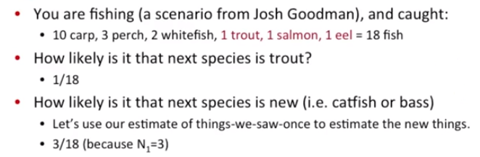
Speech and Language Processing - Jurafsky and Martin

Slide 46
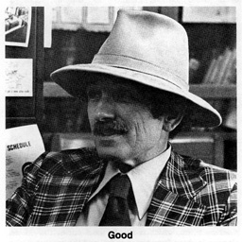
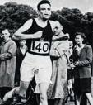
Better Smoothing
Intuition used by many smoothing algorithms
  Good-Turing
  Kneser-Ney
  Witten-Bell
Is to use the count of things we’ve seen once to help estimate the count of things we’ve never seen
Speech and Language Processing - Jurafsky and Martin

Slide 47
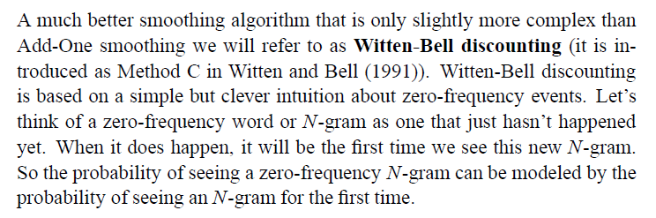

Witten Bell Discounting
Speech and Language Processing - Jurafsky and Martin

Slide 48
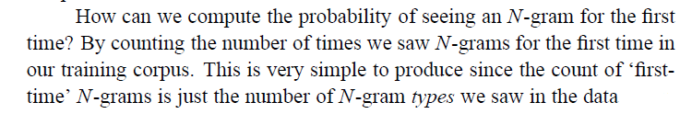
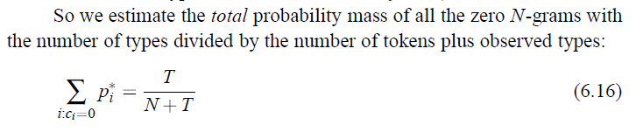
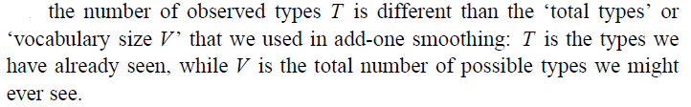
Unigram Probaility
Speech and Language Processing - Jurafsky and Martin

Slide 49
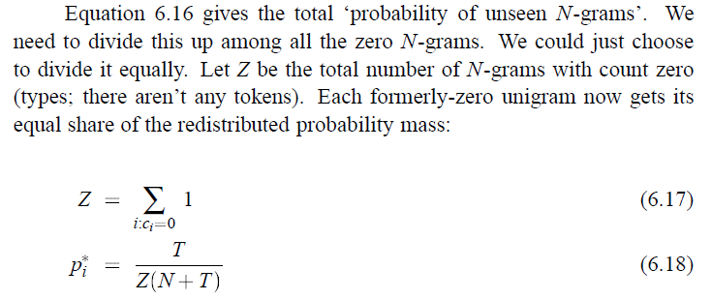
Speech and Language Processing - Jurafsky and Martin

Slide 50
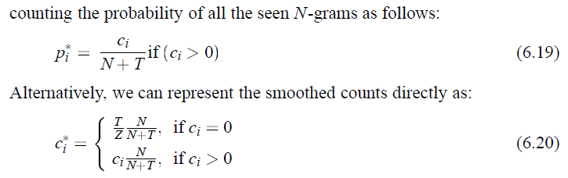
Speech and Language Processing - Jurafsky and Martin

Slide 51
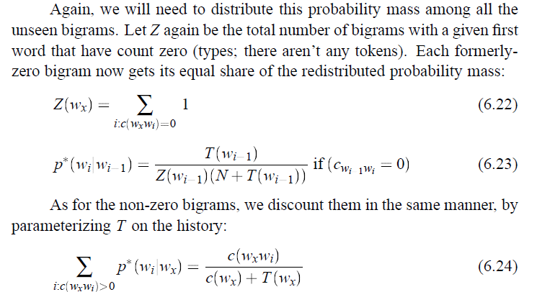
Bigram Probability

Slide 52

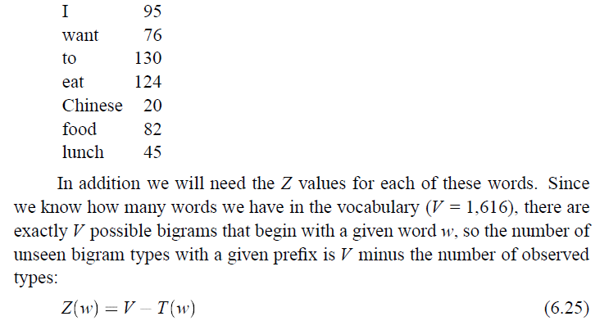

Slide 53
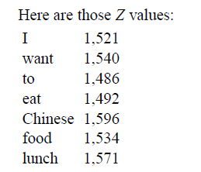
Number of Tokens, N=32268

Slide 54
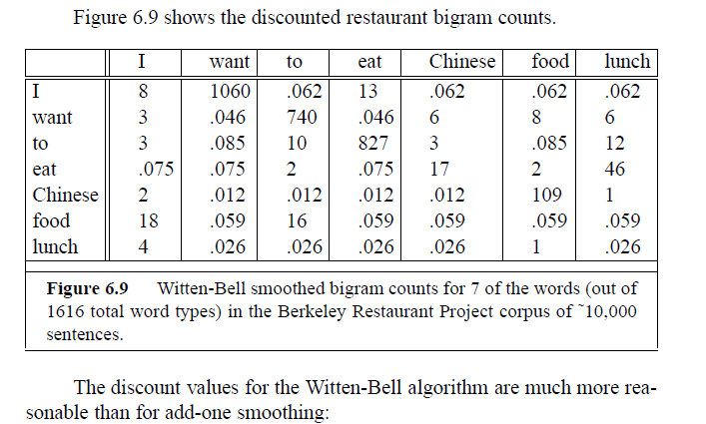

Slide 55
Good-Turing
Josh Goodman Intuition
Imagine you are fishing
  There are 8 species: carp, perch, whitefish, trout, salmon, eel, catfish, bass
You have caught
  10 carp, 3 perch, 2 whitefish, 1 trout, 1 salmon, 1 eel = 18 fish
How likely is it that the next fish caught is from a new species (one not seen in our previous catch)?
  3/18
Assuming so, how likely is it that next species is trout?
  Must be less than 1/18
Slide adapted from Josh Goodman
Speech and Language Processing - Jurafsky and Martin

Slide 56

Good-Turing
Notation: N_{x} is the frequency-of-frequency-x
  So N₁₀=1
    Number of fish species seen 10 times is 1 (carp)
  N₁=3
    Number of fish species seen 1 is 3 (trout, salmon, eel)
To estimate total number of unseen species
  Use number of species (words) we’ve seen once
  c₀* =c₁ p₀ = N₁/N
All other estimates are adjusted (down) to give probabilities for unseen
Slide from Josh Goodman
Speech and Language Processing - Jurafsky and Martin

Slide 57

Good-Turing Intuition
Notation: N_{x} is the frequency-of-frequency-x
  So N₁₀=1, N₁=3, etc
To estimate total number of unseen species
  Use number of species (words) we’ve seen once
  c₀* =c₁ p₀ = N₁/N p₀=N₁/N=3/18
All other estimates are adjusted (down) to give probabilities for unseen
P(eel) = c*(1) = (1+1) 1/ 3 = 2/3
Slide from Josh Goodman
Speech and Language Processing - Jurafsky and Martin

Slide 58
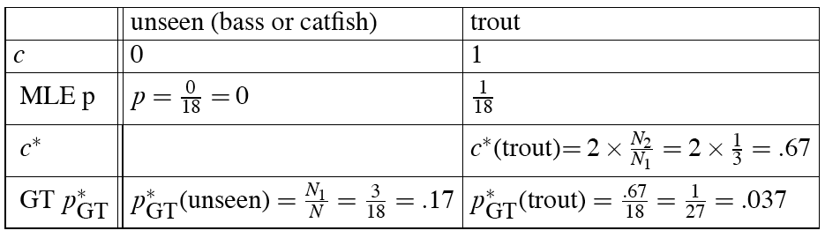
GT Fish Example
Speech and Language Processing - Jurafsky and Martin

Slide 59
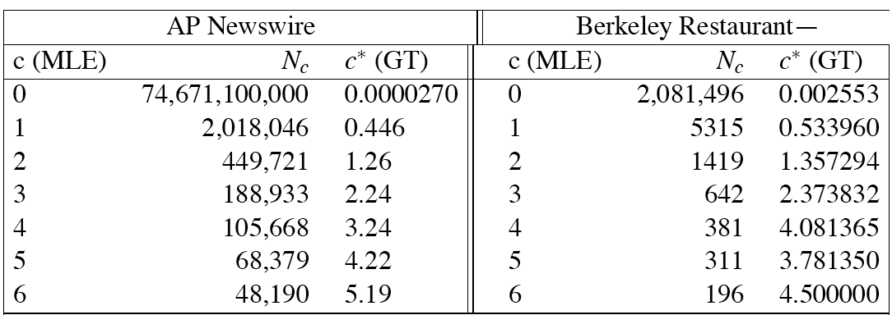
Bigram Frequencies of Frequencies and
GT Re-estimates
Speech and Language Processing - Jurafsky and Martin

Slide 60

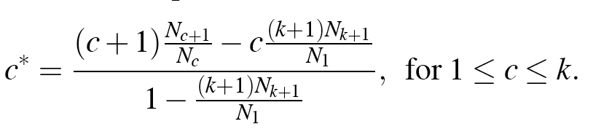
Complications
In practice, assume large counts (c>k for some k) are reliable:
That complicates c*, making it:
Also: we assume singleton counts c=1 are unreliable, so treat N-grams with count of 1 as if they were count=0
Also, need the Nk to be non-zero, so we need to smooth (interpolate) the Nk counts before computing c* from them
Speech and Language Processing - Jurafsky and Martin

Slide 61
Backoff and Interpolation
Another really useful source of knowledge
If we are estimating:
  trigram p(z|x,y)
  but count(xyz) is zero
Use info from:
  Bigram p(z|y)
Or even:
  Unigram p(z)
How to combine this trigram, bigram, unigram info in a valid fashion?
Speech and Language Processing - Jurafsky and Martin

Slide 62
Backoff Vs. Interpolation
Backoff: use trigram if you have it, otherwise bigram, otherwise unigram
Interpolation: mix all three
Speech and Language Processing - Jurafsky and Martin

Slide 63
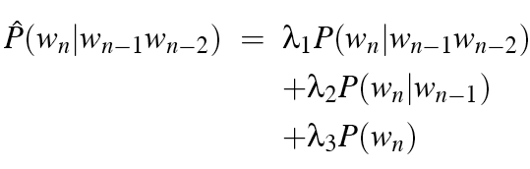

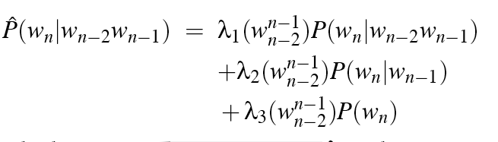
Interpolation
Simple interpolation
Lambdas conditional on context:
Speech and Language Processing - Jurafsky and Martin

Slide 64
How to Set the Lambdas?
Use a held-out, or development, corpus
Choose lambdas which maximize the probability of some held-out data
  I.e. fix the N-gram probabilities
  Then search for lambda values
  That when plugged into previous equation
  Give largest probability for held-out set
  Can use EM to do this search
Speech and Language Processing - Jurafsky and Martin

Slide 65
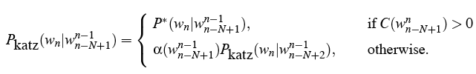
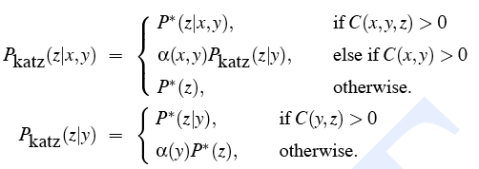
Katz Backoff
Speech and Language Processing - Jurafsky and Martin

Slide 66


Why discounts P* and alpha?
MLE probabilities sum to 1
So if we used MLE probabilities but backed off to lower order model when MLE prob is zero
We would be adding extra probability mass
And total probability would be greater than 1
Speech and Language Processing - Jurafsky and Martin

Slide 67
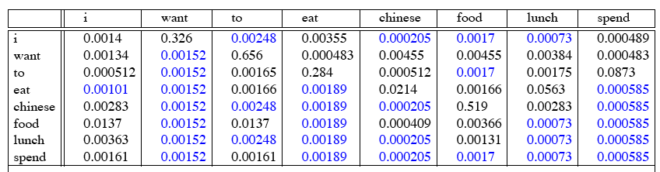
GT Smoothed Bigram
Probabilities
Speech and Language Processing - Jurafsky and Martin

Slide 68
Intuition of Backoff+Discounting
How much probability to assign to all the zero trigrams?
  Use GT or other discounting algorithm to tell us
How to divide that probability mass among different contexts?
  Use the N-1 gram estimates to tell us
What do we do for the unigram words not seen in training?
  Out Of Vocabulary = OOV words
Speech and Language Processing - Jurafsky and Martin

Slide 69
OOV words: <UNK> word
Out Of Vocabulary = OOV words
We don’t use GT smoothing for these
  Because GT assumes we know the number of unseen events
Instead: create an unknown word token <UNK>
  Training of <UNK> probabilities
    Create a fixed lexicon L of size V
    At text normalization phase, any training word not in L changed to <UNK>
    Now we train its probabilities like a normal word
  At decoding time
    If text input: Use UNK probabilities for any word not in training
Speech and Language Processing - Jurafsky and Martin

Slide 70
Practical Issues
We do everything in log space
  Avoid underflow
  (also adding is faster than multiplying)
Speech and Language Processing - Jurafsky and Martin

Slide 71
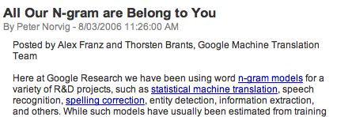

Google N-Gram Release
Speech and Language Processing - Jurafsky and Martin

Slide 72
Google N-Gram Release
serve as the incoming 92
serve as the incubator 99
serve as the independent 794
serve as the index 223
serve as the indication 72
serve as the indicator 120
serve as the indicators 45
serve as the indispensable 111
serve as the indispensible 40
serve as the individual 234
Speech and Language Processing - Jurafsky and Martin

Slide 73
Google Caveat
Remember the lesson about test sets and training sets... Test sets should be similar to the training set (drawn from the same distribution) for the probabilities to be meaningful.
So... The Google corpus is fine if your application deals with arbitrary English text on the Web.
If not then a smaller domain specific corpus is likely to yield better results.
Speech and Language Processing - Jurafsky and Martin

Slide 74
Summary
N-gram probabilities can be used to estimate the likelihood
  Of a word occurring in a context (N-1)
  Of a sentence occurring at all
Smoothing techniques deal with problems of unseen words in a corpus

