Slide 1
Chapetr-8
Part-of-Speech Tagging

Slide 2
Part-of-Speech Tagging
Taggers play an important role in speech recognition, natural language parsing and information retrieval.
The input to a tagging algorithm is a string of words and a specified tagset. The output is a single best tag for each word.
Word Classes and POS Tagging

Slide 3
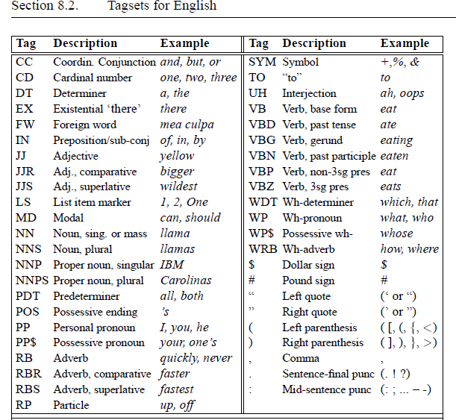
Tagsets for English
Word Classes and POS Tagging

Slide 4
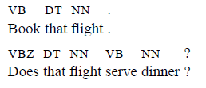
Word Classes and POS Tagging

Slide 5
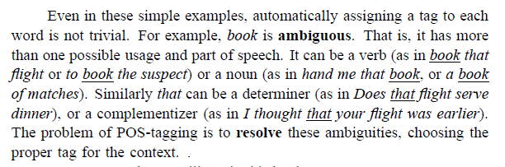
Word Classes and POS Tagging

Slide 6

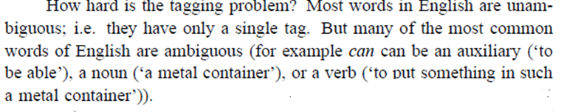
Word Classes and POS Tagging

Slide 7
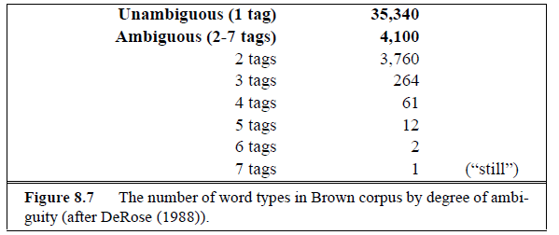
Word Classes and POS Tagging

Slide 8
Types of PoS Tagging
Rule-based PoS tagging
Stochastic PoS tagging
Transformation-based PoS tagging
Word Classes and POS Tagging

Slide 9
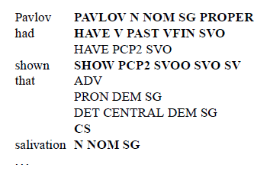
1. Rule-based PoS tagging
ENGTWOL tagger: automatically assigning tags algorithm (in 1995)
Two stage architecture.
1st stage output:
Word Classes and POS Tagging

Slide 10
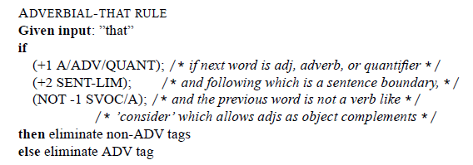
2nd stage constraints:
Word Classes and POS Tagging

Slide 11


HMM Part-of-Speech Tagging
Word Classes and POS Tagging

Slide 12
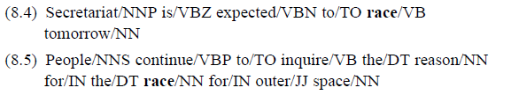
Example
Word Classes and POS Tagging

Slide 13
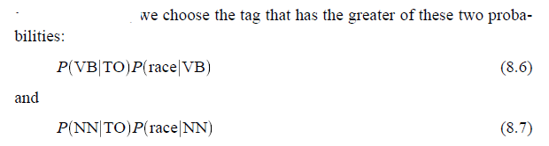



Word Classes and POS Tagging

Slide 14

3. Transformation based tagging
Stochastic tagging
Rule based tagging
Word Classes and POS Tagging

Slide 15
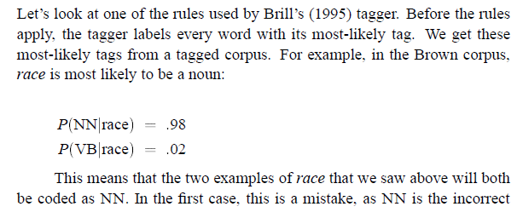
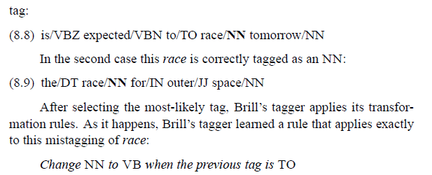
How TBL rules are applied
Word Classes and POS Tagging

Slide 16
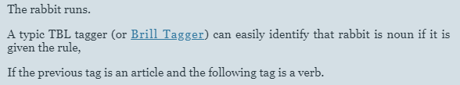
Word Classes and POS Tagging

Slide 17
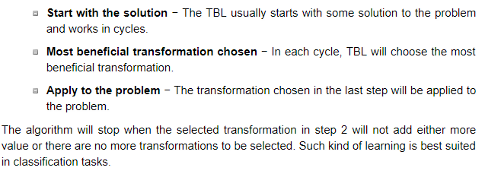
Procedure
Word Classes and POS Tagging

Slide 18
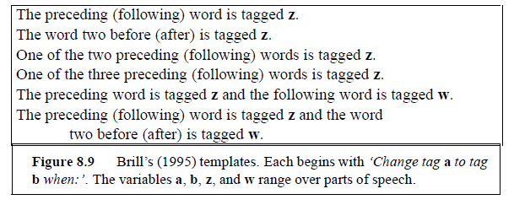
Rules template
Word Classes and POS Tagging

Slide 19
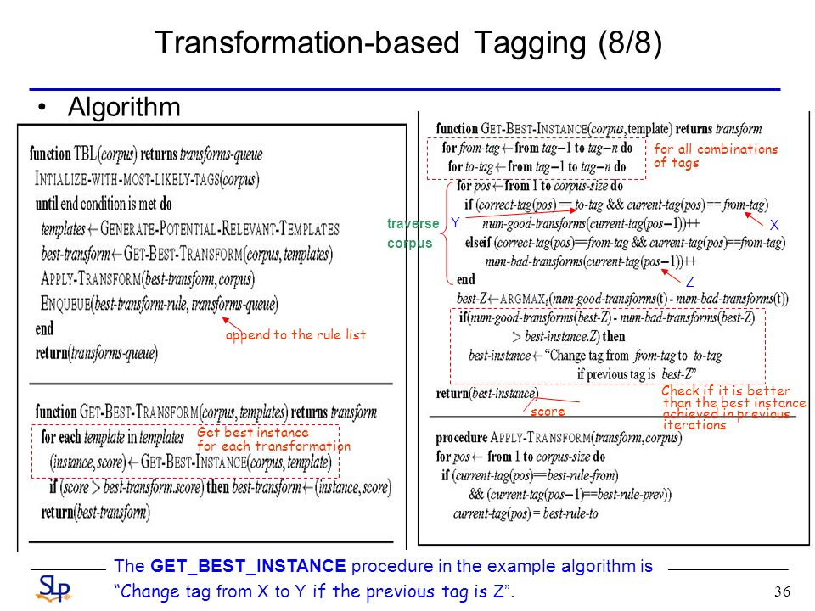
Transformation-Based Tagging
Word Classes and POS Tagging

Slide 20
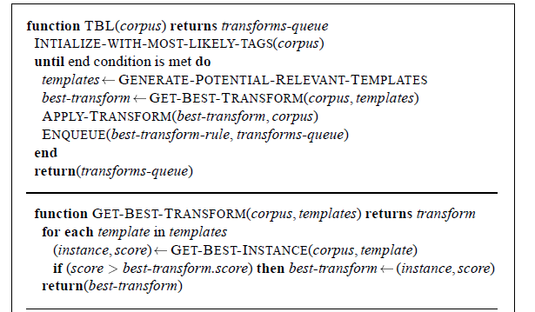
TBL algorithm for learning to tag
Word Classes and POS Tagging

Slide 21
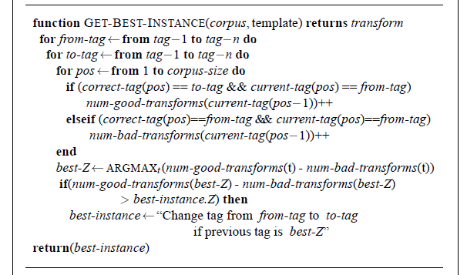
Word Classes and POS Tagging

Slide 22
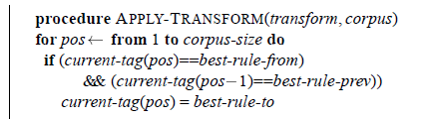
Word Classes and POS Tagging

