Slide 1
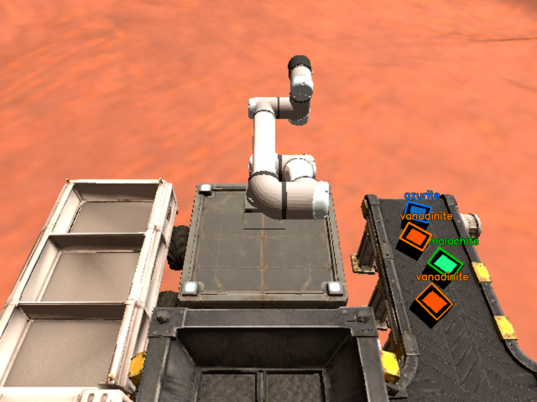
Strata Cobot
Autonomous ore sorting and haulage with two robots in ROS 2
The arm camera's view: four ores detected on the conveyor
C Saihardhik Reddy · R Gagan Chowdary · K Charan Saatvikh Reddy
Robotics course project · Amrita Vishwa Vidyapeetham
Notes:
Our project: two robots, a UR7e arm and a mobile eBot, run a mining operation in simulation with no human in the loop. Everything you will see - perception, inverse kinematics, path planning - we wrote ourselves, without MoveIt2, Nav2 or any other ready-made planner.

Slide 2
Two robots, one mining mission
1
eBot crosses the site
Three minerals, three containers
Plans its own route around the rocks to the excavation region
eBot takes on the ore
Azurite
2
blue face
Stops under the chute and collects a container of raw ore
Malachite
3
Arm sees each ore
green face
An RGB-D camera finds every ore and its 3D position
Vanadinite
4
Arm sorts it
orange face
A magnet picks each ore and drops it in the container for its kind
Notes:
The story: the eBot owns mobility, the arm owns manipulation. We built and tested each half separately; handing ore from one robot to the other is future work. Each ore is a black block with one coloured top face, and that face is how both the camera and the scoring tell them apart.

Slide 3
Four goals, each with a number to check
Subsystem | Robot | Goal | Measured by
Perception | Arm camera | Locate every ore in 3D from colour and depth images | error vs. ground truth
Manipulation | UR7e arm | Pick each ore with the magnet and drop it in its own container | ores sorted correctly
Path planning | eBot | Plan a collision-free path for each leg of the lap | length vs. shortest
Path following | eBot | Track each path and stop on every pose | tracking error
Constraint we set ourselves: no MoveIt2, no Nav2, no ready-made planner of any kind.
Notes:
We split the project into four subsystems, two per robot, and gave each one a number we could check against the simulator rather than judging by eye.

Slide 4
Four nodes, two sense-plan-act pipelines
Manipulator
Gazebo Harmonic
UR7e arm + magnet
RealSense D435i
eBot + lidar
rocks and /map
ROS 2 Jazzy bridge
RGB-D images
ore_perception
/tf ore frames
arm_manipulation
HSV face detection
depth back-projection
median per ore
damped least-squares IK
collision-checked routes
force-checked picks
/delta_joint_cmds, /magnet
Mobile robot
/map, /odom
path_planning
/ebot_path
path_following
clearance map
A*, shortcut, tighten
lap sequencing
pure pursuit
turn to final heading
stop on the pose
/cmd_vel · /spawn_ore_package
Notes:
Two Python nodes per robot. Note the arrows into the simulation: the arm accepts only velocity commands and the eBot only velocity twists, so every node closes its own control loop at 20 to 50 Hz. The two highlighted nodes hold most of the algorithmic work.

Slide 5
Find each ore by shape, name it by a colour vote
2-3 mm
10 mm
position error vs. ground truth
about what the magnet tolerates
Where: an ore's top face is the only surface 66-86 mm above the belt in the depth image
Centre of a rectangle fitted to that face, checked against the 101.6 mm size
What: the share of the face in each mineral's colour; the winner needs 2x the next
Majority vote over 20 frames; no clear winner = "uncertain", never a guess
Notes:
Our first detector found ores by tight colour thresholds. Now we separate where an ore is from what it is. Where comes from the depth camera: every ore is a block standing 76 mm above the belt, so its top face is found whatever its colour. What comes from a vote: we count how much of the face shows each mineral's colour. Fitting a rectangle to the face, instead of taking a median, keeps the position within 2 to 3 mm.

Slide 6
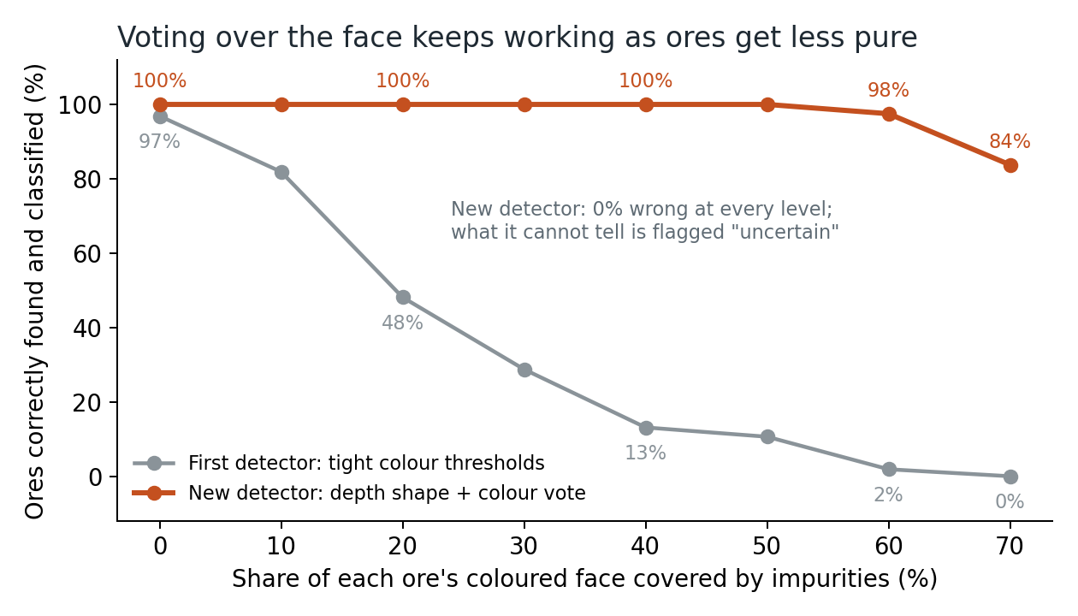
Real ores are rarely one colour, so we vote
180 real mineral photos
Held-out photos | Tight | Vote
Azurite | 10% | 37%
Malachite | 7% | 80%
Vanadinite | 17% | 93%
All | 11% | 70%
Museum photos from Wikimedia Commons. Limits calibrated on 90, tested on 90 others. Azurite is hardest: very dark, and often crusted with green malachite.
Impurities painted into a real camera frame: dark rock, brown matrix, quartz and veins of other minerals, under varied lighting. 160 ores per level.
Notes:
Our lecturer pointed out that real ores are not pure colours. We tested that two ways. First, we painted impurities into a real camera frame: the old tight thresholds fall below half at 20 percent impurity, while the vote stays perfect up to 50 percent and never picks the wrong mineral. Second, we ran both on 180 real mineral photographs: tight thresholds recognise 11 percent, the vote 70 percent on photos it was not tuned on. Azurite is hardest, because real azurite is very dark and usually mixed with malachite. A trained classifier is the next step once real samples are available.

Slide 7
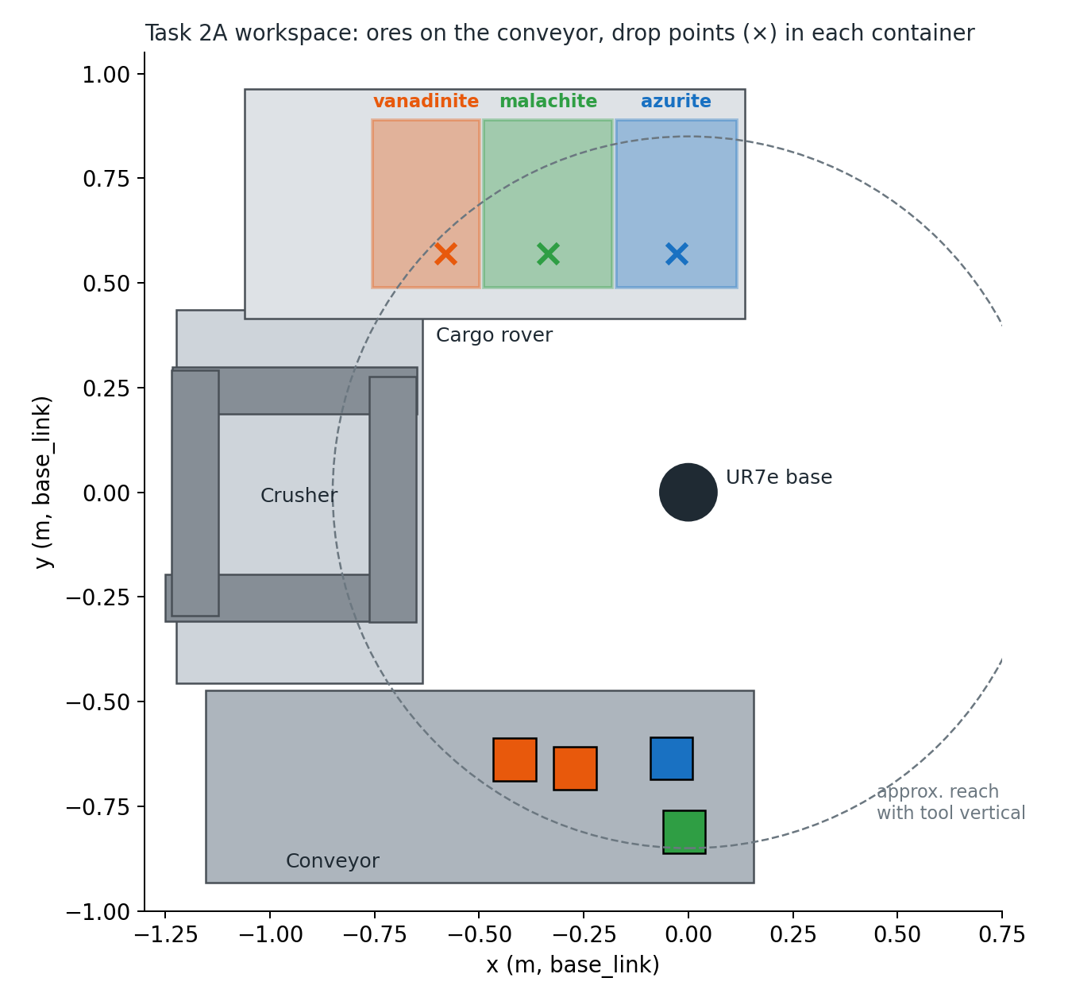
The containers were found by measuring the rover mesh
Not given to us
The cargo rover's collision mesh (GLB) was parsed and moved into base_link: three containers, 0.26-0.31 m by 0.40 m.
Which is which
Gazebo's default camera looks along +x: vanadinite nearest, malachite middle, azurite farthest.
One is out of reach
The vanadinite centre is 0.93 m from the base. Each ore is released at the nearest point inside its container, 8 cm from the walls.
Notes:
The container positions were not given. We parsed the rover's collision mesh to get exact walls. The surprise: the vanadinite container's centre is beyond the arm's reach with the tool vertical, so every ore is dropped at the reachable edge of its container. The crosses on the plot are the drop points.

Slide 8
Every pick is confirmed by the force sensor
1
2
3
4
5
Hover
Align
Descend
Lift + check
Drop
10 cm above the face, tool vertical
close the last mm on /tcp_pose_raw; magnet on
4 then 1.2 cm/s; stop at the face or 2.5 N
1.47 N = ore held; under 0.8 N, retry
carry with the ore in the collision model; release
81 mm
1.47 N
0 stops
magnet disc on a 101.6 mm face: about 10 mm to spare
force reading for a held 0.15 kg ore
safety stops across every trial
Notes:
The magnet only captures when its face is fully inside the ore face and parallel to it, so the descent is a straight vertical line with the tool held vertical. We do not trust the magnet service reply: after lifting, the force sensor must read the ore's weight, about 1.47 N, or the pick is retried. If a protective stop ever latches, the node unlocks, backs off upward and re-plans - but none happened in any trial.

Slide 9
A purpose-built IK solver plans 300x faster
5 constraints, not 6
Before: SLSQP optimiser
After: damped least squares
Tool position + vertical axis; rotation about vertical is free because the magnet is round
minutes
0.1-0.4 s
Checks once, not every step
per plan; stuck when starting above the containers
per plan, with every safety check kept
Limits, 3 cm clearance, singularity and tilt are tested on the converged result
A memory of solutions
Every solved pose is reused as a seed, so the arm always finds its way back
Δq = J^{T} (J J^{T} + λ² I)⁻¹ e, λ = 0.02
e = position error and tool-axis tilt; J = the matching 5 rows of the arm's Jacobian
Straight vertical moves
Resolved-rate control: tool velocity mapped to joints through the Jacobian
Notes:
Our first IK used a general constrained optimiser, and every gradient step re-ran the collision and singularity checks: minutes per plan. Damped least squares solves only what the problem needs - five constraints - and checks safety once at the end. Add a library of solved poses as seeds and planning drops to a fraction of a second.

Slide 10
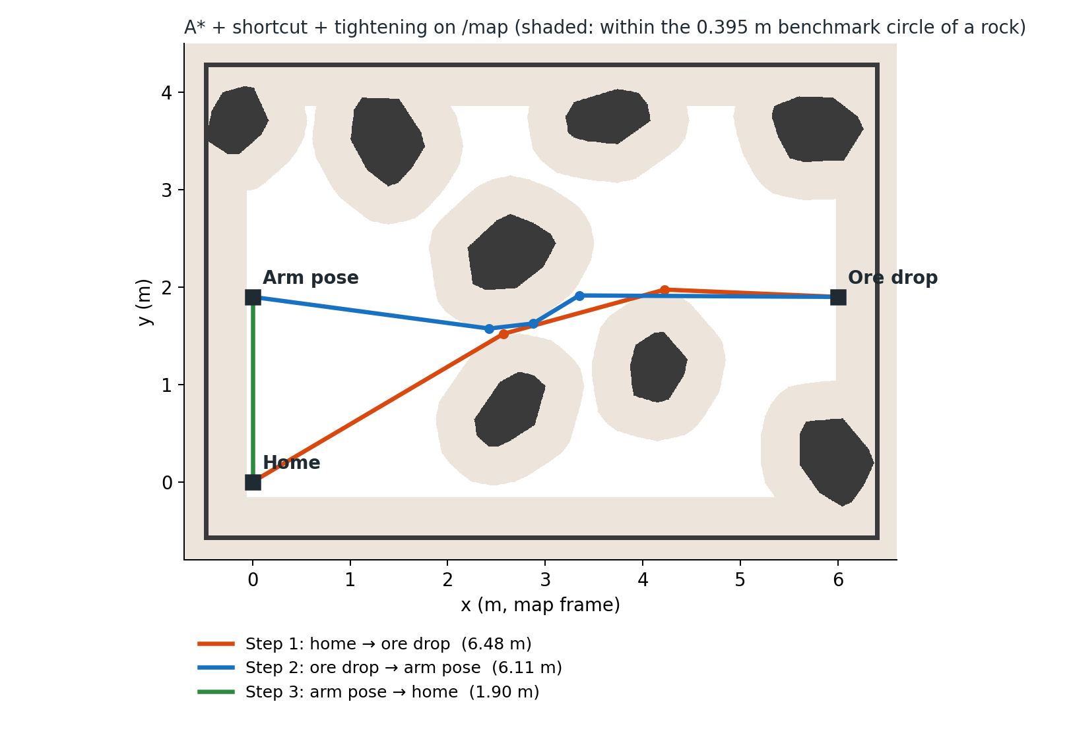
A*, then shortcut, then tighten
1
Clearance map
Distance transform of the 5 mm /map: every cell knows its distance to a rock
2
A* search
8-connected on a 5 cm grid, over cells that keep the chosen clearance
3
Shortcut
Jump to the furthest point visible with full clearance
4
Tighten
Pull each corner toward its neighbours until the legs just clear
Notes:
Home to the ore drop pose, then to the arm pose, then home. Every straight leg is re-checked on the full-resolution map. Tightening matters: without it, corners sit on 5 cm grid cells and the path is a few percent too long - which made our first version 2 percent too long.

Slide 11
Below 0.40 m clearance, paths stop getting shorter
0.395 m
reference: a circle enclosing the 0.62 x 0.49 m chassis
0.245 m
what really has to clear driving straight: the half-width
The planner estimates the reference path at 0.395 m, then takes the safest level from 0.40 to 0.34 m that is no longer. At 0.38 m the eBot keeps 13.5 cm each side; it tracked within 9 cm.
Notes:
We measure path quality against the shortest path for a 0.395 m circle that encloses the chassis. But when driving straight past a rock only the half-width must clear, so we can plan slightly inside that clearance and match the shortest length while keeping 13 cm to spare. Above 0.40 m narrow gaps close and the lap grows by up to 13 percent.

Slide 12
Every ore sorted, every lap completed, no collisions
8 / 8
Trial | Outcome
Arm 1 | 4/4 ores detected, picked and dropped in the right container
Arm 2 | New ore mix, one ore 0.83 m away: 4/4 sorted in 167 s
Robot 1 | First planner: 14.74 m lap vs 14.46 m reference (efficiency 0.98)
Robot 2 | Final planner: 14.55 m vs 14.58 m (efficiency 1.00)
Robot 3 | Final planner: 14.48 m vs 14.43 m (efficiency 0.996)
ores sorted into the right container, two trials
1.00
best path efficiency (reference / our length)
No collision and no safety stop in any trial
Robot 3 falls short only because the reference itself moved: on the same rocks it measured 6.14 m in one trial and 6.07 m in the next.
Notes:
Every trial used a freshly launched world with randomised ores or rocks, checked by the automatic evaluator that comes with the simulation. Sorting was perfect in both trials on different ore mixes. Path efficiency reached 1.00; the small shortfall in one trial comes from the reference path varying between runs.

Slide 13
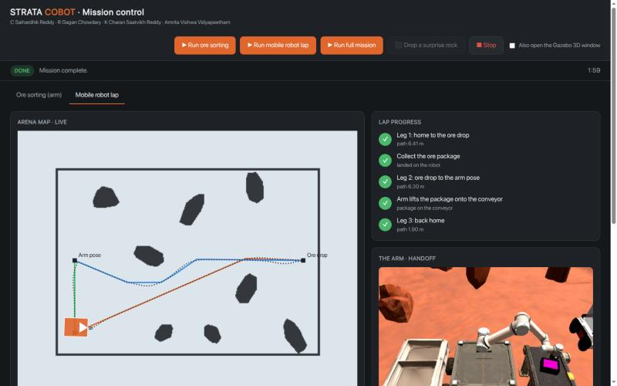
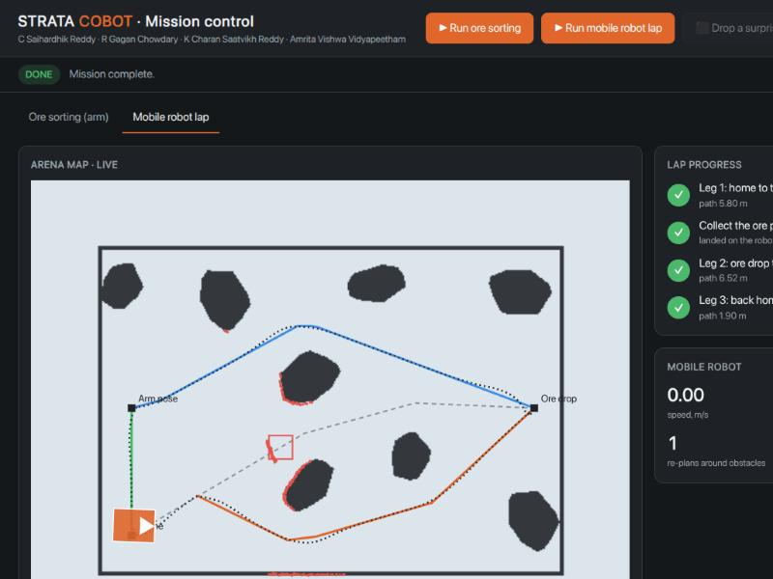
The full loop: hand-off and re-planning
Full mission, one click, about 2 min: the eBot brings the ore package, the arm lifts it onto the conveyor (2.94 N = 0.30 kg held), the eBot drives home.
Surprise rock: the lidar sees it within 0.26 m of the path, the eBot stops and the planner re-plans in 0.1 s.
Notes:
Two things the first version could not do. First, the full loop: the eBot hauls the ore package to the arm, the arm finds it with odometry and the depth camera, lifts it off the deck and places it on the conveyor, then the eBot drives home. Second, obstacles the map does not have: our paths always keep 30 cm from mapped rocks, so anything the lidar sees closer than 26 cm to the path is new. The robot stops, the planner adds it to the map and re-plans in a tenth of a second.

Slide 14
What broke, and how we fixed it
No path at all
Paths 2% too long
IK took minutes
Drop pose is 0.375 m from a wall; downsampling shaved 5 cm more. Full-resolution clearance fixed it.
Grid-snapped corners. Fine-map checks and corner tightening reached efficiency 1.00.
Checks inside every optimiser step. DLS with one final check: 0.1-0.4 s.
Arm lost after a drop
Vanadinite unreachable
Two simulations clashed
No IK seed back to the conveyor. A library of solved poses fixed it.
Container centre 0.93 m away. Release at its nearest reachable point.
A leftover simulation on the same ROS domain. One world at a time.
Notes:
Most of these were invisible until we ran full trials with automatic checking, which is the main lesson: test end to end early. The others came from measuring the geometry ourselves instead of trusting the brief.

Slide 15
Both robots complete their missions end to end
1
Sorting: 16 of 16 ores in the right container
Next
2
Planning: paths as short as the reference
Train a classifier on real ore samples
Move to physical robots
3
Hand-off: eBot to arm to conveyor
4
Re-planning around unmapped rocks
5
Every algorithm written from scratch
Thank you · Questions?
Notes:
To sum up: both halves of the mission work end to end in simulation, using only algorithms we wrote. The natural next step is the handoff, where the eBot delivers ore to the arm. Happy to take questions, and we can run a live demo.

