Slide 1


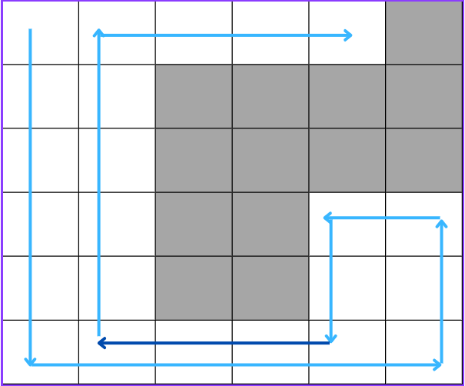
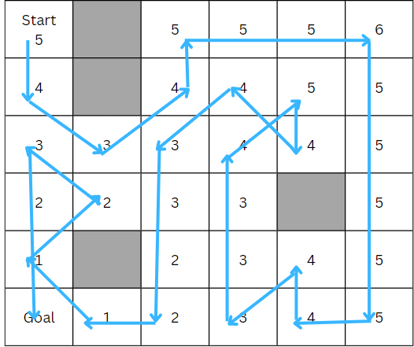
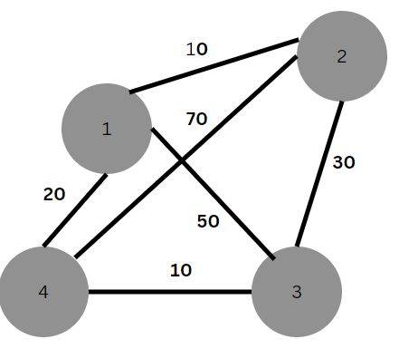
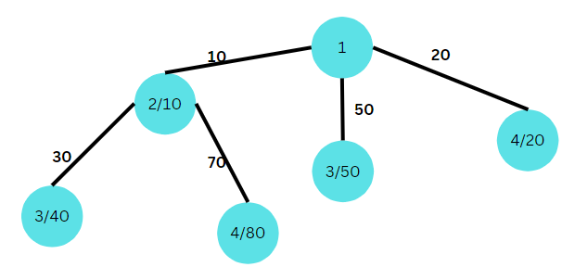
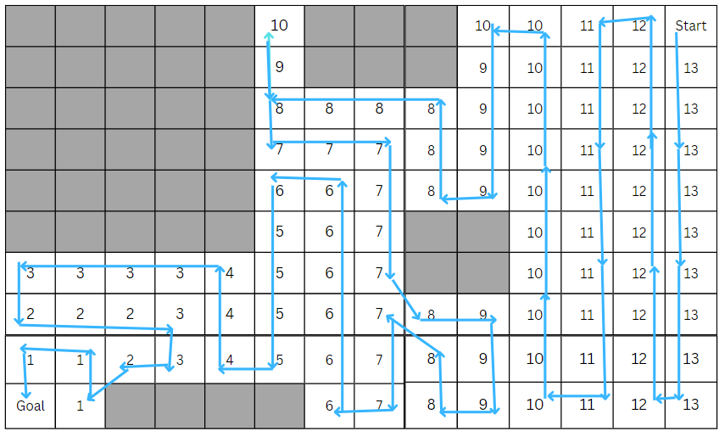
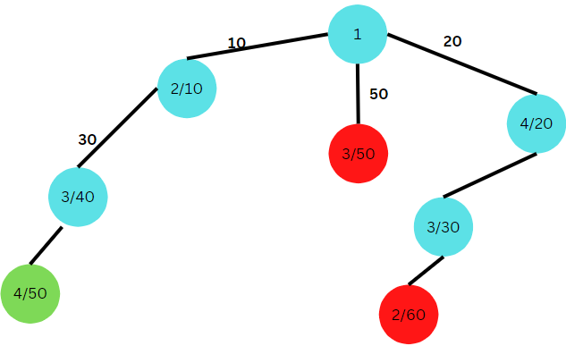
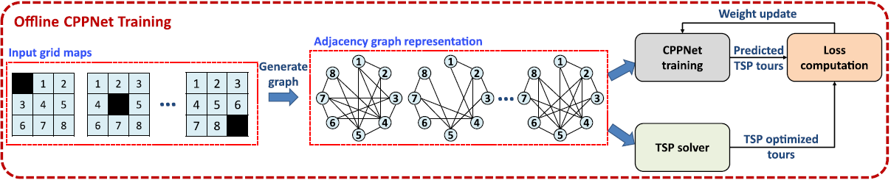
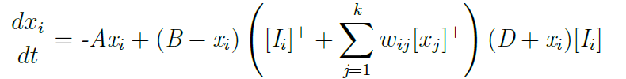
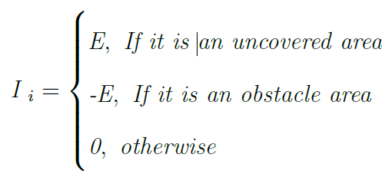
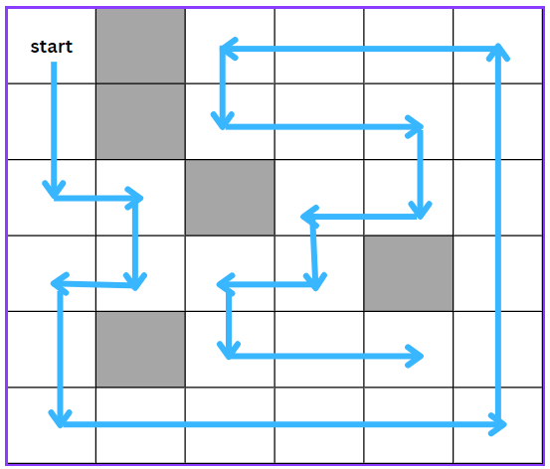
Cost is turn is not taken into account in this algorithm.
Department of Electronics and Electrical Engineering
Indian Institute of Technology Guwahati, India
Complete Coverage Path Planning by an Autonomous Vehicle using
Neural Networks
Mallavaram Sai Harini, 214102508, Under the guidance of Dr. Indrani Kar
Abstract: Complete coverage path is the planned path the robot sweeps over all areas of a particular space of 2D environment avoiding obstacles in a systematic and efficient way with the consideration of minimum cost criteria. In this phase for the static environment algorithms are designed, implemented and tested for complete path coverage taking reference from Branch and Bound, Distance transform and Complete coverage D* (CCD*) algorithms.
1. INTRODUCTION
Case 2: Case where the robot has to traverse certain cells twice in order to ensure complete
path coverage.
Mobile robot complete coverage path planning (CCPP) has wide range of applications and are of good practical value. Finding an optimal path that visits every node in the graph exactly once is NP-hard problem known as the traveling salesman problem. Practical applications of CCPP include vacuum robots, lawn mowers, cleaning robots, land mine detectors, automated harvesters, autonomous underwater vehicles, wall climbing robots etc…
floor_map=[[1,1,1,1,1,0],[1,1,0,0,0,0],[1,1,0,0,0,0],
[1,1,0,0,1,1],[1,1,0,0,1,1],[1,1,1,1,1,1]]
Total No of empty cells : 23
Cost for 90 degrees turn is considered as cost of travelling a distance of one cell = 1 unit
Total No of turns= 7
No of cells traversed two times =4
Total cost of complete path coverage = 23+7+4=34 units
Here we consider robot can turn only 90 degrees. Diagonal cells are not counted as adjacent cells
2. Motivation and Problem formulation
The entire two dimensional floor with obstacles is divided into grids of cells where the dimension of each cell is equal to the dimension of the robot.
Floor is divided into cells where each cell can have a value of 0 or 1. 0 represent obstacles and 1 represent free space. Each cell is uniquely identified by its row and column number.
Graph data structure – Adjacency list matrix is used to represent the grid map. The path traversed follows Tree data structure.
Consider the example - Tree traversal of 4*4 grid
Algorithm 2:
Two algorithms are designed and implemented.
First algorithm is a modified Branch and Bound algorithm. It uses both BFS and DFS traversal by considering the given problem as a TSP. The cost of taking turn is also considered in this algorithm. We do not consider diagonal cells as adjacent cells. It ensures that the path calculated from this follows the minimum cost criteria. But the time complexity of this algorithm is high.
Figure 8: Algorithm1 – Case2
Set DT value of all cells
Set Start to current cell. Set all Cells to Not Visited
Loop
Choose unvisited adjacent cell with highest DT. If two or more adjacent cells with same highest DT then choose the cell which is far from goal.
If No Adjacent Cell found then
Mark as Visited and stop at goal
If neighbouring cell DT less than or equal to current cell DT then mark current cell as Visited and stop at Goal
Set selected neigbouring cell as current cell.
Loop End
Explanation with an example – Implementation using state tree diagram. Aim is to find the minimum length path travelling through all nodes.
Figure 9: Algorithm2 – Result1
Cost is turn is not taken into account here
Robot can take turn of 90 or 45 degrees
Back traversing of cells is also allowed
Figure 3: TSP Graph
Figure 4: Implementation using state tree diagram - 1
Figure 6: State tree diagram - 3
Second algorithm implemented is a modified Distance transform which is defined as the task of path planning to find paths from the goal location back to the start location. A distance wave front is propagated by the path planner through all of the environment’s open space grid cells from the destination cell. The distance wave front sweeps around all the obstacles, and finally through all of the available open space in the environment. Time complexity is less. The path found may not be of minimum length.
Figure 9: Algorithm2 – Result2
Therefore the path with minimum length covering all nodes is 1—2—3—4
A graph based neural network model has to be created by taking the data obtained from the two designed algorithms.
4. Future work
3. RESULTS AND DISCUSSIONS
Algorithm 1:
Step 1: Represent the grid map of a floor in the form of a nested list containing 0s and 1s
Step 2: Assign start cell as [0,0]
Step 3: Get the adjacency list of the floor map.
Step 4: Get total no of empty cells in a floor map.
Step 5: Create Class TreeNode with attributes
data, cost, children, parent, back, length and
Methods : add_child, get_cost
Step 6: Call the method find_path to compute complete coverage path. It constitutes of :
Step 7: Start cell is assigned as root node, initially as current node and the path traverses.
.
Step 8: Check all the leaf nodes and get the leaf node with min cost and assign it as current node.
Step 9: Check its adjacent nodes for path traversal. Allow backtrace of cells only when the criteria is achieved. Check if no of cells traversed is equal to total empty cells. If yes then remove all the leaf nodes with cost equal or greater than the current path cost and continue with Step 8 until no of leaf nodes are not zero
Step 10: Else go to step8.
Step 11: Return minimum cost path .
Also the NN model has to be developed for dynamic environments using shunting equation.
Figure 10: Graph Neural Network for static environment
where xi is the neural activity of the ith neuron. Parameters A, B and D are non-negative constants representing the passive decay rate, the upper and lower bounds of the neural activity respectively, and K is the no of neural connections of the ith neuron to its neighbouring neurons within the receptive field Ri
Results from Algorithm 1:
Case 1: It is a case where each cell is traversed only once (there is no back traversing of cells).
Ex: floor_map=[[1,0,1,1,1,1],[1,0,1,1,1,1],[1,1,0,1,1,1], [1,1,1,1,0,1],[1,0,1,1,1,1],[1,1,1,1,1,1]]
The final path calculated is as follows:
Total no of empty cells : 31
Cost for 90 degrees turn is considered as cost of travelling a distance of one cell = 1 unit.
Total no of turns= 13
Total cost of complete path coverage =
31+13=44 units
Here we consider robot can turn only 90 degrees. Diagonal cells are not counted as adjacent cells
These NN models have to be interfaced on ROS-Gazebo simulation and the results should be verified.
Later CCPP has to be implemented and tested on an actual hardware.
7. REFERENCES
Z. Sheny, P. Agrawal, J. P. Wilson, R. Harvey, and S. Gupta, “Cppnet: A coverage path planning network,” in OCEANS 2021: San Diego–Porto, pp. 1–5, IEEE, 2021.
M. Dakulovi´c, S. Horvati´c, and I. Petrovi´c, “Complete coverage d* algorithm for path planning of a floor-cleaning mobile robot,” IFAC Proceedings Volumes, vol. 44, no. 1, pp. 5950–5955, 2011.
X. Qiu, J. Song, X. Zhang, and S. Liu, “A complete coverage path planning method for mobile robot in uncertain environments,” in 2006 6thWorld Congress on Intelligent Control and Automation, vol. 2, pp. 8892–8896, IEEE, 2006.
Figure 7: Alogorithm1 – Case1
ACKNOWLEDGEMENT: I thank my supervisor Dr. Indrani Kar for her valuable guidance
MTP Phase1 Evaluation , 18 November 2022, Indian Institute of Technology Guwahati, Assam

