Slide 1

Basic Details of the Team and Problem Statement
Ministry/ Organization Name: All India Council for Technical Education (AICTE).
Problem Statement: Portal to know about various National and International Scholarships
Team Name: Hexa Brains
Team Leader Name: Siraparapu Sai Harini
Institute Code:
Institute Name: VIGNAN INSTITUTE OF INFORMATION TECHNOLOGY

Slide 2
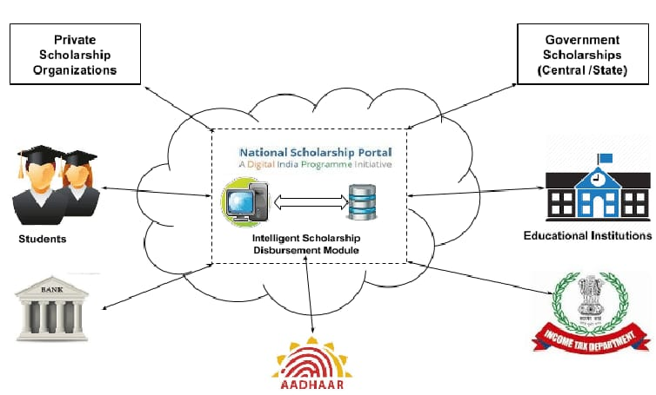
Idea/Approach Details
Describe your idea/Solution/Prototype here:
Almost similar number of students enter into colleges for taking various education to help them in seeking jobs. With time students also look for good scholarships based on the merit, skills, income, etc. Getting scholarships would help such students to even excel more.
We want to develop a portal where various National and International scholarships based on merit, study field, income etc. are shown up. This should be a real time data management which should be updated with the latest scholarships that are being offered.
Describe your Technology stack here:
HTML
CSS
JAVASCRIPT
PHP
MYSQL

Slide 3
Idea/Approach Details
Describe your Use Cases here
Simplified process for the students
Common application form for all scholarships
Scalable and Configurable platform
It provides National and International scholarships based on merit, study field, income etc

