Slide 1

CLUSTER ANALYSIS ON COUNTRY CLASSIFICATION
APPLIED DATA SCIENCE
ASSIGNMENT

Slide 2
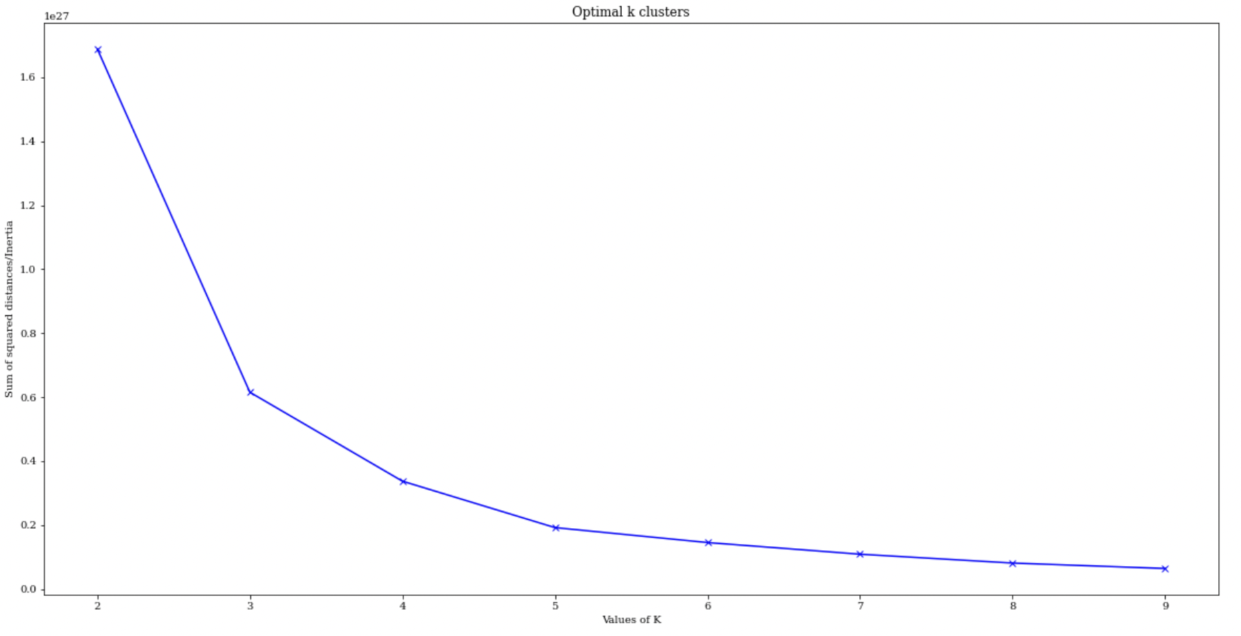
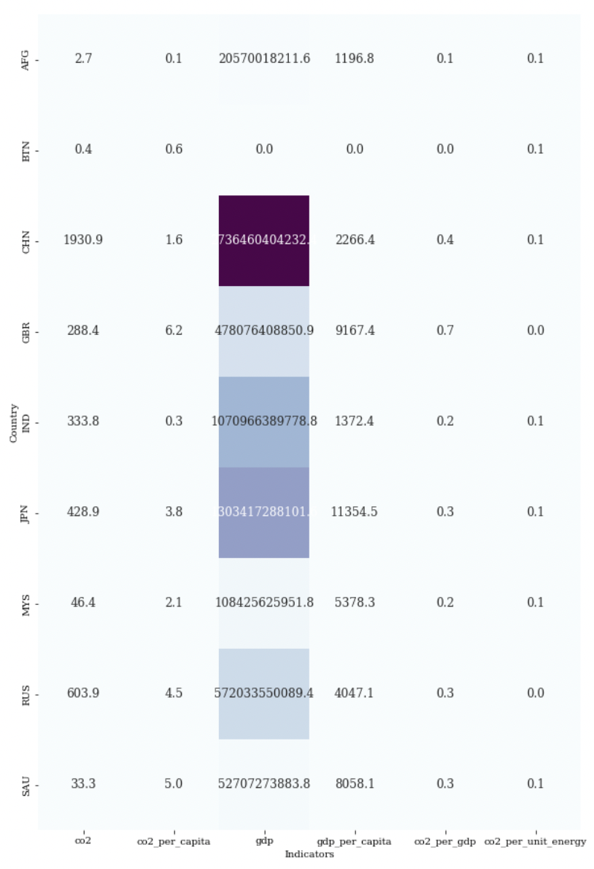
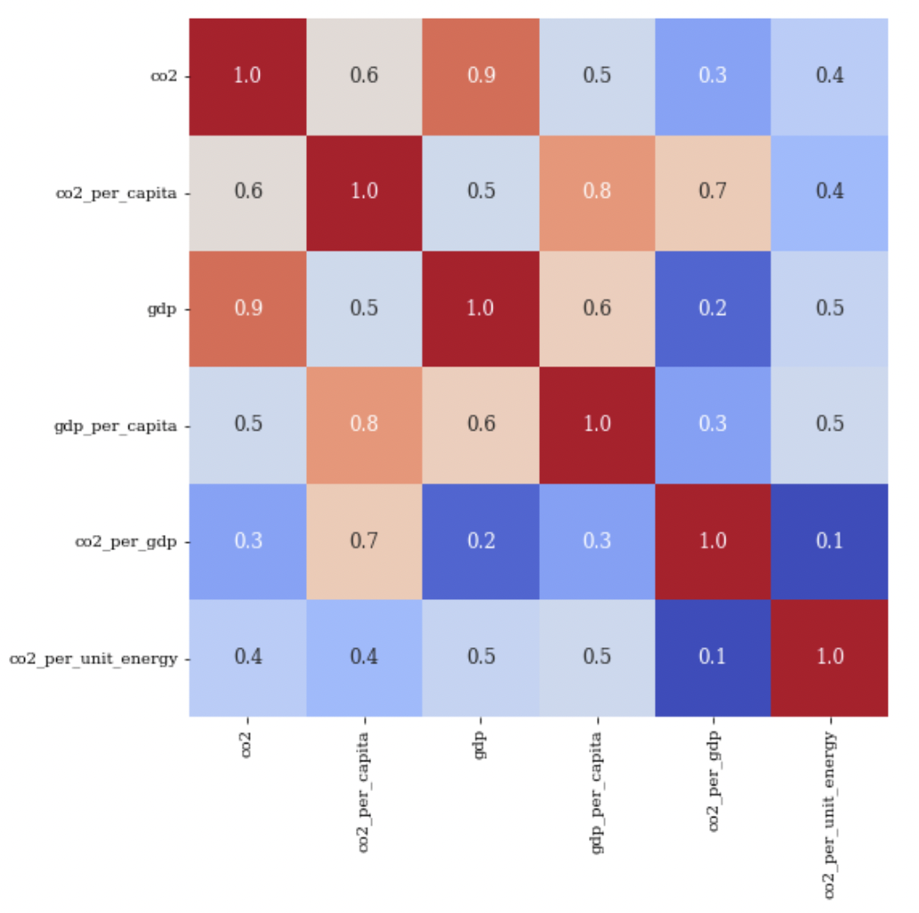
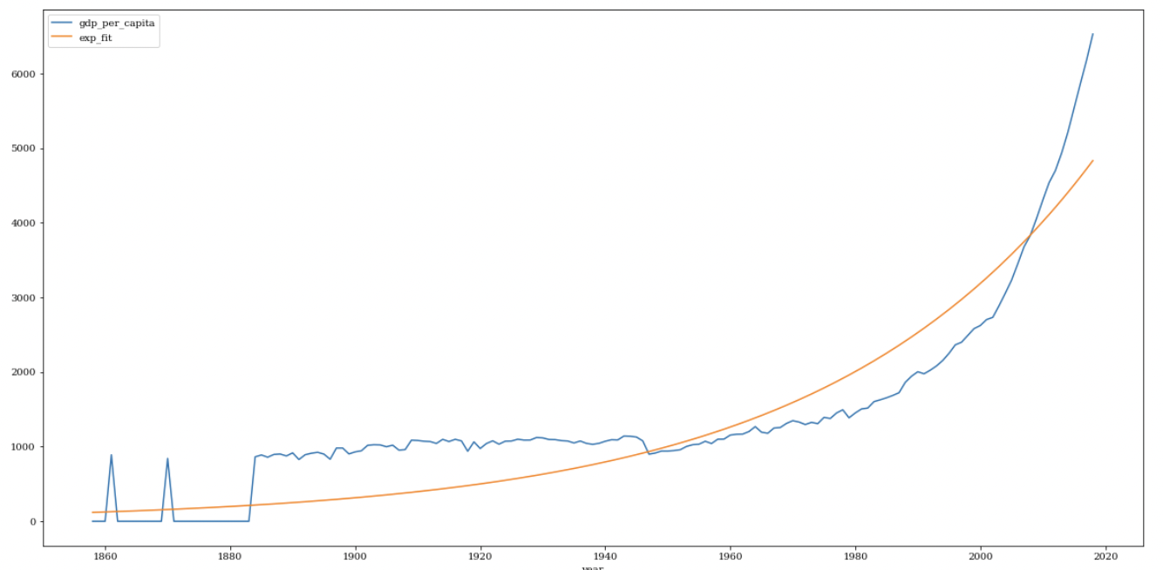
CO2 EMISSION vs GDP PER CAPITA
SAIHARISH SENTHILKUMARAN [21023211]
Introduction
Results and Analysis
Optimal Number of K - Means Clusters
Climate change is becoming more widely recognised, with an increasing number of countries vowing to reduce carbon emissions and enacting climate-related policies such as sectoral standards, carbon levies, and strategic planning.We use K-means clustering and exponential fitting to detect and analyse these structural breaks, shedding light on potentially game-changing solutions for emissions mitigation. Our research focuses on the carbon emitters, who account for 80 percent of total world carbon dioxide emissions based on GDP per capita increase.
The correlation is positive, which suggests growing per capita GDP leads to increasing carbon dioxide emissions. No turning point is found at which emissions start to decrease when reaching a high enough GDP, as our analyze claims.
Cluster | Description
0 | Overall by analyzing the co2 emission and GDP, developed countries like USA, China are playing major role in CO2 emissions that leads developing countries to focus on emission mitigation.
1 | As seen in the graph, existing climate and energy policies are expected to reduce warming relative to a world without climate policies. This graph depicts future greenhouse gas emissions scenarios based on a variety of assumptions, including: if no climate policies were implemented; if current policies were maintained; if all countries met their current future emission reduction pledges; and necessary pathways compatible with limiting warming to 1.5°C or 2°C this century.
Problem Statement
Clusters Analysis
Aim of this analysis is to predict the changes of co2 emission in future years based on GDP per Person in a country.WIth the help of fitting the data in a model and clustering it. Predict results and observations.
Procedure
Correlation Analysis
Therefore, first try to apply exponential fitting and analysis to determine what dimension these indicators could represent, followed by k-means cluster analysis to re-classify the CO2 Emissions, based on a group of intriguing indicators taken from the World Bank database.
Curve Fitting (Exponential)
Dataset
Database consists of 25989 rows and 25 indicators from this for our analysis filtering out only 8 indicators and 10 countries for better fitting. Indicators namely Co2, Co2 emission per cap, GDP, GDP per capita.
Cluster 1
Notes:
‹#›

