Slide 1


BANK LOAN ANALYTICS
ExcelR Data Analyst Project - P1141
Group 3

Slide 2

Members
Dishant Chogle
Jyothi Siva Swathi
Eswar Praneeth
Sai Harshavardhana
Saniya Patil
Sandhiya P
Sonali Virkar

Slide 3

Overview
dashboard visualization.
Domain: Finance & Banking (Consumer Credit)
Dataset: Analyzed a comprehensive financial dataset containing 39,717 loan records with 48 columns (including interest rates, loan grades, and payment history)
Goal: The project aims to assess the bank's lending portfolio health, calculate credit risk, and evaluate borrower repayment behavior.
Tech Stack:
MySQL: For data storage, complex ETL (Extract, Transform, Load), and KPI calculation.
Excel: For initial data cleaning and validation.
Tableau/Power BI: For interactive dashboard.
We were provided with the Bank Loan Analytics Project by ExcelR, which included a questionnaire and two finance datasets.
Using these three documents, we developed this project and the accompanying dashboard.

Slide 4

Objective of the project
Assess Portfolio Health & Credit Risk To distinguish between "Good" (Fully Paid) and "Bad" (Charged Off) loans by analyzing default rates across different Loan Grades (A-G). The goal is to identify high-risk borrower segments and minimize future credit loss (EAD).
Evaluate Financial Profitability To compute critical revenue metrics, including Total Funded Amount ($434M) vs. Total Repayments ($482M). This involves calculating Net Gross Profit and analyzing how average interest rates (12.02%) impact the bank’s bottom line.
Optimize Data Infrastructure (ETL) To engineer a robust SQL database capable of handling 39,000+ financial records. This includes building an ETL pipeline to clean raw CSV data, standardize date formats, and resolve schema inconsistencies for accurate reporting.
Enable Data-Driven Decision Making To transform complex tabular data into interactive dashboards (Power BI & Tableau). These visualizations track lending trends over time (2007–2011) and by region (State-wise), empowering stakeholders to make strategic lending decisions.

Slide 5
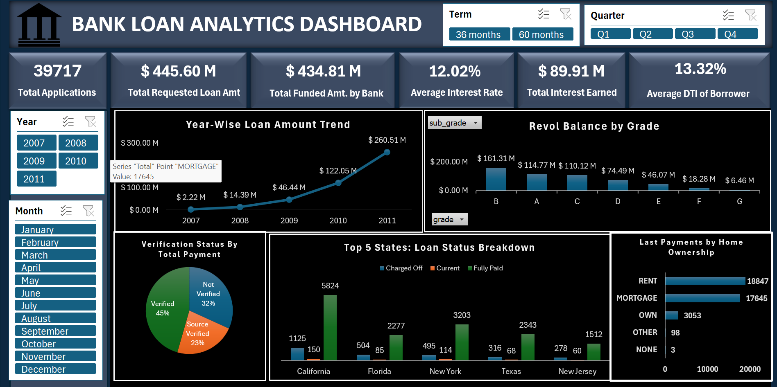
Excel Dashboard

Slide 6
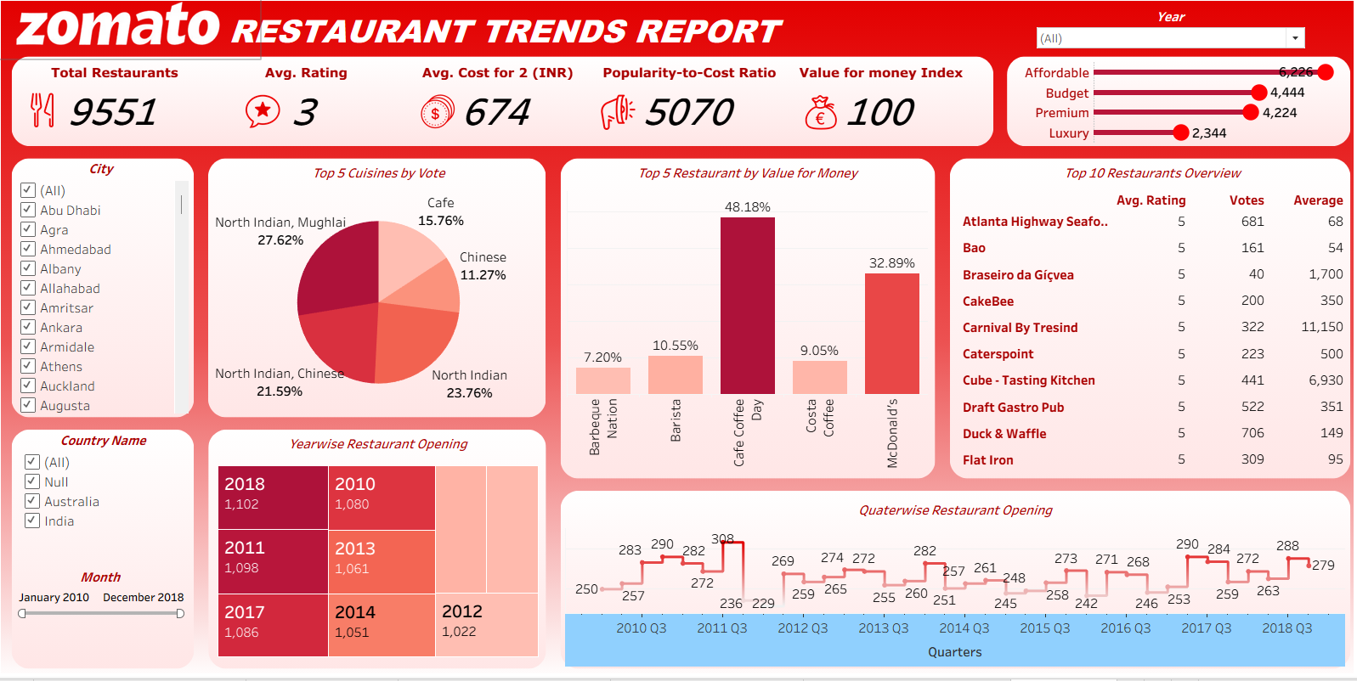
Tableau Dashboard

Slide 7
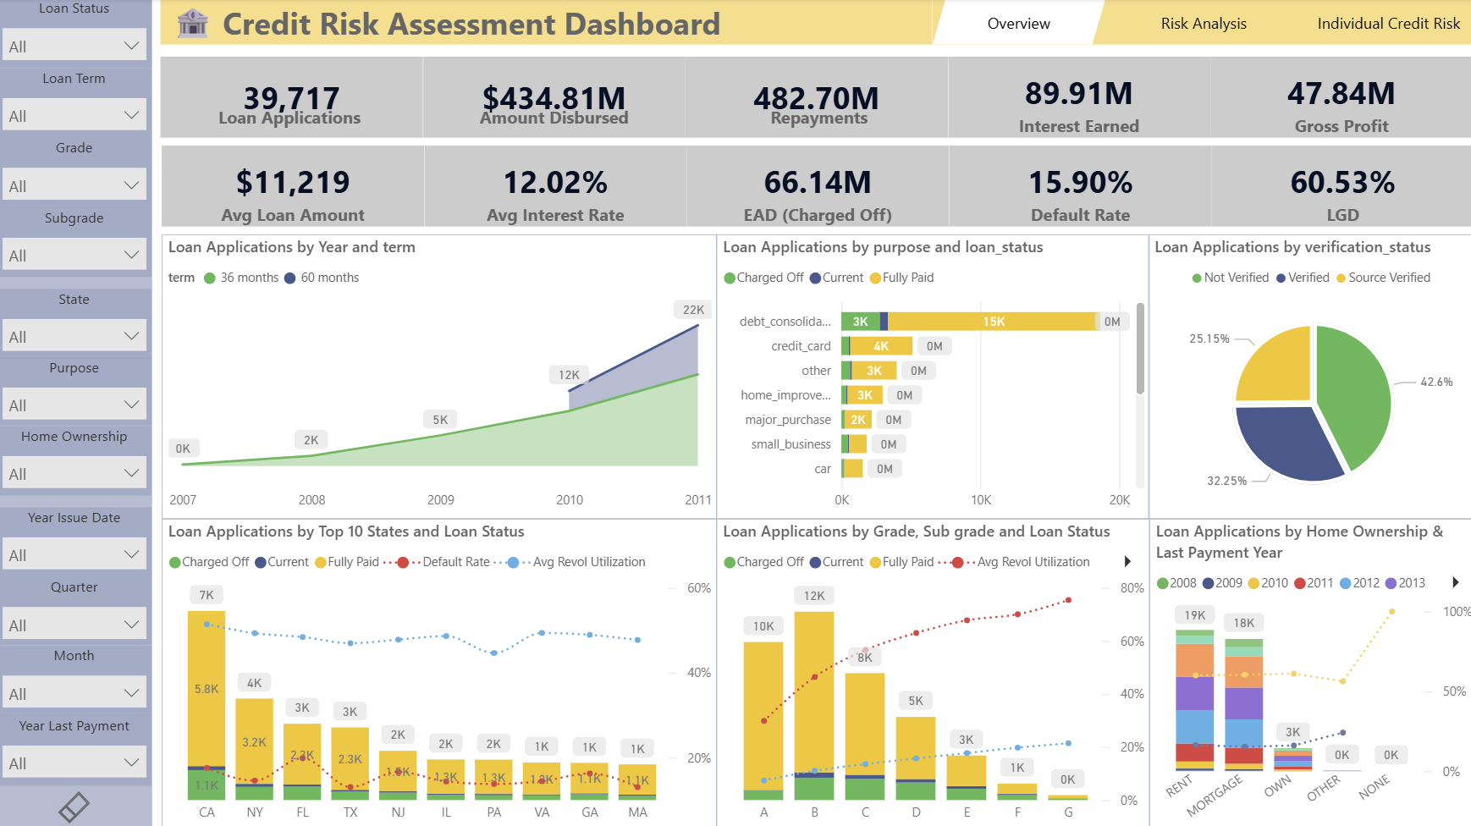
Power Bi Dashboard

Slide 8
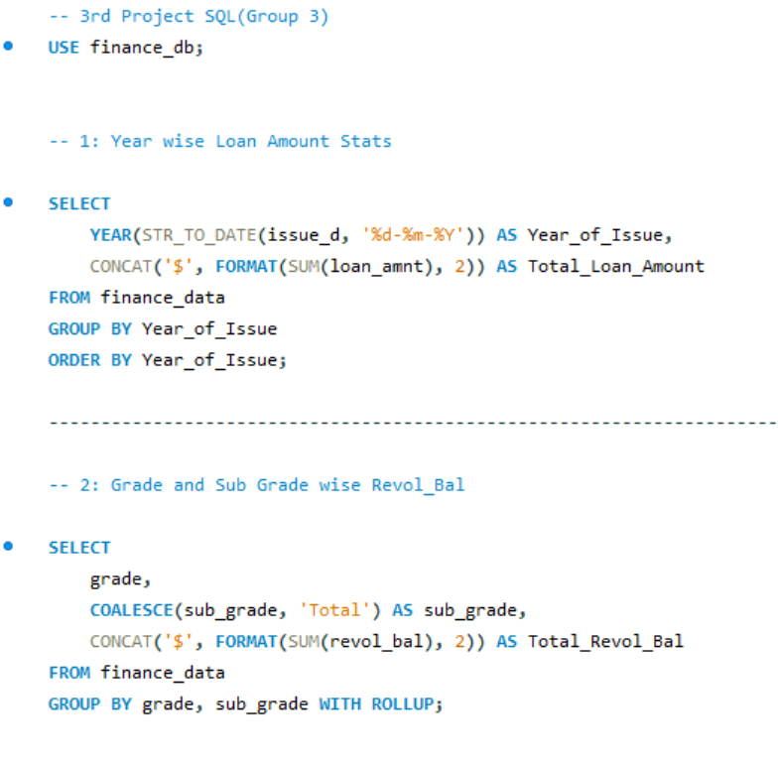
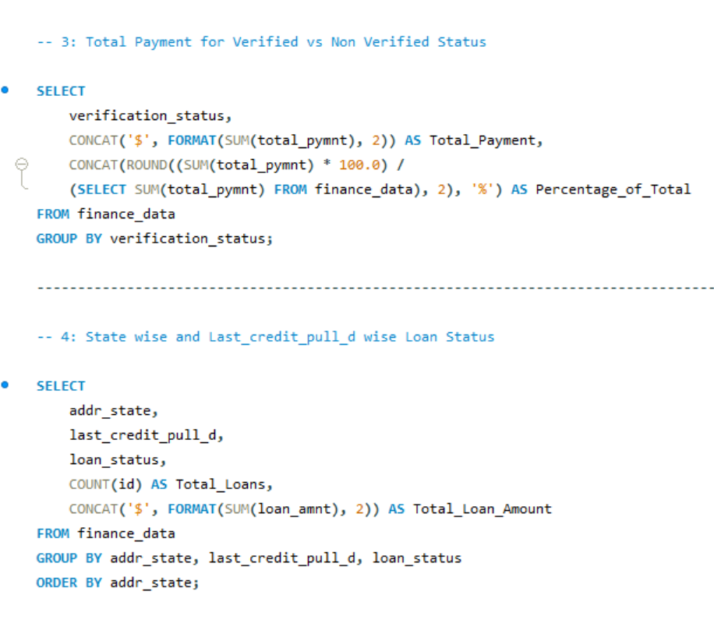
SQL QUERIES

Slide 9
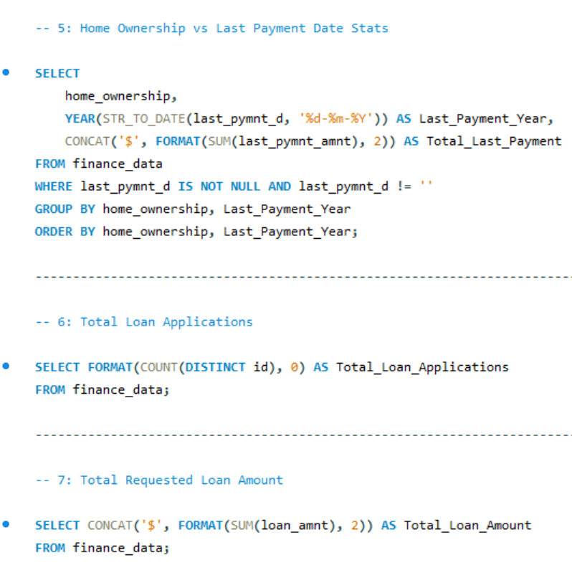
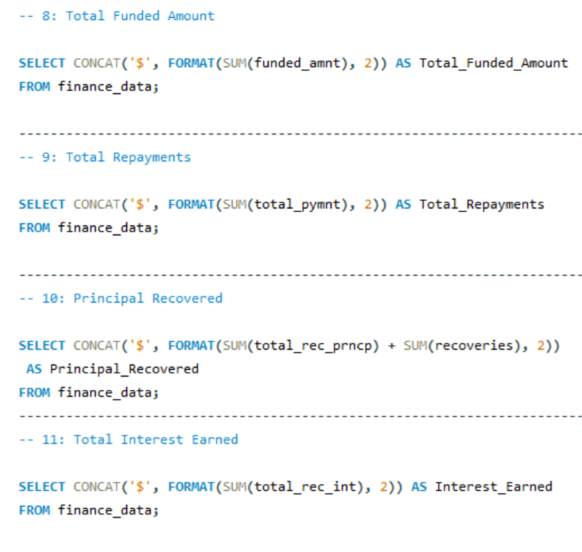

Slide 10
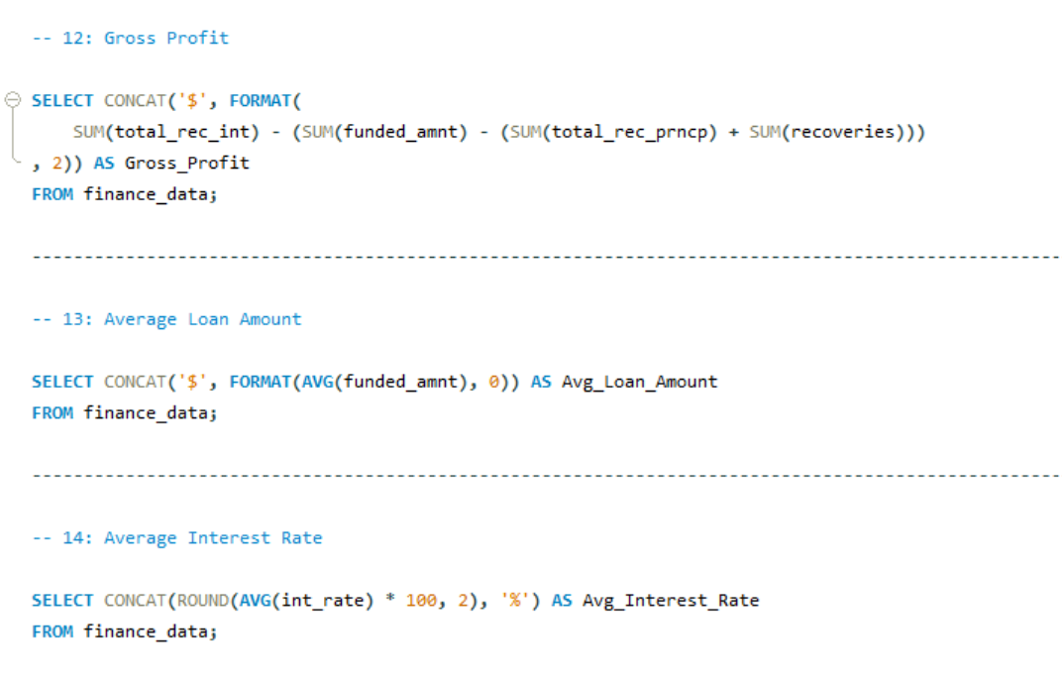

Slide 11

Conclusion & Insights
Portfolio Profitability & Financial Health
Net Revenue: The portfolio is robust and cash-flow positive. Total Repayments ($482M) significantly exceeded Total Funded Amounts ($434M), resulting in a Net Gross Profit of $47.8 Million.
Yield Efficiency: The 12.02% average interest rate is effectively priced. It generates nearly $90M in interest income, which successfully absorbs credit losses while maintaining a healthy profit margin.
Credit Risk & Borrower Segmentation
Risk Exposure: Grade B borrowers hold the highest share of the revolving balance. This indicates the portfolio is heavily weighted towards "moderate-risk" customers rather than just Prime (Grade A) or Sub-prime (Grade G).
Default Management: Despite a calculated default risk (~15%), the bank successfully recovered $392M in principal, proving the effectiveness of the current collection and recovery processes.
Market Growth & Trends
Business Expansion: The Year-over-Year analysis (Query 1) reveals exponential growth in loan applications from 2007 to 2011. This validates the bank's aggressive market acquisition strategy during this period.
Regional Concentration: State-wise analysis highlights that lending activity is not evenly distributed, identifying specific states as key revenue drivers that warrant focused marketing campaigns.
Operational Strategy
Verification Impact: The breakdown of "Verified" vs. "Non-Verified" loans (Query 3) shows that verified income sources correlate with higher repayment reliability. Recommendation: Tighten approval criteria for non-verified applicants to further reduce risk.
Asset Correlation: Homeowners contribute a stable and significant portion of last payments (Query 5), suggesting that asset ownership is a strong predictor of repayment consistency compared to renters.

Slide 12


