Slide 1
Bank Customer Churn Prediction — Demo
Patnam Sai Harshitha — 01 October-2025

Slide 2
Executive Summary
Dataset: 10,000 customers (demographics & account info)
Models trained: Decision Tree, Random Forest, Gradient Boosting, XGBoost
Best balanced model: Gradient Boosting (Recall ≈ 75%)
XGBoost (threshold tuned) can increase recall to ~92% with higher false positives

Slide 3
Model Comparison
Model | Accuracy | Recall | Precision | F1
Decision Tree | 0.79 | 0.48 | 0.5 | 0.49
Random Forest | 0.86 | 0.64 | 0.55 | 0.59
Gradient Boosting | 0.76 | 0.75 | 0.58 | 0.66
XGBoost | 0.81 | 0.69 | 0.57 | 0.62

Slide 4

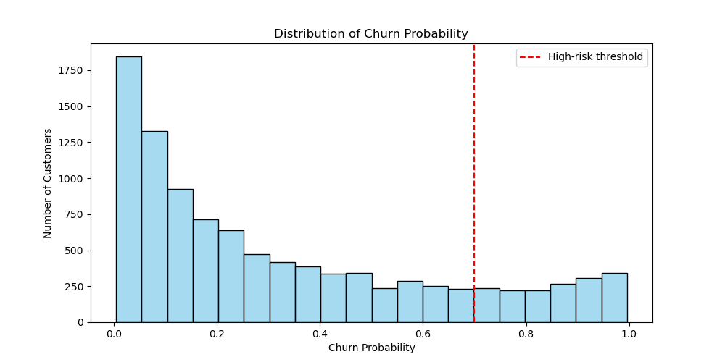
Churn Probability Distribution.

Slide 5
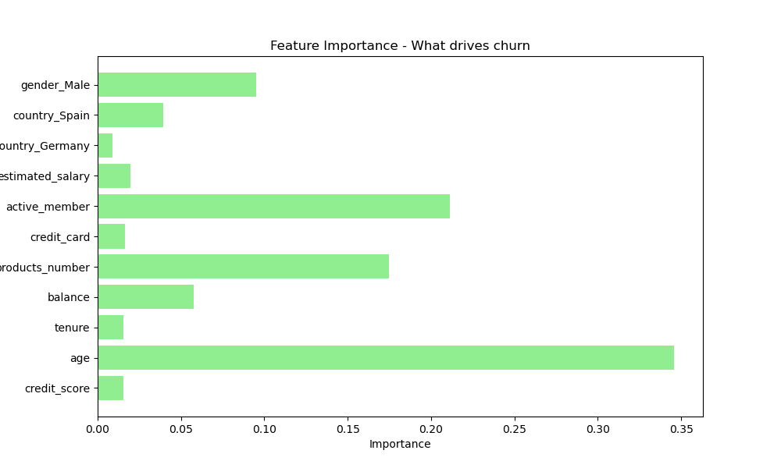
Feature Importance (Why Customers Churn).

Slide 6
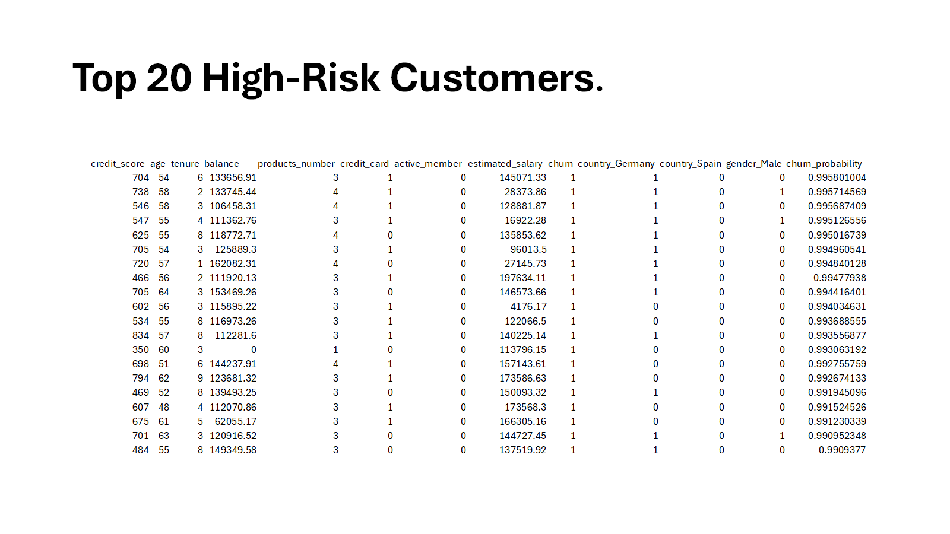
Top 20 High-Risk Customers.

Slide 7
Business Insights & Actions
High-risk customers identified: 2,070 above threshold (top 20 shown).
Key churn drivers: low balance, fewer products, short tenure.
Action plan:
Offer incentives to low-balance customers.
Cross-sell/upsell to customers with only 1 product.
Personalized calls for long-tenure but inactive members.
Monitoring: run churn model monthly, refresh reports, update high-risk list.

