Slide 1
Smart Farming Agent
“An AI-Powered Smart Farming Assistant Built with IBM watsonx Orchestrate and Granite Models”

Slide 2

Project Tile – [Smart Farming Agent]
Domain of Project – Agriculture / Smart Farming
Student Name | Recent Passport Photo | Email ID | Mobile Number [Whatsapp]
Kamma Hitesh |  | saihitesh1448@gmail.com | +91 9441903331

Slide 3
Problem Statement -
Problem Statement : Smart Farming Agent
The Challenge
Agriculture faces growing challenges with unpredictable weather, soil degradation, and lack of expert access. Farmers struggle with crop selection, fertilizer decisions, and pest management due to scattered, unreliable information. Without personalized, real-time guidance, crop yields decline and resources are wasted.
The Objective
Build an AI-powered Smart Farming Agent that delivers personalized agricultural insights and guidance for farmers, agronomists, and agri-businesses. The solution should:
Crop Recommendations – Suggest optimal crops based on soil type, season, region, and market demand.
Soil & Weather RAG Retrieval – Fetch and summarize soil health data and weather forecast details from reliable agricultural sources.
Pest & Disease Detection – Allow farmers to describe or upload crop images for instant diagnosis and treatment advice.
Irrigation & Fertilizer Guidance – Provide precise recommendations for water usage and nutrient management.
Multi-Agent Architecture –
Crop Knowledge Agent (fetches crop and soil data)
Farming Recommendation Agent (crop and soil recommendations)
Weather Advisory Agent (weather-based farming guidance)
Field Feedback Agent (crop condition tracking + analysis)
Insights Dashboard – Show crop health, soil metrics, weather trends, and actionable farming insights.

Slide 4
Technology Used
Tech Stack (Mandatory)
Use any one of the following approaches:
IBM watsonx Orchestrate + IBM Granite Models
IBM Cloud Agentic Lab with IBM Granite Models
Replicate with LangChain + RAG + IBM Granite Models
I used IBM watsonx Orchestrate in it we can’t change default models so I used GPT-OSS-120B---OpenAI

Slide 5
Proposed Solution -
Proposed Solution: AI-Powered Smart Farming Agent
The proposed solution is a multi-agent AI-powered Smart Farming Agent built using IBM watsonx Orchestrate and
IBM watsonx.ai to provide personalized, real-time agricultural guidance. The system addresses challenges in crop selection, soil management, and weather-based decision making through an intelligent, modular architecture.
At its core, the solution uses a Retrieval-Augmented Generation (RAG) pipeline to fetch accurate agricultural data from trusted sources such as FAO and ICAR datasets. This data is embedded and stored in a IBM Watson Discovery knowledge base, enabling the system to retrieve and summarize crop, soil, and weather information using GPT-OSS-120B---OpenAI.
The system consists of four key agents working in concert:
Crop Knowledge Agent retrieves and summarizes crop-specific information and best practices using RAG.
Farming Recommendation Agent generates personalized crop and soil plans based on user inputs such as location, soil type, season, and budget.
Weather Advisory Agent provides real-time weather-based farming guidance including irrigation schedules, harvesting timing, and sowing recommendations.
Field Feedback Agent allows users to describe crop conditions via text or images and delivers instant diagnosis with actionable recommendations.
The solution includes a user-friendly dashboard (built with Streamlit or React) that visualizes crop health status, soil metrics, and weather-based guidance in natural language.
IBM watsonx Orchestrate is used to orchestrate agent workflows, while watsonx Orchestrate ensures scalable agent deployment, embeddings, and AI governance. Granite models power reasoning, summarization, and personalization.
Overall, this solution delivers an end-to-end intelligent farming assistant that empowers farmers with data-driven insights, real-time feedback, and actionable recommendations for improved agricultural productivity.

Slide 6
IBM watsonx Orchestrate component Used -
1) Agent Chat Interface – Interface where users enter their queries, preferences, or field queries about crops, soil conditions, or weather (text/image).
2) IBM watsonx AI Agent - Processes user input using Granite models to generate personalized farming insights and crop recommendations.
3) Name of IBM Granite model - GPT-OSS 120B — OpenAI Compatible → Fast, efficient for real-time agricultural guidance
4) Chat output -Displays AI-generated responses such as crop plans, soil analysis, and weather-based farming suggestions.

Slide 7
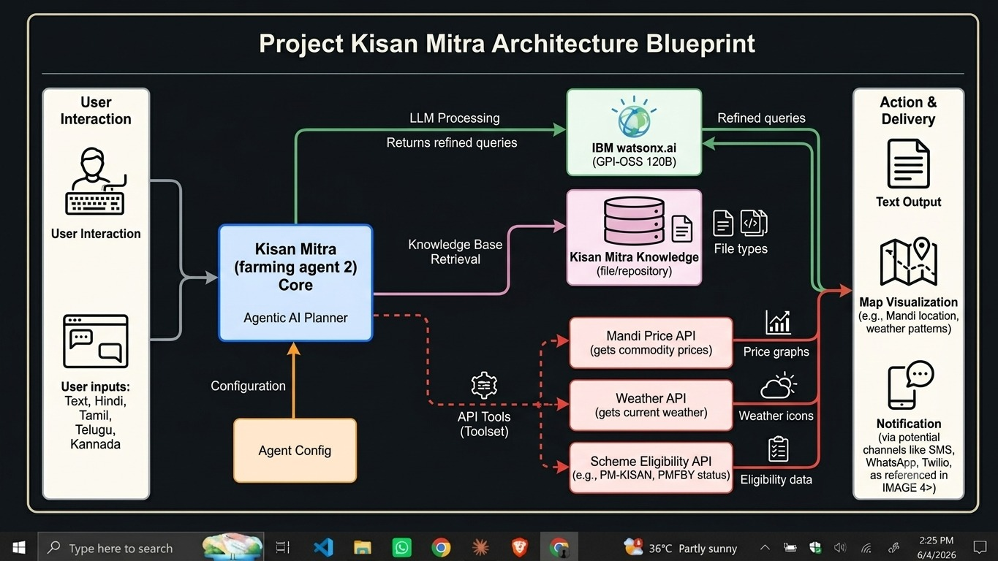
Architecture Blueprint – Smart Farming Agent

Slide 8

Role of Agentic AI in the solution
Role of Agentic AI in Smart Farming Agent
Agentic AI enables the Smart Farming Agent to function as an intelligent, autonomous system rather than a simple chatbot. Using IBM watsonx.ai and IBM Granite models, it coordinates multiple specialized agents to deliver personalized agricultural guidance.
Each agent performs a specific role—such as retrieving crop data, generating farming plans, providing weather advice, and analyzing field conditions—while working collaboratively. This multi-agent approach ensures efficient task execution and accurate results.
Agentic AI also brings context awareness, understanding farmer details like location, soil type, and crop history to generate tailored recommendations. It supports real-time adaptation, continuously updating suggestions based on user inputs like field conditions.
Additionally, agents communicate with each other, enabling better decision-making and improved outcomes.
Overall, Agentic AI makes the system proactive, personalized, and goal-driven, acting like a smart digital agronomist that helps farmers optimize yields and make data-driven decisions.

Slide 9
Technology Used
IBM watsonx Orchestrate platform -For designing and orchestrating multi-agent workflows visually
IBM Grainte model - for eg – GPT-OSS 120B (IBM Granite Compatible) – For natural language understanding, crop reasoning, and farming personalization
IBM Cloud – It provides the infrastructure to build, deploy, and scale the Smart Farming Agent efficiently. IBM Cloud enables a reliable, secure, and scalable environment for deploying the Smart Farming Agent.
RAG– RAG to fetch real data first, then generate intelligent answers, making the Smart Farming Agent more trustworthy and effective.
IBM Watsonx.ai - For model deployment, embeddings, and AI governance
Vector Database (IBM Watson Discovery) – For RAG-based agricultural knowledge retrieval and semantic search

Slide 10
Novelty and Uniqueness
The proposed Smart Farming Agent stands out by combining Agentic AI, RAG, and personalization into a single intelligent system.
Multi-Agent Intelligence – Instead of a single chatbot, multiple specialized agents collaborate to deliver accurate and context-aware crop, soil, and weather guidance.
RAG-Based Accuracy – Integrates real-time data retrieval with AI generation, reducing misinformation and ensuring trustworthy recommendations.
Hyper-Personalization – Tailors crop recommendations based on soil type, regional climate, season, and farmer resources.
Real-Time Feedback Loop – Continuously adapts recommendations based on daily field conditions and user behavior.
Multi-Modal Input – Supports text and image-based crop condition input for better usability in field environments.
Preventive Healthcare Focus – Goes beyond crop recommendations to provide pest management, disease detection, and yield optimization advice.
Scalable & Enterprise-Ready – Built on IBM watsonx.ai with IBM Granite models, ensuring reliability and governance.
This makes the solution a smart, adaptive, and proactive digital agronomist, not just a static crop recommendation tool.

Slide 11
Git Hub Link
GitHub Repository URL : https://github.com/saihitesh1448/farming-agent.git
·
·

Slide 12
Future Scope
1. Integration with IoT Sensors & Smart Devices –
The system can be integrated with IoT soil sensors, weather stations, and drone imagery to collect real-time field data such as soil moisture, temperature, and crop health. This will enable the Smart Farming Agent to provide more precise and dynamic farming recommendations.
2.AI-Powered Voice Assistant & Regional Language Support –
Enhancing the system with a voice-enabled assistant and support for regional Indian languages (Hindi, Telugu, Tamil, etc.) will improve accessibility for rural farmers. This makes the solution inclusive and practical for diverse farming communities across the country.
·
·
·

Slide 13


