Slide 1

Student Details
Name: Ganesula V V S S Sai Ganesh
SkillsBuild email id: saiganesh663188@gmail.com
College Name: Bonam Venkata Chalamayya Institute of Technology and Science
Internship Domain: Cyber Security with Kali Linux
Internship Start and End Date: 15/05/2024 to 25/06/2024

Slide 2

Project title/problem statement
Project: Hiding Text in an Image Using Steganography
Steganography is the art and science of writing hidden messages in such a way that no one, apart from the sender and intended recipient, suspects the existence of the message. This project aims to develop a secure method to hide text within an image without noticeably altering the image.

Slide 3
agenda
Overview of steganography
Project objective and scope
End users
Solution and value proposition
Customization and personalization
Methodology and modeling
Results and analysis
Resources and references

Slide 4
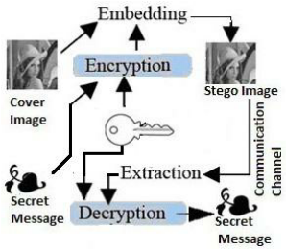
Project overview
What is Steganography?
Steganography involves embedding hidden messages within digital media, such as images, audio, or video files.
It is a form of security through obscurity, complementing encryption.
Project Goal:
Hide a text message within an image file.
Ensure that the image appears unchanged to the human eye.

Slide 5
Who are the end users of this project?
Who Benefits from This Project?
Cybersecurity Experts: Utilize hidden communications to enhance security measures.
Journalists and Whistleblowers: Protect confidential sources and sensitive information.
Everyday Users: Ensure personal messages remain private and secure.

Slide 6
Your solution and its value proposition
Solution:
Developed a python-based tool to encode and decode text messages within images.
The tool uses lsb (least significant bit) steganography to embed the message.
Value Proposition:
Security: conceals messages without detection.
Simplicity: user-friendly interface for non-experts.
Efficiency: minimal impact on image quality and size.

Slide 7
How did you customize the project and make it your own
How We Made It Unique:
Enhanced Encoding: implemented a more robust delimiter system to mark the end of the message, ensuring accurate extraction.
User-friendly Scripts: simplified the process with clear, step-by-step scripts.
Efficiency Improvements: optimized the algorithm to handle larger messages and high-resolution images.

Slide 8
modelling
Encoding Process:
Convert Message To Binary: transform the text message into binary format.
Embed Binary Into Pixels: embed the binary data into the least significant bits of the image pixels.
Save The Encoded Image: store the modified image with the hidden message.
Decoding Process:
Extract Binary Data: retrieve the binary data from the image pixels.
Convert Binary To Text: translate the binary data back into the original text message.
Identify Message End: use the delimiter to accurately determine the end of the message.

Slide 9
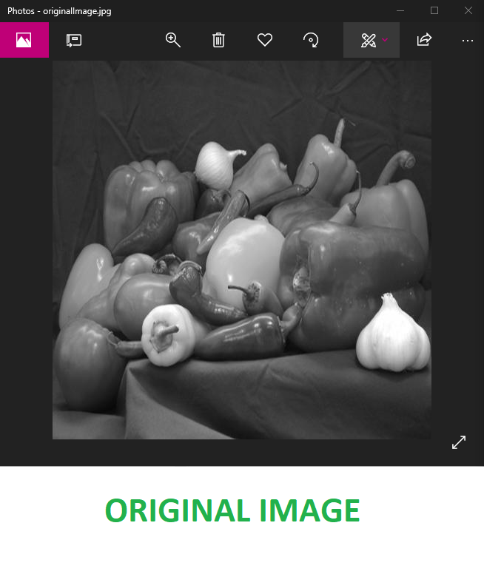
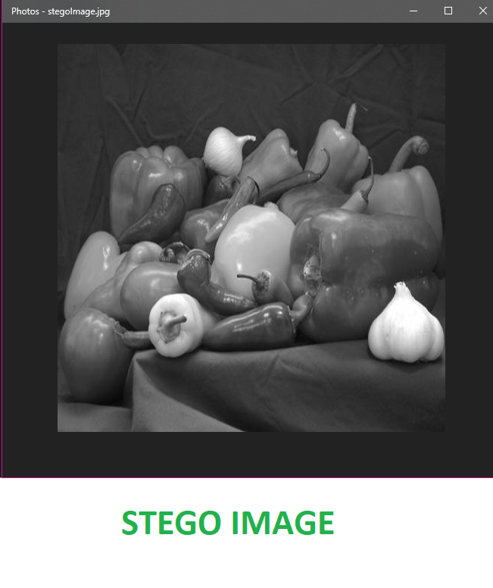
results
Encoding Results:
Successfully hid messages in various images with no visible changes.
Preserved the quality and size of the original image.
Decoding Results:
Accurately retrieved hidden messages from encoded images.
Demonstrated robustness across different image formats and resolutions.
Outcome:
Validated the effectiveness of the LSB steganography technique.
Ensured secure and undetectable message transmission.

Slide 10
links
Project Code:
GitHub Repository Link:
https://github.com/saii-ganesh/cybersecurity_project.git
References:
Research papers and articles on steganography.
Python libraries and tools used in the project.

Slide 11
conclusion
Summary:
Implemented a steganography technique to securely hide text within images.
Demonstrated practical applications for enhanced security and privacy.
Future Work:
Explore advanced steganography methods for even greater security.
Develop applications for real-world scenarios, such as secure communications and data protection.

