Slide 1
Model View Controller (MVC) an architecture

Slide 2
Model View Controller (MVC)
The intent of MVC is to keep neatly separate objects into one of tree categories
  Model
    The data, the business logic, rules, strategies, and so on
  View
    Displays the model and usually has components that allows user to edit change the model
  Controller
    Allows data to flow between the view and the model
    The controller mediates between the view and model

Slide 3
Model
The Model's responsibilities
  Provide access to the state of the system
  Provide access to the system's functionality
  Can notify the view(s) that its state has changed

Slide 4
View
The view's responsibilities
  Display the state of the model to the user
At some point, the model (a.k.a. the observable) must registers the views (a.k.a. observers) so the model can notify the observers that its state has changed

Slide 5
Controller
The controller's responsibilities
  Accept user input
    Button clicks, key presses, mouse movements, slider bar changes
  Send messages to the model, which may in turn notify it observers
  Send appropriate messages to the view
In Java, listeners are controllers

Slide 6
MVC Misunderstood
MVC is understood by different people in different ways
It is often misunderstood, but most software developers will say it is important; powerful
Lets start it right:
  MVC is a few patterns put together

Slide 7
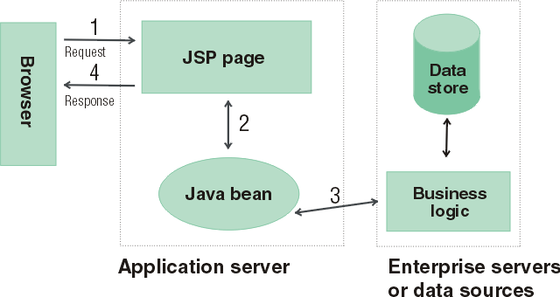
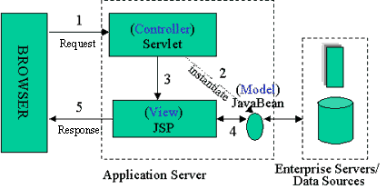
Java Server Pages
Model 2 Architecture to serve dynamic content
  Model: Enterprise Beans with data in the DBMS
    JavaBean: a class that encapsulates objects and can be displayed graphically
  Controller: Servlets create beans, decide which JSP to return, do the bulk of the processing
  View: The JSPs generated in the presentation layer (the browser)

Slide 8
OO-tips writes
The MVC paradigm is a way of breaking an application, or even just a piece of an application's interface, into three parts: the model, the view, and the controller.
MVC was originally developed to map the traditional input, processing, output roles into the GUI realm:
  Input --> Processing --> Output
  Controller --> Model --> View

Slide 9
Wikipedia writes
Model-View-Controller (MVC) is a software architecture that separates an application's data model, user interface, and control logic into three distinct components so that modifications to one component can be made with minimal impact to the others.
MVC is often thought of as a software design pattern. However, MVC encompasses more of the architecture of an application than is typical for a design pattern. Hence the term architectural pattern may be useful (Buschmann, et al 1996), or perhaps an aggregate design pattern.

Slide 10
MVC Benefits
Clarity of design
  easier to implement and maintain
Modularity
  changes to one doesn't affect other modules
  can develop in parallel once you have the interfaces
Multiple views
  games, spreadsheets, powerpoint, Eclipse, UML reverse engineering, ….

Slide 11
Summary (MVC)
The intent of MVC is to keep neatly separate objects into one of tree categories
  Model
    The data, the business logic, rules, strategies, and so on
  View
    Displays the model and often has components to allow users to change the state of the model
      Imagine pressing arrow on a HuntTheWumpus view Demo JeyPressed
  Controller
    Allows data to flow between the view and the model
    The controller mediates between the view and model

Slide 12
Model
The Model's responsibilities
  Provide access to the state of the model
    getters, toString, other methods that provide info
  Provide access to the system's functionality
    changeRoom(int), shootArrow(int)
  Notify the view(s) that its state has changed
// If extending Java’s Obervable class, do NOT forget
// to tell yourself your state has changed
super.setChanged();
// Otherwise, the next notifyObservers message will not
// send update messages to the registered Observers
this.notifyObservers();

Slide 13
View
The view's responsibilities
  Display the state of the model to users, accept input
The model (a.k.a. the Observable) must register the views (a.k.a. Observers) so the model can notify the observers that its state has changed
  Java’s Observer/Observable support provides
  public void addObserver(Observer o)
  // Adds an observer to the set of observers for this
  // object, provided that it is not the same as some
  // observer already in the set.

Slide 14
Controller
The controller's responsibilities
  Respond to user input (events)
    Button click, key press, mouse click, slider bar change
  Send messages to the model, which may in turn notify it observers
  Send appropriate messages to the view
In Java, controllers are implemented as listeners
  An ActionListener object and its actionPerformed method is a Controller

Slide 15
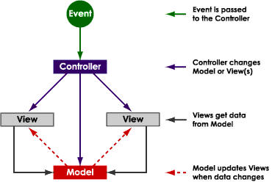
One view of MVC

