Slide 1
Life Cycle of Servlet
Servlet life cycle contains five steps:
Loading of Servlet
Creating instance of Servlet
Invoke init() once
Invoke service() repeatedly for each client request
Invoke destroy()
Instance and objects are same thing.
Invoking a method means calling a method.
Here are the five steps of servlet life cycle.
Step 1: Loading of Servlet
When the web server (e.g. Apache Tomcat) starts up, the servlet container deploy and loads all the servlets.
Step 2: Creating instance of Servlet
Once all the Servlet classes loaded, the servlet container creates instances of each servlet class. Servlet container creates only once instance per servlet class and all the requests to the servlet are executed on the same servlet instance.

Slide 2
Step 3: Invoke init() method
Once all the servlet classes are instantiated, the init() method is invoked for each instantiated servlet. This method initializes the servlet. There are certain init parameters that you can specify in the deployment descriptor (web.xml) file. For example, if a servlet has value >=0 then its init() method is immediately invoked during web container startup.
You can specify the element in web.xml file like this:
<servlet> <servlet-name>MyServlet</servlet-name> <servlet-class>com.beginnersbook.MyServletDemo</servlet-class> <load-on-startup>1</load-on-startup> </servlet>Now the init() method for corresponding servlet class com.beginnersbook.MyServletDemo would be invoked during web container startup.
Note: The init() method is called only once during the life cycle of servlet.
Step 4: Invoke service() method
Each time the web server receives a request for servlet, it spawns a new thread that calls service() method. If the servlet is GenericServlet then the request is served by the service() method itself, if the servlet is HttpServlet then service() method receives the request and dispatches it to the correct handler method based on the type of request.

Slide 3
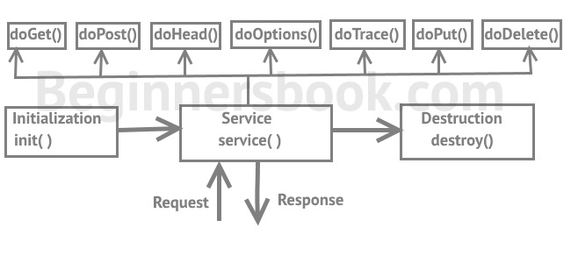
For example if it is a Get Request the service() method would dispatch the request to the doGet() method by calling the doGet() method with request parameters. Similarly the requests like Post, Head, Put etc. are dispatched to the corresponding handlers doPost(), doHead(), doPut() etc. by service() method of servlet.

Slide 4
Step 5: Invoke destroy() method
When servlet container shuts down(this usually happens when we stop the web server), it unloads all the servlets and calls destroy() method for each initialized servlets.
Web Server: it can handle HTTP Requests send by clients and responds the request with an HTTP Response.
Web Application(webapp): I would refer this as webapp in this guide. Basically the project is your web application, it is the collection of servlets.
Web Container: Also known as Servlet Container and Servlet Engine. It is a part of Web Server that interacts with Servlets. This is the main component of Web Server that manages the life cycle of Servlets.

Slide 5
Servlet structure
A Servlet is an Java application programming interface (API) running on the server, which intercepts requests made by the client and generates/sends a response. The javax.servlet and javax.servlet.http packages provide interfaces and classes for writing servlets.

Slide 6
A simple servlet that generates plain text
example - (HelloWorld.java)
package testPackage; // Always use packages. import java.io.*;
import javax.servlet.*;
import javax.servlet.annotation.*;
import javax.servlet.http.*; @WebServlet("/hello")
public class HelloWorld extends HttpServlet { @Override
public void doGet(HttpServletRequest request, HttpServletResponse response) throws ServletException, IOException
{
PrintWriter out = response.getWriter(); out.println("Hello World!");
}
}

Slide 7
doGet
Notice that there is no main() method in above program. When user enters a URL on the address line of browser the browser sends the request and the servlet’s doGet() method is called by the Container (tomcat).
doGet method takes two arguments: HttpServletRequest and HttpServletResponse
HttpServletRequest lets you get all of the incoming data; like form/query data, request headers.
HttpServletResponse lets you send document content and reponse headers back to the client.
doGet method throw two execeptions ServletException and IOException you need to include them in method signature.
You can get a PrintWriter from the response object. Use the PrintWriter object to send document content to the browser.

Slide 8
Servlet execution
step1:
down load apache tomcat 9 version from apachetomcat.org
from there goto version 9 and from there cin core click on 32/64 bit windows service installer.
step2:after installation run as administrator then create login and password .
step 3:automatically it selects the path of java jre and it links to it.
step 4:next we need to set the paths like CATALINA_HOME,PATH,CLASSPATH,JAVA_HOME
CATALINA_HOME as C:\Program Files\Apache Software Foundation\Tomcat 9.0
CLASSPATH as C:\Program Files\Apache Software Foundation\Tomcat 9.0\lib\servlet-api.jar
JAVA_HOME as C:\Program Files\Java
PATH as C:\Program Files\Java\jdk-9.0.1\bin

Slide 9
step 5:create a folder in side webapps as "programs" in that create another folder
"WEB_INF" and create another folder "classes".plce .class files in side classes folder
copy web.xml from conf folder and paste it in programs folder which is parallel to
classes folder.create "servlets" folder parallel to WEB_INF in which store all html files.
step6:for every java servlet there should be one web.xml and one html files should be
available with in this folder at appropriate places.

Slide 10
step7:running servlet
(i)inside conf folder in web.xml file we need to make listings to be "true".
(ii) then compile java servlet
(iii)type in browser as http:/local host/3030 it displays apache tomcat page
(iv)now we found manager app click on that enter user id and password
(v)then we found our folder programs.
(vi)click on that go to servlets then click on a paricular html file automatically it links to servlet
and servlet execution will be done.

Slide 11
ServletRequest Interface
An object of ServletRequest is used to provide the client request information to a servlet such as content type, content length, parameter names and values, header informations, attributes etc.

Slide 12
Methods of ServletRequest interface:
There are many methods defined in the ServletRequest interface. Some of them are as follows:
Method | Description
public String getParameter(String name) | is used to obtain the value of a parameter by name.
public String[] getParameterValues(String name) | returns an array of String containing all values of given parameter name. It is mainly used to obtain values of a Multi select list box.
java.util.Enumeration getParameterNames() | returns an enumeration of all of the request parameter names.
public int getContentLength() | Returns the size of the request entity data, or -1 if not known.
public String getCharacterEncoding() | Returns the character set encoding for the input of this request.
public String getContentType() | Returns the Internet Media Type of the request entity data, or null if not known.
public ServletInputStream getInputStream() throws IOException | Returns an input stream for reading binary data in the request body.
public abstract String getServerName() | Returns the host name of the server that received the request.
public int getServerPort() | Returns the port number on which this request was received.

Slide 13
RequestDispatcher in Servlet
The RequestDispatcher interface provides the facility of dispatching the request to another resource it may be html, servlet or jsp. This interface can also be used to include the content of another resource also. It is one of the way of servlet collaboration.
There are two methods defined in the RequestDispatcher interface.
Methods of RequestDispatcher interface
The RequestDispatcher interface provides two methods. They are:
public void forward(ServletRequest request,ServletResponse response)throws ServletException,java.io.IOException:Forwards a request from a servlet to another resource (servlet, JSP file, or HTML file) on the server.
public void include(ServletRequest request,ServletResponse response)throws ServletException,java.io.IOException:Includes the content of a resource (servlet, JSP page, or HTML file) in the response.

Slide 14
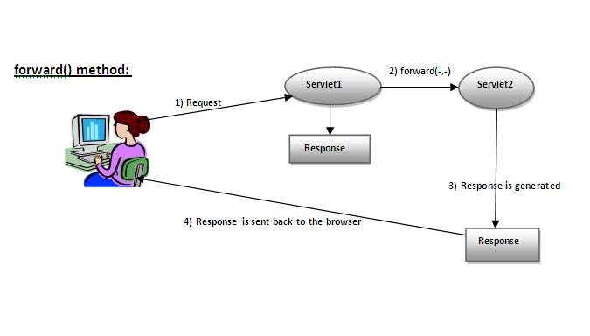

Slide 15
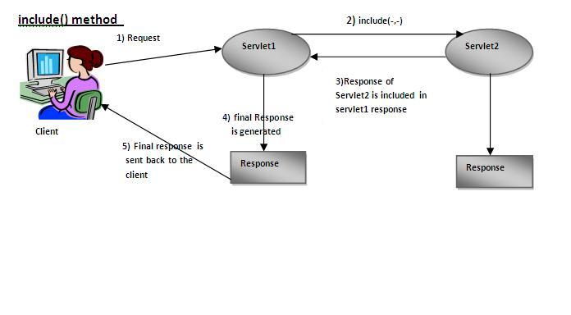

Slide 16
SendRedirect()
The sendRedirect() method of HttpServletResponse interface can be used to redirect response to another resource, it may be servlet, jsp or html file.
It accepts relative as well as absolute URL.
It works at client side because it uses the url bar of the browser to make another request. So, it can work inside and outside the server.

Slide 17
Difference between forward() and sendRedirect() method
There are many differences between the forward() method of RequestDispatcher and sendRedirect() method of HttpServletResponse interface.
They are given below:
forward() method | sendRedirect() method
The forward() method works at server side. | The sendRedirect() method works at client side.
It sends the same request and response objects to another servlet. | It always sends a new request.
It can work within the server only. | It can be used within and outside the server.
Example: request.getRequestDispacher("servlet2").forward(request,response); | Example: response.sendRedirect("servlet2");

Slide 18
ServletConfig Interface
An object of ServletConfig is created by the web container for each servlet. This object can be used to get configuration information from web.xml file.
If the configuration information is modified from the web.xml file, we don't need to change the servlet. So it is easier to manage the web application if any specific content is modified from time to time.
Advantage of ServletConfig
The core advantage of ServletConfig is that you don't need to edit the servlet file if information is modified from the web.xml file.
Methods of ServletConfig interface
public String getInitParameter(String name):Returns the parameter value for the specified parameter name.
public Enumeration getInitParameterNames():Returns an enumeration of all the initialization parameter names.
public String getServletName():Returns the name of the servlet.
public ServletContext getServletContext():Returns an object of ServletContext.

Slide 19
ServletContext Interface
An object of ServletContext is created by the web container at time of deploying the project. This object can be used to get configuration information from web.xml file. There is only one ServletContext object per web application.
If any information is shared to many servlet, it is better to provide it from the web.xml file using the <context-param> element.
Advantage of ServletContext
Easy to maintain if any information is shared to all the servlet, it is better to make it available for all the servlet. We provide this information from the web.xml file, so if the information is changed, we don't need to modify the servlet. Thus it removes maintenance problem.
Usage of ServletContext Interface
There can be a lot of usage of ServletContext object. Some of them are as follows:
The object of ServletContext provides an interface between the container and servlet.
The ServletContext object can be used to get configuration information from the web.xml file.
The ServletContext object can be used to set, get or remove attribute from the web.xml file.
The ServletContext object can be used to provide inter-application communication.

Slide 20
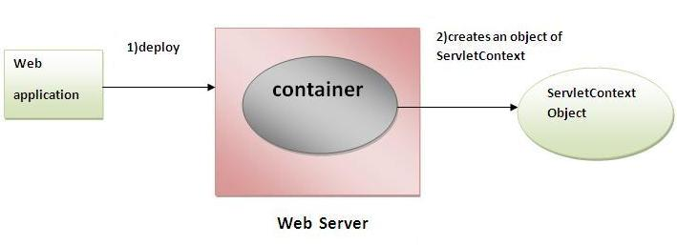

Slide 21
There is given some commonly used methods of ServletContext interface.public String getInitParameter(String name):Returns the parameter value for the specified parameter name. public Enumeration getInitParameterNames():Returns the names of the context's initialization parameters. public void setAttribute(String name,Object object):sets the given object in the application scope. public Object getAttribute(String name):Returns the attribute for the specified name. public Enumeration getInitParameterNames():Returns the names of the context's initialization parameters as an Enumeration of String objects. public void removeAttribute(String name):Removes the attribute with the given name from the servlet context.
Commonly used methods of ServletContext interface

Slide 22
Managing Sessions in Servlets (or) statemanagement techniques
HTTP is a stateless protocol. All requests and responses are independent. But sometimes you need to keep track of client's activity across multiple requests. For eg. When a User logs into your website, not matter on which web page he visits after logging in, his credentials will be with the server, until he logs out. So this is managed by creating a session.
Session Management is a mechanism used by the Web container to store session information for a particular user. There are four different techniques used by Servlet application for session management. They are as follows:
Cookies
Hidden form field
URL Rewriting
HttpSession
Session is used to store everything that we can get from the client from all the requests the client makes.The basic concept behind session is, whenever a user starts using our application, we can save a unique identification information about him, in an object which is available throughout the application, until its destroyed. So wherever the user goes, we will always have his information and we can always manage which user is doing what. Whenever a user wants to exit from your application, destroy the object with his information.

Slide 23
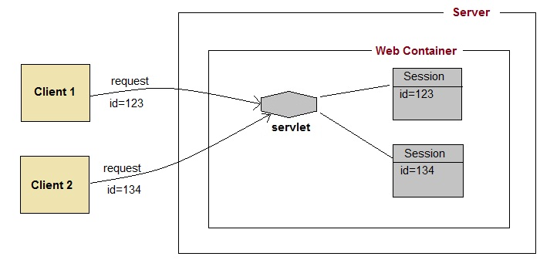
SESSION WORKING

Slide 24
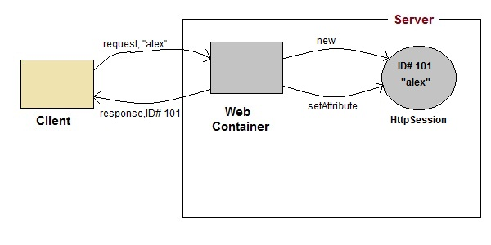
HttpSession
HttpSession object is used to store entire session with a specific client. We can store, retrieve and remove attribute from HttpSession object. Any servlet can have access to HttpSession object throughout the getSession() method of the HttpServletRequest object.
HTTP session works like

Slide 25
On client's first request, the Web Container generates a unique session ID and gives it back to the client with response. This is a temporary session created by web container.
The client sends back the session ID with each request. Making it easier for the web container to identify where the request is coming from.
The Web Container uses this ID, finds the matching session with the ID and associates the session with the request.

Slide 26
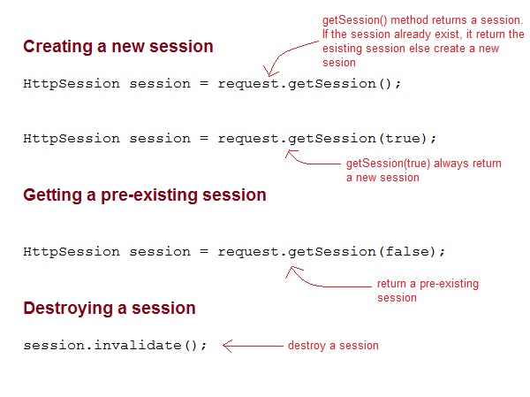
http session interface

Slide 27
Some Important Methods of HttpSession
Methods | Description
long getCreationTime() | returns the time when the session was created, measured in milliseconds since midnight January 1, 1970 GMT.
String getId() | returns a string containing the unique identifier assigned to the session.
long getLastAccessedTime() | returns the last time the client sent a request associated with the session
int getMaxInactiveInterval() | returns the maximum time interval, in seconds.
void invalidate() | destroy the session
boolean isNew() | returns true if the session is new else false
void setMaxInactiveInterval(int interval) | Specifies the time, in seconds,after servlet container will invalidate the session.

Slide 28
index.html
<form method="post" action="Validate"> User: <input type="text" name="user" /><br/> Password: <input type="text" name="pass" ><br/> <input type="submit" value="submit"> </form>

Slide 29
web.xml
<web-app..>
<servlet>
<servlet-name>Validate</servlet-name>
<servlet-class>Validate</servlet-class>
</servlet>
<servlet>
<servlet-name>Welcome</servlet-name>
<servlet-class>Welcome</servlet-class>
</servlet>
<servlet-mapping>
<servlet-name>Validate</servlet-name>
<url-pattern>/Validate</url-pattern>
</servlet-mapping>
<servlet-mapping>
<servlet-name>Welcome</servlet-name>
<url-pattern>/Welcome</url-pattern> </servlet-mapping>
<welcome-file-list>
<welcome-file>index.html </welcome-file>
</welcome-file-list>
</web-app>

Slide 30
Validate.java
import java.io.*;
import javax.servlet.*;
import javax.servlet.http.*;
public class Validate extends HttpServlet
{ protected
void doPost(HttpServletRequest request, HttpServletResponse response) throws ServletException, IOException { response.setContentType("text/html;charset=UTF-8"); String name = request.getParameter("user");
String pass = request.getParameter("pass"); if(pass.equals("1234")) { //creating a session HttpSession session = request.getSession(); session.setAttribute("user", name); response.sendRedirect("Welcome"); } } }

Slide 31
Welcome.java
import java.io.*; import javax.servlet.*; import javax.servlet.http.*; public class Welcome extends HttpServlet { protected void doGet(HttpServletRequest request, HttpServletResponse response) throws ServletException, IOException { response.setContentType("text/html;charset=UTF-8"); PrintWriter out = response.getWriter(); HttpSession session = request.getSession(); String user = (String)session.getAttribute("user"); out.println("Hello "+user); } }

Slide 32
Using Cookies for Session Management:
Cookies are small pieces of information that are sent in response from the web server to the client.
Cookies are the simplest technique used for storing client state.
Cookies are stored on client's computer. They have a lifespan and are destroyed by the client browser at the end of that lifespan.
Using Cookies for storing client state has one shortcoming though, if the client has turned of Cookie saving settings in his browser then, client state can never be saved because the browser will not allow the application to store cookies.

Slide 33
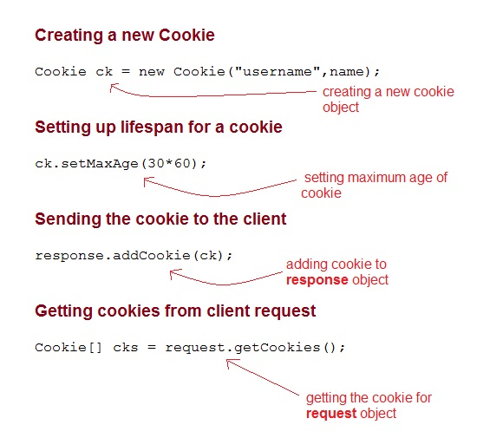
Cookies API
Cookies are created using Cookie class present in Servlet API. Cookies are added to response object using the addCookie() method. This method sends cookie information over the HTTP response stream. getCookies() method is used to access the cookies that are added to response object.

Slide 34
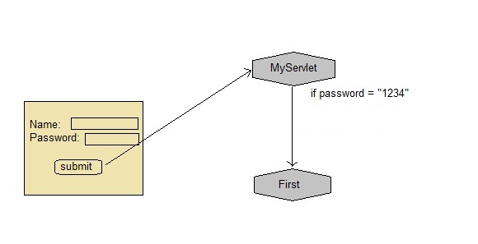
Example demonstrating usage of Cookies

Slide 35
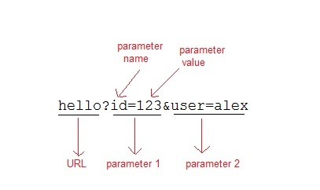
Using URL Rewriting for Session Management
If the client has disabled cookies in the browser then session management using cookie wont work. In that case URL Rewriting can be used as a backup. URL rewriting will always work.
In URL rewriting, a token(parameter) is added at the end of the URL. The token consist of name/value pair seperated by an equal(=) sign.
For Example:

Slide 36
When the User clicks on the URL having parameters, the request goes to the Web Container with extra bit of information at the end of URL. The Web Container will fetch the extra part of the requested URL and use it for session management.
The getParameter() method is used to get the parameter value at the server side.

Slide 37
Using Hidden Form Field for Session Management
Hidden form field can also be used to store session information for a particular client. In case of hidden form field a hidden field is used to store client state. In this case user information is stored in hidden field value and retrieved from another servlet.
Advantages :
Does not have to depend on browser whether the cookie is disabled or not.
Inserting a simple HTML Input field of type hidden is required. Hence, its easier to implement.
Disadvantage :
Extra form submission is required on every page. This is a big overhead.

Slide 38
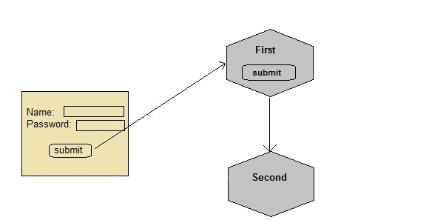
Example demonstrating usage of Hidden Form Field for Session

