Slide 1
ADO.NET
.NET Data Access and Manipulation

Slide 2
Overview
What is ADO.NET?
Disconnected vs. connected data access models
ADO.NET Architecture
ADO.NET Core Objects
Steps of Data Access
Advanced Techniques and UI Tools

Slide 3
What is ADO.NET?
A data-access technology that enables applications to connect to data stores and manipulate data contained in them in various ways
Former version was ADO (ActiveX Data Object)

Slide 4
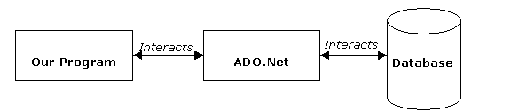
What is ADO.NET?
An object oriented framework that allows you to interact with database systems

Slide 5
Objective of ADO.NET
Support disconnected data architecture,
Tight integration with XML,
Common data representation
Ability to combine data from multiple and varied data sources
Optimized facilities for interacting with a database

Slide 6
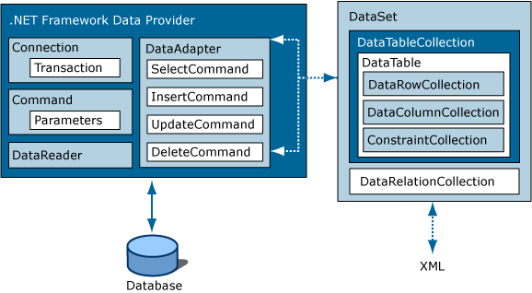
ADO.NET Architecture

Slide 7
ADO.NET Core Objects
Core namespace: System.Data
.NET Framework data providers:
Data Provider | Namespace
SQL Server | System.Data.SqlClient
OLE DB | System.Data.OleDb
ODBC | System.Data.Odbc
Oracle | System.Data.OracleClient

Slide 8
ADO.NET Core Objects
Object | Description
Connection | Establishes a connection to a specific data source. (Base class: DbConnection)
Command | Executes a command against a data source. Exposes Parameters and can execute within the scope of a Transaction from a Connection. (The base class: DbCommand)
DataReader | Reads a forward-only, read-only stream of data from a data source. (Base class: DbDataReader)
DataAdapter | Populates a DataSet and resolves updates with the data source. (Base class: DbDataAdapter)
DataTable | Has a collection of DataRows and DataColumns representing table data, used in disconnected model
DataSet | Represents a cache of data. Consists of a set of DataTables and relations among them

Slide 9
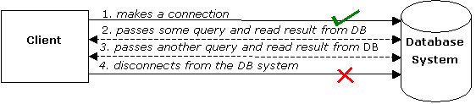
Connected Data Access Model

Slide 10
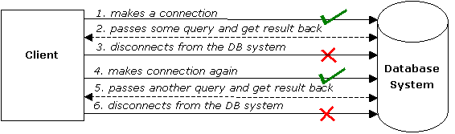
Disconnected Data Access Model

Slide 11
Pros and Cons
 | Connected | Disconnected
Database Resources | - | +
Network Traffic | - | +
Memory Usage | + | -
Data Access | - | +

Slide 12
Steps of Data Access: Disconnected Environment
Defining the connection string
Defining the connection
Defining the command
Defining the data adapter
Creating a new DataSet object
SELECT -> fill the dataset object with the result of the query through the data adapter
Reading the records from the DataTables in the datasets using the DataRow and DataColumn objects
UPDATE, INSERT or DELETE -> update the database through the data adapter

Slide 13
using System;
using System.Data;
using System.Data.SqlClient;
namespace SampleClass
{
class Program
{
static void Main(string[] args)
{
string connStr =
Properties.Settings.Default.connStr;
SqlConnection conn = new SqlConnection(connStr);
string queryString = "SELECT * from titles;";
SqlDataAdapter da = new
SqlDataAdapter(queryString,conn);
DataSet ds = new DataSet();
da.fill(ds);
// Work on the data in memory using
// the DataSet (ds) object
}
}
}
EXAMPLE

Slide 14
Disconnected –
Update, Delete, Insert
SqlDataAdapter da = new SqlDataAdapter();
DataSet ds = new DataSet();
SqlCommandBuilder cmdBuilder = new SqlCommandBuilder(da);
da.Fill(ds);
INITIAL CODE
DataRow dr = ds.Tables[0].Rows[0];
dr.Delete();
da.UpdateCommand = builder.GetUpdateCommand();
da.Update(ds);
DELETE
DataRow dr = ds.Tables[0].Rows[0];
dr["CustomerName"] = "John";
da.UpdateCommand = builder.GetUpdateCommand();
da.Update(ds);
UPDATE
DataRow dr = ds.Tables[0].NewRow();
dr["CustomerName"] = "John";
dr["CustomerSurName"] = "Smith";
ds.Tables[0].Rows.Add(dr);
da.UpdateCommand = builder.GetUpdateCommand();
da.Update(ds);
INSERT

Slide 15
Steps of Data Acces : Connected Environment
Create connection
Create command (select-insert-update-delete)
Open connection
If SELECT -> use a DataReader to fetch data
If UPDATE,DELETE, INSERT -> use command object’s methods
Close connection

Slide 16
static void Main()
{
string connectionString =
Properties.Settings.Default.connStr;
string queryString = "SELECT CategoryID, CategoryName FROM dbo.Categories;";
SqlConnection connection = new SqlConnection(connectionString);
SqlCommand command = new SqlCommand(queryString,connection);
try
{
connection.Open();
SqlDataReader reader = command.ExecuteReader();
while (reader.Read())
{
Console.WriteLine("\t{0}\t{1}“,reader[0],reader[1]);
}
reader.Close();
connection.close();
}
catch (Exception ex)
{
Console.WriteLine(ex.Message);
}
}
EXAMPLE

Slide 17
Connected – Update, Delete, Insert
Command class core methods:
  ExecuteNonQuery : Executes a SQL statement against a connection object
  ExecuteReader: Executes the CommandText against the Connection and returns a DbDataReader
  ExecuteScalar: Executes the query and returns the first column of the first row in the result set returned by the query

Slide 18
Connected – Update, Delete, Insert
string connString = Properties.Settings.Default.connStr;
SqlConnection conn = new SqlConnection(connString);
SqlCommand cmd = new SqlCommand("delete from
Customers" + "where custID=12344", conn);
conn.Open();
cmd.ExecuteNonQuery();
conn.Close();
Can be an update or insert command

Slide 19
Choosing a DataReader or a Dataset
The type of functionality application requires should be considered
Use a dataset to:
  Cache data locally in your application so that you can manipulate it
  Remote data between tiers or from an XML Web service
  Interact with data dynamically such as binding to a Windows Forms control or combining and relating data from multiple sources
  Perform extensive processing on data without requiring an open connection to the data source, which frees the connection to be used by other clients
If readonly data is needed use DataReader to boost performance

Slide 20
Best Practices
Don’t create a new connection string for every code connecting to DB
Use app.config file to keep your connection strings through the application scope
  Right click on project and select properties
  Select settings from the left tabbed menu
  add the connection string to the table and save project, Name field is the name of the string to access at runtime
Accessing settings at runtime:
string connStr = Properties.Settings.Default.connStr;
You can keep any other variable to reach at runtime using this technique

Slide 21
After .NET Framework 2.0
To minimize the code written by developers new UI tools and objects have been intoduced with .NET Framework 2.0

Slide 22
After .NET Framework 2.0
Strongly Typed vs Untyped Datasets
  Untyped: DataSet and DataTables included are created at runtime completely using code
  Strongly Typed: Dataset is created at design time, it is defined by an xsd schema

Slide 23
After .NET Framework 2.0
TableAdapter
  provides communication between your application and a database
  Provides update/delete/insert functions
  Encapsulates a SQLDataAdapter object
  MSDN link:
  http://msdn.microsoft.com/en-us/library/bz9tthwx(VS.80).aspx

Slide 24
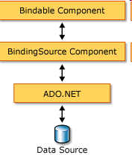
After .NET Framework 2.0
BindingSource
  Binds UI components to a strongly typed Dataset
  Ex: Binds a DataGridView to a DataTable
  Sets a DataSet as a datasource and datamember as a dataset table
  EndEdit() method: Applies changes made to data through a GUI control to the data source bound to that control
  MSDN link:
  http://msdn.microsoft.com/en-us/library/xxxf124e(VS.80).aspx

Slide 25
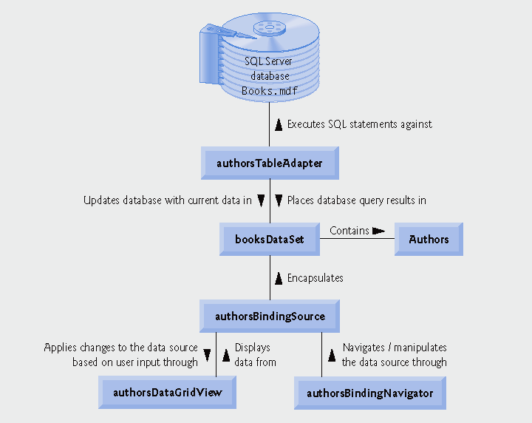
After .NET Framework 2.0
An example of databinding model

Slide 26
After .NET Framework 2.0
Binding Navigator
  Used for creating a standardized means for users to search and change data on a Windows Form
  Used with BindingNavigator with the BindingSource component to enable users to move through data records on a form and interact with the records
  MSDN link:
  http://msdn.microsoft.com/en-us/library/8zhc8d2f(VS.80).aspx

Slide 27
After .NET Framework 2.0
TableAdapterManager
  New component in Visual Studio 2008
  Builds upon existing data features (typed datasets and TableAdapters) and provides the functionality to save data in related data tables.
  Manages inserts/updates/deletes without violating the foreign-key constraints
  MSDN link:
  http://msdn.microsoft.com/en-us/library/bb384426.aspx

Slide 28
Hands On: Create a DB Navigator
Create a DB navigator with UI components and wizards

Slide 29
Hands On: Custom queries
Create a filter mechanism on an DataGridView with using custom queries
Manage datatables and TableAdapters

Slide 30
Hands On: Managing multiple tables
Create a navigation system with using the relations between two tables

