Slide 1
XML Parsers

Slide 2
XML Parsers
What is a XML parser?
DOM and SAX parser API

Slide 3
What is a XML Parser?
It is a software library (or a package) that provides methods (or interfaces) for client applications to work with XML documents
It checks the well-formattedness
It may validate the documents
It does a lot of other detailed things so that a client is shielded from that complexities

Slide 4
Parsers
What is a parser?
  A program that analyses the grammatical structure of an input, with respect to a given formal grammar
  The parser determines how a sentence can be constructed from the grammar of the language by describing the atomic elements of the input and the relationship among them

Slide 5
XML-Parsing Standards
We will consider two parsing methods that implement W3C standards for accessing XML
SAX (Simple API for XML)
  event-driven parsing
  “serial access” protocol
  Read only API
DOM (Document Object Model)
  convert XML into a tree of objects
  “random access” protocol
  Can update XML document (insert/delete nodes)

Slide 6
SAX Parser
SAX = Simple API for XML
XML is read sequentially
When a parsing event happens, the parser invokes the corresponding method of the corresponding handler
The handlers are programmer’s implementation of standard Java API (i.e., interfaces and classes)
Similar to an I/O-Stream, goes in one direction

Slide 7
DOM Parser
DOM = Document Object Model
Parser creates a tree object out of the document
User accesses data by traversing the tree
  The tree and its traversal conform to a W3C standard
The API allows for constructing, accessing and manipulating the structure and content of XML documents

Slide 8
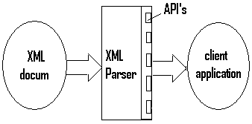
What is a XML Parser?
(continued)

Slide 9
DOM and SAX Parsers in general
DOM: Document Object Model
SAX: Simple API for XML
A DOM parser implements DOM API
A SAX parser implement SAX API
Most major parsers implement both DOM and SAX API’s

Slide 10
DOM and SAX Parsers
DOM parsers
DOM Document object
Main features of DOM parsers

Slide 11
DOM and SAX Parsers
DOM Document Object
A DOM document is an object containing all the information of an XML document
It is composed of a tree (DOM tree) of nodes , and various nodes that are somehow associated with other nodes in the tree but are not themselves part of the DOM tree

Slide 12
DOM and SAX Parsers
DOM Document Object
There are 12 types of nodes in a DOM Document object
Document node
Element node
Text node
Attribute node
Processing instruction node
…….

Slide 13
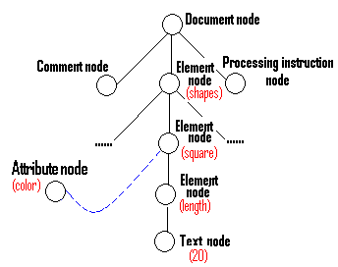
DOM and SAX Parsers
DOM parsers – continued (Appendix)

Slide 14
DOM and SAX Parsers main features of DOM parsers
A DOM parser creates an internal structure in memory which is a DOM document object
Client applications get the information of the original XML document by invoking methods on this Document object or on other objects it contains
DOM parser is tree-based (or DOM obj-based)
Client application seems to be pulling the data actively, from the data flow point of view

Slide 15
DOM and SAX Parsers main features of DOM parsers (cont.)
Advantage:
(1) It is good when random access to widely
separated parts of a document is required
(2) It supports both read and write operations
Disadvantage:
(1) It is memory inefficient
(2) It seems complicated, although not really

Slide 16
DOM and SAX Parsers
SAX parsers
It does not first create any internal structure
Client does not specify what methods to call
Client just overrides the methods of the API and place his own code inside there
When the parser encounters start-tag, end-tag,etc., it thinks of them as events

Slide 17
DOM and SAX Parsers
SAX parsers (cont.)
When such an event occurs, the handler automatically calls back to a particular method overridden by the client, and feeds as arguments the method what it sees
SAX parser is event-based,it works like an event handler in Java (e.g. MouseAdapter)
Client application seems to be just receiving the data inactively, from the data flow point of view

Slide 18
DOM and SAX Parsers
SAX parsers (cont.)
Advantage:
(1) It is simple
(2) It is memory efficient
(3) It works well in stream application
Disadvantage:
The data is broken into pieces and clients never have all the information as a whole unless they create their own data structure

