Slide 1
Network Intrusion Detection
Using Machine Learning
CAPSTONE PROJECT
Presented By:
1. SAIJAL TOMAR-GRAPHIC ERA HILL UNIVERSITY-CSE

Slide 2
OUTLINE
Problem Statement (Should not include solution)
Proposed System/Solution
System Development Approach (Technology Used)
Algorithm & Deployment
Result (Output Image)
Conclusion
Future Scope
References

Slide 3
Problem Statement
Cyber-attacks are becoming more common and dangerous, especially on computer networks. These attacks can include denial of service (DoS), probing attempts, and unauthorized access such as User to Root (U2R) and Remote to Local (R2L). Most traditional security systems are slow or unable to detect new types of threats in real time. There is a need for a smarter, automated solution that can monitor network traffic continuously and identify suspicious behaviour quickly and accurately. This project aims to develop a Machine Learning-based Network Intrusion Detection System (NIDS) that can classify network activity as normal or malicious.

Slide 4
Proposed Solution
This project aims to build a Network Intrusion Detection System (NIDS) using machine learning that can automatically detect and classify different types of cyber-attacks from normal traffic. The system will:
Data Collection:
Use a Kaggle dataset with labeled network data.
Gather features related to network traffic like protocol type, service, bytes transferred, and connection flags.
Data Preprocessing:
Clean and preprocess the data by handling missing values, duplicates, and outliers.
Machine Learning Algorithm:
Train and evaluate multiple algorithms (e.g., Decision Tree, Random Forest, SVM).
Select the best-performing model based on accuracy and consistency.
Deployment:
Deploy the trained model using IBM Cloud Watson Machine Learning service.
Enable users to input test records and get live classification as normal or anomaly.
Evaluation:
Measure model accuracy, precision, recall, and F1-score.
Perform confidence analysis to understand prediction reliability.

Slide 5
System Approach
The “System Approach” section outlines the overall strategy and tools used for developing and deploying the
machine learning-based intrusion detection system.
System requirements
IBM Cloud (mandatory)
IBM Watson Studio for model training, testing, and deployment
IBM Cloud Object Storage for uploading datasets

Slide 6
Algorithm & Deployment
Algorithm Selection:
Snap Decision Tree Classifier (selected by IBM AutoAI for best performance)
Other models evaluated: Random Forest, Support Vector Machine (SVM)
Data Input:
Protocol type, service, and connection flags
Source and destination byte counts
Training Process:
Supervised learning using labeled data (normal and various attack types)
Prediction Process:
Model deployed on IBM Watson Studio with real-time prediction enabled through an API endpoint.

Slide 7
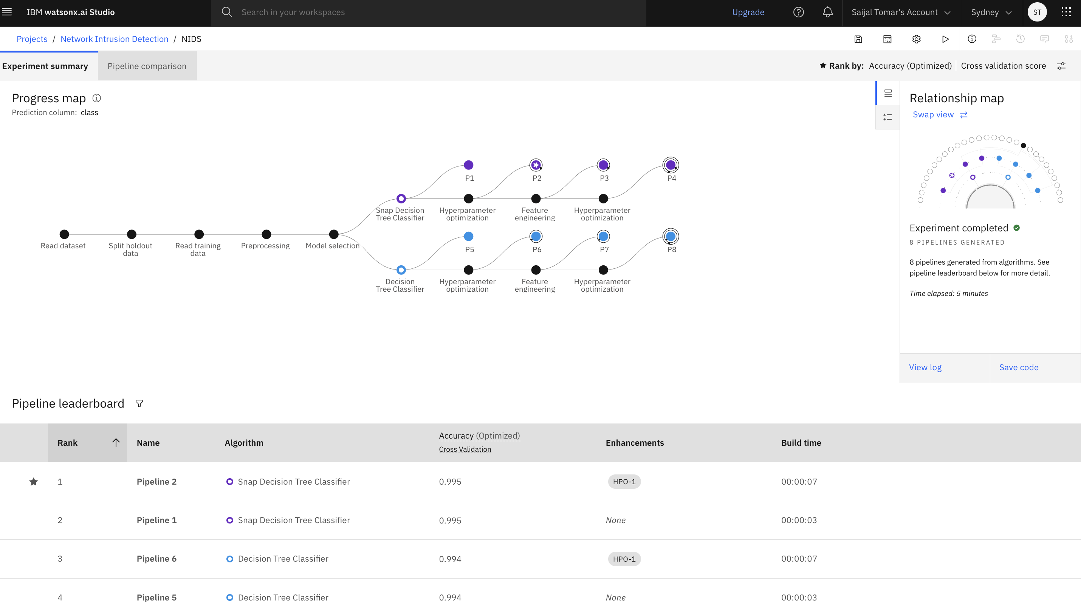
Result

Slide 8
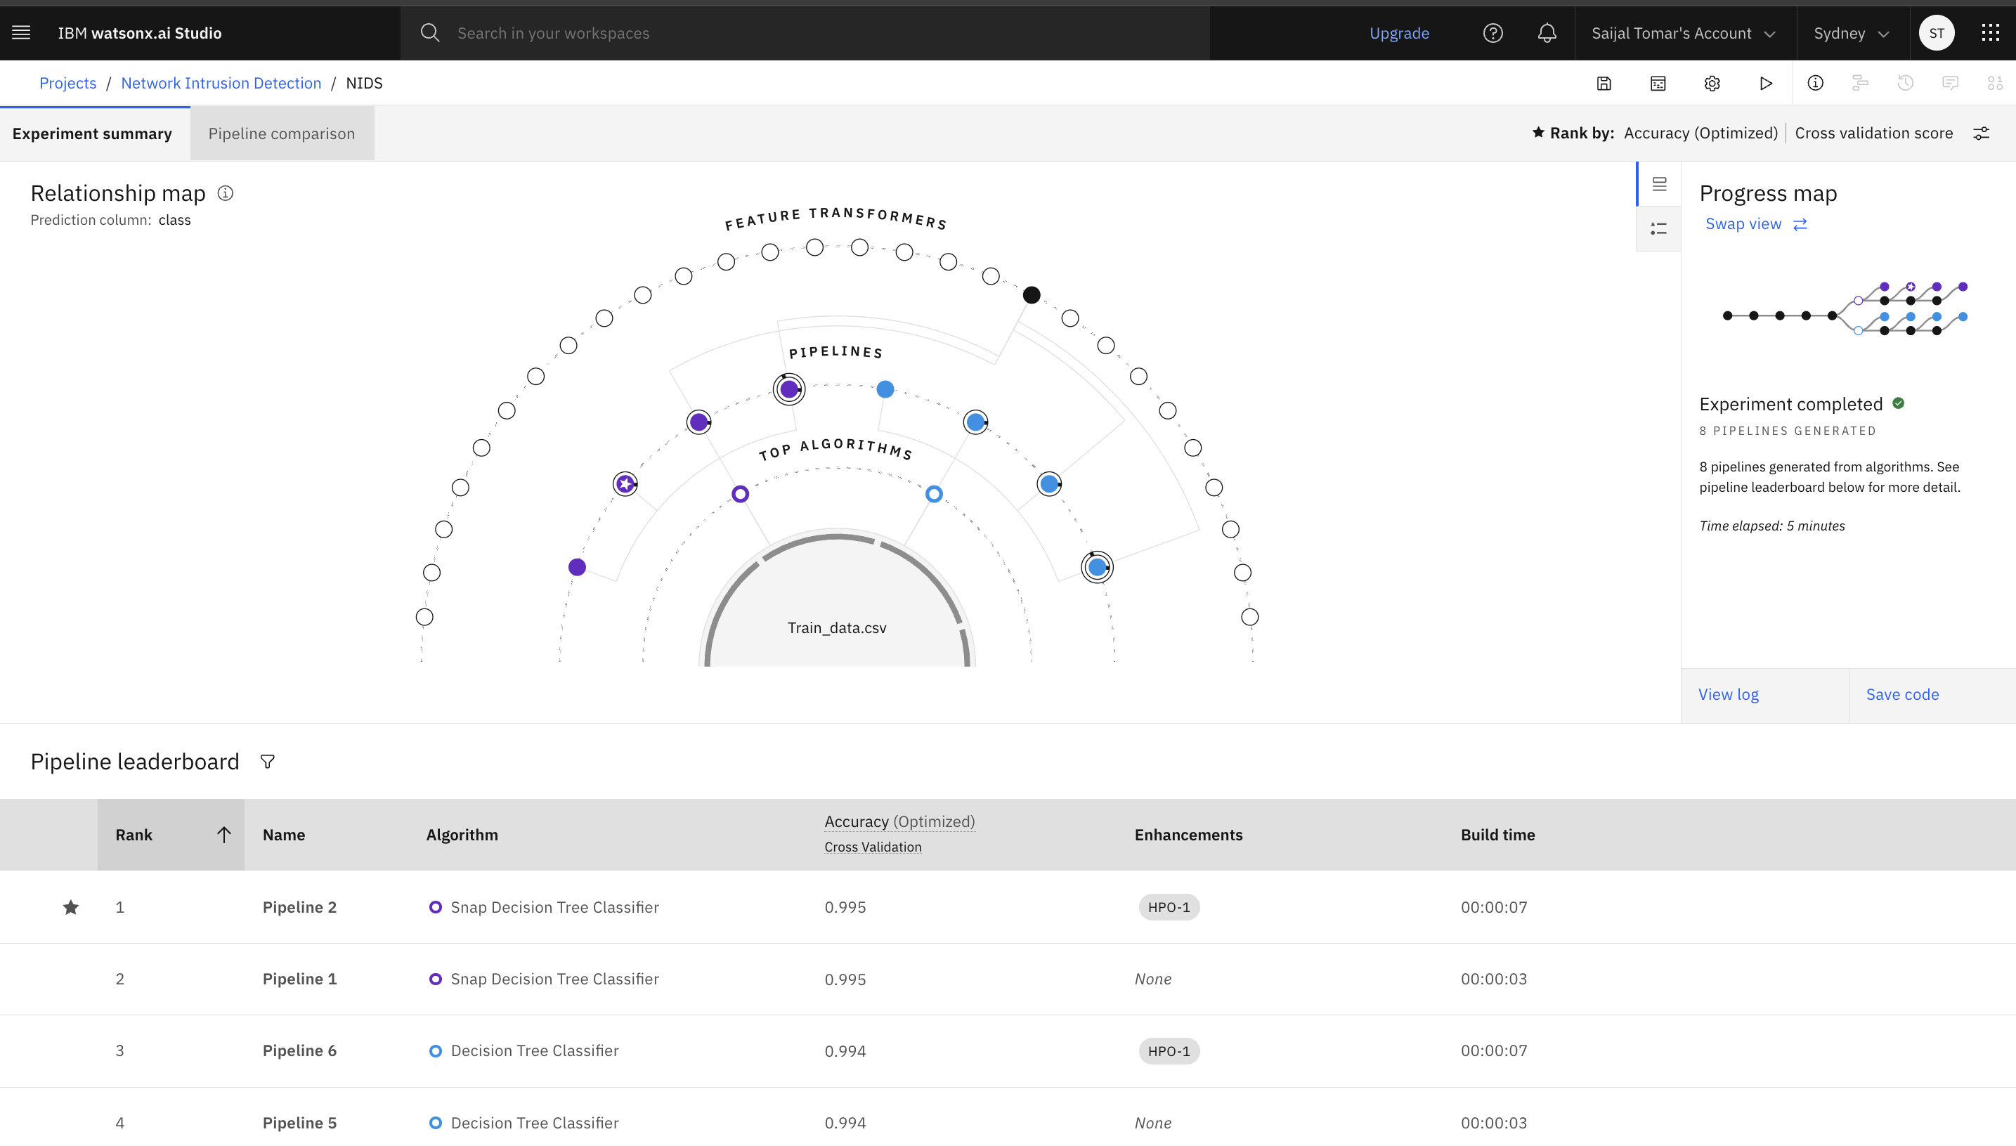
Result

Slide 9
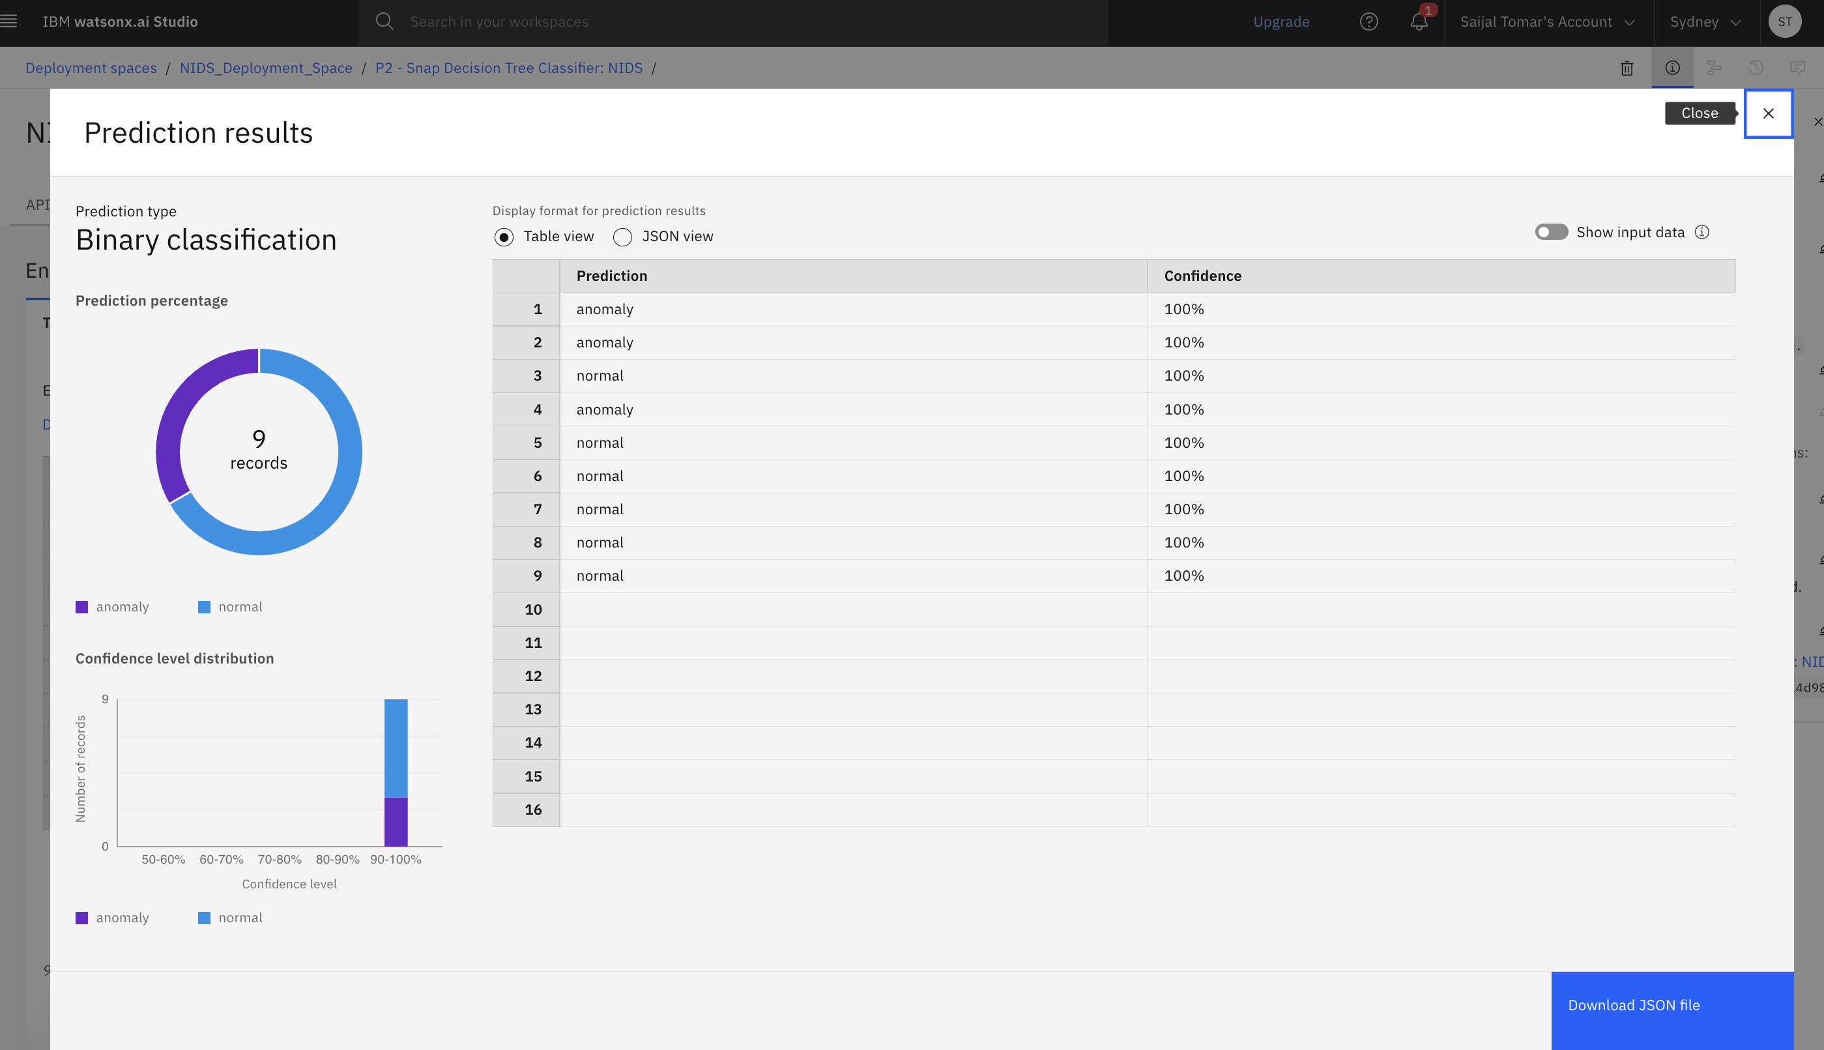
Result

Slide 10
Conclusion
The project successfully developed a machine learning-based Network Intrusion Detection System (NIDS) using IBM Watson Studio.
The model accurately classified network traffic as either normal or anomalous with high confidence using the Snap Decision Tree algorithm.
Deployment on IBM Cloud enabled real-time predictions through an API endpoint.
Some challenges included handling high-dimensional data, preprocessing categorical features, and ensuring clean input formatting for deployment.
Overall, the solution proved effective in enhancing cybersecurity by detecting potential threats early and supporting proactive defense.

Slide 11
Future scope
Improve the model using deep learning
Handle encrypted traffic
Integrate with live network monitoring tools
Expand the system to detect new, unseen types of attacks
Add an automatic response system to block threats in real-time

Slide 12
References
Kaggle Dataset– Network Intrusion Detection -https://www.kaggle.com/datasets/sampadab17/network-intrusion-detection
IBM Cloud Docs
Research papers on Intrusion Detection Systems
Articles on machine learning in cybersecurity

Slide 13
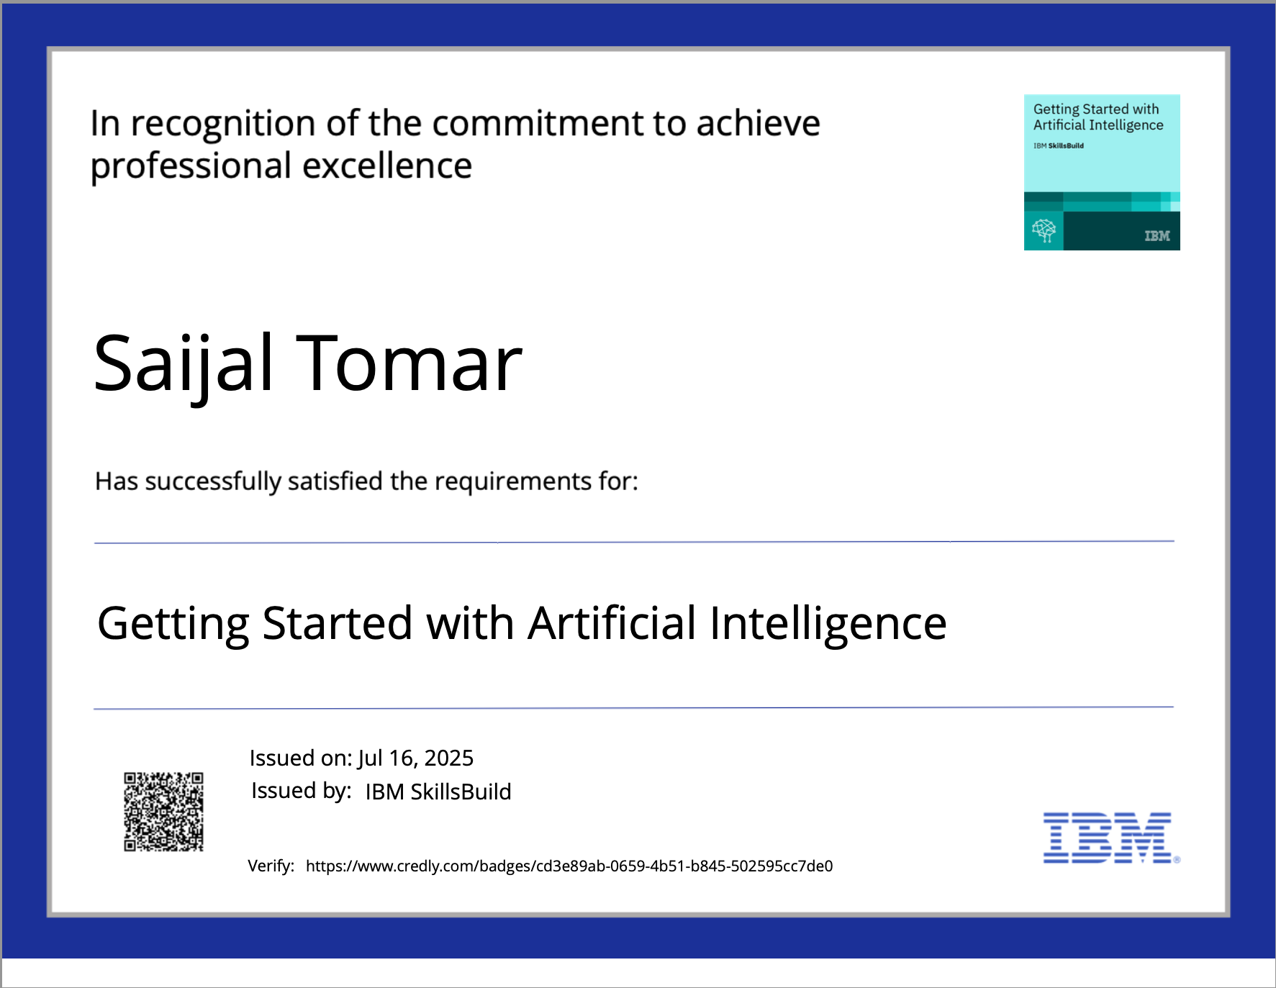
IBM Certifications
Screenshot/ credly certificate( getting started with AI)

Slide 14
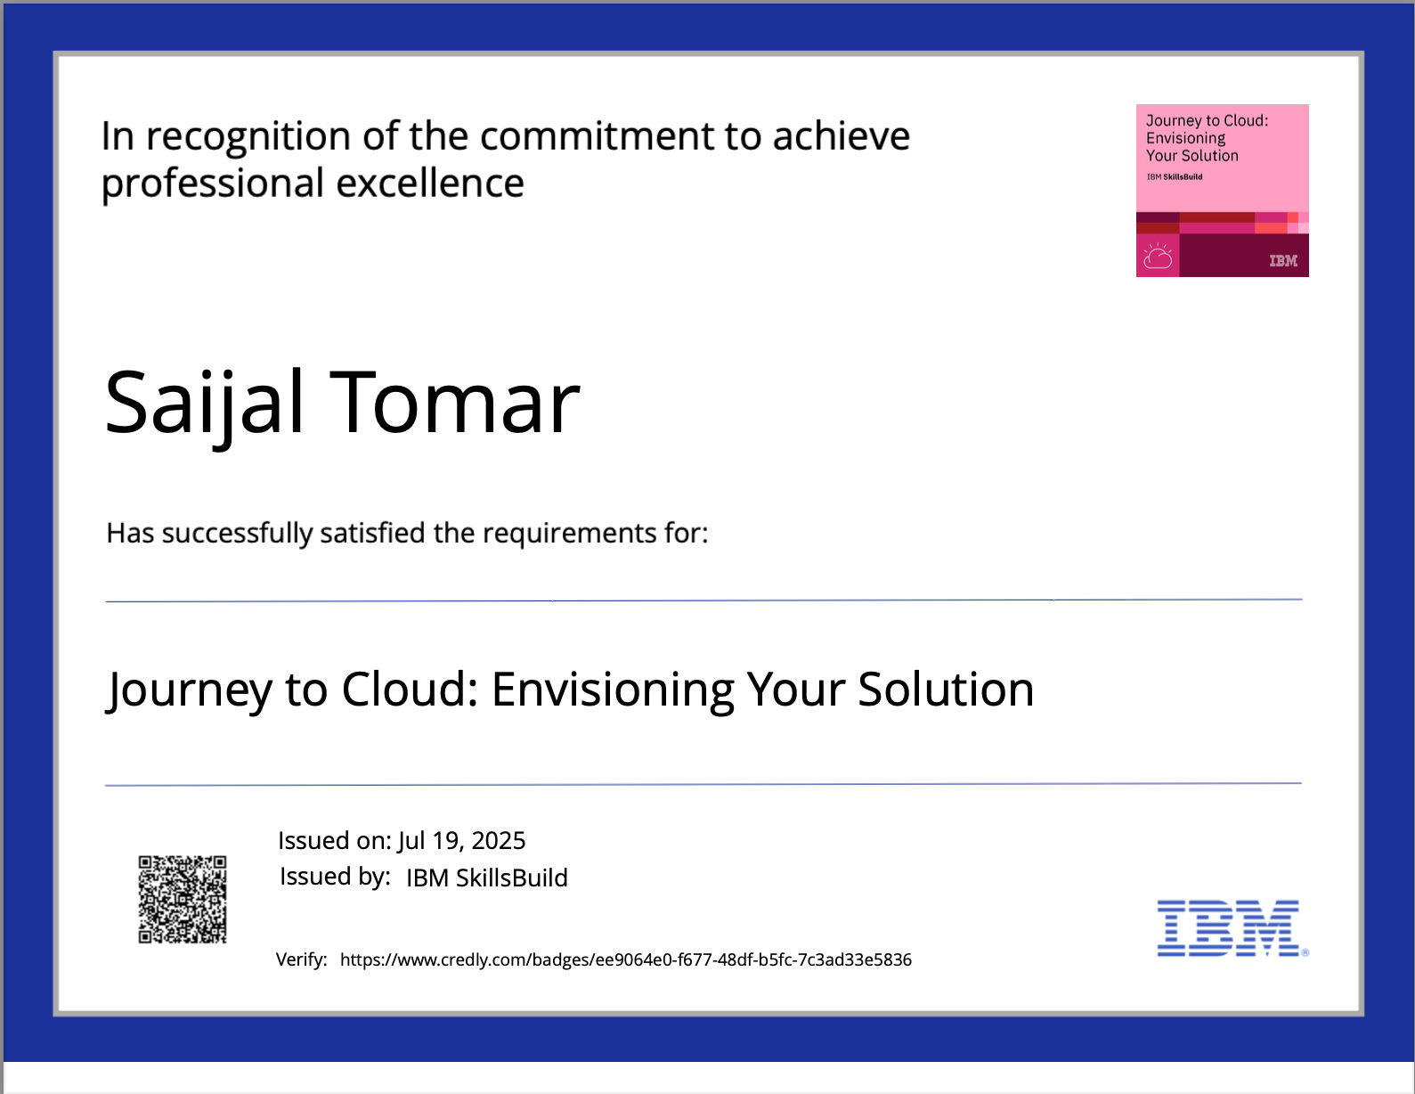
IBM Certifications
Screenshot/ credly certificate( Journey to Cloud)

Slide 15
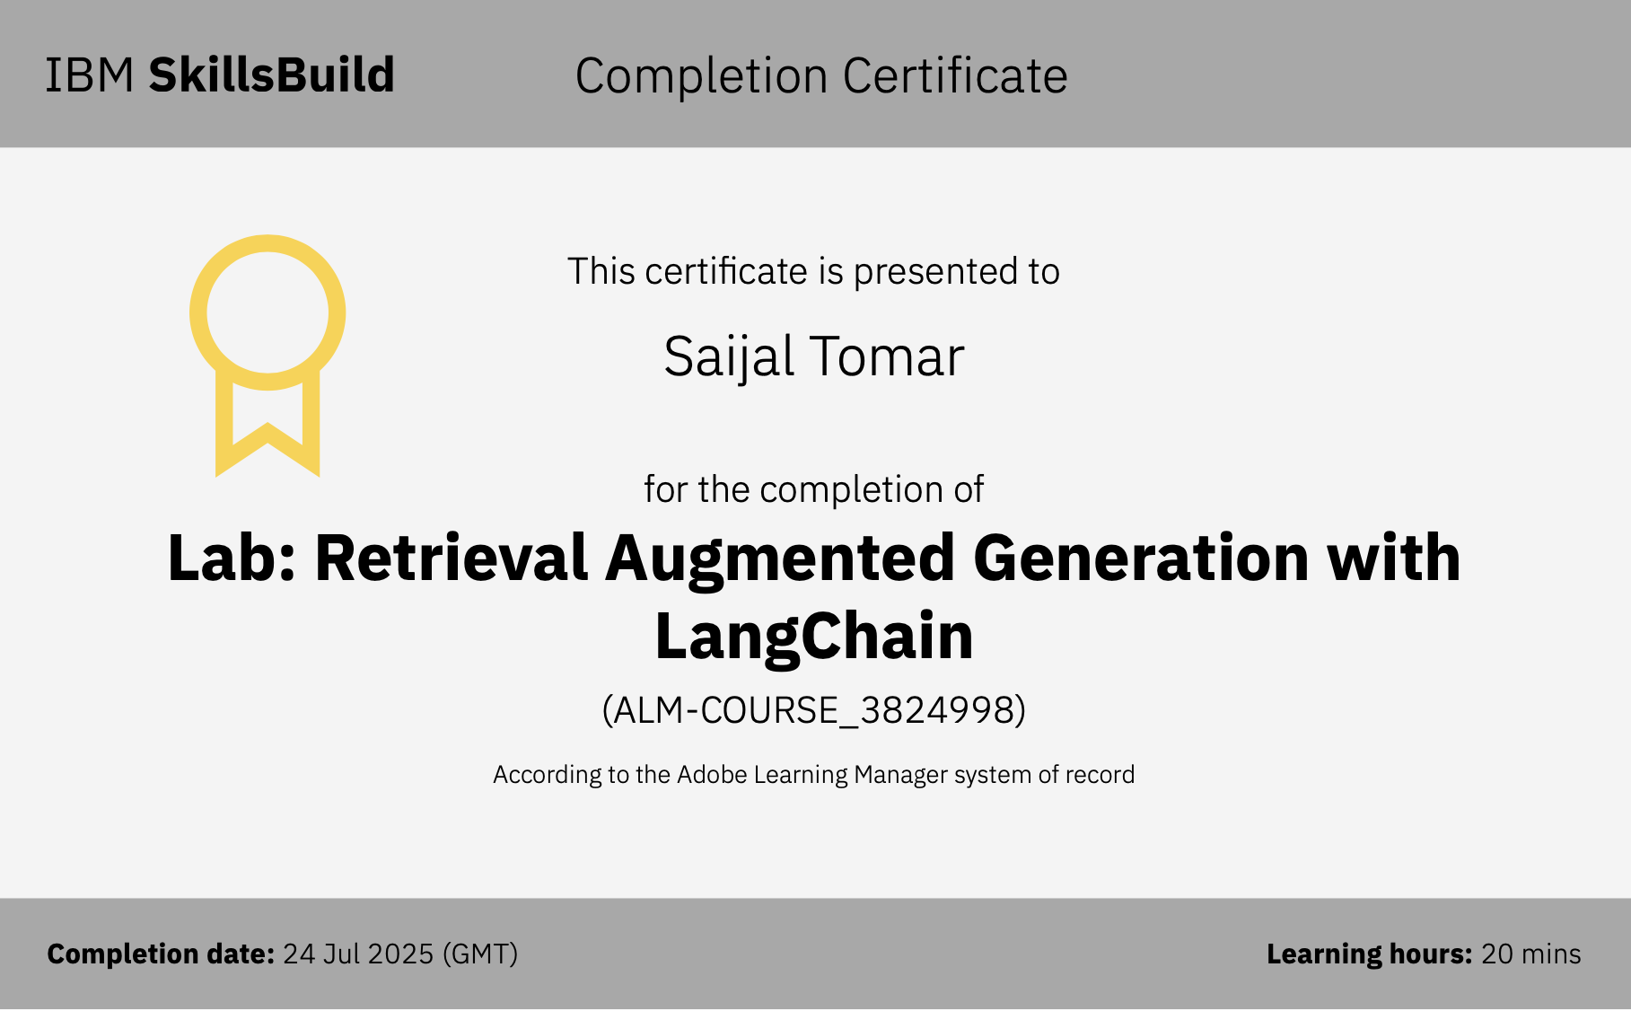
IBM Certifications
Screenshot/ credly certificate( RAG Lab)

Slide 16
THANK YOU

