Slide 1
Introduction to MATLAB
Sai Janani Ganesan
Graduate Student
Matysiak Lab
Notes:
Rm 2125

Slide 2
Outline
Basics: How to get started, declare variables, basic commands, for loops, if statements
Functions: What are functions; How to create and execute simple functions
Solving ODEs: how to solve (a) 1 ODE, (b) system of ODEs
Useful tips regarding solvers

Slide 3
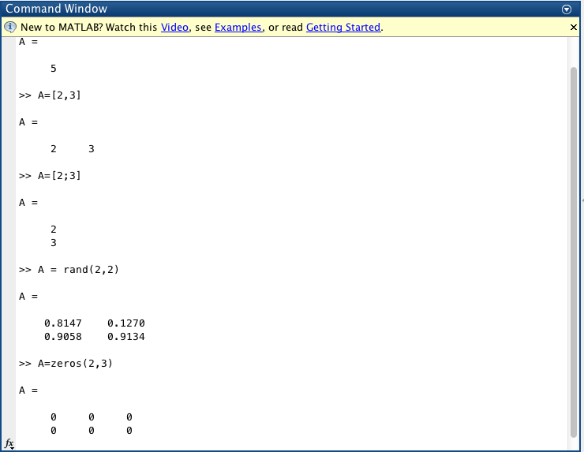
Basics of MATLAB

Slide 4
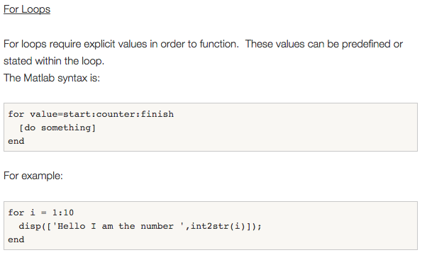
For Loops

Slide 5
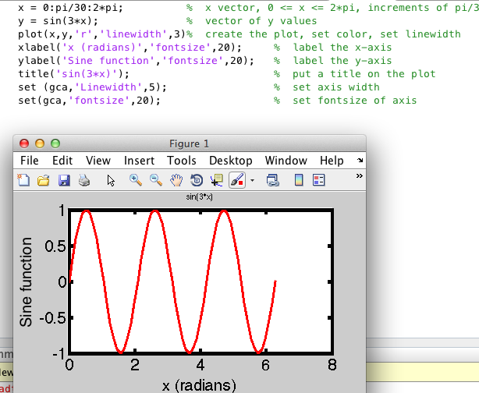
Plotting Data

Slide 6
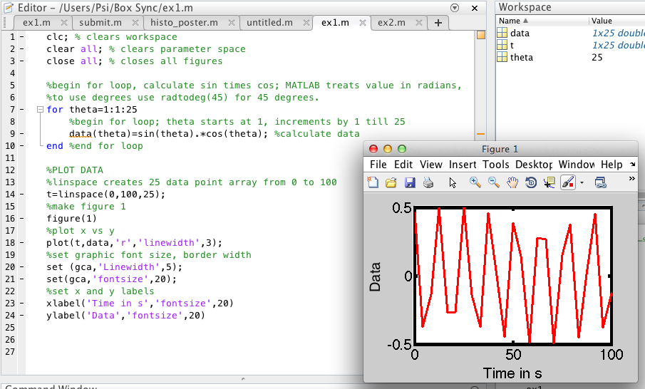
For Loops

Slide 7
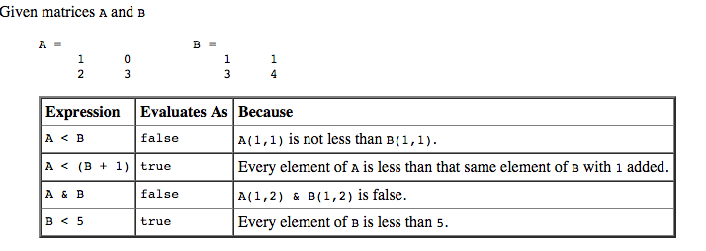
If Statements
if expression
statements
end
if expression1
statements1
elseif expression2
statements2
else
statements3
end

Slide 8
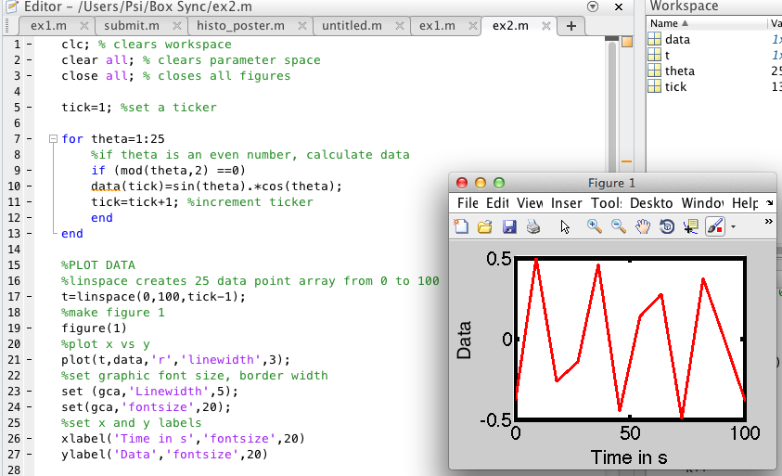
If statements

Slide 9
Functions
Format:
function [outputs] = function_name (inputs)
Functions make programming easy, your code reusable
A function need not always output data
A function can call another function and so on

Slide 10
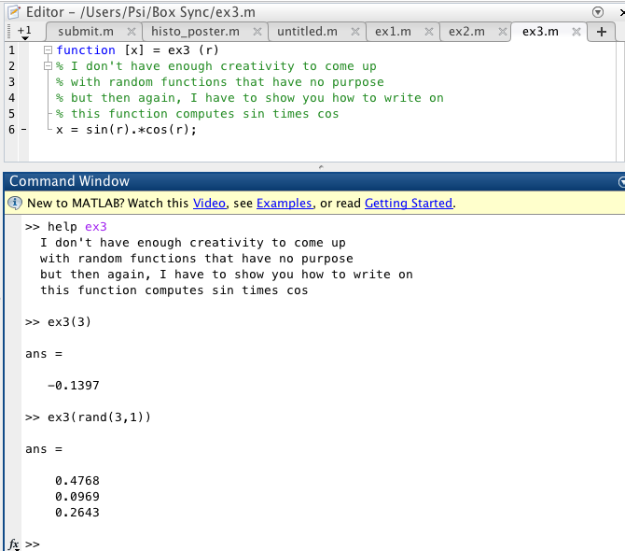
Function: example 1

Slide 11
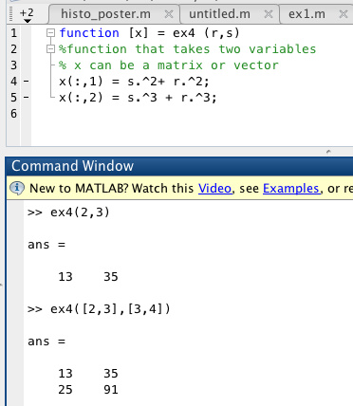
Function: example 2

Slide 12
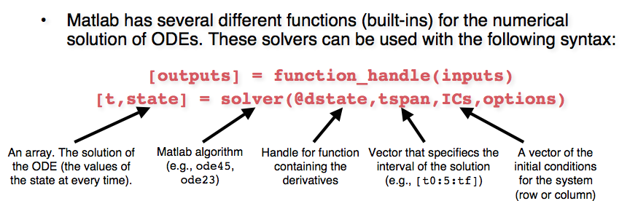
Solving ODEs
Ode45 is a MATLAB function that takes another function (dstate) as input
You need to write a function dstate, and call ode45 (or other solvers)

Slide 13
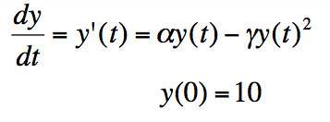
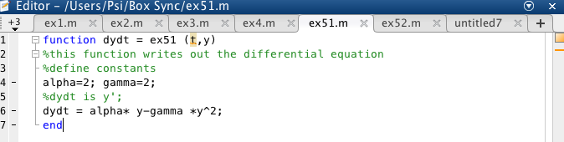
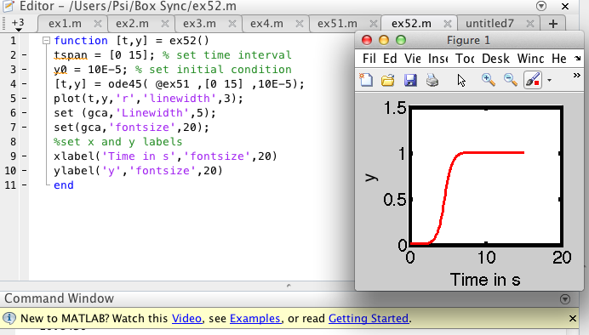
Solving 1 ODE

Slide 14

Solve Rate Equations: system of ODEs
Rates: k1,k2 and k3
Initial value: A0=1; B0=0; C0=0
Rate values: k1=5; k2=2; k3=1

Slide 15
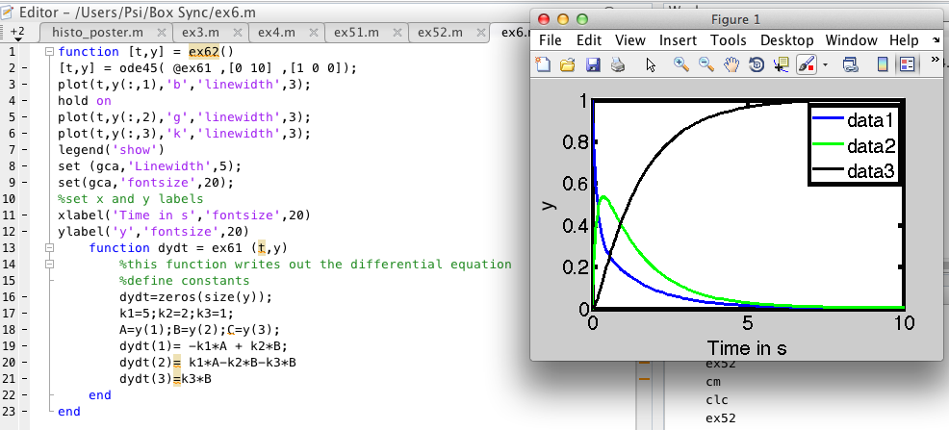
Solve Rate Equations: system of ODEs

Slide 16
