Slide 1
How data moves through a neural network
The network transforms input features into a prediction one layer at a time.
INPUT LAYER
HIDDEN LAYER 1
HIDDEN LAYER 2
OUTPUT LAYER
X₁
ŷ
X₂
Features such as X₁ and X₂
Neurons combine inputs
using learned weights
The next layer refines
the pattern
A class prediction
Information flows forward. During training, weights are adjusted to reduce prediction error.

Slide 2
What each component does
These parts work together while the network learns from examples.
Layers
Neurons
The input layer receives features. Hidden layers process them. The output layer gives the prediction.
Each neuron combines incoming values and passes the result forward.
Weights
Activation functions
Weights control how strongly one neuron affects another. Training changes these values.
An activation such as Tanh lets the network represent curved and more complex patterns.
Loss functions
Optimization algorithms
Loss measures the difference between predictions and correct answers. Lower loss usually means a closer fit.
The optimizer updates weights during training to reduce loss.

Slide 3
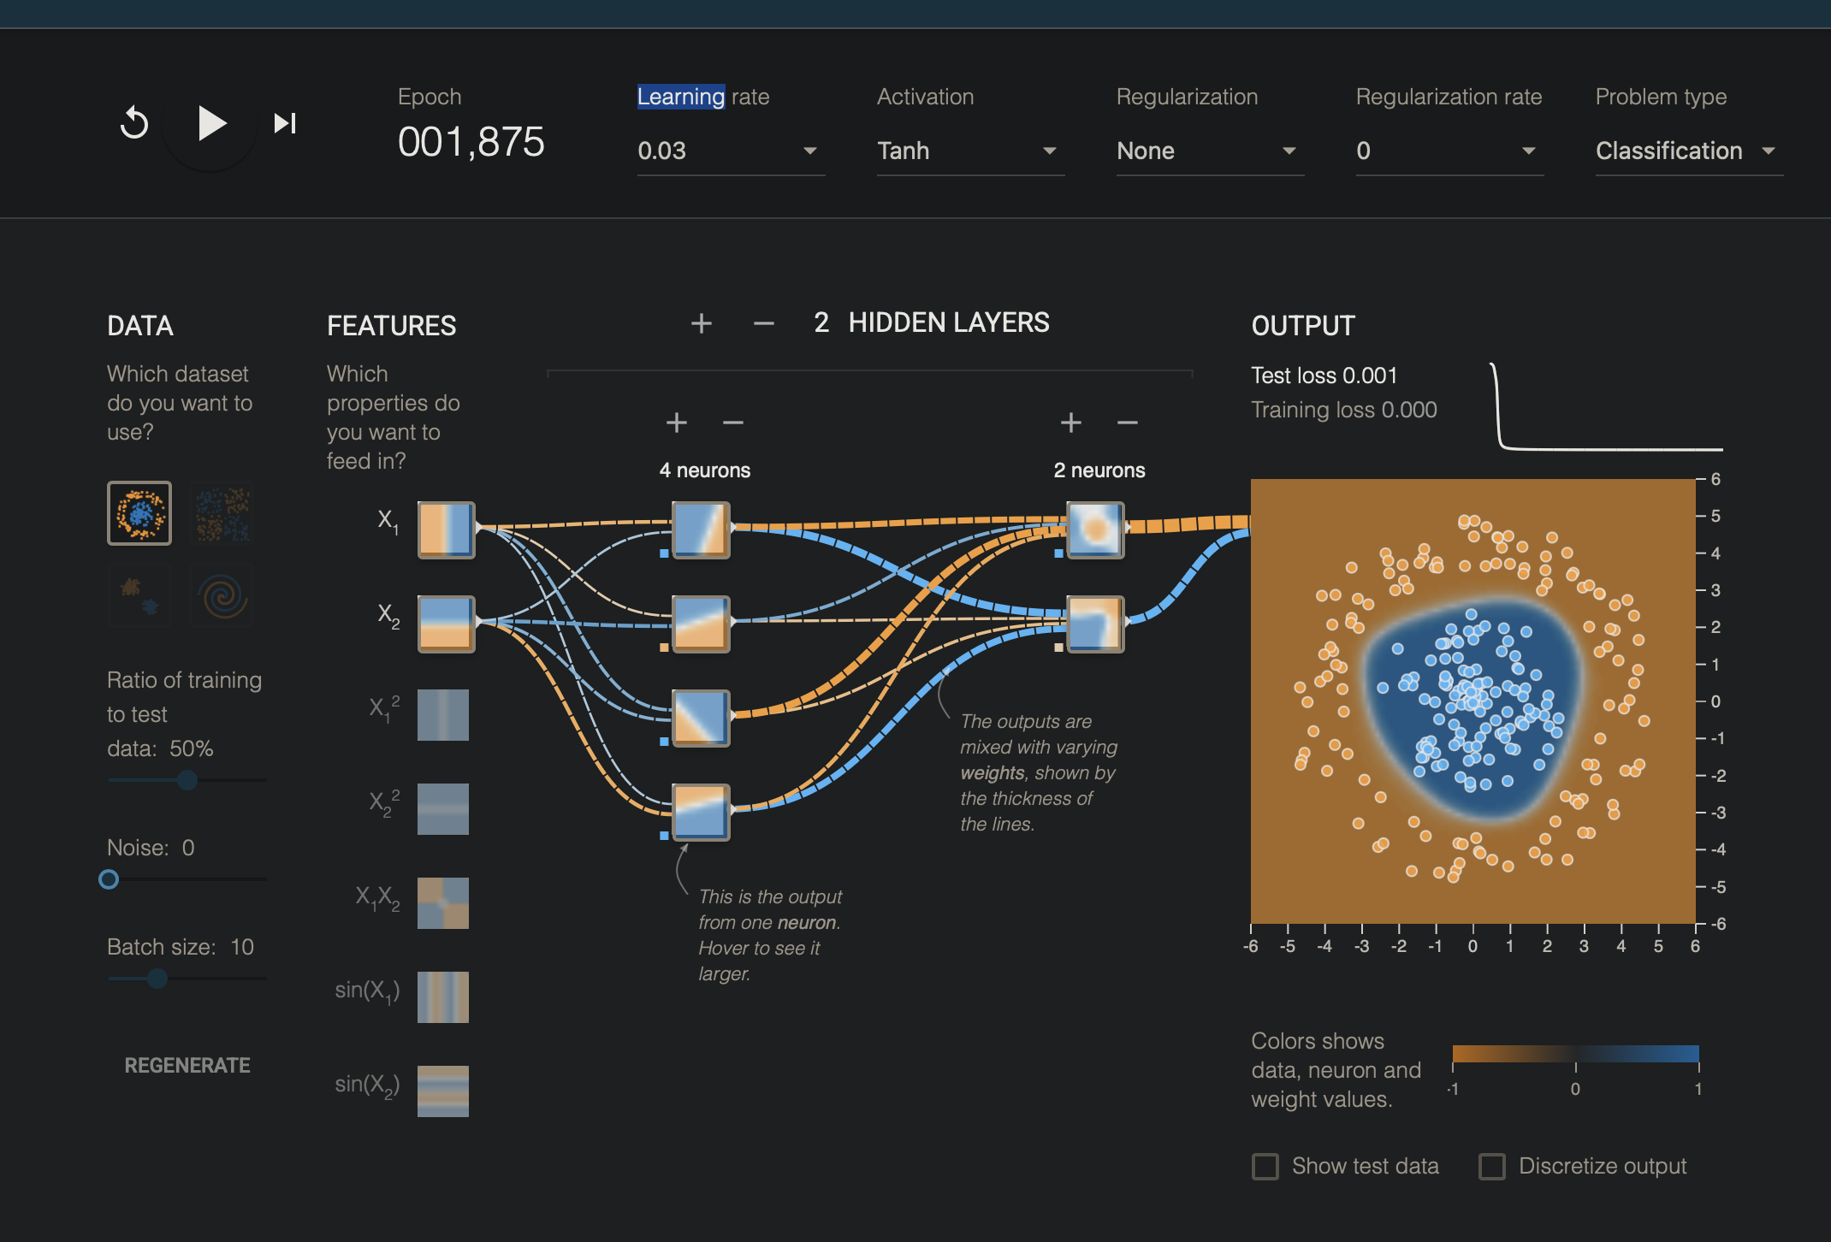
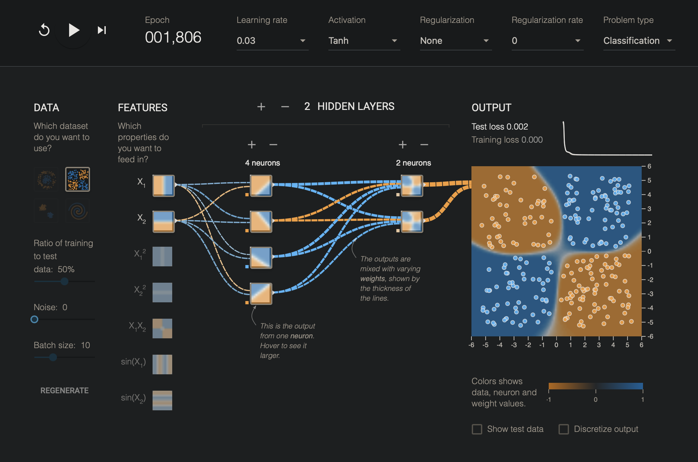
Circle and XOR results
Same setup in each run: X₁ and X₂, two hidden layers (4 then 2 neurons), noise 0, batch size 10, 50% training data.
Circle
XOR
Epoch 1,875 · Training loss 0.000 · Test loss 0.001
Epoch 1,806 · Training loss 0.000 · Test loss 0.002
The network separated the center cluster from the outer ring.
The boundary divided the alternating groups into four regions.

Slide 4
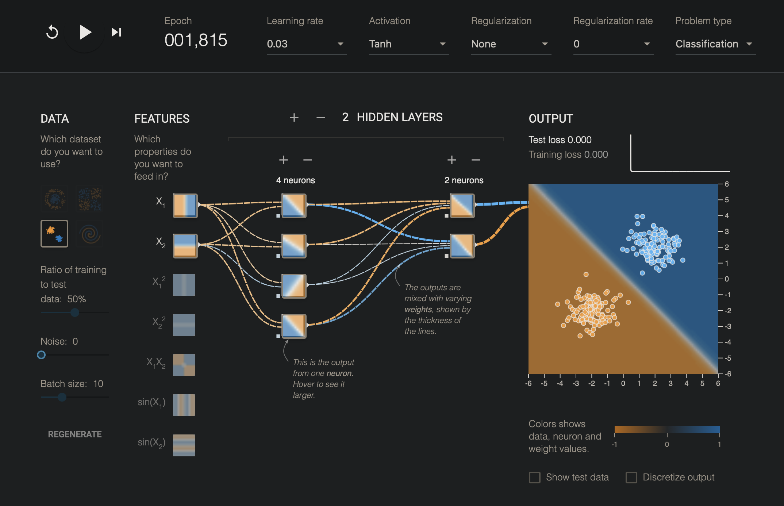
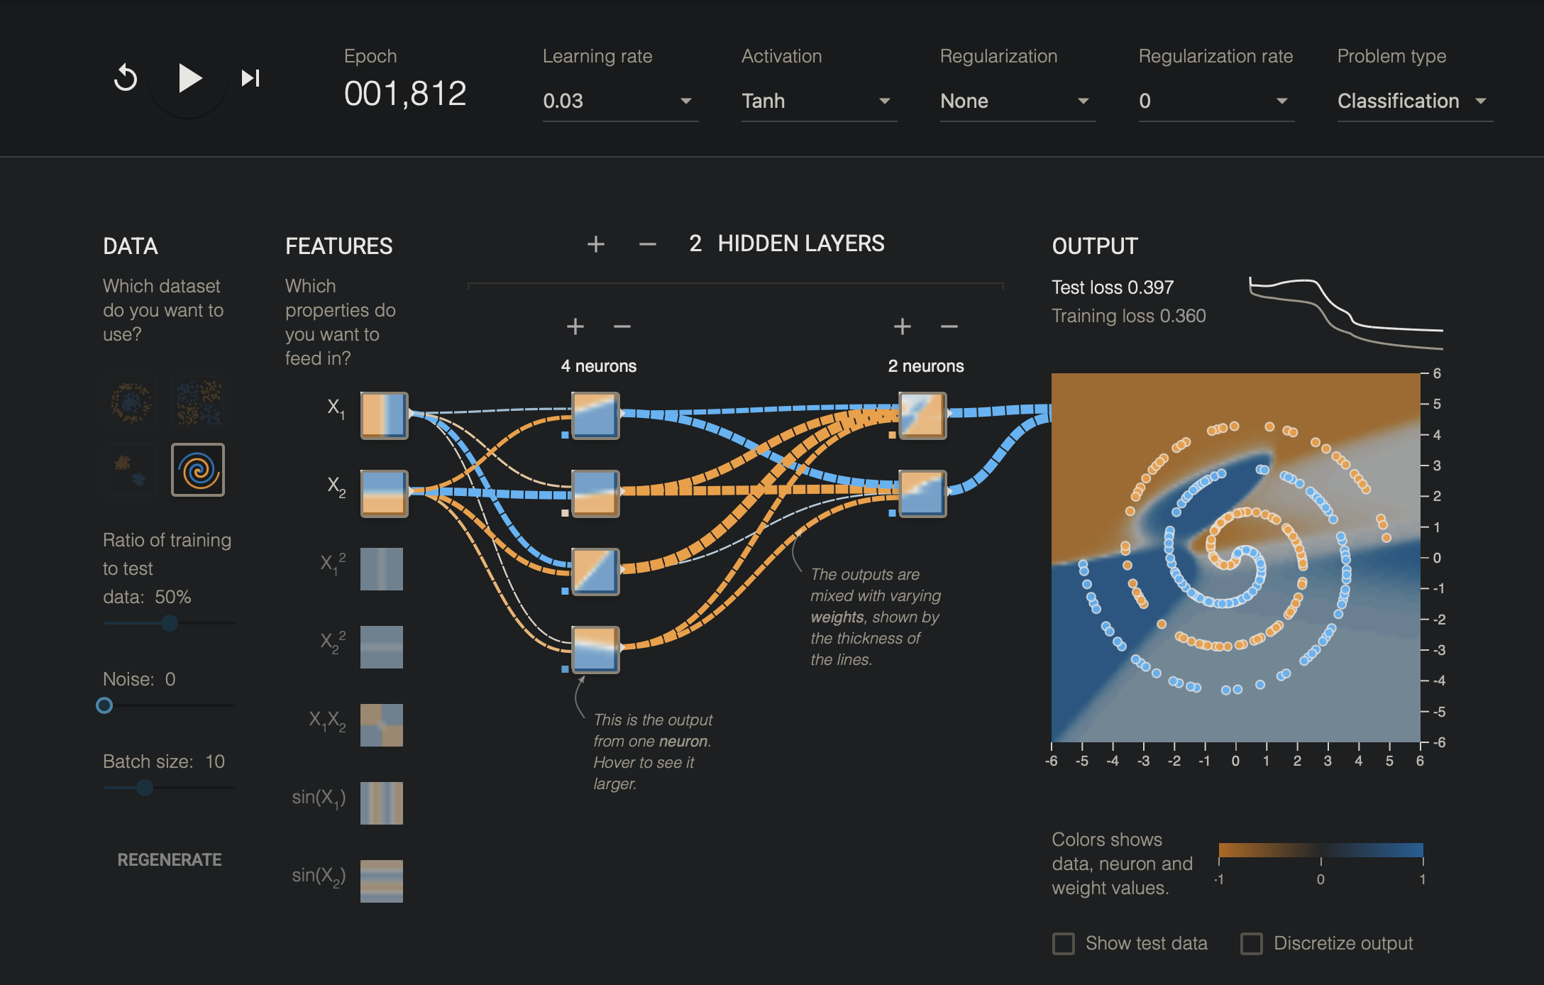
Gaussian and Spiral results
Same setup in each run: X₁ and X₂, two hidden layers (4 then 2 neurons), noise 0, batch size 10, 50% training data.
Gaussian
Spiral
Epoch 1,815 · Training loss 0.000 · Test loss 0.000
Epoch 1,812 · Training loss 0.360 · Test loss 0.397
A diagonal boundary separated the two clusters.
The model began following the coils, but the pattern was harder to separate.

Slide 5
What I learned
The screenshots show how the same network responds to different patterns.
The circle, XOR, and Gaussian runs reached very low losses with this setup. The Spiral run was harder: both losses stayed higher and its boundary did not match the coils as closely.
Visualizing the network helped me connect its layers and weights to the boundary it learns. The loss numbers show how close its predictions were, while the plot makes it easier to see which patterns were simple or difficult for this model.
A useful next comparison would be to add neurons or raise the noise, then check how the plot and test loss change.

