Slide 1

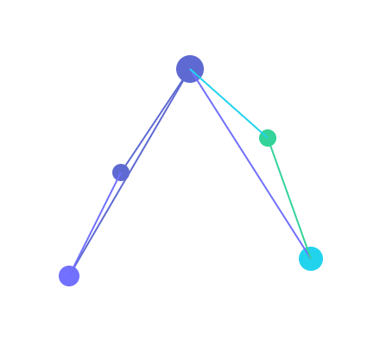
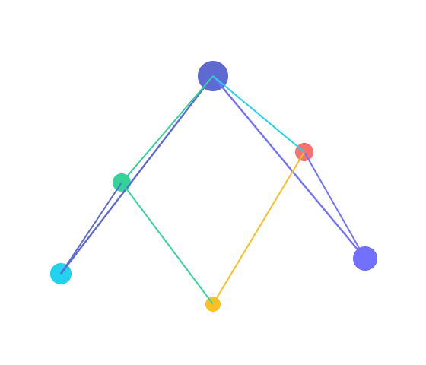
prism
CONFIDENTIAL · APRIL 2026 · V2.0
PLATFORM INTELLIGENCE · CPT ENGINE · IRIS AI
One truth for your entire infrastructure.
Prism builds a unified knowledge graph over your entire technology estate — 13+ platforms, 17 entity types, zero brittle configuration.
CPT Engine · Patent Pending
Iris AI · Zero Hallucinations
Self-Hosted · SOC2 Ready
K8s-Native · Model-Agnostic
See Everything. Understand Everything. Secure Everything.
Notes:
Good [morning/afternoon]. Enterprises today operate hundreds of platform tools — and they've built a fragile house of cards on top of name-matching. Prism solves that at the root. Let me show you how.

Slide 2
THE ENTERPRISE PROBLEM
Your tools don't agree on what anything is called.
130+ platform tools per enterprise
Each produces its own inventory. None agree on names, owners, or state.
40%
130+
engineer time lost to tool fragmentation
platform tools per enterprise
Same service. Five different names.
payments-svc · payment_service · PaymentService · payments · svc-pay Name-matching breaks every time.
NAME COLLISION IN THE WILD
40% of engineering time lost to context-switching
Platform
Entity name
Chasing down ownership, dependencies, and blast radius — manually, every incident.
K8s
payments-svc
GitHub
payment_service
AI answers are ungrounded — and wrong
Datadog
PaymentService
Every general-purpose copilot hallucinates on infrastructure questions because it has no live graph.
ServiceNow
svc-pay
prism
payments · 1 entity resolved
Notes:
The average enterprise runs 130 tools. The data from those tools constantly disagrees — not because teams are careless, but because the same service gets called five different things in five different systems. Every name-based matcher fails here. The cost: engineers spend 40% of their time navigating this fog instead of building.

Slide 3
DUAL-CHANNEL · FIVE PROCESSING LAYERS
CPT ENGINE · PATENT PENDING
CHANNEL 1
CHANNEL 2
Platform APIs
Documents
Match by shape, not by name.
K8s · GitHub · Datadog · Kafka · 9 more
.docx · .xlsx · Swagger · Confluence
▼
Every competitor uses name-matching. It breaks every time. CPT fingerprints entities by topological shape — how they connect, behave, and relate across every platform simultaneously.
L2
Topological Fingerprinting
Match by graph shape, not name
▼
Perspective Convergence
L3
Hungarian algorithm — globally optimal alignment
TOPOLOGICAL FINGERPRINTING · 5 DIMENSIONS
▼
Confidence-Weighted Truth Resolution
Structural
35%
in/out degree, neighbor signature
L4
K8s replicas + Datadog latency + doc ownership
Resource
25%
ports, protocols, resource class
Semantic
20%
vector embedding, not exact match
▼
Causal Graph Construction
Behavioral
10%
request rate, error rate, deploy freq
L5
Infers WHY — not just THAT — via temporal correlation
Temporal
10%
entity age, change velocity
▼
UNIFIED KNOWLEDGE GRAPH
Live state + business context + ownership + compliance
Notes:
This is the CPT engine — Convergent Perspective Topology. Patent pending. Instead of matching by name, CPT fingerprints every entity by its topological shape: how it connects, what ports it exposes, how it behaves over time. Five weighted dimensions, a Hungarian-algorithm optimal alignment, and confidence-weighted truth resolution. The result: one unified knowledge graph that never lies.

Slide 4




DIFFERENTIATION
Prism is not a CMDB replacement.
It's the intelligence layer that makes every tool you own finally tell the truth.
Iris AI
Security
Every persona
Deployment
Zero hallucinations by design
Built for regulated industries
One platform, five roles
Data never leaves your network
Developer · SRE · Product Owner · Auditor · Executive. Iris tailors format, depth and alerts per role. The same graph, the right lens.
7-safeguard anti-hallucination pipeline. Every answer traces to a graph node or document. Confidence scored 0.0–1.0. Model-agnostic: GPT-4o, Claude, Bedrock, Ollama.
7-layer security architecture. AES-256 per-tenant encryption, BYOK, RBAC with 7 roles. SOC2 Type II architecture ready. HIPAA and PCI-DSS compliant by design.
Self-hosted first — K8s-native via Helm + ArgoCD. SaaS multi-tenant in Phase 3. 13 connectors shipping: K8s, GitHub, Datadog, ArgoCD, Kafka, AWS, ServiceNow and more.
Developer — blast radius, deps
SRE — health, SPOFs, remediations
0 hallucinations · 97% accuracy
SOC2 · PCI-DSS · HIPAA · GDPR
Auditor — compliance, evidence
13 connectors · EKS-native · Helm
Notes:
Prism isn't just data unification. Iris — our AI copilot — is graph-grounded by design. Every answer traces to a specific node. No hallucinations. And because we're model-agnostic, customers bring their own LLM. We're SOC2 ready, HIPAA-architecture ready, and deployed self-hosted so data never leaves the customer's network.

Slide 5


DEPLOYMENT · INFRASTRUCTURE
Deploy anywhere. Your data stays yours.
Self-Hosted
·
SaaS
4-LAYER SYSTEM ARCHITECTURE
Self-Hosted
SaaS · Multi-Tenant
AWS · Azure · On-Prem
Prism-managed · Phase 3
PRESENTATION
Topology · App Lens · Iris Chat · 13 modules
API Servers
×3 replicas
EKS Fargate
auto-scaling
▼ REST + WebSocket
Frontend
×2 replicas
Neo4j
DB per tenant · isolated
INTELLIGENCE
Iris · CPT Engine · Compliance · Blast Radius · LLM Router
Neo4j
r5.2xl · DB-per-tenant
ElastiCache
managed Redis
Redis 7
CloudFront + WAF
▼ Parameterized Cypher
cache · queue
OWASP rules
DATA
Vault / KMS
BYOK secrets
Cognito + Stripe
auth · billing
Neo4j 5.x · Redis 7 · S3/MinIO · DB-per-tenant
Helm
ArgoCD
EKS / OpenShift
Managed
Auto-scale
Stripe billing
▼ Adapter Pattern
CONNECTORS
K8s · GitHub · Datadog · ArgoCD · Kafka · AWS · ServiceNow · Jira · Vault · SonarQube · Terraform · Nexus · API Connect
GRAPH ISOLATION
ENCRYPTION
Separate Neo4j DB per tenant — queries physically cannot cross boundaries
AES-256 + per-tenant Fernet · BYOK · Vault/KMS · TLS everywhere
◆ Data never leaves your network
◆ DB-per-tenant · zero cross-bleed
Notes:
Prism ships two ways: fully self-hosted inside your AWS, Azure, or on-prem environment — your data never leaves — or as a managed SaaS on Prism's infrastructure with DB-per-tenant isolation. Either way the architecture is identical: four layers, 13 connectors, and a Neo4j knowledge graph that is physically isolated per customer.

Slide 6
DESIGN PARTNER PROGRAM · APRIL 2026
The path to $10M ARR starts with three pilots.
prism
REVENUE TRAJECTORY
PRICING
Year
Customers
ARR
Starter
Professional
Enterprise
Y1
3–5 pilots
$150K–$250K
$36K
$96K
$180K
Y2
10–20
$800K–$1.6M
$3K / month
$8K / month
$15K / month
Up to 5 platforms 3 core modules 10 docs/mo
Up to 15 platforms All modules 100 docs/mo
Unlimited platforms All + Prism LLM 24/7 + CSM
Y3
30–50
$3M–$5M
Y4
80–120
$9.6M–$14.4M
"Your infrastructure speaks. Iris translates."
Ready for a technical discovery call?
PRISM · APRIL 2026 · CONFIDENTIAL
Bring your architecture diagram. We'll show you what Prism resolves in 48 hours.
Open Prism
30-minute call · No commitment
Notes:
Three pilots in Year 1. Twenty customers in Year 2. The path to ten million ARR is clear. We're looking for design partners willing to deploy Prism in their environment and give us the feedback that sharpens it. The next step is a technical discovery call — let's find 30 minutes.

