Slide 1

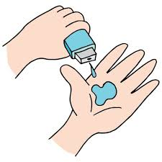
FFE Batch2_Group13
Final Project - IBM SkillsBuild Innovation Camp 2021

Slide 2
PROJECT TITLE
Recognize the pattern of Mall Visiting customers to find the most profitable customers using Clustering

Slide 3
AGENDA
Data analysis phase-
cleaning the data and checking for null values and outliers
Get insights about correlations between each pair
Determine the level of the customers attractiveness
Clustering phase-
Customer segmentation
Determine the attractiveness criteria
Determine the level of the customers attractiveness

Slide 4
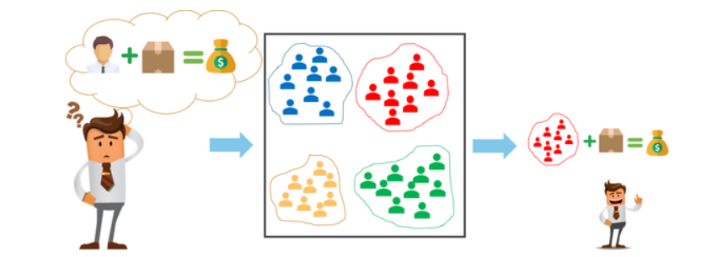
OUR PROJECT IN A CREATIVE WAY

Slide 5

PROBLEM STATEMENT
Finding the pattern of most profitable customers to visit a mall using parameters like , annual income, spending score and age to help the mall in race to increase the customers and to make huge profits using unsupervised learning like K-Means Clustering.
Data Source: Kaggle

Slide 6

PROJECT OVERVIEW
Firstly, collected the public dataset containing the information about 200 customers from Kaggle,
Statistical analysis is made on the dataset.
Data cleaning is done to make it well structured.
Exploratory data analysis and data visualization have been done to better understand the dependency of parameters.
Based on previous analysis, clustering algorithms are used to make segmentation between customers.
Based on the segmentation proper decision about customers is made.

Slide 7

WHO ARE THE END USERS?
This project can be helpful for following people-
Shopping Mall Authorities
Business Authorities in the mall
Marketing individuals
Even some customers

Slide 8
YOUR SOLUTION AND ITS VALUE PROPOSITION
Among the visiting customers in a mall, there are variations between the amount of spending on products by the customers.
Such spending behaviour is highly dependent on their annual income, age(hence mindset) and possibly gender.
Being able to understand specific factors and their dependence, the customers can be divided into many categories say, “General”, “Miser”, “Careful”, “Spendthrift”, “Important”.
Upon observing each segment of customers, the business unit can take specific marketing decisions to maximize their profit.

Slide 9
THE WOW IN OUR SOLUTION
We found out the pattern in mall visiting customers , we used age, spending score and annual income as factors.
After the completion of project you can see , cluster 1 are most profitable customers, high spending score and high annual income and they all are young aged. So the malls can concentrate more on these age group of people to have huge profits.
cluster 3 and 0 have high annual income , but still they are not interested to buy more, they should do something to attract these people for profits
so, by seeing the result in our project , the mall can decide what age group of people to attract more, what to do attract rich customers, and come up with the business strategy.

Slide 10
MODELLING
The pipeline of our model is as follows:
Importing the data and required libraries,
Checking for the missing and null values,
Preprocessing,
One hot encoding,
Normalization,
Data visualization,
Using K-Means Clustering algorithm to find clusters,
Studying the segments of customers and inferring the conclusion.

Slide 11
RESULTS : Statistics of the data
 | CustomerID | Age | Annual Income (k$) | Spending Score (1-100)
count | 200.000000 | 200.000000 | 200.000000 | 200.000000
mean | 100.500000 | 38.850000 | 60.560000 | 50.200000
std | 57.879185 | 13.969007 | 26.264721 | 25.823522
min | 1.000000 | 18.000000 | 15.000000 | 1.000000
25% | 50.750000 | 28.750000 | 41.500000 | 34.750000
50% | 100.500000 | 36.000000 | 61.500000 | 50.000000
75% | 150.250000 | 49.000000 | 78.000000 | 73.000000
max | 200.000000 | 70.000000 | 137.000000 | 99.000000

Slide 12
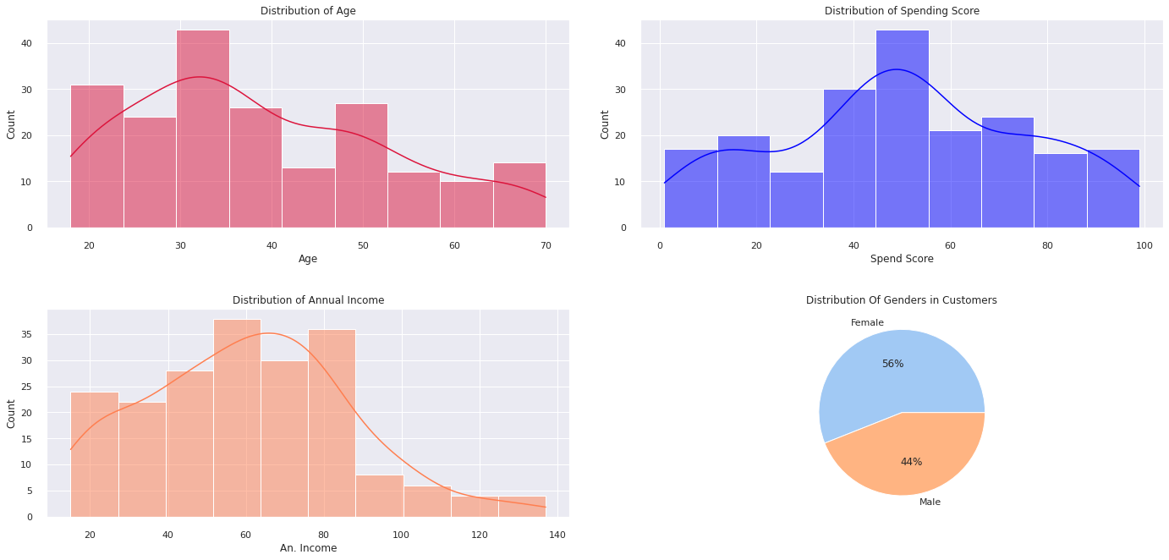
Distributions of the parameters
Demo Link

Slide 13
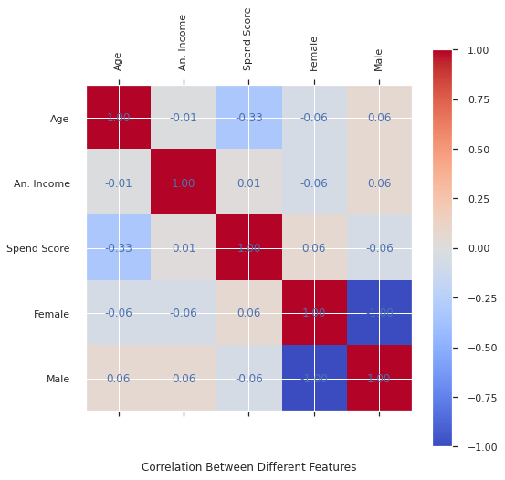
Correlation between parameters
Demo Link

Slide 14
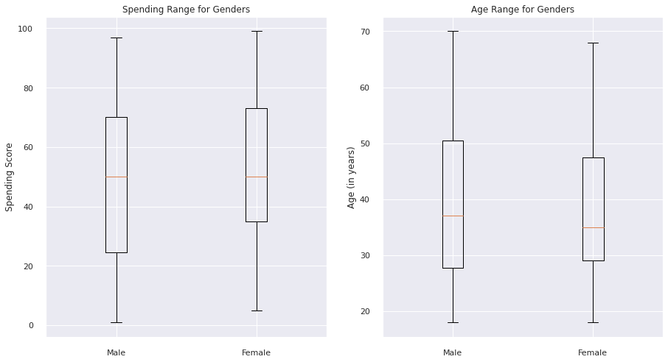
Range of Spending Score, Age by Gender

Slide 15
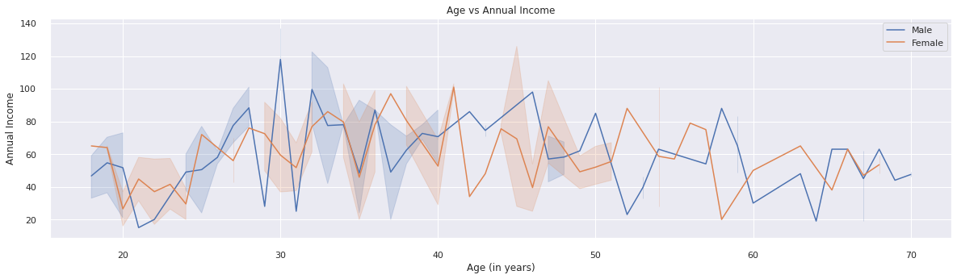
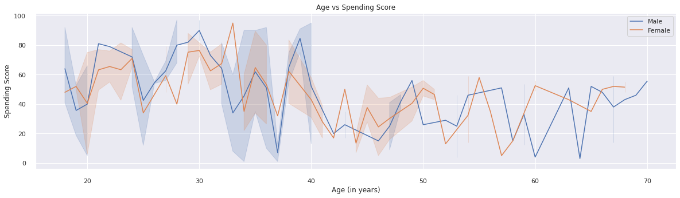
Dependency of Spend. Score, An. Income, and Age

Slide 16
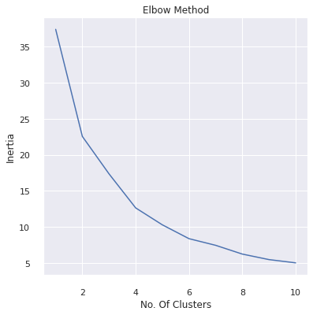
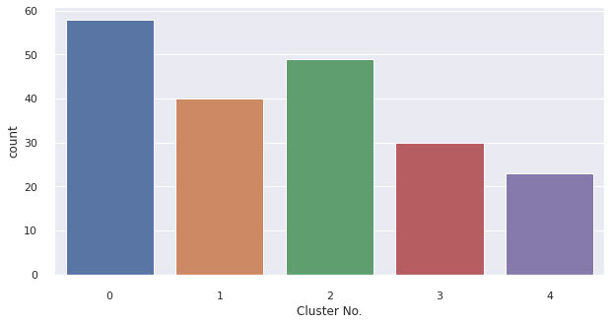
Clustering based on “Age”, “Spend. Score”, “An. Income”
By Elbow method the optimal number of clusters is found to be 5.

Slide 17
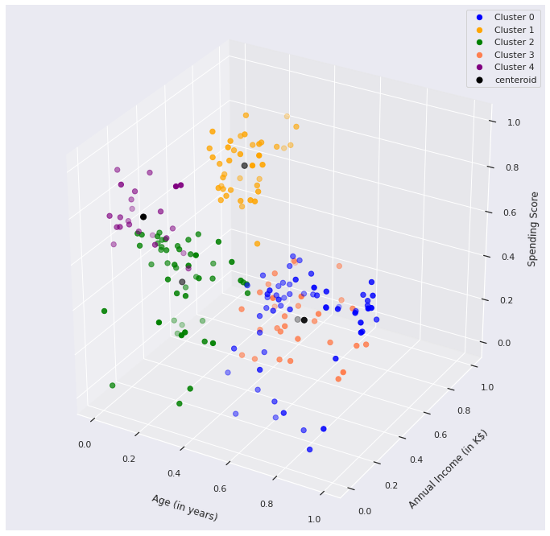
Visualization of clusters based on “Age”, “Spend. Score”, “An. Income”

Slide 18
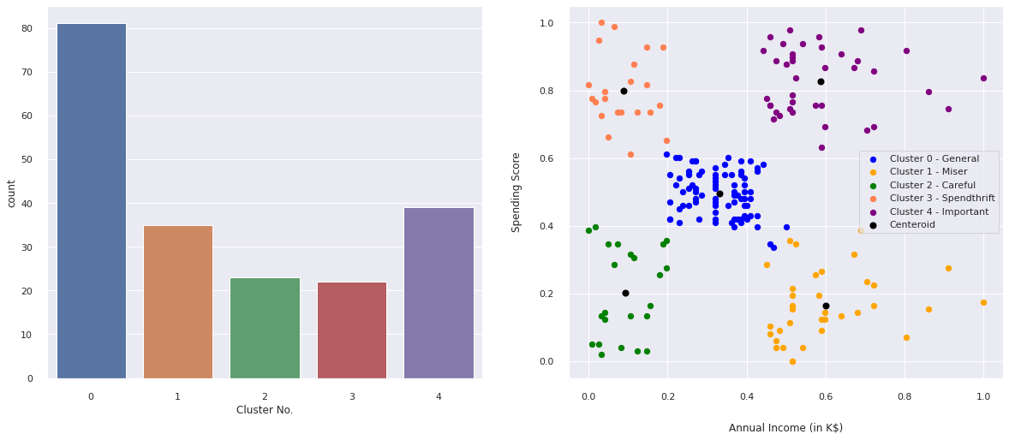
Clustering based on “Spend. Score”, “An. Income”

Slide 19

CONCLUSIONS
After all this observations and analysis, we have successfully found required clusters of customers.
By looking in spending score and annual income, it can be seen there is a crowd of customers which are more shopaholic than others and some others are more general type of customers.
These important customers can be served customized service in the mall to increase the profit of businesses.
If the business unit has some data of unseen customers in the model it can be given to the model, and the model can predict the optimal cluster to which each customer will belong to, and hence they can decide how much service to give to the customers.

Slide 20
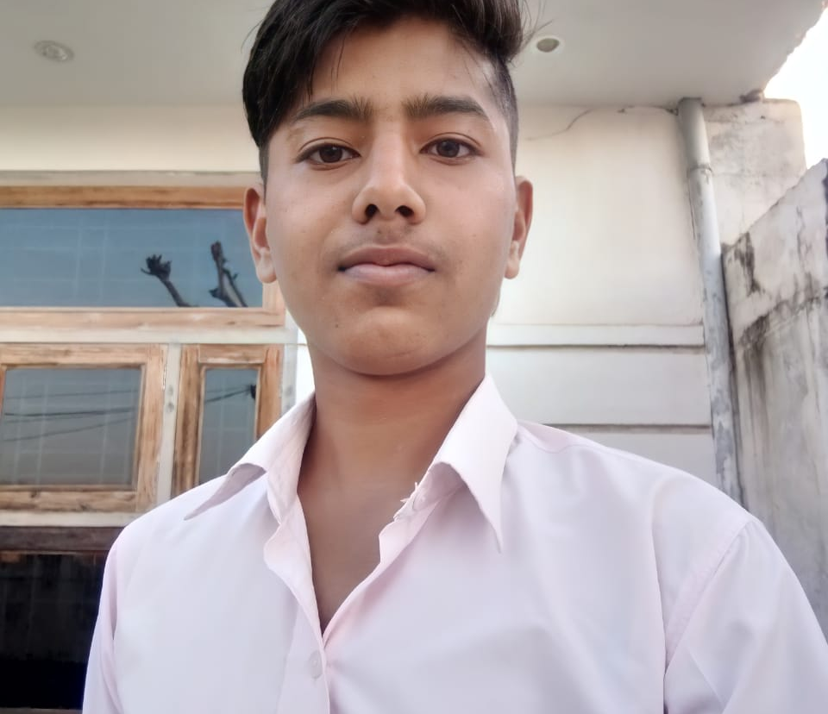




MEET OUR TEAM
Vinod Meena, Team Leader
Btech 2nd year,
CSE Department,
IIT Kharagpur
Saikat Das
Btech 4th year,
CSE Department,
Kalyani Government Engineering college
KODAVALI SRI SURYA VAMSI
Btech 2nd year,
IT Department,
,IIEST Shibpur.
Myla Yeshwanth
Btech 2nd year,
CSE Department,
IIEST Shibpur.
GAJULA SAI JAYANTH
Btech 2nd year,
CSE Department
,IIEST Shibpur.

Slide 21
Thank You
any queries?

