Slide 1
Big Data Marketing Cluster and Regression Analysis
Saijie Pan @Tongji
Friday, 5/17/2019

Slide 2
Cluster Analysis
Q: What is a cluster?
A: A group of similar data points
The concept of similarity is central to the definition of a cluster, and therefore to cluster analysis.
In general, greater similarity between points leads to better clustering.

Slide 3
Cluster Analysis
Q: What is the purpose of cluster analysis?
A: To enhance our understanding of a dataset by dividing the data into groups.
Clustering provides a layer of abstraction from individual data points.
The goal is to extract and enhance the natural structure of the data.

Slide 4
Cluster Analysis
Clustering can be useful in a wide variety of domains, including:
Genetics
Consumer internet
Business
and so on.

Slide 5
Cluster Analysis
There are many kinds of classification procedures. For this class, we will be focusing on K-means clustering, which is one of the most popular clustering algorithms.
K-means is an iterative method that partitions a dataset into k clusters.

Slide 6
K-means Algorithm
Choose k initial centroids (note that k is an input)
For each point:
find distance to each centroid
assign point to nearest centroid
Recalculate centroid positions
Repeat steps 2-3 until stopping criteria met

Slide 7
Step 1: Choose Initial Centroids
Q: How do you choose the initial centroid positions?
A: There are several options:
- randomly (but may yield divergent behavior)
- perform alternative clustering task, use resulting centroids as initial k-means centroids
- start with global centroid, choose point at max distance, repeat (but might select outlier)

Slide 8
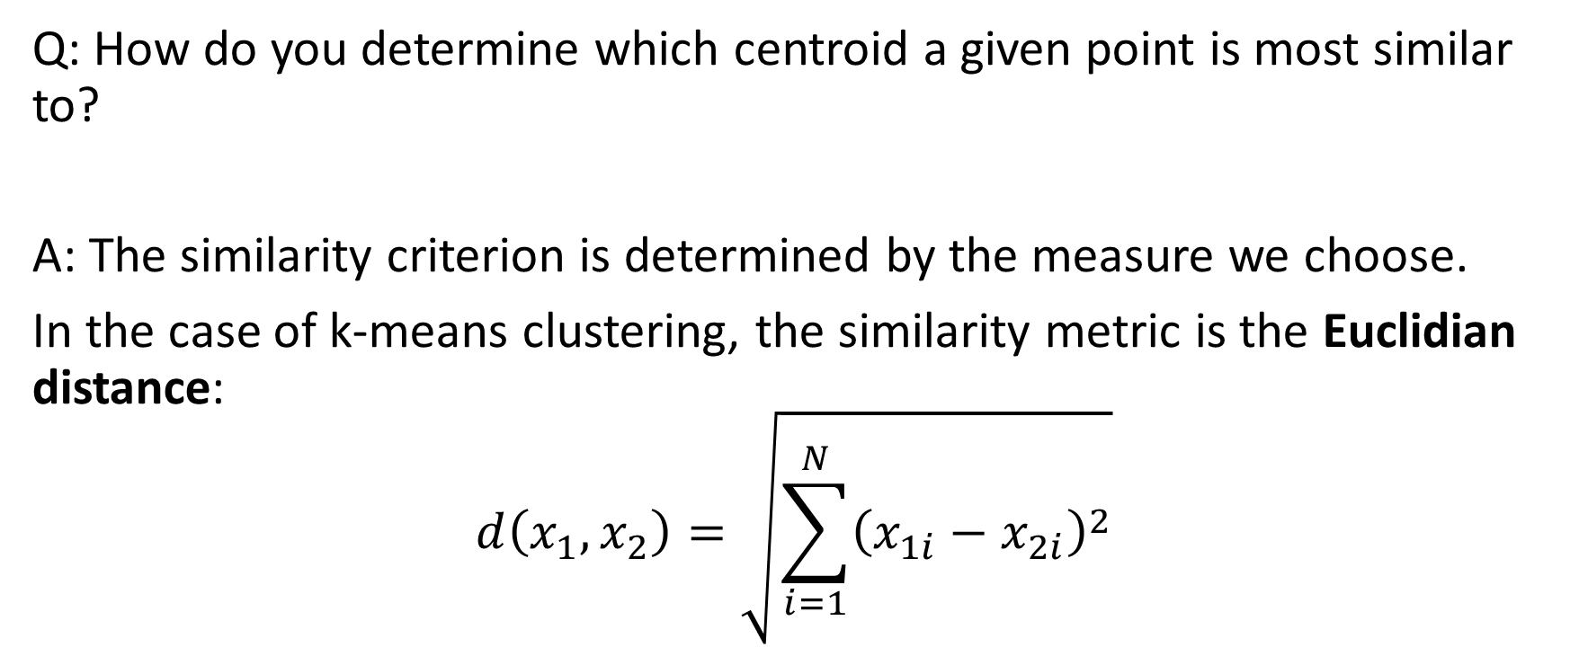
Step 2: Assess Similarity
Q: How do you determine which centroid a given point is most similar to?
A: The similarity criterion is determined by the measure we choose.
In the case of k-means clustering, the similarity metric is the Euclidian distance:
$$d\left(x_{1},x_{2}\right)=\sqrt{\sum_{i=1}^{N}{{\left(x_{1i}−x_{2i}\right)}^{2}}}$$

Slide 9
Step 3: Recomputing the center
Q: How do we recompute the positions of the centers at each iteration of the algorithm?
A: By calculating the centroids. (i.e., the geometric center)

Slide 10
Step 4: Convergence
We iterate until some stopping criteria are met; in general, suitable convergence is achieved in a small number of steps.
Stopping criteria can be based on the centroids (e.g. if positions change by no more than ϵ) or on the points (e.g. if no more than x% change clusters between iterations).

Slide 11
Strengths and Weaknesses
Strengths:
K-means is a popular algorithm because of its computational efficiency and simple and intuitive nature.
Weaknesses:
However, K-means is highly scale dependent, and is not suitable for data with widely varying shapes and densities.

Slide 12
Example
View online:
https://nbviewer.jupyter.org/github/saijie/big-data-marketing/blob/master/big_data_marketing_kmeans.ipynb
Open in Jupyter Notebook:
(

