Slide 1

Introduction to OpenMP
Part1. Getting Started
人工智能学院
缪青海
miaoqh@ucas.ac.cn

Slide 2
Content
Getting started with OpenMP
Core features of OpenMP
Work with OpenMP
Advanced topics on OpenMP

Slide 3

Introduction
OpenMP is one of the most common parallel programming models in use today.
简单、易用、易学
最适合作为并行编程的入门

Slide 4
OpenMP Overview
The OpenMP Architecture Review Board (ARB).
API for Writing Multithreaded Applications.
  A set of complier directives and library routines for parallel application programmers.
  Greatly simplifies writing multi-threaded programs in Fortran, C and C++.
  Standardizes last 20 years of SMP practice.

Slide 5
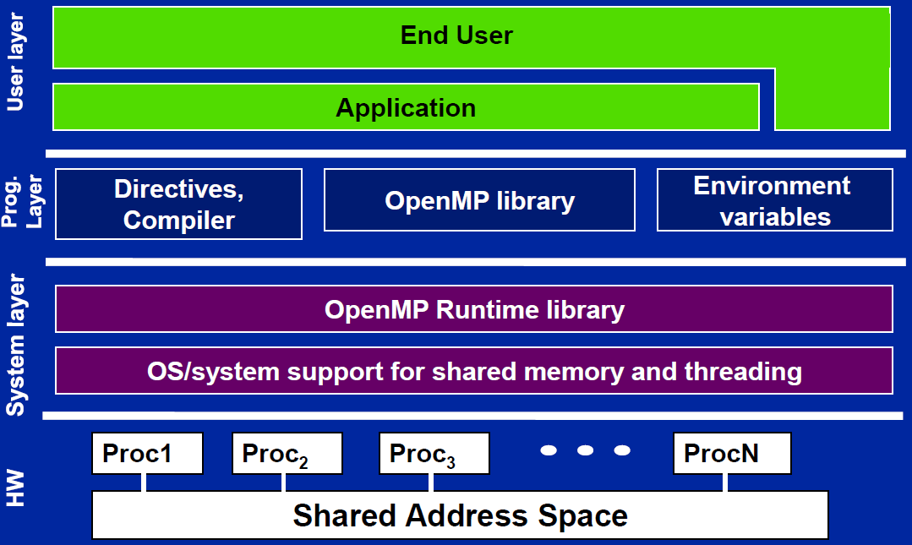
OpenMP Solution Stack

Slide 6
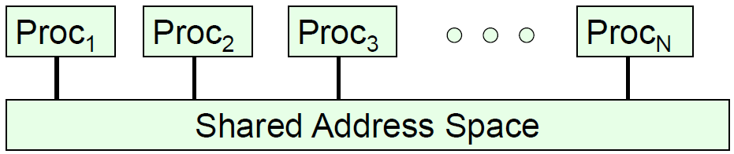
Shared memory computer
Symmetric multiprocessor (SMP):
  a shared address space with “equal-time” access for each processor, and the OS treats every processor the same way.
Non Uniform address space multiprocessor (NUMA)
  Different memory regions have different access costs … think of memory segmented into “Near” and “Far” memory.

Slide 7
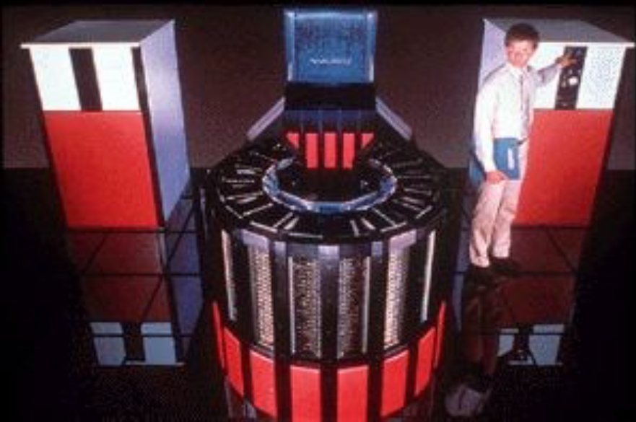
Shared memory computer
Symmetric multiprocessor (SMP): Cray-2
The last large scale SMP computer.
Released in 1985 with 4 “heads”, 1.9 GFLOPS peak performance
fasted supercomputer in the world until 1990

Slide 8
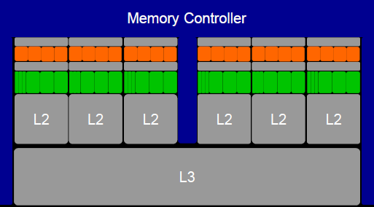
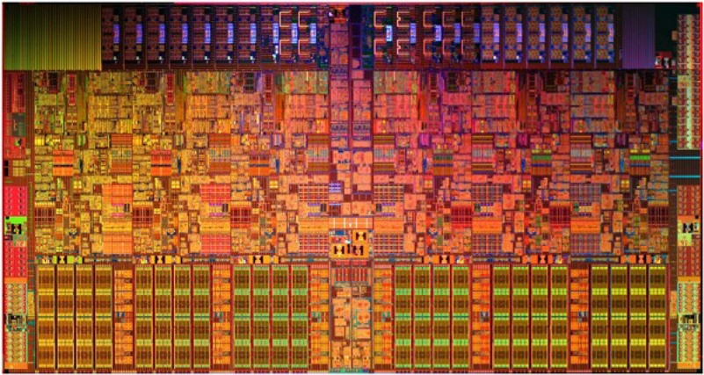
Shared memory computer
Intel i7-970, is it an SMP ?
6 cores, 2-way multithreaded, 6-wide superscalar, quad-issue, 4-wide SIMD (on 3 of 6 pipelines)
4.5 KB (6 x 768 B) “Architectural” Registers, 192 KB (6 x 32 KB) L1 Cache, 1.5 MB (6 x 256 KB) L2 cache, 12 MB L3 Cache
MESIF Cache Coherence, Processor Consistency Model

Slide 9
Shared memory computer
Intel i7-970, is it an SMP ?
6 cores, 2-way multithreaded, 6-wide superscalar, quad-issue, 4-wide SIMD (on 3 of 6 pipelines)
4.5 KB (6 x 768 B) “Architectural” Registers, 192 KB (6 x 32 KB) L1 Cache, 1.5 MB (6 x 256 KB) L2 cache, 12 MB L3 Cache
MESIF Cache Coherence, Processor Consistency Model
It is NUMA.

Slide 10
Shared memory computer
Shared memory computers are everywhere …
  目前大多数笔记本电脑和服务器都配置多核处理器；
虽然真实情况稍微复杂:
  … any multiprocessor CPU with a cache is a NUMA system.
但对大多数并行任务来说，可以把它们看作SMP，用共享内存编程模型来进行并行程序设计。

Slide 11
OpenMP getting started
条件准备
  For new to parallel programming:
    Knowledge of C/C++ programming language.
    Access to a Complier that support OpenMP.

Slide 12
OpenMP 核心语法
Most of the constructs in OpenMP are:
compiler directives （指导、指引）
Example
#pragma omp construct [clause [clause]…]
#pragma omp parallel num_threads(4)

Slide 13
OpenMP 核心语法
Function prototypes and types in the file:
  头文件 #include <omp.h>
在代码中何处使用 OpenMP？
  寻找可并行代码块 “structured block”:
  使用openMP标记一行或多行语句，成为一个结构化模块，使用编译器指导语句并行执行.

Slide 14
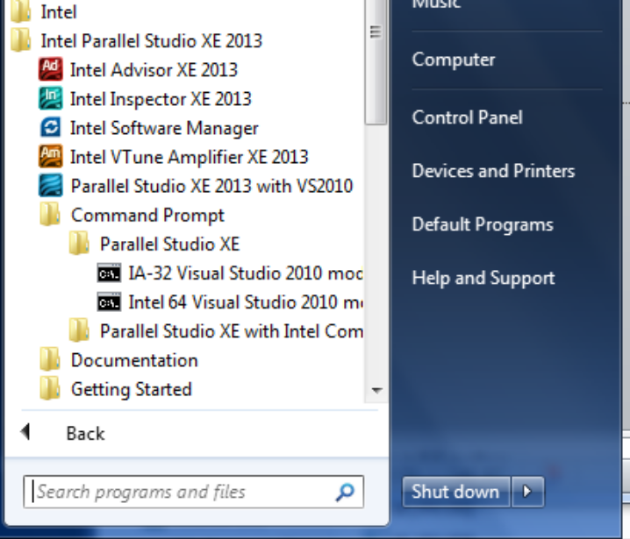
OpenMP Compiler - 1
Intel on Windows:
Launch SW dev environment
cd to the directory that holds your source code
Build software for program foo.c
􀂋 icl /Qopenmp foo.c
Set number of threads environment variable
􀂋 set OMP_NUM_THREADS=4
Run your program
􀂋 foo.exe

Slide 15
OpenMP Compiler - 2
MS Visual Studio:
Start “new project”;
Select win 32 console project;
  Drag and drop your source file into the source folder on the visual studio solution explorer
  Activate OpenMP;
    Go to project properties/configuration properties/C.C++/language … and activate OpenMP
  Set number of threads inside the program
  Build the project and Run

Slide 16
OpenMP Compiler - 3
Linux and OS X with gcc:
  export OMP_NUM_THREADS=4
  gcc -fopenmp foo.c
  ./a.out

Slide 17
Hello world
Part A:
  #include <stdio.h>
  int main()
  {
    int ID = 0;
    printf(“ hello(%d) ”, ID);
    printf(“ world(%d) \n”, ID);
    return 0;
  }
串行

Slide 18
Hello world
Part B:
  #include <stdio.h>
  #include <omp.h>
  int main()
  {
    #pragma omp parallel
    {
      int ID = omp_get_thread_num();
      printf(“ hello(%d) ”, ID);;
      printf(“ world(%d) \n”, ID);
    }
    return 0;
  }
并行

Slide 19
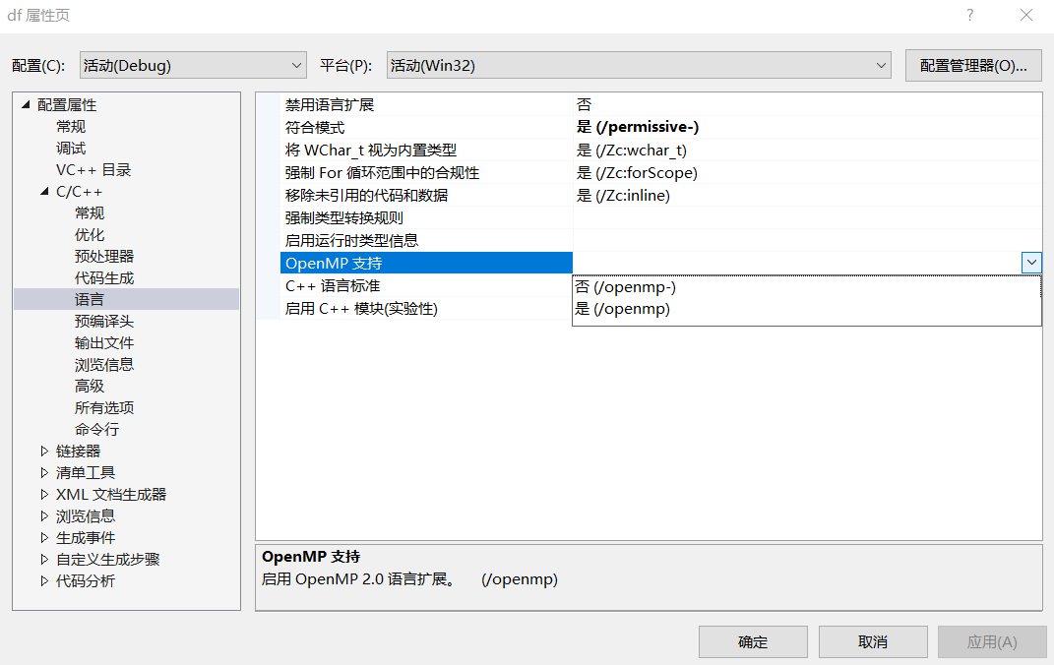
OpenMP Compiler
Visual Studio 2017

Slide 20
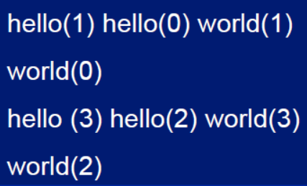
Hello world
Output:
  #include <stdio.h>
  #include <omp.h>
  int main()
  {
    #pragma omp parallel
    {
      int ID = omp_get_thread_num();
      printf(“ hello(%d) ”, ID);;
      printf(“ world(%d) \n”, ID);
    }
    return 0;
  }

Slide 21
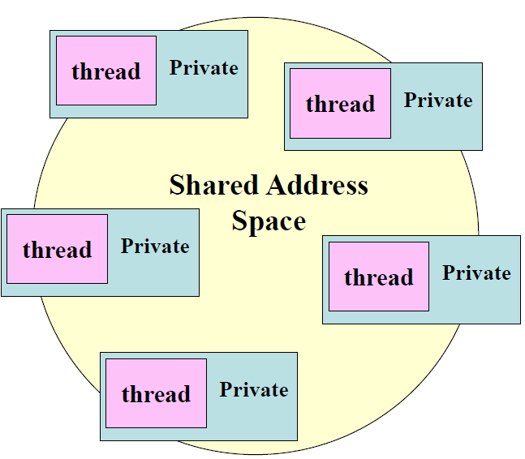
OpenMP How do threads interact?
OpenMP 两个重要特性:
  OS scheduler decides when to run which threads … interleaved for fairness.
  线程之间通过共享变量来实现通信。
共享变量会造成数据访问冲突:
  race condition:
  – when the program’s outcome changes as the threads are scheduled differently.

Slide 22
OpenMP How do threads interact?
如何避免冲突？同步
  – Use synchronization to protect data conflicts.
同步会导致性能下降:
  要最小化同步带来的损失，程序员需要精心安排数据的访问。

Slide 23

OpenMP resources
http://www.openmp.org

Slide 24
references
Tim Mattson, A “Hands-on” Introduction to OpenMP, Intel Corp.
Mark Bull, Parallel Programming with OpenMP, EPCC, University of Edinburgh, UK.
迟学斌等，并行计算与实现技术，科学出版社。

Slide 25
作业
搭建并行编程环境：
  Linux
  Windows / MacOs
运行HelloWorld示例

