Slide 1

Introduction to MPI
Part3. Advanced Topics
人工智能学院
缪青海
miaoqh@ucas.ac.cn

Slide 2
Content
  Remote Memory Access
  MPI Parallel I/O

Slide 3
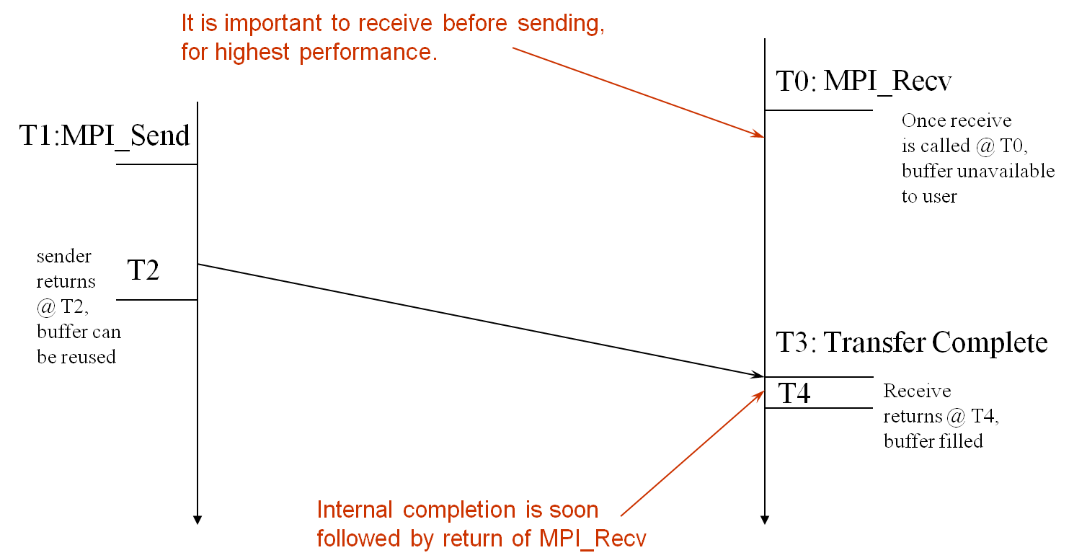
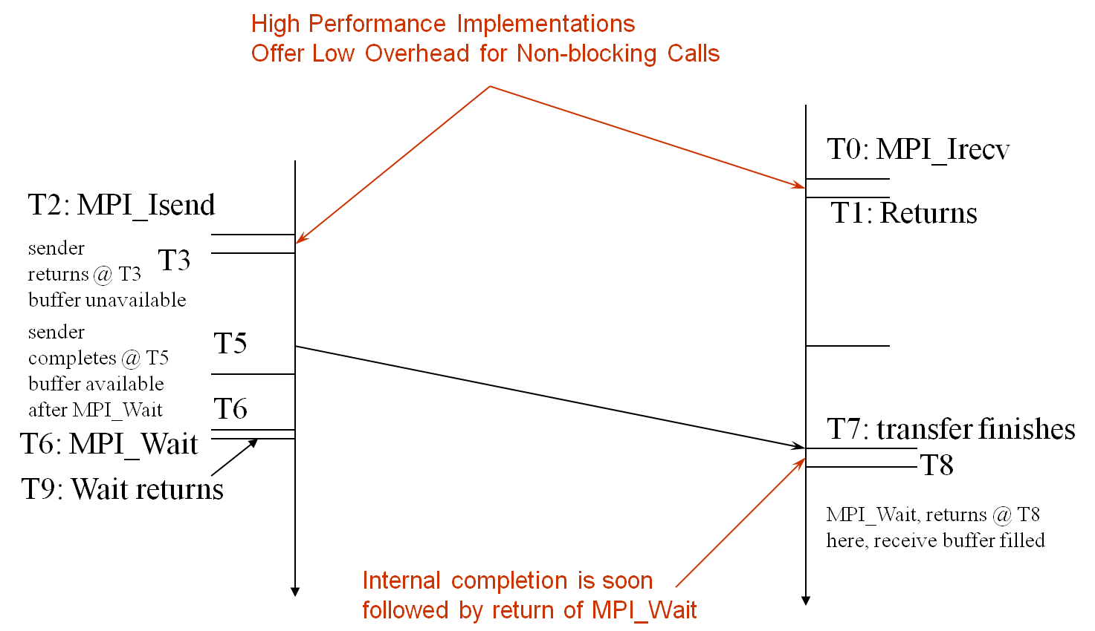
MPI Communication
time
time
Blocking
Non-Blocking
Two sides co-operating

Slide 4
One-sided Communication
The basic idea of one-sided communication:
  decouple data movement with process synchronization
  be able move data without requiring that the remote process synchronize:
    Each process exposes a part of its memory to other processes
    Other processes can directly read from or write to this memory

Slide 5
One-sided Communication
Process 0
Process 1
Process 2
Process 3
Remotely
Accessible
Memory
Private
Memory
Remotely
Accessible
Memory
Private
Memory
Remotely
Accessible Memory
Private
Memory
Remotely
Accessible Memory
Private
Memory
Private
Memory
Private
Memory
Private
Memory
Private
Memory

Slide 6
One-sided Communication
Process 0
Process 1
Process 2
Process 3
Remotely
Accessible
Memory
Remotely
Accessible
Memory
Remotely
Accessible Memory
Remotely
Accessible Memory
Private
Memory
Private
Memory
Private
Memory
Private
Memory

Slide 7
One-sided Communication
Process 0
Process 1
Process 2
Process 3
Global Address Space
Remotely
Accessible
Memory
Remotely
Accessible
Memory
Remotely
Accessible Memory
Remotely
Accessible Memory
Private
Memory
Private
Memory
Private
Memory
Private
Memory

Slide 8
One-sided Communication
Process 0
Process 1
Process 2
Process 3
Global Address Space
Remotely
Accessible
Memory
Remotely
Accessible
Memory
Remotely
Accessible Memory
Remotely
Accessible Memory
Private
Memory

Slide 9
Two-sided Communication Example
Memory
Processor
Processor
Memory
Memory
Segment
Memory
Segment
Memory
Segment
Memory
Segment
Memory
Segment
Send
Recv
Send
Recv
MPI implementation
MPI implementation

Slide 10
One-sided Communication Example
Memory
Processor
Processor
Memory
Memory
Segment
Memory
Segment
Memory
Segment
Memory
Segment
Send
Recv
Send
Recv
MPI implementation
MPI implementation

Slide 11
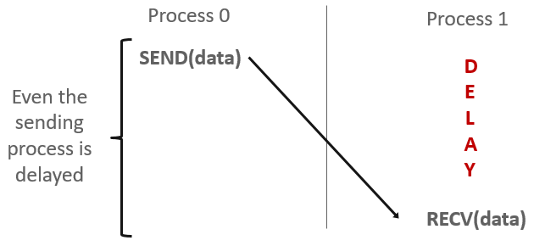
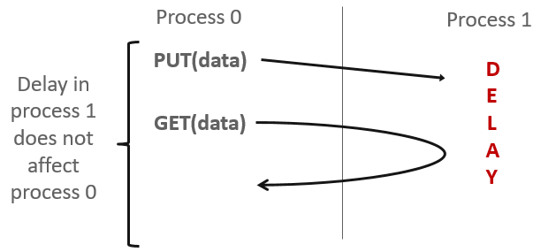
Comparing One-sided and Two-sided

Slide 12
Keys in MPI RMA
How to create remote accessible memory?
Reading, Writing and Updating remote memory
Data Synchronization
Memory Model

Slide 13
Creating Public Memory
Any memory used by a process is, by default, only locally accessible
  X = malloc(100);
Once the memory is allocated, the user has to make an explicit MPI call to declare a memory region as remotely accessible
  MPI terminology for remotely accessible memory is a “window”
  A group of processes collectively create a “window”

Slide 14
Creating Public Memory
Once a memory region is declared as remotely accessible:
  all processes in the window can read/write data to this memory
  without explicitly synchronizing with the target process.

Slide 15
Window creation models
Four models exist
  MPI_WIN_CREATE
    You already have an allocated buffer that you would like to make remotely accessible
  MPI_WIN_ALLOCATE
    You want to create a buffer and directly make it remotely accessible
  MPI_WIN_CREATE_DYNAMIC
    You don’t have a buffer yet, but will have one in the future
    You may want to dynamically add/remove buffers to/from the window
  MPI_WIN_ALLOCATE_SHARED
    You want multiple processes on the same node share a buffer

Slide 16
MPI_WIN_CREATE
int MPI_Win_create(void *base, MPI_Aint size,
int disp_unit, MPI_Info info,
MPI_Comm comm, MPI_Win *win)
Expose a region of memory in an RMA window
  Only data exposed in a window can be accessed with RMA ops.
Arguments:
  base - pointer to local data to expose
  size - size of local data in bytes (nonnegative integer)
  disp_unit - local unit size for displacements, in bytes (positive integer)
  info - info argument (handle)
  comm - communicator (handle)
  win - window (handle)

Slide 17
Example with MPI_WIN_CREATE
int main(int argc, char ** argv)
{
int *a; MPI_Win win;
MPI_Init(&argc, &argv);
/* create private memory */
MPI_Alloc_mem(1000*sizeof(int), MPI_INFO_NULL, &a);
/* use private memory like you normally would */
a[0] = 1; a[1] = 2;
/* collectively declare memory as remotely accessible */
MPI_Win_create(a, 1000*sizeof(int), sizeof(int),
MPI_INFO_NULL, MPI_COMM_WORLD, &win);
/* Array ‘a’ is now accessibly by all processes in
* MPI_COMM_WORLD */
MPI_Win_free(&win);
MPI_Free_mem(a);
MPI_Finalize(); return 0;
}
Notes:
Say that this should be avoided like the pest ☺

Slide 18
MPI_WIN_ALLOCATE
int MPI_Win_allocate(MPI_Aint size, int disp_unit,
MPI_Info info, MPI_Comm comm, void *baseptr,
MPI_Win *win)
Create a remotely accessible memory region in an RMA window
  Only data exposed in a window can be accessed with RMA ops.
Arguments:
  size - size of local data in bytes (nonnegative integer)
  disp_unit - local unit size for displacements, in bytes (positive integer)
  info - info argument (handle)
  comm - communicator (handle)
  baseptr - pointer to exposed local data
  win - window (handle)

Slide 19
Example with MPI_WIN_ALLOCATE
int main(int argc, char ** argv)
{
int *a; MPI_Win win;
MPI_Init(&argc, &argv);
/* collectively create remote accessible memory in a window */
MPI_Win_allocate(1000*sizeof(int), sizeof(int), MPI_INFO_NULL,
MPI_COMM_WORLD, &a, &win);
/* Array ‘a’ is now accessible from all processes in
* MPI_COMM_WORLD */
MPI_Win_free(&win);
MPI_Finalize(); return 0;
}

Slide 20
MPI_WIN_CREATE_DYNAMIC
int MPI_Win_create_dynamic(MPI_Info info, MPI_Comm comm,
MPI_Win *win)
Create an RMA window, to which data can later be attached
  Only data exposed in a window can be accessed with RMA ops
Initially “empty”
  Application can dynamically attach/detach memory to this window by calling MPI_Win_attach/detach
  Application can access data on this window only after a memory region has been attached
Window origin is MPI_BOTTOM
  Displacements are segment addresses relative to MPI_BOTTOM
  Must tell others the displacement after calling attach

Slide 21
Example with MPI_WIN_CREATE_DYNAMIC
int main(int argc, char ** argv)
{
int *a; MPI_Win win;
MPI_Init(&argc, &argv);
MPI_Win_create_dynamic(MPI_INFO_NULL, MPI_COMM_WORLD, &win);
/* create private memory */
a = (int *) malloc(1000 * sizeof(int));
/* use private memory like you normally would */
a[0] = 1; a[1] = 2;
/* locally declare memory as remotely accessible */
MPI_Win_attach(win, a, 1000*sizeof(int));
/* Array ‘a’ is now accessible from all processes */
/* undeclare remotely accessible memory */
MPI_Win_detach(win, a); free(a);
MPI_Win_free(&win);
MPI_Finalize(); return 0;
}

Slide 22
Data movement
MPI provides ability to read, write and atomically modify data in remotely accessible memory regions
  MPI_PUT
  MPI_GET
  MPI_ACCUMULATE
  MPI_GET_ACCUMULATE
  MPI_COMPARE_AND_SWAP
  MPI_FETCH_AND_OP

Slide 23
Data movement: Put
MPI_Put(void * origin_addr, int origin_count,
MPI_Datatype origin_datatype, int target_rank,
MPI_Aint target_disp, int target_count,
MPI_Datatype target_datatype, MPI_Win win)
Target Process
Move data from origin, to target
Separate data description triples for origin and target
RMA
Window
Local
Buffer
Origin Process

Slide 24
Data movement: Get
MPI_Get(void * origin_addr, int origin_count,
MPI_Datatype origin_datatype, int target_rank,
MPI_Aint target_disp, int target_count,
MPI_Datatype target_datatype, MPI_Win win)
Move data to origin, from target
Target Process
RMA
Window
Local
Buffer
Origin Process

Slide 25
Atomic Data Aggregation: Accumulate
MPI_Accumulate(void * origin_addr, int origin_count,
MPI_Datatype origin_datatype, int target_rank,
MPI_Aint target_disp, int target_count,
MPI_Datatype target_dtype, MPI_Op op, MPI_Win win)
Atomic update operation, similar to a put
  Reduces origin and target data into target buffer using op argument as combiner
  Predefined ops only, no user-defined operations
Different data layouts between
target/origin OK
  Basic type elements must match
Op = MPI_REPLACE
  Implements f(a,b)=b
  Atomic PUT
Target Process
+=
RMA
Window
Local
Buffer
Origin Process

Slide 26
Atomic Data Aggregation: Get Accumulate
MPI_Get_accumulate(void *origin_addr, int origin_count,
MPI_Datatype origin_dtype, void *result_addr,
int result_count, MPI_Datatype result_dtype,
int target_rank, MPI_Aint target_disp,
int target_count, MPI_Datatype target_dype,
MPI_Op op, MPI_Win win)
Atomic read-modify-write
  Op = MPI_SUM, MPI_PROD, MPI_OR, MPI_REPLACE, MPI_NO_OP, …
  Predefined ops only
Result stored in target buffer
Original data stored in result buf
Different data layouts between
target/origin OK
  Basic type elements must match
Atomic get with MPI_NO_OP
Atomic swap with MPI_REPLACE
Target Process
+=
RMA
Window
Local
Buffer
Origin Process

Slide 27
Atomic Data Aggregation: CAS and FOP
MPI_Compare_and_swap(void *origin_addr,
void *compare_addr, void *result_addr,
MPI_Datatype datatype, int target_rank,
MPI_Aint target_disp, MPI_Win win)
MPI_Fetch_and_op(void *origin_addr, void *result_addr,
MPI_Datatype datatype, int target_rank,
MPI_Aint target_disp, MPI_Op op, MPI_Win win)
CAS: Atomic swap if target value is equal to compare value
FOP: Simpler version of MPI_Get_accumulate
  All buffers share a single predefined datatype
  No count argument (it’s always 1)
  Simpler interface allows hardware optimization

Slide 28
Ordering of Operations in MPI RMA
No guaranteed ordering for Put/Get operations
Result of concurrent Puts to the same location undefined
Result of Get concurrent Put/Accumulate undefined
  Can be garbage in both cases

Slide 29
Ordering of Operations in MPI RMA
Result of concurrent accumulate operations to the same location are defined according to the order in which the occurred
  Atomic put: Accumulate with op = MPI_REPLACE
  Atomic get: Get_accumulate with op = MPI_NO_OP
Accumulate operations from a given process are ordered by default
  User can tell the MPI implementation that (s)he does not require ordering as optimization hint
  You can ask for only the needed orderings: RAW (read-after-write), WAR, RAR, or WAW

Slide 30
RMA Synchronization Models
RMA data access model
  When is a process allowed to read/write remotely accessible memory?
  When is data written by process X is available for process Y to read?
  RMA synchronization models define these semantics
Three synchronization models provided by MPI:
  Fence (active target)
  Post-start-complete-wait (generalized active target)
  Lock/Unlock (passive target)
Data accesses occur within “epochs”
  Access epochs: contain a set of operations issued by an origin process
  Exposure epochs: enable remote processes to update a target’s window
  Epochs define ordering and completion semantics
  Synchronization models provide mechanisms for establishing epochs
    E.g., starting, ending, and synchronizing epochs

Slide 31
Fence: Active Target Synchronization
MPI_Win_fence(int assert, MPI_Win win)
Collective synchronization model
Starts and ends access and exposure epochs on all processes in the window
All processes in group of “win” do an MPI_WIN_FENCE to open an epoch
Everyone can issue PUT/GET operations to read/write data
Everyone does an MPI_WIN_FENCE to close the epoch
All operations complete at the second fence synchronization
Target
Origin
Fence
Fence
Get
Fence
Fence

Slide 32
Stencil Computation by RMA Fence
RMA window
PUT
Target buffers
Origin buffers
PUT
PUT
PUT

Slide 33
PSCW: Generalized Active Target Synchronization
MPI_Win_post/start(MPI_Group grp, int assert, MPI_Win win)
MPI_Win_complete/wait(MPI_Win win)
Like FENCE, but origin and target specify who they communicate with
Target: Exposure epoch
  Opened with MPI_Win_post
  Closed by MPI_Win_wait
Origin: Access epoch
  Opened by MPI_Win_start
  Closed by MPI_Win_complete
All synchronization operations may block, to enforce P-S/C-W ordering
  Processes can be both origins and targets
Target
Origin
Post
Start
Get
Complete
Wait

Slide 34
Lock/Unlock: Passive Target Synchronization
Active Target Mode
Passive Target Mode
Post
Lock
Start
Get
Get
Complete
Unlock
Wait
Passive mode: One-sided, asynchronous communication
  Target does not participate in communication operation
Shared memory-like model

Slide 35
Passive Target Synchronization
MPI_Win_lock(int locktype, int rank, int assert, MPI_Win win)
MPI_Win_unlock(int rank, MPI_Win win)
Begin/end passive mode epoch
  Target process does not make a corresponding MPI call
  Can initiate multiple passive target epochs to different processes
  Concurrent epochs to same process not allowed (affects threads)
Lock type
  SHARED: Other processes using shared can access concurrently
  EXCLUSIVE: No other processes can access concurrently
Notes:
XIN: Concurrent epochs to same process not allowed (affects threads)??

Slide 36
Advanced Passive Target Synchronization
MPI_Win_lock_all(int assert, MPI_Win win)
MPI_Win_unlock_all(MPI_Win win)
MPI_Win_flush/flush_local(int rank, MPI_Win win)
MPI_Win_flush_all/flush_local_all(MPI_Win win)
Lock_all: Shared lock, passive target epoch to all other processes
  Expected usage is long-lived: lock_all, put/get, flush, …, unlock_all
Flush: Remotely complete RMA operations to the target process
  Flush_all – remotely complete RMA operations to all processes
  After completion, data can be read by target process or a different process
Flush_local: Locally complete RMA operations to the target process
  Flush_local_all – locally complete RMA operations to all processes

Slide 37
Which synchronization mode should I use, when?
RMA communication has low overheads versus send/recv
  Two-sided: Matching, queuing, buffering, unexpected receives, etc…
  One-sided: No matching, no buffering, always ready to receive
  Utilize RDMA provided by high-speed interconnects (e.g. InfiniBand)

Slide 38
Which synchronization mode should I use, when?
Active mode: bulk synchronization
  E.g. ghost cell exchange
Passive mode: asynchronous data movement
  Useful when dataset is large, requiring memory of multiple nodes
  Also, when data access and synchronization pattern is dynamic
  Common use case: distributed, shared arrays
Passive target locking mode
  Lock/unlock – Useful when exclusive epochs are needed
  Lock_all/unlock_all – Useful when only shared epochs are needed

Slide 39
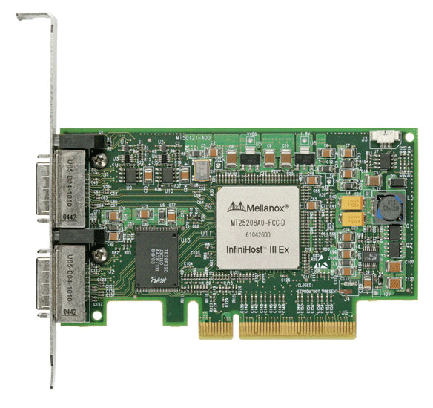
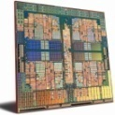
MPI RMA Memory Model
MPI-3 provides two memory models: separate and unified
MPI-2: Separate Model
  Logical public and private copies
  MPI provides software coherence between window copies
  Extremely portable, to systems that don’t provide hardware coherence
MPI-3: New Unified Model
  Single copy of the window
  System must provide coherence
  Superset of separate semantics
    E.g. allows concurrent local/remote access
  Provides access to full performance potential of hardware
Public
Copy
Unified
Copy
Private
Copy
Notes:
SEPARATE window model: two copies
Public copy: shared memory in shared memory machines or main memory in distributed memory machines,
Private copy: fast buffers, local caches to each processes
Example: Intel SCC, NEC SX machine
Go to ”Insert (View) | Header and Footer" to add your organization, sponsor, meeting name here; then, click "Apply to All"

Slide 40
MPI RMA Memory Model (separate windows)
Same source
Same epoch
Diff. Sources
X
Public
Copy
X
Private
Copy
load
store
store
Very portable, compatible with non-coherent memory systems
Limits concurrent accesses to enable software coherence
Notes:
Needs memory synchronization in MPI software,
Can be logically think as:
MPI_Win_lock: copy data from public copy to private copy
MPI_Win_unlock: copy data from private copy to public copy, if there are modification on private copy
Last case: copy back data will overwrite the new value written by MPI_PUT

Slide 41
MPI RMA Memory Model (unified windows)
Same source
Same epoch
Diff. Sources
X
Unified
Copy
load
store
store
Allows concurrent local/remote accesses
Concurrent, conflicting operations are allowed (not invalid)
  Outcome is not defined by MPI (defined by the hardware)
Can enable better performance by reducing synchronization

Slide 42
MPI RMA Operation Compatibility (Separate)
 | Load | Store | Get | Put | Acc
Load | OVL+NOVL | OVL+NOVL | OVL+NOVL | NOVL | NOVL
Store | OVL+NOVL | OVL+NOVL | NOVL | X | X
Get | OVL+NOVL | NOVL | OVL+NOVL | NOVL | NOVL
Put | NOVL | X | NOVL | NOVL | NOVL
Acc | NOVL | X | NOVL | NOVL | OVL+NOVL
This matrix shows the compatibility of MPI-RMA operations when two or more processes access a window at the same target concurrently.
OVL – Overlapping operations permitted
NOVL – Nonoverlapping operations permitted
X – Combining these operations is OK, but data might be garbage
Notes:
local STOREs combines with PUT/ACC, result is garbage,
For all others, as long as memory locations are not conflict, combination of operations is permitted,
Only in three situations, conflict operations are allowed:
Atomic (ACC)
Sequential (LOAD/STORE)
Read-only (GET, LOAD)
Go to ”Insert (View) | Header and Footer" to add your organization, sponsor, meeting name here; then, click "Apply to All"

Slide 43
MPI RMA Operation Compatibility (Unified)
 | Load | Store | Get | Put | Acc
Load | OVL+NOVL | OVL+NOVL | OVL+NOVL | NOVL | NOVL
Store | OVL+NOVL | OVL+NOVL | NOVL | NOVL | NOVL
Get | OVL+NOVL | NOVL | OVL+NOVL | NOVL | NOVL
Put | NOVL | NOVL | NOVL | NOVL | NOVL
Acc | NOVL | NOVL | NOVL | NOVL | OVL+NOVL
This matrix shows the compatibility of MPI-RMA operations when two or more processes access a window at the same target concurrently.
OVL – Overlapping operations permitted
NOVL – Nonoverlapping operations permitted
Notes:
Go to ”Insert (View) | Header and Footer" to add your organization, sponsor, meeting name here; then, click "Apply to All"

Slide 44
Content
  Remote Memory Access
  MPI Parallel I/O

Slide 45
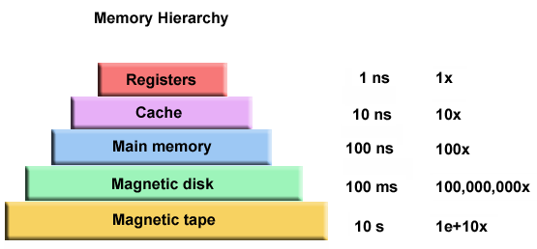
Performance of I/O

Slide 46
Traditional I/O
Traditional approaches
  Each process writes to a separate file
    Often requires an additional post-processing step
    Without post-processing, restarts must use same number of processor
  Result sent to a master processor, which collects results and writes out to disk
  Each processor calculates position in file and writes individually

Slide 47
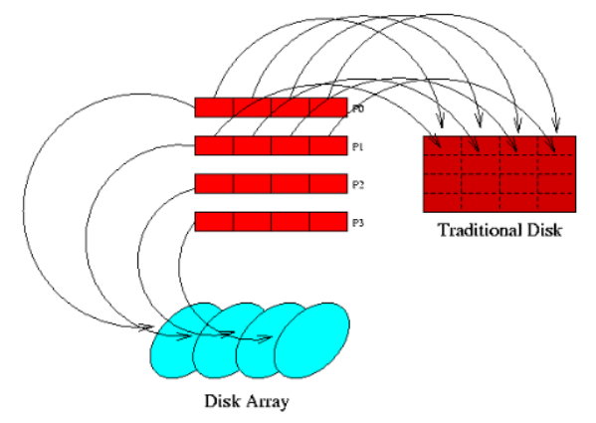
What is parallel I/O
Multiple processes accessing a single file

Slide 48
What is parallel I/O
MPI I/O approaches
  MPI-I/O is a set of extensions to the original MPI standard
    This is an interface specification:
    It does NOT give implementation specifics.
  It provides routines for file manipulation and data access
  Calls to MPI-I/O routines are portable across a large number of architectures

Slide 49
Why use parallel I/O
Often, both data and file access is non-contiguous
  Ghost cells cause non-contiguous data access
  Block or cyclic distributions cause non-contiguous file access
Want to access data and files with as few I/O calls as possible

Slide 50
Why use parallel I/O
Many users do not have time to learn the complexities of I/O optimization.
Use of parallel I/O can simplify coding
  Single read/write operation vs. multiple read/write operations
Parallel I/O potentially offers significant performance improvement over traditional approaches

Slide 51
Terms and Definitions
Displacement - Number of bytes from the beginning of a file
etype - unit of data access within a file
filetype - datatype used to express access patterns of a file
file view - definition of access patterns of a file
  Defines what parts of a file are visible to a process

Slide 52
Terms and Definitions
Offset - Position in the file, relative to the current view, expressed in terms of number of etypes
file pointers - offsets into the file maintained by MPI
  Individual file pointer - local to the process that opened the file
  Shared file pointer - shared (and manipulated) by the group of processes that opened the file

Slide 53
FILE MANIPULATION
MPI_FILE_OPEN( MPI_Comm comm, char *filename, int mode,
MPI_Info info, MPI_File *fh, ierr )
Opens the file identified by filename on each processor in communicator Comm
Collective over this group of processors
Each processor must use same value for mode and reference the same file
info is used to give hints about access patterns

Slide 54
DERIVED DATATYPES & VIEWS
Derived datatypes are not part of MPI-I/O
  They are used extensively in conjunction with MPI-I/O
A filetype is really a datatype expressing the access pattern of a file;
Filetypes are used to set file views.

Slide 55
CONCLUSIONS
MPI-I/O potentially offers significant improvement in I/O performance
This improvement can be attained with minimal effort on part of the user
  Simpler programming with fewer calls to I/O routines
  Easier program maintenance due to simple API

Slide 56
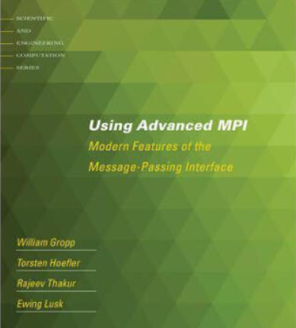
Reference Book
For more advanced features
Using Advanced MPI
  RMA
  Parallel I/O
  Dynamic process management
  …
http://www.mcs.anl.gov/research/projects/mpi/usingmpi/

