Slide 1

Introduction to MPI
Part5. Hybrid Computing and GPU
人工智能学院
缪青海
miaoqh@ucas.ac.cn

Slide 2
Content
  MPI Hybrid Programming
  Accelerators and GPU

Slide 3
Content
MPI + Threads
Hybrid with Shared Memory
Hybrid with Accelerators

Slide 4
MPI and Threads
MPI describes parallelism between processes (with separate address spaces)
Thread parallelism provides a shared-memory model within a process
OpenMP and Pthreads are common models
  OpenMP provides convenient features for loop-level parallelism. Threads are created and managed by the compiler, based on user directives.
  Pthreads provide more complex and dynamic approaches. Threads are created and managed explicitly by the user.

Slide 5
Programming for Multicore
Common options for programming multicore clusters
  All MPI
    MPI between processes both within a node and across nodes
    MPI internally uses shared memory to communicate within a node
  MPI + OpenMP
    Use OpenMP within a node and MPI across nodes
  MPI + Pthreads
    Use Pthreads within a node and MPI across nodes
The latter two approaches are known as:
  “hybrid programming”

Slide 6
Hybrid Programming: MPI+Threads
MPI-only Programming
In MPI-only programming, each MPI process has a single program counter
In MPI+threads hybrid programming, there can be multiple threads executing simultaneously
  All threads share all MPI objects (communicators, requests)
  The MPI implementation might need to take precautions to make sure the state of the MPI stack is consistent
Rank 0
Rank 1
MPI+Threads Hybrid Programming
Rank 0
Rank 1

Slide 7
MPI’s Four Levels of Thread Safety
MPI defines four levels of thread safety：
  MPI_THREAD_SINGLE:
    only one thread exists in the application
  MPI_THREAD_FUNNELED:
    multithreaded, but only the main thread makes MPI calls (the one that called MPI_Init_thread)
  MPI_THREAD_SERIALIZED:
    multithreaded, but only one thread at a time makes MPI calls
  MPI_THREAD_MULTIPLE:
    multithreaded and any thread can make MPI calls at any time (with some restrictions to avoid races)

Slide 8
MPI’s Four Levels of Thread Safety
Thread levels are in increasing order
  If an application works in FUNNELED mode, it can work in SERIALIZED
MPI defines an alternative to MPI_Init
  MPI_Init_thread(requested, provided)
    Application gives level it needs;
    MPI implementation gives level it supports

Slide 9
MPI_THREAD_SINGLE
There are no threads in the system
  E.g., there are no OpenMP parallel regions
int main(int argc, char ** argv)
{
int buf[100];
MPI_Init(&argc, &argv);
for (i = 0; i < 100; i++)
compute(buf[i]);
/* Do MPI stuff */
MPI_Finalize();
return 0;
}

Slide 10
MPI_THREAD_FUNNELED
All MPI calls are made by the master thread
  Outside the OpenMP parallel regions, In OpenMP master regions
int main(int argc, char ** argv)
{
int buf[100], provided;
MPI_Init_thread(&argc, &argv, MPI_THREAD_FUNNELED, &provided);
if (provided < MPI_THREAD_FUNNELED)
MPI_Abort(MPI_COMM_WORLD, 1);
#pragma omp parallel for
for (i = 0; i < 100; i++)
compute(buf[i]);
/* Do MPI stuff */
MPI_Finalize();
return 0;
}

Slide 11
MPI_THREAD_SERIALIZED
Only one thread can make MPI calls at a time
  Protected by OpenMP critical regions
int main(int argc, char ** argv)
{
int buf[100], provided;
MPI_Init_thread(&argc, &argv, MPI_THREAD_SERIALIZED, &provided);
if (provided < MPI_THREAD_SERIALIZED)
MPI_Abort(MPI_COMM_WORLD, 1);
#pragma omp parallel for
for (i = 0; i < 100; i++) {
compute(buf[i]);
#pragma omp critical
/* Do MPI stuff */
}
MPI_Finalize();
return 0;
}

Slide 12
MPI_THREAD_MULTIPLE
Any thread can make MPI calls any time (restrictions apply)
int main(int argc, char ** argv)
{
int buf[100], provided;
MPI_Init_thread(&argc, &argv, MPI_THREAD_MULTIPLE, &provided);
if (provided < MPI_THREAD_MULTIPLE)
MPI_Abort(MPI_COMM_WORLD, 1);
#pragma omp parallel for
for (i = 0; i < 100; i++) {
compute(buf[i]);
/* Do MPI stuff */
}
MPI_Finalize();
return 0;
}
Notes:
What are the restrictions?

Slide 13
Threads and MPI
An implementation is not required to support levels higher than MPI_THREAD_SINGLE; that is:
  An implementation is not required to be thread safe
  A fully thread-safe implementation will support MPI_THREAD_MULTIPLE
A program that calls MPI_Init (instead of MPI_Init_thread) should assume that only MPI_THREAD_SINGLE is supported
A threaded MPI program that does not call MPI_Init_thread is an incorrect program (common user error we see)

Slide 14
Specification of MPI_THREAD_MULTIPLE
Ordering:
  When multiple threads make MPI calls concurrently, the outcome will be as if the calls executed sequentially in some (any) order;
  Ordering is maintained within each thread;

Slide 15
Specification of MPI_THREAD_MULTIPLE
Ordering:
  User must ensure that collective operations on the same communicator, window, or file handle are correctly ordered among threads
    E.g., cannot call a broadcast on one thread and a reduce on another thread on the same communicator
  It is the user's responsibility to prevent races when threads in the same application post conflicting MPI calls
    E.g., accessing an info object from one thread and freeing it from another thread

Slide 16
Specification of MPI_THREAD_MULTIPLE
Blocking:
  Blocking MPI calls will block only the calling thread;
  will not prevent other threads from running or executing MPI functions.

Slide 17
The Current Situation
All MPI implementations support
  MPI_THREAD_SINGLE (duh)
They probably support MPI_THREAD_FUNNELED even if they don’t admit it.
  Does require thread-safe malloc
  Probably OK in OpenMP programs

Slide 18
The Current Situation
Many (but not all) implementations support THREAD_MULTIPLE
  Hard to implement efficiently though (lock granularity issue)
“Easy” OpenMP programs (loops parallelized with OpenMP, communication in between loops) only need FUNNELED
  So don’t need “thread-safe” MPI for many hybrid programs

Slide 19
Why hard to optimize PI_THREAD_MULTIPLE
Thread safety does not come for free
The implementation must protect certain data structures or parts of code with mutexes or critical sections.
To measure the performance impact, we ran tests to measure communication performance when using multiple threads versus multiple processes
  For results, see Thakur/Gropp paper: “Test Suite for Evaluating Performance of Multithreaded MPI Communication,” Parallel Computing, 2009

Slide 20
Why hard to optimize PI_THREAD_MULTIPLE
MPI internally maintains several resources
Because of MPI semantics, it is required that all threads have access to some of the data structures
  E.g., thread 1 can post an Irecv, and thread 2 can wait for its completion – thus the request queue has to be shared between both threads
  Since multiple threads are accessing this shared queue, it needs to be locked – adds a lot of overhead

Slide 21
Why hard to optimize PI_THREAD_MULTIPLE
Hybrid programming with MPI+threads does not do much to reduce the complexity of thread programming
  Your application still has to be a correct multi-threaded application
  On top of that, you also need to make sure you are correctly following MPI semantics
Many commercial debuggers offer support for debugging hybrid MPI+threads applications (mostly for MPI+Pthreads and MPI+OpenMP)

Slide 22
Content
MPI + Threads
Hybrid with Shared Memory
Hybrid with Accelerators

Slide 23
Hybrid Programming with Shared Memory
MPI-3 allows different processes to allocate shared memory through MPI
  MPI_Win_allocate_shared
Uses many of the concepts of one-sided communication
Applications can do hybrid programming using MPI or load/store accesses on the shared memory window
Other MPI functions can be used to synchronize access to shared memory regions
Can be simpler to program than threads

Slide 24
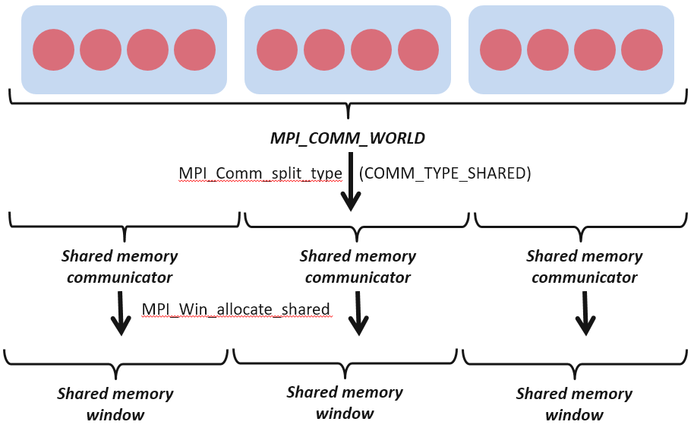
Creating Shared Memory Regions in MPI

Slide 25
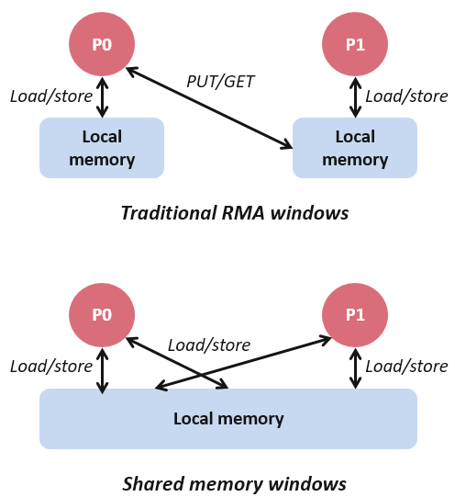
Regular RMA windows vs. Shared memory windows
Shared memory windows allow application processes to directly perform load/store accesses on all of the window memory
  E.g., x[100] = 10
All of the existing RMA functions can also be used on such memory for more advanced semantics such as atomic operations
Can be very useful when processes want to use threads only to get access to all of the memory on the node
  You can create a shared memory window and put your shared data

Slide 26
Memory allocation and placement
Shared memory allocation does not need to be uniform across processes；
The MPI standard does not specify where the memory would be placed；
The total allocated shared memory on a communicator is contiguous by default
  Users can pass an info hint called “noncontig” that will allow the MPI implementation to align memory allocations from each process to appropriate boundaries to assist with placement

Slide 27
Shared Arrays with Shared memory windows
int main(int argc, char ** argv)
{
int buf[100];
MPI_Init(&argc, &argv);
MPI_Comm_split_type(..., MPI_COMM_TYPE_SHARED, .., &comm);
MPI_Win_allocate_shared(comm, ..., &win);
MPI_Win_lockall(win);
/* copy data to local part of shared memory */
MPI_Win_sync(win);
/* use shared memory */
MPI_Win_unlock_all(win);
MPI_Win_free(&win);
MPI_Finalize();
return 0;
}

Slide 28
Content
MPI + Threads
Hybrid with Shared Memory
Hybrid with Accelerators

Slide 29
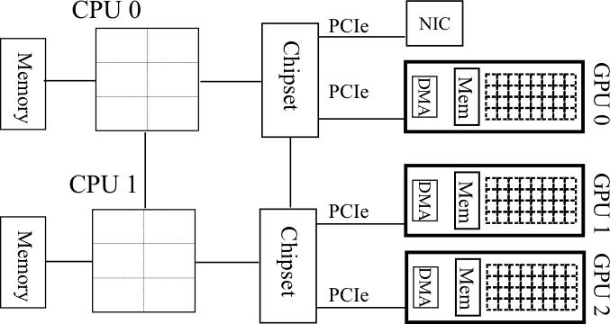
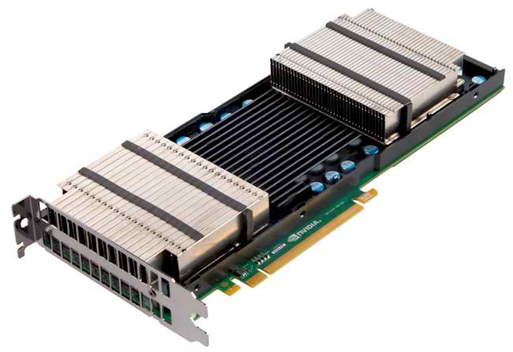
Accelerators in Parallel Computing
General purpose, highly
parallel processors
  High FLOPs/Watt and FLOPs/$
  Unit of execution Kernel
  Separate memory subsystem
  Prog. Models: CUDA, OpenCL, …
Clusters with accelerators are becoming common
New programmability and performance challenges for programming models and runtime systems

Slide 30
Hybrid Programming with Accelerators
Many users are looking to use accelerators within their MPI applications
The MPI standard does not provide any special semantics to interact with accelerators
  Current MPI threading semantics are considered sufficient by most users.
  There are some research efforts for making accelerator memory directly accessibly by MPI, but those are not a part of the MPI standard.

Slide 31
Current Model for MPI+Accelerator Applications
GPU
GPU
P0
P1
P2
P3
GPU
GPU

Slide 32
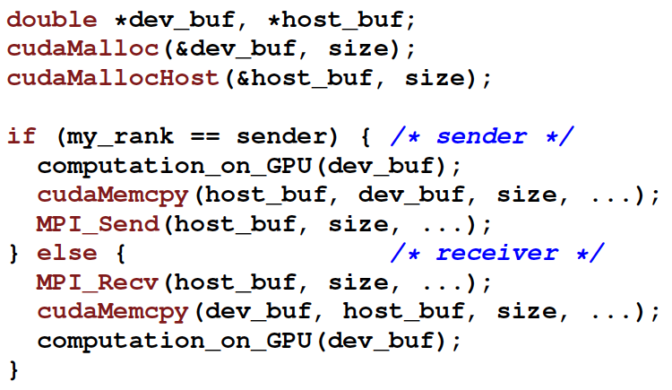
Current Model for MPI+Accelerator Applications
GPU
GPU
P0
P1
P2
P3
GPU
GPU

Slide 33
Alternate MPI+Accelerator models being studied
Some MPI implementations (MPICH, Open MPI, MVAPICH) are investigating how the MPI implementation can directly send/receive data from accelerators
  Unified virtual address (UVA) space techniques where all memory (including accelerator memory) is represented with a “void *”
  Communicator and datatype attribute models where users can inform the MPI implementation of where the data resides
Clear performance advantages demonstrated in research papers
  Could be incorporated in a future version of the standard

Slide 34
Content
  MPI Hybrid Programming
  Accelerators and GPU

Slide 35
Content
Accelerators
GPU Architectures
Compute Unified Device Architecture
nVidia GPU series

Slide 36
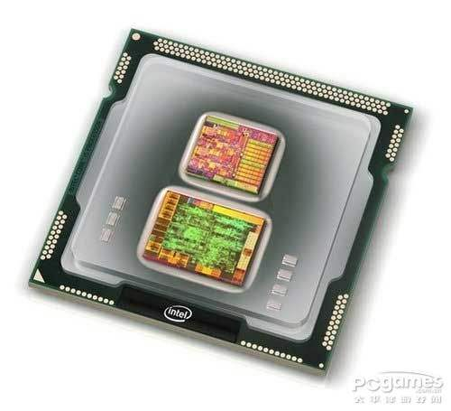
Why Accelerators?
What are CPUs doing :
  Branch Control
  Memory Accessing
  Computing
Limited performance on computing intensive applications.

Slide 37
What are Accelerators?
Accelerators:
  Speed up the computing
  Usually work along side the GPU.
  Getting popular…
Classes:
CPU
GPU
FPGA
ASIC
Scientific Visualization Using ParaView – Fall 2014

Slide 38

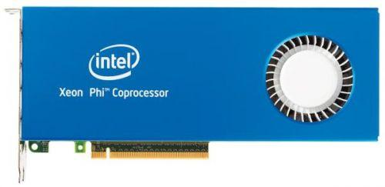
CPU Accelerators
CPU Accelerators:
  Intel Xeon Phi
  With up to 72 out-of-order cores,
  over 3 tera FLOPS of double-precision
  MIC
Scientific Visualization Using ParaView – Fall 2014

Slide 39
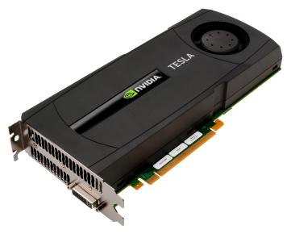
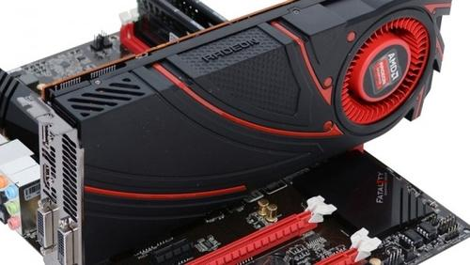
GPU Accelerators
GPU Accelerators:
  Nvidia Tesla K80
  AMD Radeon
Scientific Visualization Using ParaView – Fall 2014

Slide 40
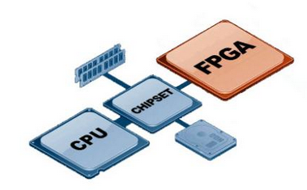
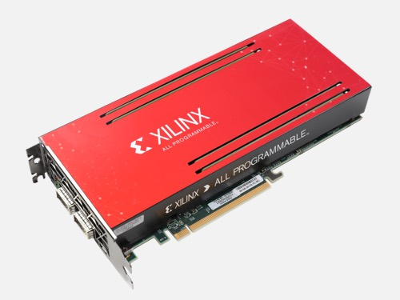
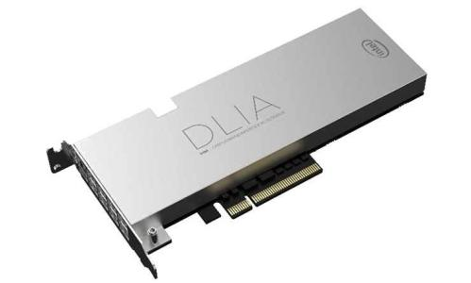
FPGA Accelerators
FPGA Accelerators:
  Xilinx
  Altera
Scientific Visualization Using ParaView – Fall 2014

Slide 41
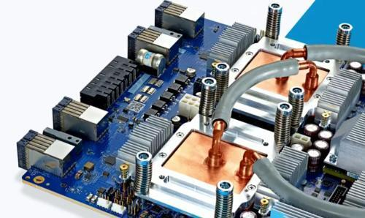
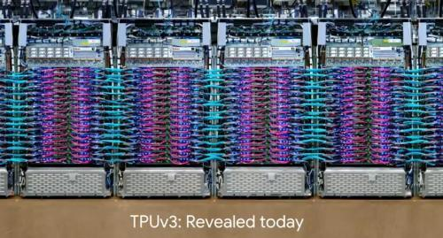
ASIC Accelerators
ASIC Accelerators:
  Google TPU
  TPU 3.0 for AI
  Work with TensorFlow
  Up to 100PFlops
Scientific Visualization Using ParaView – Fall 2014

Slide 42
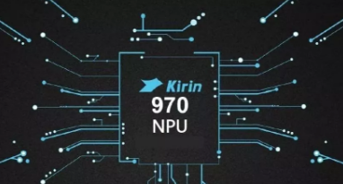
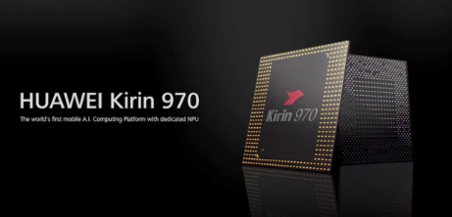
ASIC Accelerators
ASIC Accelerators:
  寒武纪 NPU

Slide 43
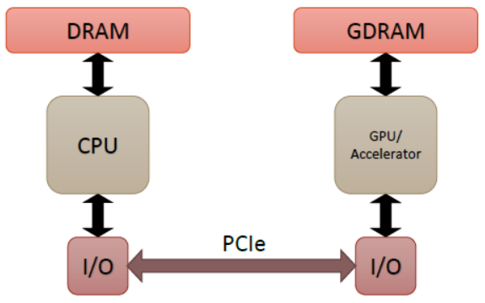
Accelerated Systems
CPUs and Accelerators are used together
GPUs cannot be used instead of CPUs
GPUs perform compute heavy parts
Communication is via PCIe bus
PCIe3.0: up to 8 GB per second throughput
NVLINK: 5-12x faster than PCIe3.0

Slide 44
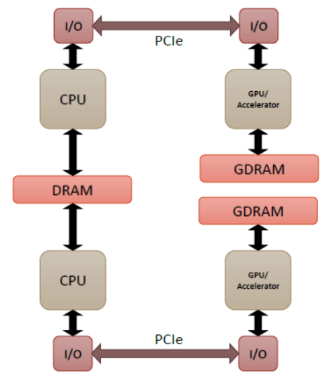
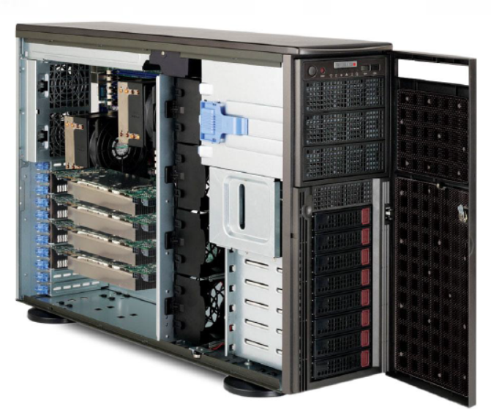
Larger Accelerated Systems
Can have multiple CPUs and Accelerators within each “Shared Memory Node”
CPUs share memory but accelerators do not!

Slide 45
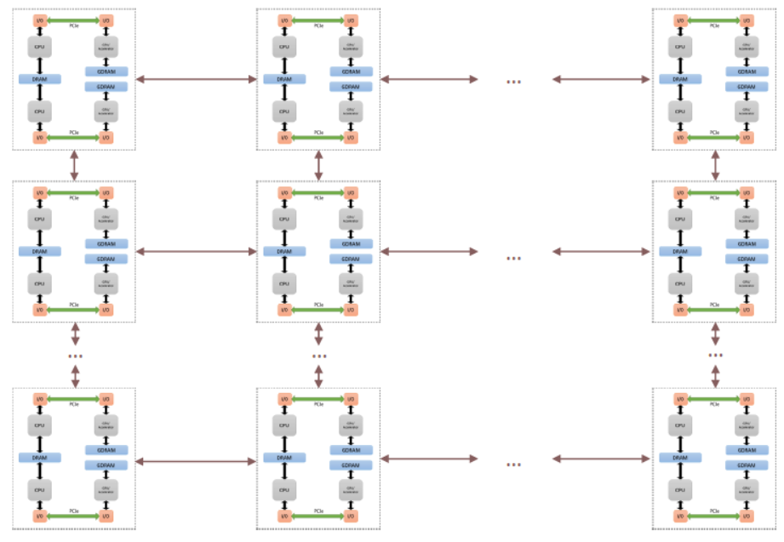
Accelerated Supercomputers

Slide 46
Content
Accelerators
GPU Architectures
Compute Unified Device Architecture
nVidia GPU series

Slide 47
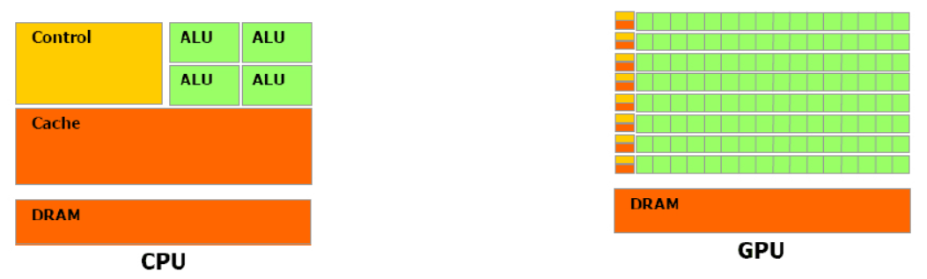
CPU vs GPU
V.S.
Scientific Visualization Using ParaView – Fall 2014

Slide 48
CPU vs GPU
V.S.
Large cache
Powerful ALU
Complex control mechanism
Small cache
Energy efficient ALU
Simple control mechanism
Scientific Visualization Using ParaView – Fall 2014

Slide 49


CPU vs GPU
CPU
  Latency oriented
  Optimized for serial code performance
  Good for single complex tasks
GPU
  Throughput oriented
  Massively parallel architecture
  Optimized for performing many similar tasks simultaneously (data parallel)
Scientific Visualization Using ParaView – Fall 2014

Slide 50
Taxonomy of a GPU
GPU is
  SIMD
    Multiple processing elements performing the same operation simultaneously
  SPMD
    Multiple autonomous processors simultaneously executing a program on different data
    Program execution can have an independent path for each data point
  SPMT (Single Instruction Multiple Thread)
    Each thread has its own registers
    Each thread has multiple addresses
    Each thread has multiple flow paths
Scientific Visualization Using ParaView – Fall 2014

Slide 51
Early GPU
Early GPU:
  Hardware has evolved from the demand for increased quality of 3D computer graphics
  Specialized for parallel manipulating of graphics pipeline
    Vertices (points of triangles)
    Fragments (potential pixels)
  Graphics pipeline became programmable in early 2000
    NVIDIA GeForce 3 and ATI Radeon 9700
    Programmable pixel and vertex shaders
Scientific Visualization Using ParaView – Fall 2014

Slide 52
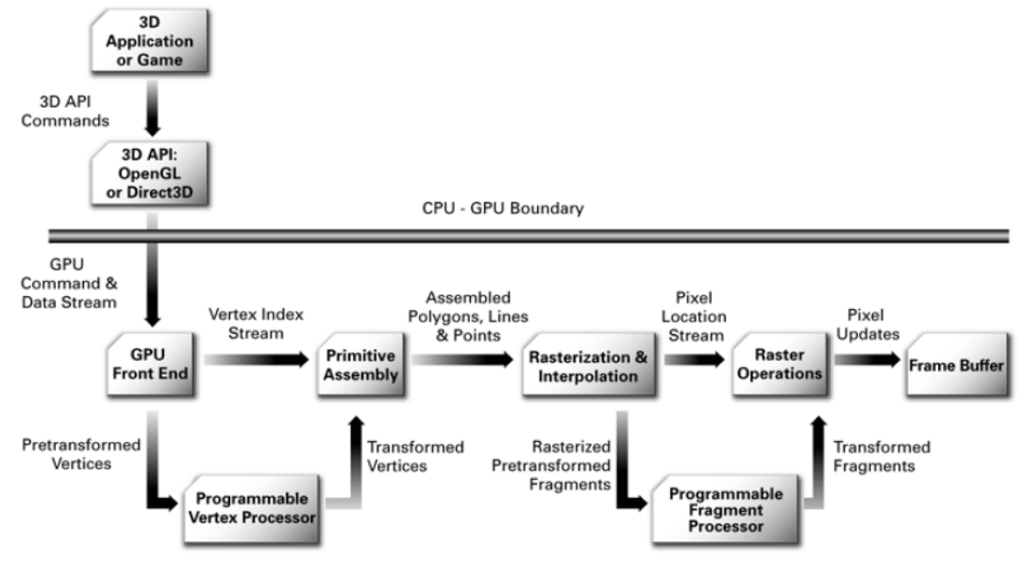
GPU Graphics Pipeline
How to program?
Scientific Visualization Using ParaView – Fall 2014

Slide 53
Content
Accelerators
GPU Architectures
Compute Unified Device Architecture
nVidia GPU series

Slide 54
GPGPU
  General Purpose computation on Graphics Hardware
    First termed by Mark Harris (NVIDIA) in 2002
    Recognized the use of GPUs for non graphics applications
  Requires mapping a problem into graphics concepts
    Data into textures (images)
    Computation into shaders
  Later unified processors were used rather than fixed stages
    2006: GeForce 8series
Scientific Visualization Using ParaView – Fall 2014

Slide 55
Unified Processors and CUDA
  Compute Unified Device Architecture (CUDA)
    First released in 2006/7
  Targeted new bread of unified “streaming multiprocessors”
  C like programming for GPUs
    No computer graphics: General purpose programming models
    Revolutionized GPU programming for general purpose use
Scientific Visualization Using ParaView – Fall 2014

Slide 56
Other GPU programming technics
  GPU Accelerated Libraries and Applications
    MATLAB, Ansys, etc
    GPU mostly abstracted from end user
  GPU Accelerated Directives (OpenACC)
    Helps compiler auto generate code for the GPU
    Very similar to OpenMP
  OpenCL
    Inspired by CUDA but targeted at more general data parallel architectures
    Cross platform
Scientific Visualization Using ParaView – Fall 2014

Slide 57
Content
Accelerators
GPU Architectures
Compute Unified Device Architecture
nVidia GPU series

Slide 58
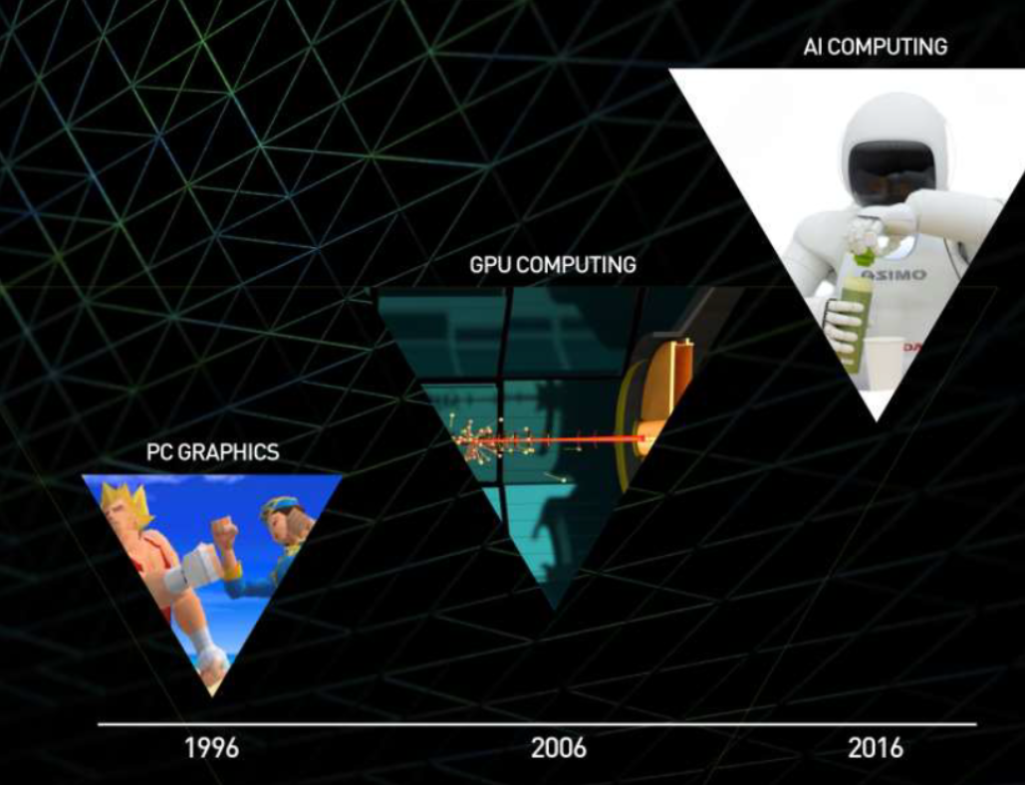
Nvidia GPU Roadmap

Slide 59
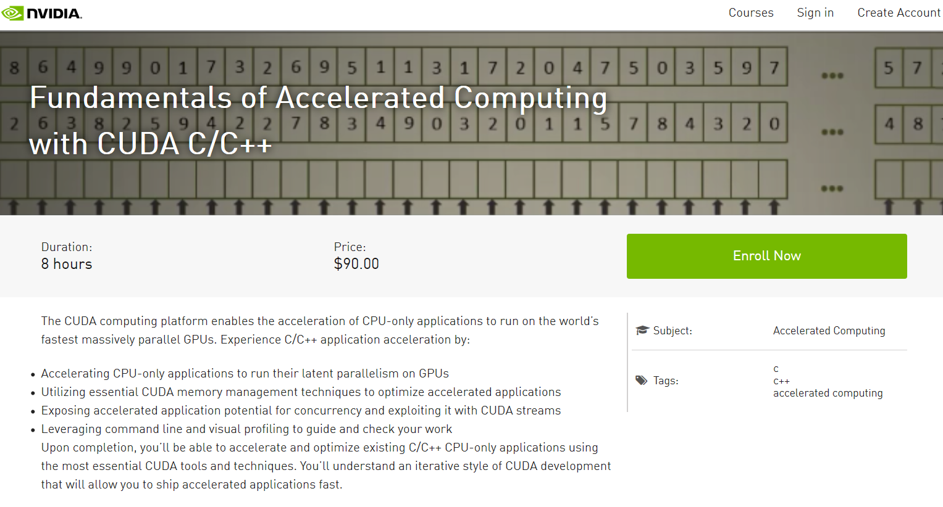
Home work
https://courses.nvidia.com/courses/course-v1:DLI+C-AC-01+V1/about

